Slide 1
Protocol management
Network Management week 11
Aisyatul Karima, 2015

Slide 2
Outline
Syslog
Netconf
Netflow
IPFIX

Slide 3
Syslog
propose : to write the system message on log
Syslog design similarity with CLI
Part of syslog :
Header
Message body

Slide 4
Example syslog

Slide 5
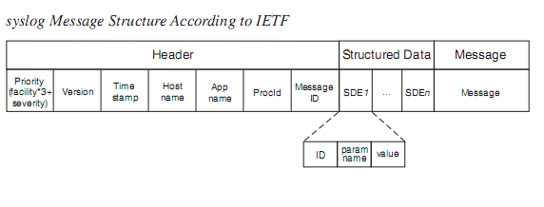
Syslog protocol
Syslog message

Slide 6
Syslog deployment
Two roles are distinguished with respect to the systems that are involved in the exchange of syslog messages:
The syslog sender sends the syslog messages.
The syslog receiver is the recipient of syslog messages.

Slide 7
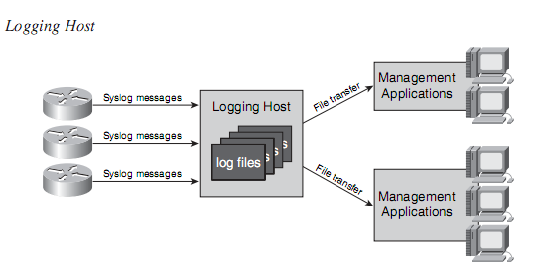

Slide 8
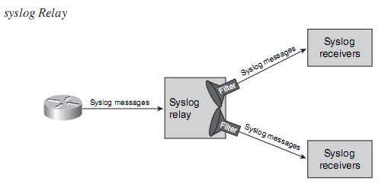

Slide 9
Netconf
Netconf is one such management protocol.
It is geared speciﬁcally toward managing the conﬁguration of data-networking devices.
Netconf is best positioned in the conﬁguration management space,
it can ﬁll the void left by SNMP, as explained earlier, and by CLI,
It is geared more to human users
It is not easily accessible to management applications.

Slide 10
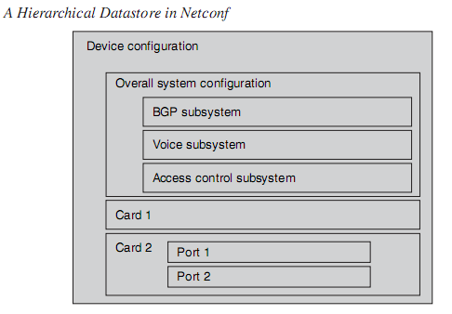
Netconf Datastore
As a protocol, Netconf provides the operations that are necessary to manage those datastores.
For example, Netconf offers operations that allow a manager to change the contents of what a particular datastore contains

Slide 11
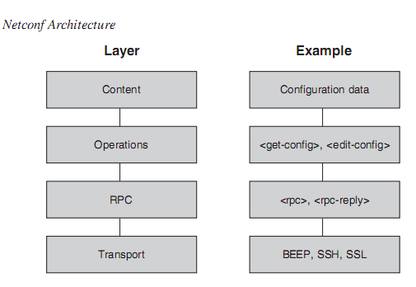
Netconf Architecture

Slide 12
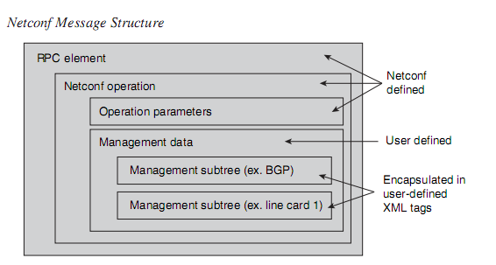

Slide 13
Netconf Operation
Netconf offers the following management operations :
Get-config
Get
Edit-config
Copy-config
Delete-config
Lock and unlock

Slide 14
In addition to those management operations, Netconf offers two operations to terminate a Netconf session:
close session is the graceful variant that allows operations that are already in progress to end before the session is torn down,
whereas kill-session aborts the session abruptly.

Slide 15
Netflow
Netﬂow was ﬁrst introduced by Cisco and is geared toward collecting data about networking trafﬁc from a device.
You can use this data to answer questions such as the following:
Who are the top “talkers” in the network ?
How much trafﬁc is being exchanged between two destinations?
How are links in the network being used?
Where are the trafﬁc bottlenecks in the network

Slide 16
IPFlows
Netﬂow communicates statistical information about IP-based data trafﬁc that “ﬂows” over a router
A ﬂow is uniquely identiﬁed by the following pieces of information (in database parlance, they would be considered keys):
Source address
Source port
Destination address
Destination port
Protocol type (for example, whether the IP packet carries TCP or UDP)
Type of Service (TOS) byte (a byte in IP that identiﬁes the type of service, used to differentiate different categories of trafﬁc)
Input logical interface

Slide 17
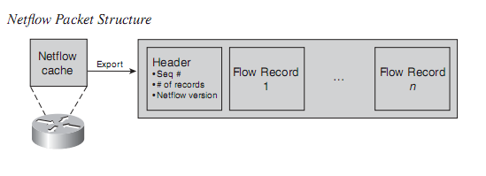
Netflow Protocol

