Slide 1
Security network management
Network Management week 12
Aisyatul Karima,

Slide 2
Outline
Security Threats
Control Access
Security Methode

Slide 3
Security Management
What should be secured in networks?
information security
computer security
network security

Slide 4
Security Requirements
Secrecy
making information accessible to only authorized users
includes the hiding of the existence of information
Integrity
making information modifiable to only authorized users
Availability
making resources available to only authorized users

Slide 5
Security Threats
Interruption
destroyed or becomes unavailable or unusable
threat to “availability”
Interception
an unauthorized party gains access
threat to “secrecy”
Modification
an unauthorized party makes modification
threat to “integrity”
Fabrication
an unauthorized party inserts false information
Masquerade
an entity pretends to be a different entity

Slide 6
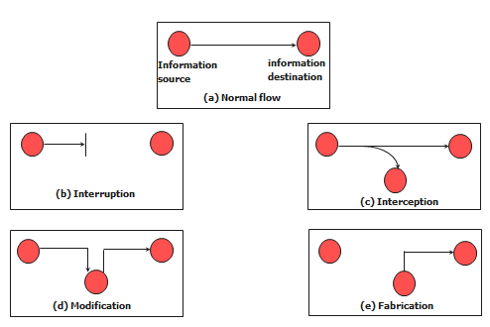
Types of Security Threats

Slide 7
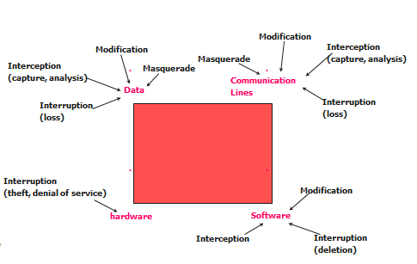
Security Threats and Network Assets

Slide 8
Security Management Functions
Maintain Security Information
event logging, monitoring usage of security-related resources
receiving notification and reporting security violations
maintaining and examining security logs
maintaining backup copies of security-related files
Control Resource Access Service
use access control (authentication and authorization)
security codes (e.g., passwords)
routing tables, accounting tables, etc.
Control the Encryption Process
must be able to encrypt messages between managers & agents
specify encryption algorithms

Slide 9
Summary
Network control is concerned with setting and changing parameters of various parts of network resources as consequences of network monitoring and analysis
Configuration control and security control are two essential aspects of network control

Slide 10
Control Access
Using Firewall
Using SNMP

