Slide 1
RMON Remote Monitoring
Network Management

Slide 5
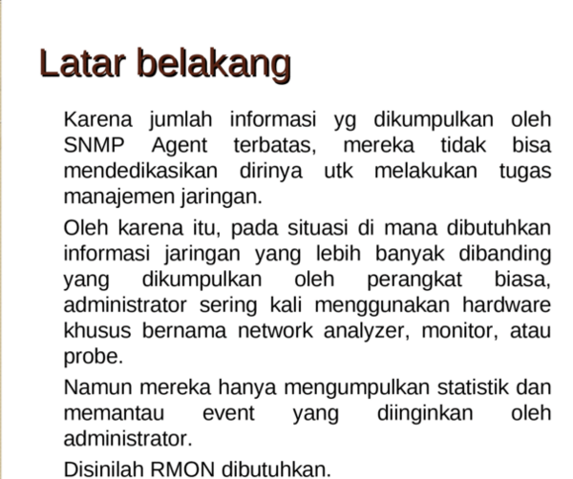

Slide 9
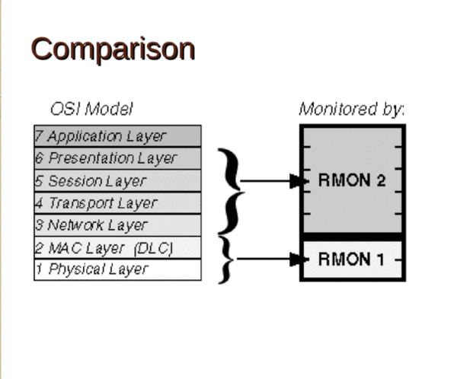

Slide 11
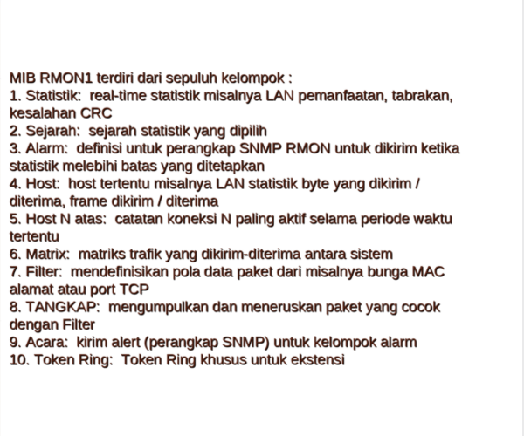

Slide 13
