Slide 1
Achievement Motivation

Slide 2
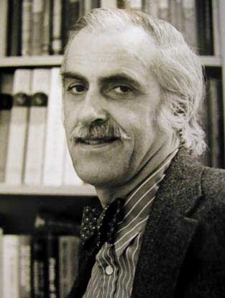
David McClelland
1917-1998
Boston University
Harvard
Achievement motivation
Need to achieve
nAch

Slide 3
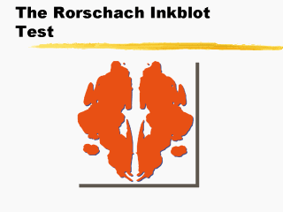
Personality assessment
Projective Test
Present subjects with an ambiguous stimulus and ask them to describe it or tell a story about it.

Slide 4
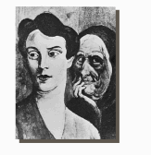
Thematic Apperception Test
Who are the persons?
What is happening?
What led up to situation?
What is being thought or wanted? By whom?
What will happen?
What will be done?

Slide 5
McClelland’s methodology
Subjects shown 4-6 pictures.
Not from the TAT.
People involved in tasks.
Ex: Two men working on a machine.
View for 20 second each.
Write a story about each picture.

Slide 6

Write a story based on questions:
Who is the person?
What is happening?
What led up to situation?
What is being thought or wanted?
What will happen?
What will be done?

Slide 7

Story content with high nAch
Main character
Ambitious
Making plans to forge ahead
Attempting to reach a goal

Slide 8

Stories low in nAch
Main character
Yielding to pressure
Failing in endeavors
Avoiding responsibility

Slide 9
Motivating force
In people with high nACh
Pleasure in success
Confident of abilities
Experienced success
Sets realistic goals

Slide 10
For people low in nAch
Motivating force is fear of failure
Long history of experiencing failure
Afraid of ridicule and dissapointment

Slide 11
nAch and risk-taking
What kind of risk-taker is Santa?
Getting all the wreaths onto the north pole?
Moderate risk-taker.
Chose a task of intermediate difficulty.
High in nAch.

Slide 12
Person with low nAch
Might pick a task that was too difficult.
Should we expect success?
Not blame him if he fails.
Didn’t expect him to succeed.

Slide 13
Children with ring toss
High nAch children picked middle distance.
Challenge but not impossible.
Low nAch picked long distances (couldn’t win).
Or near distances (couldn’t lose).

Slide 14
Parenting styles
Parents who reward
self-control and independence →
child with high nAch
Set high standards
Child works at own level
Makes mistakes
Encourage good performance

Slide 15
Parents of low achievers
Set impossibly high standards.
Punish child when he or she doesn’t achieve goal.
Or jump in and solve the problem.
Parent’s actions don’t encourage self-control.
Child begins to fear failure.

Slide 16
Applications of nAch
McClelland interested in applications to business and global economy.
Business executives had higher nAch than men in other occupations.
Particularly real estate and investments.

Slide 17
Historical studies
McClelland in his later years extended theory.
Industrial revolution → preceded by surge in achievement themes in literature.
Interesting theories but not scientific.

Slide 18
Cognitive Choice Theory
Richard Atkinson
Based on McClelland’s ideas.
We all balance need to achieve with fear of failure.
Different aspects of our life.
Install new motherboard in my computer.
Build a deck in my backyard.

Slide 19
Prepare for exam
Need to achieve vs fear of Failure.
nAch > fF →approach behavior.
Looking forward to success.
Positive frame.
Good outlook.

Slide 20

Negative frame
fF > nAch →
avoidance behavior.
May work hard to prepare.
Tense and anxious
frame of mind.
Bad outlook.

Slide 21
Attribution theory
Bernard Weiner
Attribution: things happen for a reason.
What reason do you give for success or failure?
Your frame of mind makes a huge difference.

Slide 22


Positive frame (high nAch)
Attribute success:
Own ability or effort.
Attribute failure:
Lack of effort.
Try harder next time.

Slide 23
Negative frame (low nAch)
Attribute success:
Easy test.
Lucky break.
Attribute failure:
Lack of ability.
Same outcome next time.

Slide 24
Locus of Control
Positive frame has internal locus of control.
Intrinsic motivation.
Negative frame has external locus of control.
Extrinsic motivation.

Slide 25
Overcoming negative frame
Learning optimism.
Math anxiety.
Start out with easy task.
Learn to value success.
External reward at first.
Internalize the motivation with continued success.

