Slide 1
CULTURAL CONFLICT
By: Neni Kurniawati, M.Hum.

Slide 2
Communication and Culture
Intercultural communication is communication between members of different cultures.
Communication process: differing perceptions, attitudes, and interpretations.
Culture determine their member’s communication style

Slide 3
Interaction between groups
Humans are by nature social beings, forming groups out of shared interests and needs.
The interests and needs of groups interact and produce competition with other groups.
Competition between groups is expressed as a political struggle/conflict
Conflict occurs when behavioral differences are compounded by cultural differences.

Slide 4
Conflict Theory
There are two broad categories of conflict theory:
1. Pluralistic (liberal/conservative)
conflicts emerge in response to particular situations or events that bring into sharp relief groups’ competition for social or economic advantage
2. Radical (critical/Marxist)
social conflict mainly in terms of struggle between social classes in the context of the structured inequalities of capitalists societies

Slide 5
Conflict Theory
Marx’ communist manifesto means of production determine the structure of society
Richard Quinney: All conflict is organized around capitalist versus the poor
Primary goal of capitalist is maintaining the power
The real power and authority is exclusive to the ruling class/group

Slide 6
Conflict theory
Thorsten Seilin:
Culture conflict is a condition that occurs when the rules and norms of an individual’s culture conflict with the role demands of conventional society
Cultural conflict has to do with discrepant norms and values that derive from differing definitions of right and wrong.
Cultural conflict said to bring about criminal behavior

Slide 7
Ethnocentrism
Judging another culture solely by the values and standards of one’s culture
Concern to language, behavior, customs, and religion
Define cultural identity
Ethnocentric individual believe that they are better than other individuals

Slide 8
Ethnocentrism
Examples:
- European Imperialism
- The Mandate of Heaven
- Nazi Germany

Slide 9
Stereotype
A thought about specific types of individuals or certain ways of doing things, but that belief may or may not reflect reality.
Etymology: solid impression
Reflect expectations and beliefs about the characteristics of members of groups perceived as different from one’s own.
What people think of others.
Serve cognitive functions on an interpersonal level and social functions on an intergroup level

Slide 10
Stereotype
common stimuli or socialization
The biggest stereotypes: racial. Sexual, and gender remarks
Common in various cultural media, e.g. Hollywood movies
- Latin Americans: gang members, illegal immigrants, house maid, etc.
- Nigger: ?
- Chinese: ?
- Russian: ?

Slide 11
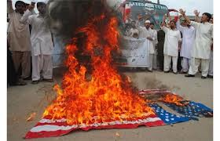
Culture Stereotype
All white Americans are obese, lazy, dim-witted, friendly, generous, arrogant, etc
All Arabs and Muslims are terrorists
Italian and French people are the best lovers
All Jews are greedy
All Asians are good in math, business

Slide 12
Prejudice
Represents the emotional response
The affective component of intergroup attitudes
People create stereotypes to justify ingroup actions towards outgroup.
Example:
1. Justification or ignorance
2. unwillingness to rethink one’s attitudes and behavior
3. Preventing some people entering some fields or activities

Slide 13
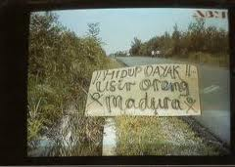
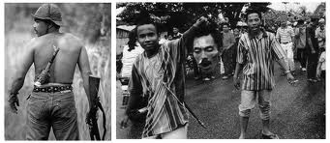

Slide 14
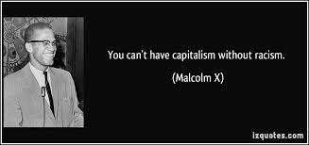
Discrimination
The behavioral component of prejudicial reactions
Refers to actions
E.g.: American to Nigger - Chinese to Malay

Slide 15
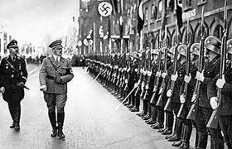
Chauvinism
an exaggerated, patriotism and a belligerent belief in national superiority and glory.

