Slide 1
Distributed Database
Modern Database Management
6th Edition
Jeffrey A. Hoffer, Mary B. Prescott, Fred R. McFadden

Slide 2
Definition
Distributed Database:
A database logic which is physically spit among computers that located in different locations and connected by a communication device

Slide 3
Example

Slide 4
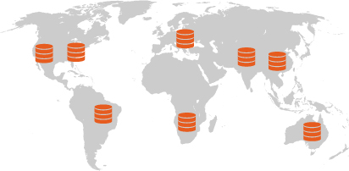
More Example

Slide 5
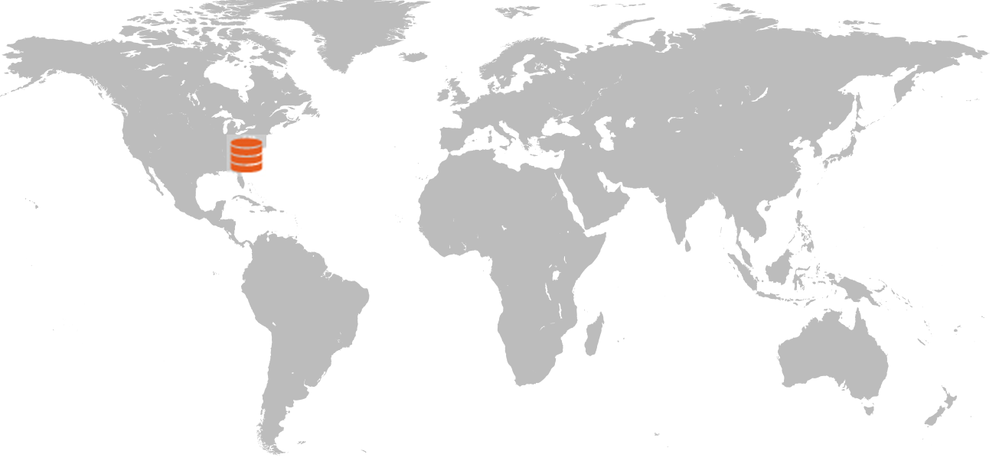
Distributed vs. Centralized

Slide 6
Advantages of Distributed Database
Lower communication costs
Fast response to specific queries
Local sites can operate the database when the network connection is lost
Increasing confidence
Local control of the data

Slide 7
Disadvantages of Distributed Database
Software cost and complexity
The cost of process
Data integrity
Slow response to specific queries

Slide 8
Several Options for Distributing The Database
Data replication
Whole data is distributed to different sites
Horizontal partitioning
Another row in a table is distributed to different sites
Vertical partitioning
Another column in a table is distributed to different sites

Slide 9
Horizontal Partitioning
Most of rows of a table at another site
Advantages –
Optimal local access → better performance
Only the corresponding data are available → safe
Join inter-partition → easily in the query (union)
Disadvantage
Access data between partitions → inconsistent process speed
No data backup → enforce replication

Slide 10
Vertical Partitioning
Most of the columns of a table are on other sites
Advantage and disadvantage are close to the horizontal partition, unless the combination of data between partitions is more difficult because it requires joins (instead of unions)

Slide 11
Distributed DBMS
Distributed database requires distributed DBMS
Distributed DBMS functions:
Put the data in a distributed data dictionary
Specifies the location from where to get the data and process components
DBMS translates between nodes with other DBMS (using middleware)
Consistency of data (via multiphase commit protocols)
Global primary key control
Scalability, security, concurrency, query optimization, repair (recovery)

Slide 12
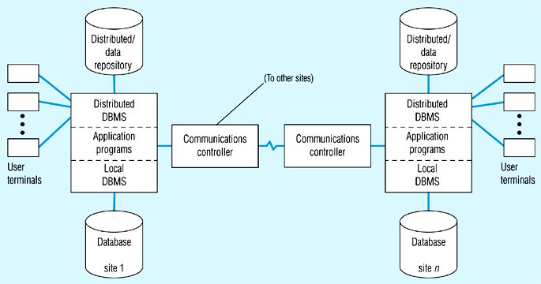
Distributed DBMS Architecture

Slide 13
Steps Taken on Local Transaction
2
1
3
5
4

Slide 14
Steps Taken on Global Transaction
2
3
1
7
6
8
4
5

