Slide 1
Drawing Tree
wijanarto

Slide 2
Any Tree
3
1
2
3
1
18
Insert Leveling
Traversal Preorder
4
6
11
21
5
6
11
9
4
16
19
24
7
8
10
5
14
26
Value
3,1,18,11,4,21,16,5,14,24,26,19
Sequences
1,2, 3, 4, 5, 6, 7, 8, 9,10, 11,12
Notes:
Pre : 3,1,18,11,4,5,16,14,21,19,24,26
In : 1,3,4,5,11,14,16,18,19,21,24,26
Post :1,5,4,14,16,11,19,26,24,21,18,3

Slide 3
BST
Traversal Methods
LDR =Left Data Right
LRD =Left Right Data
DLR =Data Left Right
RDL =Righ Data Left
RLD =Right Left Data
DRL =Data Right Left

Slide 4
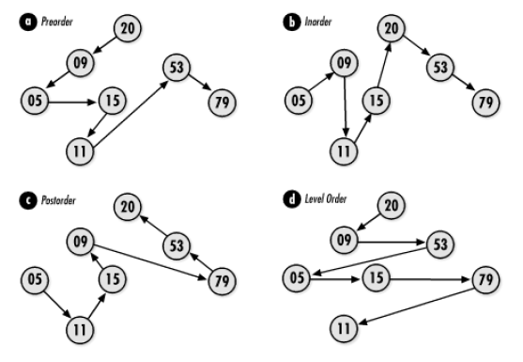
Traversal Tree

Slide 5
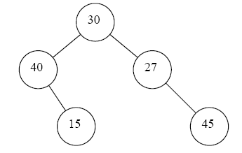
Drawing Any BTree
There are any Btree..
1 Pre Order : print left right
3 In Order : left print rigth
1
3
5
5 Post Order : left right print
Print on every visited node
4
4
4
2
1
2
3
2
1
5
5
3

Slide 6
Reading Tree Pictures
Pre Order = 30, 40, 15, 27, 45
In Order = 40, 15, 30, 27, 45
Post Order = 15, 40, 45, 27, 30
Level = 30, 40, 27, 15, 45
(Reading level, start from root, left, right, down to next level, left, right, and so forth.. )

Slide 7
Example 1
Given Tree In Order : 7, 4, 3, 12, 6, 1, 13
Question:
Draw any binary tree in InOrder
Write list in PreOrder?

Slide 8
Answer 1
Any BTree InOrder
PreOrder from picture InOrder
InOrder :
LDR /
Left Data right
PreOrder :
DLR /
Data left right
12
4
1
1
7
4
7
3
13
12, 7, 3, 4, 13, 6, 1
1 2 3 4 5 6 7
2
3
5
7
3
4
3
6
5
6
2
3
6
4
6
1
1
1
4
4
4
1
7
7
4
7
Result notUNIque
7, 4, 3, 12, 6, 1, 13
1 2 3 4 5 6 7

Slide 9
Example 2 Ordered
Given Tree In Order : 1, 2, 3, 4, 5, 6,7
Question:
Draw any Binary Tree in InOrder
Write list in PostOrder?

Slide 10
Answer 2
Any BTree InOrder
PostOrder from InOrder
InOrder :
LDR /
Left Data right
PreOrder :
LRD /
left right Data
3
3
2
7
5
1, 2, 4, 7, 6, 5, 3
1 2 3 4 5 6 7
7
1
2
5
4
6
1
6
4
5
6
1
1
4
5
6
6
4
5
2
2
2
4
1
7
7
3
4
5
Result not unique
1, 2, 3, 4, 5, 6, 7
1 2 3 4 5 6 7
4
5
6
6

Slide 11
Solution Drawing InOrder
Tree :
InOrder
PreOrder
➔ Draw PostOrder
Tree :
InOrder
PostOrder
➔ Draw PreOrder

Slide 12
Drawing tree from pre and inorder
Given list pre and inorder in binary tree, we can draw unique tree from them
Preorder
Inorder
a
b
c
d
f
g
e
c
b
f
d
g
a
e

Slide 13
Drawing tree from pre and inorder
Given list pre and inorder in binary tree, we can draw unique tree from them
Preorder
inorder
a
b
c
d
f
g
e
c
b
f
d
g
a
e

Slide 14
Drawing tree from pre and inorder
Given list pre and inorder in binary tree, we can draw unique tree from them
a
Preorder
inorder
a
b
c
d
f
g
e
c
b
f
d
g
a
e

Slide 15
Drawing tree from pre and inorder
Given list pre and inorder in binary tree, we can draw unique tree from them
a
Preorder
Inorder
a
b
c
d
f
g
e
c
b
f
d
g
a
e

Slide 16
Drawing tree from pre and inorder
Given list pre and inorder in binary tree, we can draw unique tree from them
a
Preorder
inorder
a
b
c
d
f
g
e
c
b
g
a
f
d
e

Slide 17
Drawing tree from pre and inorder
Given list pre and inorder in binary tree, we can draw unique tree from them
a
Preorder
Inorder
e
a
b
c
d
f
g
e
c
b
g
a
f
d
e
b
c
d
f
g
c
b
f
d
g

Slide 18
Drawing tree from pre and inorder
Given list pre and inorder in binary tree, we can draw unique tree from them
a
Preorder
inorder
b
e
a
b
c
d
f
g
e
c
b
g
a
f
d
e
b
c
d
f
g
c
b
f
d
g

Slide 19
Drawing tree from pre and inorder
Given list pre and inorder in binary tree, we can draw unique tree from them
a
Preorder
inorder
b
e
a
b
c
d
f
g
e
c
b
g
a
f
d
e
b
c
d
f
g
c
b
f
d
g

Slide 20
Drawing tree from pre and inorder
Given list pre and inorder in binary tree, we can draw unique tree from them
a
Preorder
inorder
b
e
a
b
c
d
f
g
e
c
b
g
a
f
d
e
b
c
d
f
g
c
b
f
d
g

Slide 21
Drawing tree from pre and inorder
Given list pre and inorder in binary tree, we can draw unique tree from them
a
Preorder
inorder
b
e
a
b
c
d
f
g
e
c
b
g
a
f
d
e
c
b
c
d
f
g
c
b
f
d
g

Slide 22
Drawing tree from pre and inorder
Given list pre and inorder in binary tree, we can draw unique tree from them
a
Preorder
inorder
b
e
a
b
c
d
f
g
e
c
b
g
a
f
d
e
c
b
c
d
f
g
c
b
f
d
g
d
f
g
f
d
g

Slide 23
Drawing tree from pre and inorder
Given list pre and inorder in binary tree, we can draw unique tree from them
a
Preorder
Postorder
b
e
a
b
c
d
f
g
e
c
b
g
a
f
d
e
c
b
c
d
f
g
c
b
f
d
g
d
f
g
f
d
g

Slide 24
Drawing tree from pre and inorder
Given list pre and inorder in binary tree, we can draw unique tree from them
a
Preorder
inorder
b
e
a
b
c
d
f
g
e
c
b
g
a
f
d
e
c
b
c
d
f
g
c
b
f
d
g
d
f
g
f
d
g

Slide 25
Drawing tree from pre and inorder
Given list pre and inorder in binary tree, we can draw unique tree from them
a
Preorder
inorder
b
e
a
b
c
d
f
g
e
c
b
g
a
f
d
e
c
d
b
c
d
f
g
c
b
f
d
g
d
f
g
f
d
g

Slide 26
Drawing tree from pre and inorder
Given list pre and inorder in binary tree, we can draw unique tree from them
a
Preorder
inorder
b
e
a
b
c
d
f
g
e
c
b
g
a
f
d
e
c
d
b
c
d
f
g
c
b
f
d
g
d
f
g
f
d
g

Slide 27
Drawing tree from pre and inorder
Given list pre and inorder in binary tree, we can draw unique tree from them
a
Preorder
inorder
b
e
a
b
c
d
f
g
e
c
b
g
a
f
d
e
c
d
b
c
d
f
g
c
b
f
d
g
d
f
g
f
d
g

Slide 28
Drawing tree from pre and inorder
Given list pre and inorder in binary tree, we can draw unique tree from them
a
Preorder
inorder
b
e
a
b
c
d
f
g
e
c
b
g
a
f
d
e
c
d
b
c
d
f
g
c
b
f
d
g
c
d
d
f
g
f
d
g

Slide 29
Drawing tree from pre and inorder
You can do with post and inrder
In post , root always at the end of list

Slide 30
How about pre andpost
Tree is not unique
Pre : a b c
Post : c b a
a
a
b
b
c
c

Slide 31
Special case
If every internal node from binary tree there exist 2 child, then tree could determine from pre and post order traversal
a
preorder
postorder
a
b
c
d
f
g
e
c
f
g
d
b
e
a

Slide 32
Special Case
If every internal node from binary tree there exist 2 child, then tree could determine from pre and post order traversal
a
e
preorder
postorder
a
b
c
d
f
g
e
c
f
g
d
b
e
a

Slide 33
Special Case
If every internal node from binary tree there exist 2 child, then tree could determine from pre and post order traversal
a
e
preorder
postorder
a
b
c
d
f
g
e
c
f
g
d
b
e
a
Cause e in preorder no child
Then e must be leaf and places at the right of a

Slide 34
Special Case
If every internal node from binary tree there exist 2 child, then tree could determine from pre and post order traversal
a
e
preorder
postorder
a
b
c
d
f
g
e
c
f
g
d
b
e
a
b
c
d
f
g
c
f
g
d
b

Slide 35
Special Case
If every internal node from binary tree there exist 2 child, then tree could determine from pre and post order traversal
a
b
e
preorder
postorder
a
b
c
d
f
g
e
c
f
g
d
b
e
a
b
c
d
f
g
c
f
g
d
b

Slide 36
Special Case
If every internal node from binary tree there exist 2 child, then tree could determine from pre and post order traversal
a
b
e
preorder
postorder
a
b
c
d
f
g
e
c
f
g
d
b
e
a
b
c
d
f
g
c
f
g
d
b

Slide 37
Special Case
a
If every internal node from binary tree there exist 2 child, then tree could determine from pre and post order traversal
b
e
d
Cause d is right child of b, then in
Preorder, node behind its right of b, and c must be left child of b.
The rest we follow post method
preorder
postorder
a
b
c
d
f
g
e
c
f
g
d
b
e
a
b
c
d
f
g
c
f
g
d
b

Slide 38
Special Case
a
If every internal node from binary tree there exist 2 child, then tree could determine from pre and post order traversal
b
e
c
d
Cause c on the post is leaf, and at the left of b
Then we can draw it.
preorder
postorder
a
b
c
d
f
g
e
c
f
g
d
b
e
a
b
c
d
f
g
c
f
g
d
b

Slide 39
Special Case
a
If every internal node from binary tree there exist 2 child, then tree could determine from pre and post order traversal
b
e
c
d
f
g
preorder
postorder
a
b
c
d
f
g
e
c
f
g
d
b
e
a
b
c
d
f
g
c
f
g
d
b
d
f
g
f
g
d

Slide 40
Another example
Given tree :
In Order : 5, 10, 15, 20, 25, 30, 35, 40, 45, 50, 55
Post Order : 5, 15, 25, 20, 30, 10, 35, 50, 55, 45, 40
(index) 11 10 9 8 7 6 5 4 3 2 1
Root is 40, becaouse in Post Order the right most value is the root.
How do we draw the picture In Order ?

Slide 41
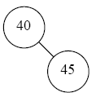
In Order : 5, 10, 15, 20, 25, 30, 35, 40, 45, 50, 55 Post Order : 5, 15, 25, 20, 30, 10, 35, 50, 55, 45, 40 Step 1

Slide 42
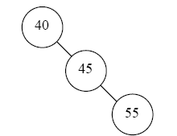
In Order : 5, 10, 15, 20, 25, 30, 35, 40, 45, 50, 55 Post Order : 5, 15, 25, 20, 30, 10, 35, 50, 55, 45, 40 Step 2

Slide 43
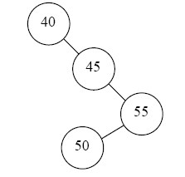
In Order : 5, 10, 15, 20, 25, 30, 35, 40, 45, 50, 55 Post Order : 5, 15, 25, 20, 30, 10, 35, 50, 55, 45, 40 Step 3

Slide 44
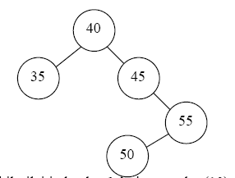
In Order : 5, 10, 15, 20, 25, 30, 35, 40, 45, 50, 55 Post Order : 5, 15, 25, 20, 30, 10, 35, 50, 55, 45, 40 Step 4

Slide 45
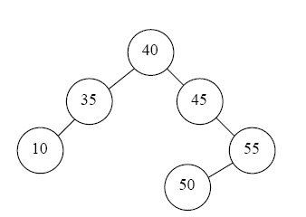
In Order : 5, 10, 15, 20, 25, 30, 35, 40, 45, 50, 55 Post Order : 5, 15, 25, 20, 30, 10, 35, 50, 55, 45, 40 Step 5

Slide 46
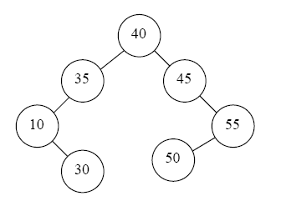
In Order : 5, 10, 15, 20, 25, 30, 35, 40, 45, 50, 55 Post Order : 5, 15, 25, 20, 30, 10, 35, 50, 55, 45, 40 Step 6

Slide 47
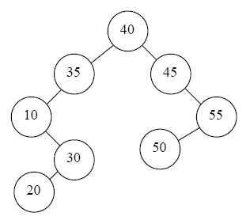
In Order : 5, 10, 15, 20, 25, 30, 35, 40, 45, 50, 55 Post Order : 5, 15, 25, 20, 30, 10, 35, 50, 55, 45, 40 Step 7

Slide 48
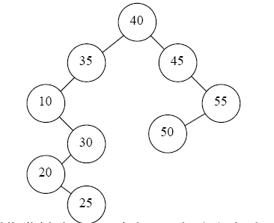
In Order : 5, 10, 15, 20, 25, 30, 35, 40, 45, 50, 55 Post Order : 5, 15, 25, 20, 30, 10, 35, 50, 55, 45, 40 Step 8

Slide 49
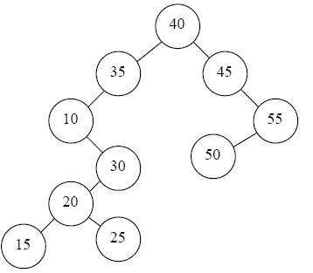
In Order : 5, 10, 15, 20, 25, 30, 35, 40, 45, 50, 55 Post Order : 5, 15, 25, 20, 30, 10, 35, 50, 55, 45, 40 Step 9

Slide 50
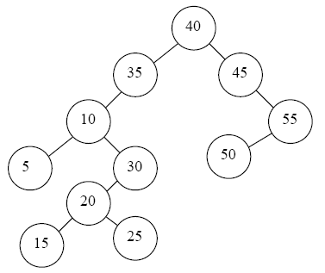
In Order : 5, 10, 15, 20, 25, 30, 35, 40, 45, 50, 55 Post Order : 5, 15, 25, 20, 30, 10, 35, 50, 55, 45, 40 Step 10

Slide 51
What we’ve got so far ?
To read and draw tree we need :
In and Pre OR In and post TRAVERSAL LIST
Thats all

