Slide 1
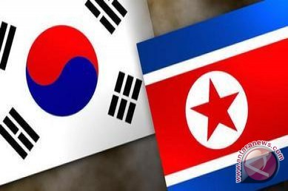
EDUCATION IN KOREA
By:
Octavia Putri C11.2013.01432
Necky Wahyu C11.2013.01428
Citra Ayu Yulia C11.2013.01445
Steffy Natalie C11.2013.01447

Slide 2
MAP

Slide 3
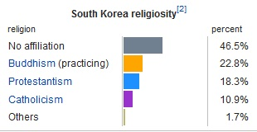
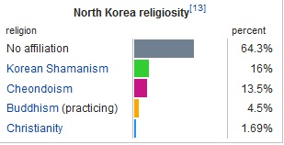
ABOUT KOREA
NORTH KOREA
SOUTH KOREA
Democratic People's Republic of Korea (Choson) 조선
Population: 23 million
Capital: pyongyang
Religion:
Republic of Korea 한국 ( Hanguk)
Population: 50 million
Capital: seoul
Religion:

Slide 4
Level/Grade | Typical age
Infant School
Nursery School | 0-3
Kindergarten | 4-6
Primary School
1st Grade | 6-7
2nd Grade | 7-8
3rd Grade | 8-9
4th Grade | 9-10
5th Grade | 10-11
6th Grade | 11-12
Middle School
7th grade | 12-13
8th Grade | 13-14
9th Grade | 14-15
High School
10th Grade | 15-16
11th Grade | 16-17
12th Grade | 17-18
Post-secondary education
Tertiary education (College or University) | Ages vary (usually four years, referred to as Freshman, Sophomore, Junior and Senior years)

Slide 5
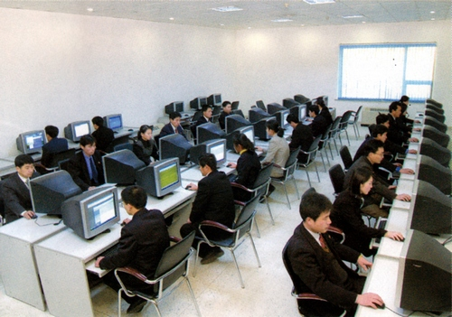
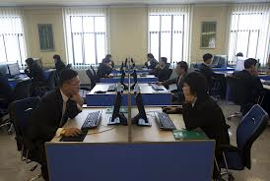
North Korea

Slide 6
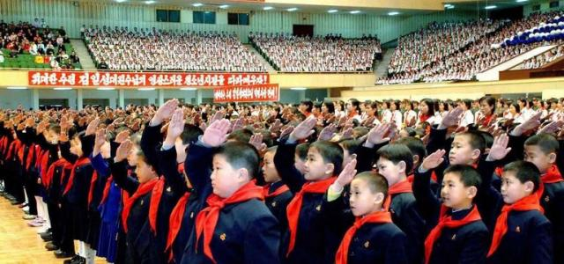
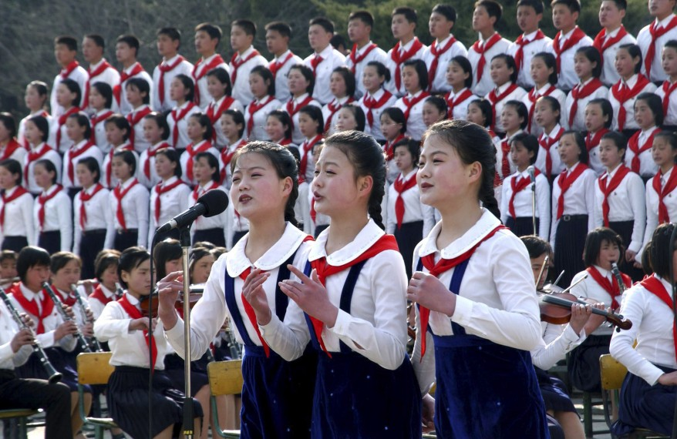
School’s Uniform

Slide 7
Pre-school
Elementary school
Junior high school
High education
Non-formal education

Slide 8
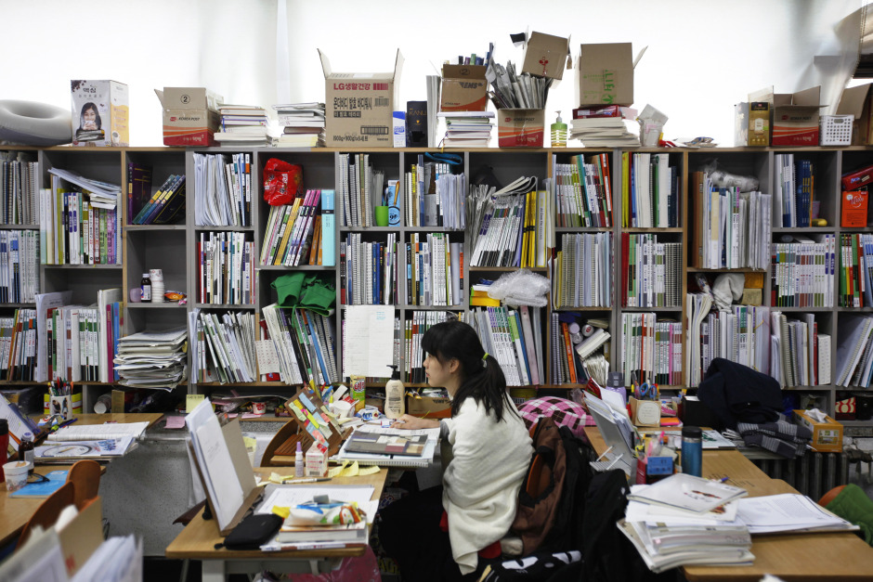
South Korea

Slide 9
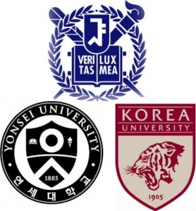

Slide 10
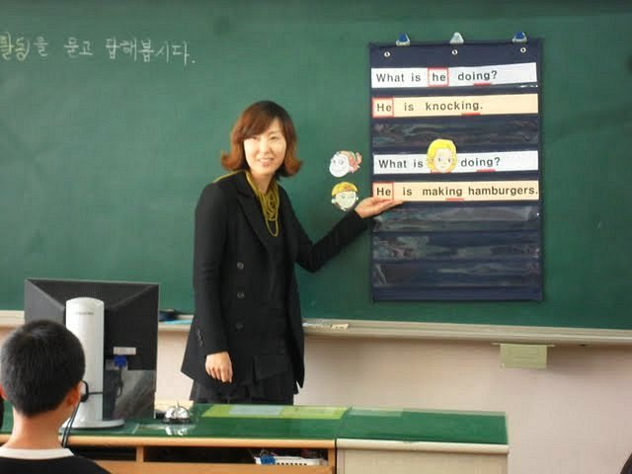

Slide 11
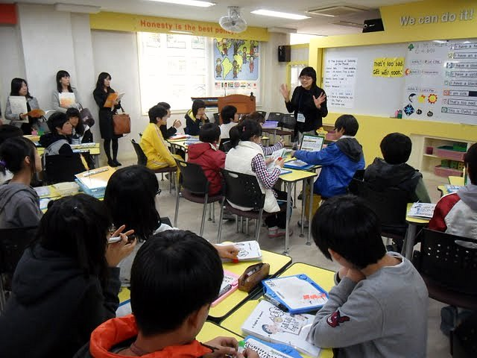

Slide 12
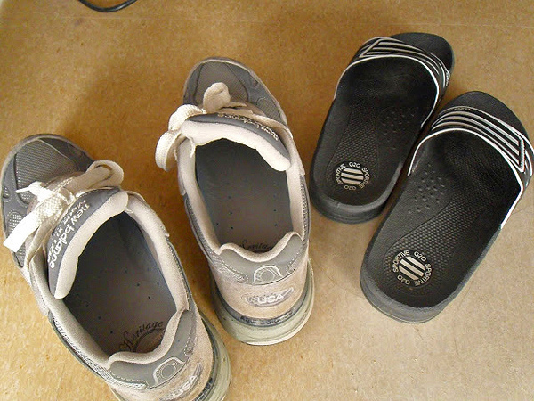
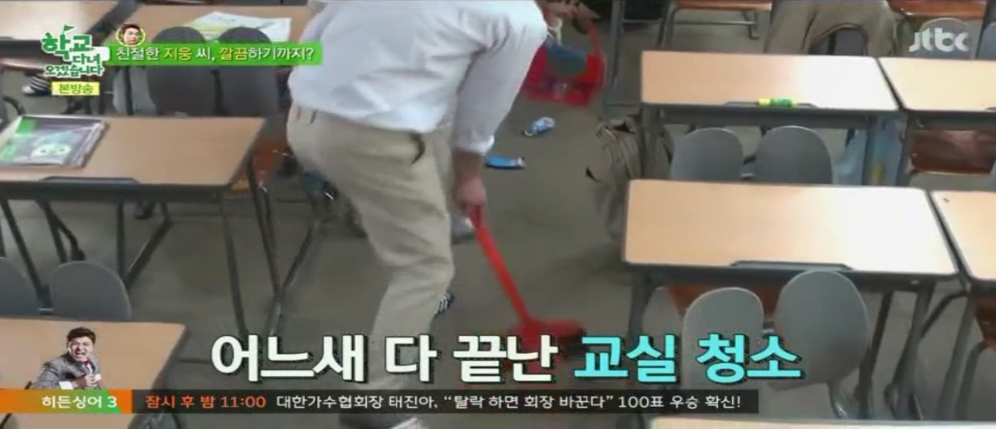

Slide 13
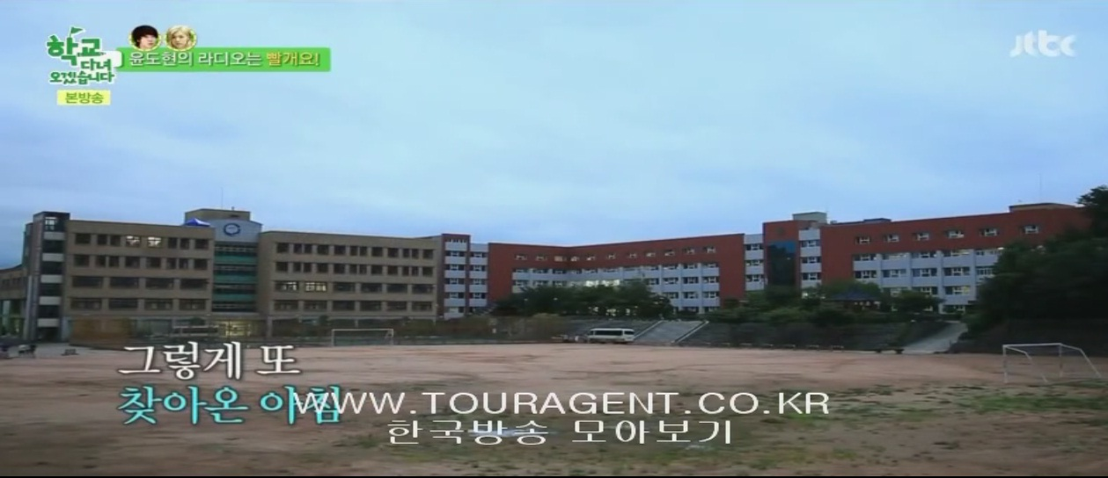
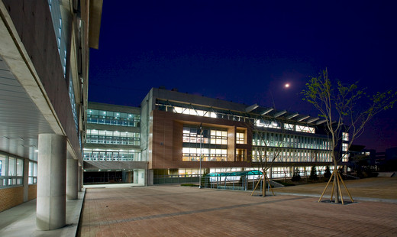
SCHOOL BUILDING

Slide 14
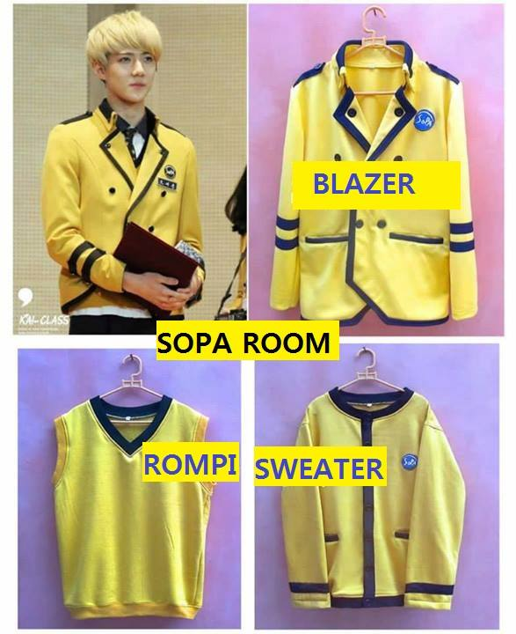
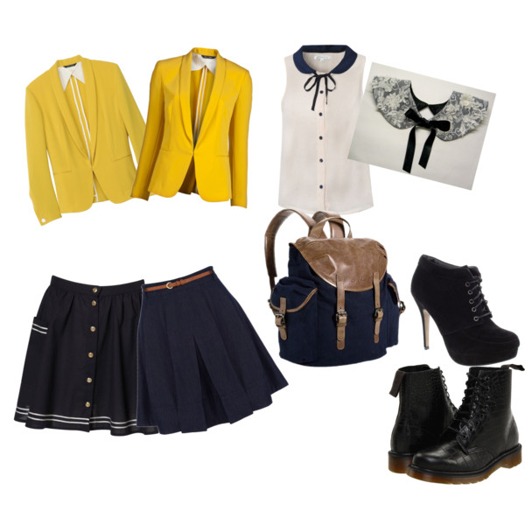
SCHOOL UNIFORM

Slide 15
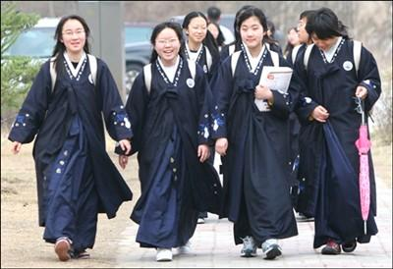
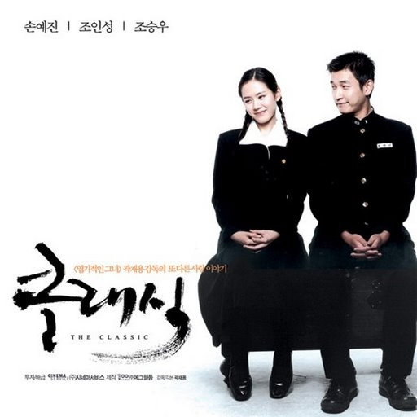
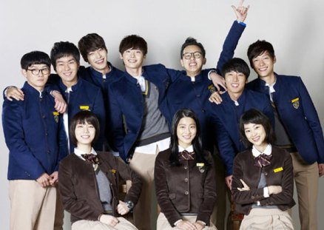
HISTORY

Slide 16
