Slide 1
UNIT 2
CAREER

Slide 2
Eight common interview questions and answers
Click this YouTube link https://www.youtube.com/watch?v=1mHjMNZZvFo to watch the video.
Watch and summarize it with your own language.

Slide 3
Application Letter Content your application letter will the employer know what position you are
applying for, why the employer should select you for an interview, and how you will follow-up
First Paragraph: The first paragraph of your job application letter should include information on why you are writing. Mention the job you are applying for and where you found the position. If you have a contact at the company, include it.
Middle Paragraphs: The next section of your cover letter should describe what you have to offer the company. Make strong connections between your abilities and the requirements listed in the job posting. Mention specifically how your skills and experience match the job. Expand on the information in your resume, don't just repeat it. Try to support each statement you make with a piece of evidence. Use several shorter paragraphs or bullets rather than one large block of text.
Final Paragraph: Conclude your application letter by thanking the employer for considering you for the position. Include information on how you will follow-up. State that you will do so and indicate when (one week's time is typical). You may want to reduce the time between sending out your resume and follow up if you fax or email it.
Complimentary Close:
Sincerely,
Signature
Contact Information
The first section of your letter should include information on how
the employer can contact you. If you have contact information for
the employer, include that. Otherwise, just list your information.
Your Personal Information
First Name Last Name Street Address City, State, Zip Code Phone Number Email Address
Date
Employer Contact Information (if you have it) Name Title Company Address City, State, Zip Code
Salutation Dear Mr./Ms. Last Name or Dear Hiring Manager:
.

Slide 4
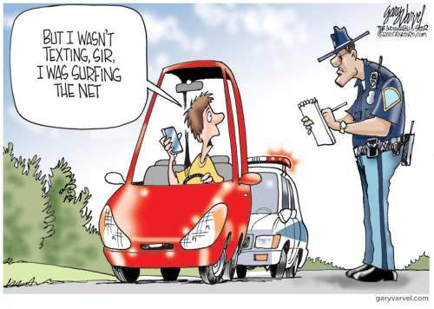
Past Continuous Tense
The past continuous tense, also known as the past progressive tense, refers to a continuing action or state that was happening at some point in the past.
In other words, it expresses an unfinished or incomplete action in the past.
Function of past continuous tense can be seen for:
To show that someone is in the middle of an action.
Example: I was calling him when he came home.
Is used to describe an action taking place when another occurred.
Example: While they were painting the door, I was painting the windows.
For an action that was taking place in the past when an interrupted action happened.
Example: While he was working on his laptop, he fell asleep

Slide 5
EXERCISE Make a creative cv
Type “creative CV example” in your browser in your smartphone or your laptop to find what you are looking for

Slide 6
You may watch the video below.
It will help you to make a CV or just the assignment said “a Creative CV”
https://www.youtube.com/watch?v=KO6zV5C0COc

