Slide 1
Javascript

Slide 2
JavaScript Introduction
JavaScript Can Change HTML Content
JavaScript Can Change HTML Attributes
JavaScript Can Change HTML Styles (CSS)
JavaScript Can Hide HTML Elements
JavaScript Can Show HTML Elements

Slide 3
JavaScript Where To
JavaScript in <head>
JavaScript in <body>
External JavaScript

Slide 4
Head

Slide 5
body

Slide 6
External
myScript.js
function myFunction() { document.getElementById("demo").innerHTML = "Paragraph changed.";}

Slide 7
JavaScript Display Possibilities
Writing into an alert box, using window.alert().
Writing into the HTML output using document.write().
Writing into an HTML element, using innerHTML.
Writing into the browser console, using console.log().

Slide 8
Example

Slide 9
Array

Slide 10
Object

Slide 11
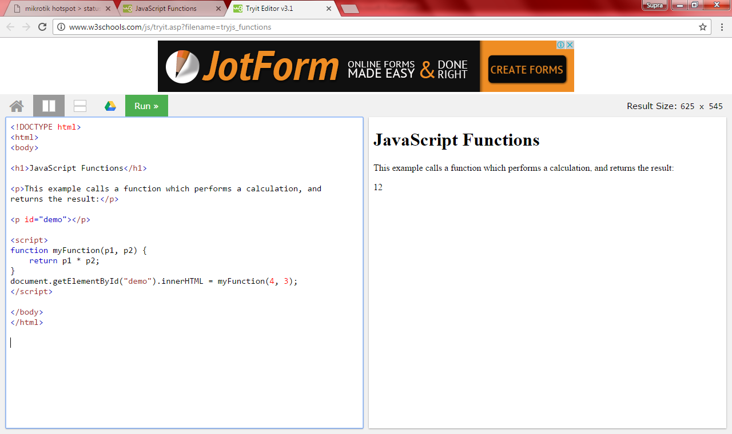
Function

Slide 12
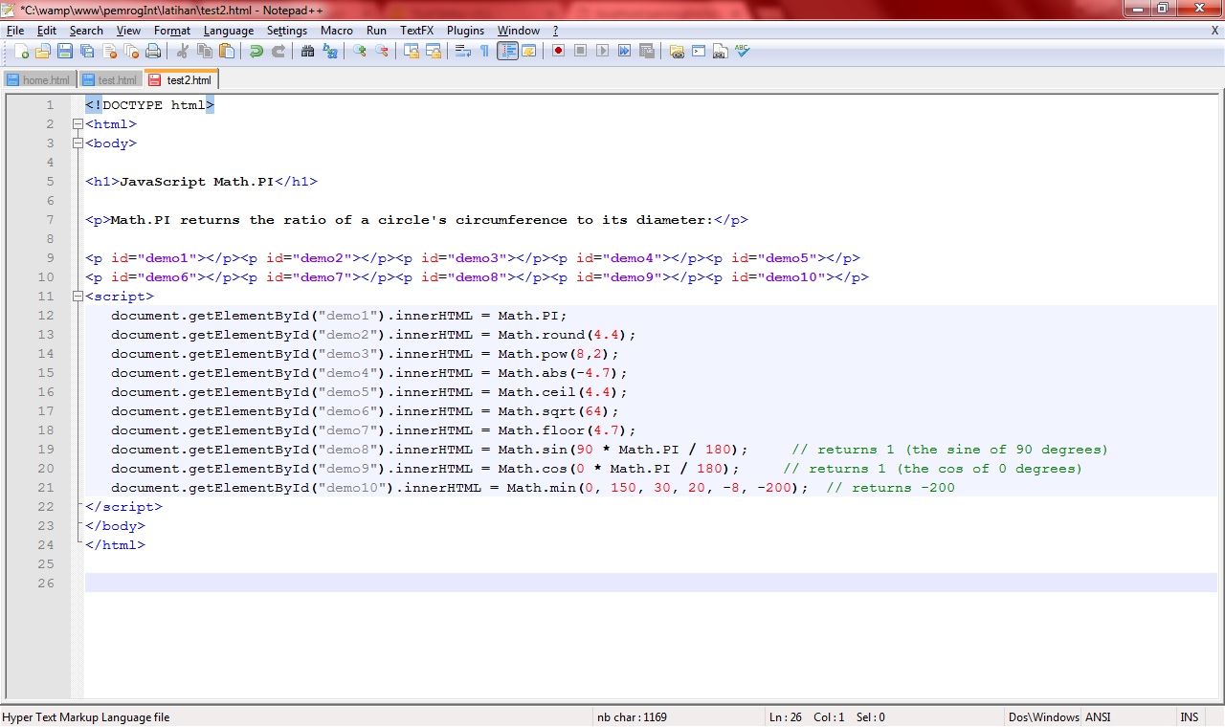
Math

Slide 13
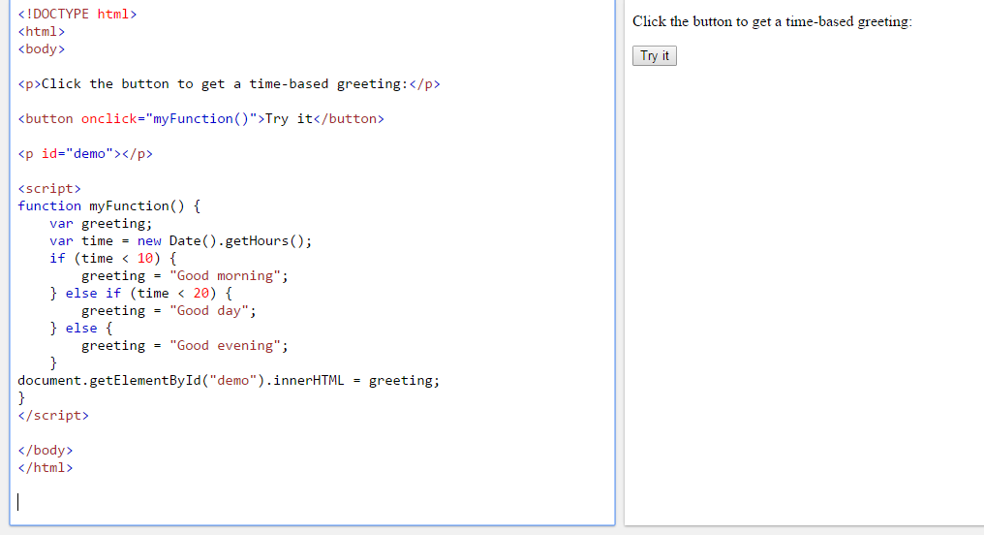
Condition - IF

Slide 14
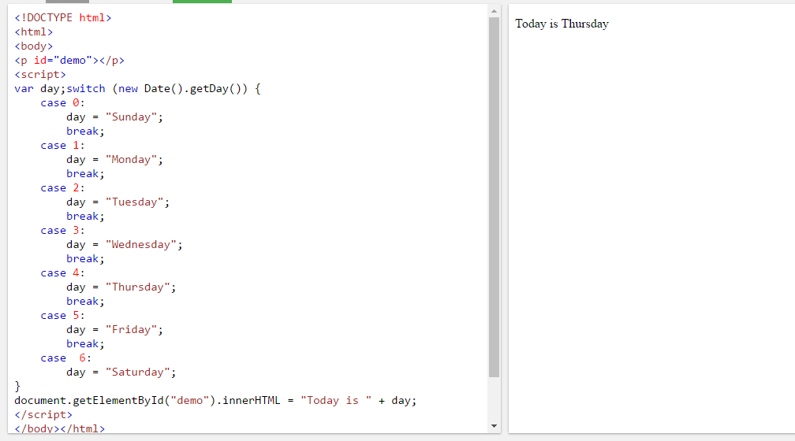
Condition - Switch

Slide 15
Loop - For

Slide 16
Loop - While

Slide 17
Loop – do While

Slide 18
Form

Slide 19
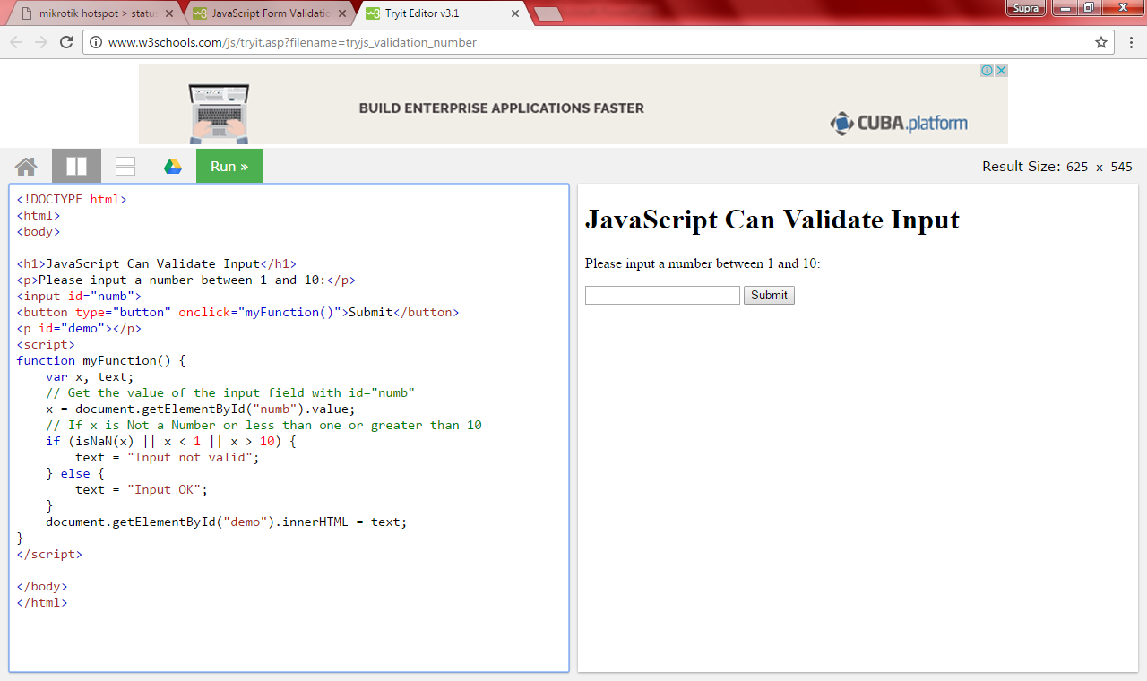
Form

Slide 20
Form

