Slide 1
Predicate Logic

Slide 2
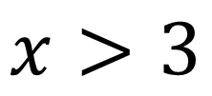
The limitation of propositional logic
$$x>3$$
Is not a proposition
Because we can not tell whether it is true or false unless we know the value of $x.$
Notes:
Thus the propositional logic can not deal with such sentences. However, such assertions appear quite often in mathematics and we want to do inferencing on those assertions.

Slide 3
Predicate Logic
The statement “$x$ is greater than 3” has two parts:
Subject : $x$ is the subject of the statement
Predicate : “is greater than 3”
We denote the statement “$x$ is greater than 3” by $P(x)$, where $P$ is the
predicate “is greater than 3” and $x$ is the variable.
The statement $P(x)$ is also called the value of propositional function $P$ at $x$.
Notes:
A predicate becomes a proposition when specific values are assigned to the variables.

Slide 4
More on Predicate Logic
A predicate becomes a proposition when specific values are assigned to the variables.
$P\left(x_{1},x_{2},x_{3},…,x_{n}\right)$ is called a predicate of $n$variables or $n$ arguments
Examples:
$Father(x)$ : unary predicate
$Brother(x,y)$ : binary predicate
$Sum(x,y,z)$ : ternary predicate
$P(x,y,z,t)$ : $n$-ary predicate

Slide 5
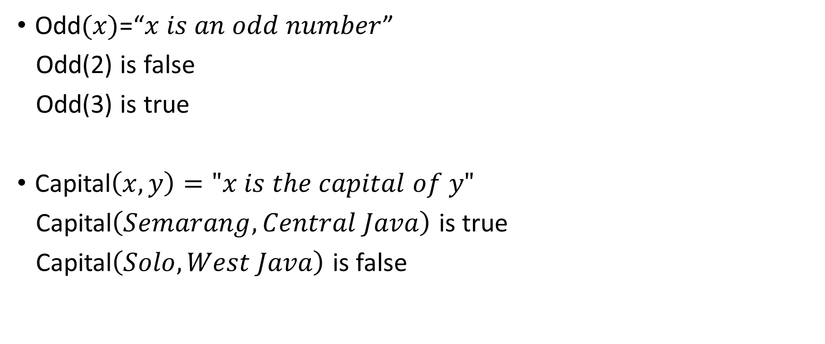
Example of Predicate Logic
Odd$(x)$=“$x is an odd number$”
Odd(2) is false
Odd(3) is true
Capital$\left(x,y\right)="x is the capital of y"$
Capital$\left(Semarang,Central Java\right)$ is true
Capital$\left(Solo,West Java\right)$ is false

Slide 6
Quantifier
A predicate becomes a proposition when we assign it fixed values.
However, another way to make a predicate into a proposition is to quantify it.
Such quantification can be done with two quantifiers: the universal quantifier and the existential quantifier

Slide 7
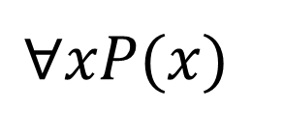
Universal Quantifier
$P(x)$is true for all values of $x$in the universe of discourse
which can be read : “for all $x$”
“For every $x$”
“for any”
“for arbitrary”
“for each”
$$∀xP(x)$$

Slide 8
Universal Quantifier – Example
Let
$P\left(x\right):$“$x$ must take a discrete mathematics course”
$Q(x)$: “$x$ is a computer science student”
Express the statement:
“Every computer science student must take a discrete mathematics course”.
“Everybody must take a discrete mathematics course or be a computer science student”
$$∀x(Q(x) → P(x))$$
$$∀x(Q(x) ∨ P(x))$$

Slide 9
Universal Quantifier – Example 2
Express the statement “for every $x$ and for every $y$, $x + y > 10$”

Slide 10
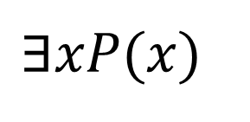
Existential Quantifier
The existential quantification of a predicate $P(x)$ is the proposition “There exists an $x$ in the universe of discourse such that $P(x)$ is true.”
which can be read “there exists an $x$”
“for some”
“for at least one”
$$∃xP(x)$$

Slide 11
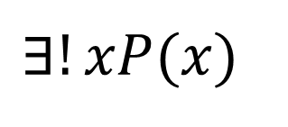
More on Existential Quantifier
$$∃!xP(x)$$
which can be read “there exists a unique”
there is one and only one

Slide 12
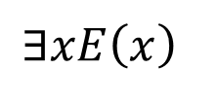
Quantifier - Example
Let
$N(x): x$is a non-negative integer
$E(x): x$is even
$O(x): x$is odd
$P(x): x$is prime
Translate into logical notation.
There exists an even integer.
Every integer is even or odd.
All prime integers are non-negative.
Not all primes are odd.
$$∃xE\left(x\right)$$
$$∀x(E\left(x\right)∨O\left(x\right))$$
$$∀x(P\left(x\right)→N\left(x\right))$$
$$¬∀x(P\left(x\right)→O\left(x\right))$$

Slide 13
Quantifier - Example 2
Let
$P(x): x$is a lion
$Q(x): x$is fierce
$R(x): x$drinks coffee
Translate into logical notation.
all lions are fierce
some lions do not drink coffee
some fierce creatures do not drink coffee
$$∀x(P\left(x\right)→Q\left(x\right))$$
$$∃x(P\left(x\right)∧R\left(x\right))$$
$$∃x(Q\left(x\right)∧R\left(x\right))$$

Slide 14
Negating Quantified Statements
DeMorgan’s laws for quantifiers:
$$¬∃xP\left(x\right)≡ ∀x¬P\left(x\right)$$
$¬(∀x,P\left(x\right)→Q\left(x\right)) ≡ ∃x(P(x)∧¬Q\left(x\right)$)
$¬(∃x,P\left(x\right)∧Q\left(x\right)) ≡∀x(P(x)→¬Q\left(x\right)$)

Slide 15
Statement | Equivalent Statement | Negation of Statement
All A are B | There are no A that are not B | Some A are not B
Some A are not B | Not all A are B | All A are B
Some A are B | There exists at least one A that is a B | No A are B
No A are B | All A are not B | Some A are B

Slide 16
Quantifier - Example 3
All dogs are animals.
Some kids do not like video games.
Some video games are nonviolent.
No math courses are difficult

Slide 17
Entailment

Slide 18
Definition
A sentence A entails another sentence B if, whenever A is true, B must also be true
A|=B

Slide 19
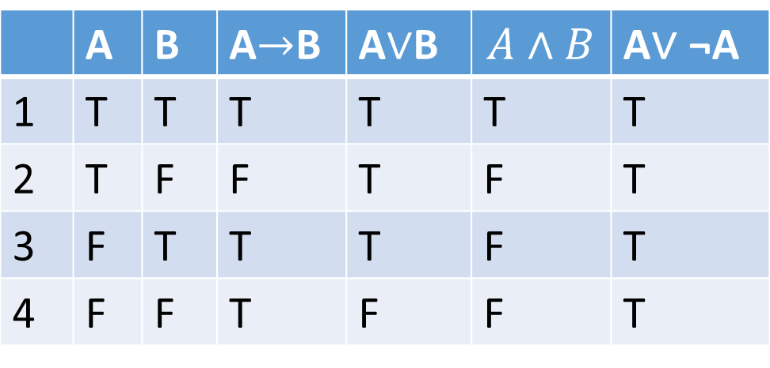
Entailment in Propositional Logic: Examples
$\left\{A,A→B\right\}|=B$
$\{A\}|=A∨B$
$\{A,B\} |=A∧B$
$\{A\} |≠A∧B$
{A∨ ¬A} $|≠$ A
 | A | B | A$→$B | A$∨$B | $$A∧B$$ | A∨ ¬A
1 | T | T | T | T | T | T
2 | T | F | F | T | F | T
3 | F | T | T | T | F | T
4 | F | F | T | F | F | T

Slide 20
Another Example
Which one of the following statement is entailment?
$\{p∧q\}|=p$
{$p∨q\}|=p$
$\{¬q,p∨q\}|=p$
{$p\}|=p∨q$
$\{p\}|=p∧q$

