Slide 1
Evaluasi
PROGRAM STUDI DESAIN KOMUNIKASI VISUAL
MATA KULIAH
PEMASARAN DAN PRILAKU KONSUMEN
Tim Pengampu Matakuliah
<a href='https://www.freepik.com/free-photos-vectors/background'>Background vector created by freepik - www.freepik.com</a>

Slide 2
PROGRAM STUDI
DESAIN KOMUNIKASI VISUAL
MATA KULIAH
PEMASARAN DAN PRILAKU KONSUMEN
Capaian Pembelajaran
Mahasiswa memahami adanya beberapa macam proses keterlibatan konsumen dalam sebuah pembelian
Kemampuan Akhir yang Diharapkan
Mahasiswa dapat memahami dan menjelaskan proses evaluasi keterlibatan konsumen dalam sebuah pembelian.

Slide 3
Consumers as Problem Solvers
PROGRAM STUDI
DESAIN KOMUNIKASI VISUAL
MATA KULIAH
PEMASARAN DAN PRILAKU KONSUMEN
Consumer purchase = response to problem
We are interested in a purchase, and go through a series of steps in order accomplish it
Can seem automatic or very complicated
Complicated by so much consumer choice
Decision-making process

Slide 4
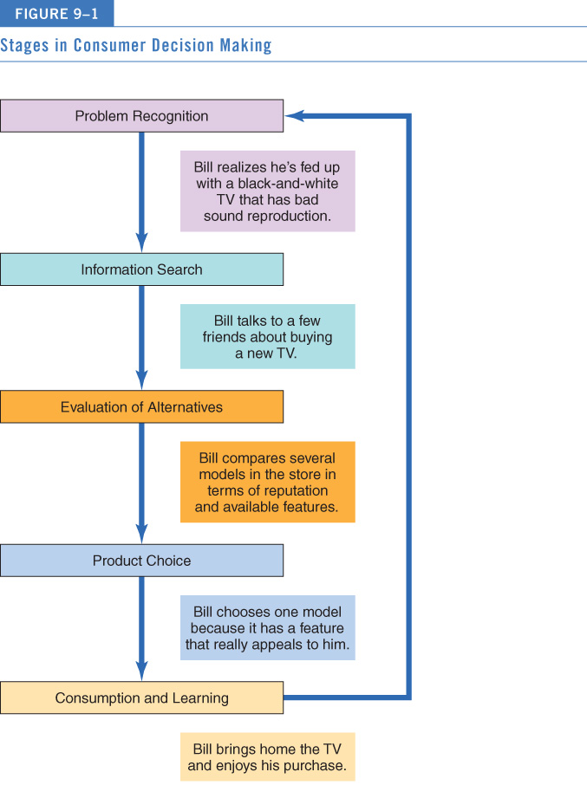
Decision-Making Process
PROGRAM STUDI
DESAIN KOMUNIKASI VISUAL
MATA KULIAH
PEMASARAN DAN PRILAKU KONSUMEN

Slide 5
Perspectives on Decision-Making
PROGRAM STUDI
DESAIN KOMUNIKASI VISUAL
MATA KULIAH
PEMASARAN DAN PRILAKU KONSUMEN
Rational perspective - consumers:
Integrate as much information as possible with what they already know about a product
Weigh pluses and minuses of each alternative
Arrive at a satisfactory decision
Think about it: Are all of your purchase decisions rational? Why or why not?
Other models of decision-making:
Purchase momentum: Occurs when consumers buy beyond needs
Behavioural influence perspective: Consumers buy based on environmental cues, such as a sale
Experiential perspective: Consumers buy based on totality of product’s appeal

Slide 6
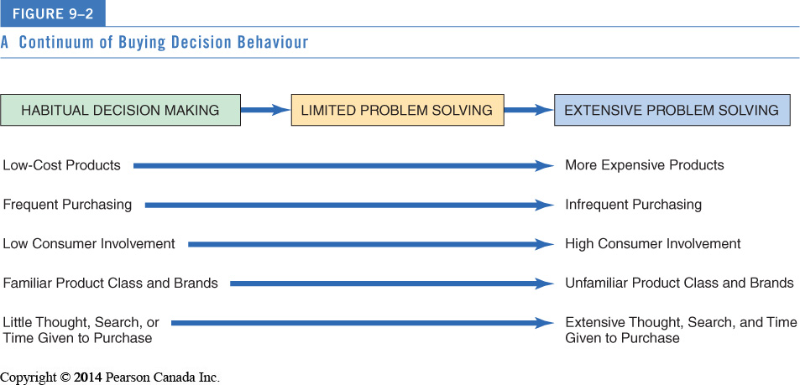
Continuum of Buying Decision Behavior
PROGRAM STUDI
DESAIN KOMUNIKASI VISUAL
MATA KULIAH
PEMASARAN DAN PRILAKU KONSUMEN

Slide 7
Types of Consumer Decision-Making
PROGRAM STUDI
DESAIN KOMUNIKASI VISUAL
MATA KULIAH
PEMASARAN DAN PRILAKU KONSUMEN
Extended problem solving:
Initiated by a motive that is central to self-concept
Consumer feels that eventual decision carries a fair degree of risk
Limited problem solving:
Buyers not as motivated to search for information or to evaluate rigorously
Buyers use simple decision rules to choose
Habitual decision making:
Choices made with little to no conscious effort

Slide 8
Habitual Decision Making
PROGRAM STUDI
DESAIN KOMUNIKASI VISUAL
MATA KULIAH
PEMASARAN DAN PRILAKU KONSUMEN
Automaticity: Choices made with little/no conscious effort
Efficient decisions: minimal time/energy
Challenge for marketers…
Consumers must be convinced to “unfreeze” their former habit and replace it with new one

Slide 9
Limited Problem Solving
PROGRAM STUDI
DESAIN KOMUNIKASI VISUAL
MATA KULIAH
PEMASARAN DAN PRILAKU KONSUMEN
Straightforward choices
Simple decision rules to choose among alternatives
Cognitive shortcuts

Slide 10
Extended Problem Solving
PROGRAM STUDI
DESAIN KOMUNIKASI VISUAL
MATA KULIAH
PEMASARAN DAN PRILAKU KONSUMEN
Initiated by self-concept motive
Eventual purchase decision is perceived as a risk
Consumer collects extensive information
Internal and external search
Careful evaluation of brand attributes (one at a time)

Slide 11
Problem Recognition
PROGRAM STUDI
DESAIN KOMUNIKASI VISUAL
MATA KULIAH
PEMASARAN DAN PRILAKU KONSUMEN
Occurs when consumer sees difference between current state and ideal state
Need recognition: actual state moves downward
Opportunity recognition: Ideal state moves upward

Slide 12
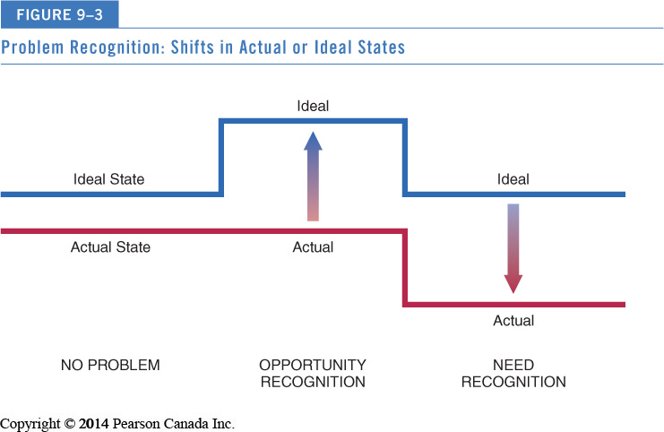
Problem Recognition: Shifts in Actual or Ideal States
PROGRAM STUDI
DESAIN KOMUNIKASI VISUAL
MATA KULIAH
PEMASARAN DAN PRILAKU KONSUMEN

Slide 13
Information Search
PROGRAM STUDI
DESAIN KOMUNIKASI VISUAL
MATA KULIAH
PEMASARAN DAN PRILAKU KONSUMEN
Information search: Process by which consumer surveys the environment for appropriate data to make reasonable decision
Prepurchase versus Ongoing Search
 | Prepurchase Search | Ongoing Search
Determinants | Involvement with purchase | Involvement with product
Motives | Making better purchase decisions | Building a bank of information for future use
Outcomes | Better purchase decisions | Increased impulse buying

Slide 14
Internal versus External Search
PROGRAM STUDI
DESAIN KOMUNIKASI VISUAL
MATA KULIAH
PEMASARAN DAN PRILAKU KONSUMEN
Internal search
Scanning memory to assemble product alternative information
External search
Obtaining information from ads, retailers, catalogs, friends, family, people-watching, Consumer Reports, etc.

Slide 15
Online Search
PROGRAM STUDI
DESAIN KOMUNIKASI VISUAL
MATA KULIAH
PEMASARAN DAN PRILAKU KONSUMEN
Many of us shop without leaving home via Yahoo, Google and other internet sites
“New info shopper”: individuals who automatically go to the internet first
60% of online consumers now search using Google or Bing as a first option
40% then go on to use other social media platforms
75% then follow the company’s Facebook page post purchase
Think about it: Do you research online for products more than actually buying online?

Slide 16
Do Consumers Always Search Rationally?
PROGRAM STUDI
DESAIN KOMUNIKASI VISUAL
MATA KULIAH
PEMASARAN DAN PRILAKU KONSUMEN
External searches are surprisingly low
Low income shoppers search less
Satisficing v maximizing
Personalized product recommendations
Brand switching: Select familiar brands when decision situation is ambiguous
Variety seeking: Desire to choose new alternatives over more familiar ones

Slide 17
Do Consumers Always Search Rationally?
PROGRAM STUDI
DESAIN KOMUNIKASI VISUAL
MATA KULIAH
PEMASARAN DAN PRILAKU KONSUMEN
External searches are surprisingly low
Low income shoppers search less
Satisficing v maximizing
Personalized product recommendations
Brand switching: Select familiar brands when decision situation is ambiguous
Variety seeking: Desire to choose new alternatives over more familiar ones

Slide 18
Biases in the Decision-Making Process
PROGRAM STUDI
DESAIN KOMUNIKASI VISUAL
MATA KULIAH
PEMASARAN DAN PRILAKU KONSUMEN
Mental accounting: Framing a problem in terms of gains/losses influences our decisions
Sunk-cost fallacy: Reluctant to waste something we have paid for
Prospect theory: Risk differs when consumer faces options involving gains versus those involving losses

Slide 19
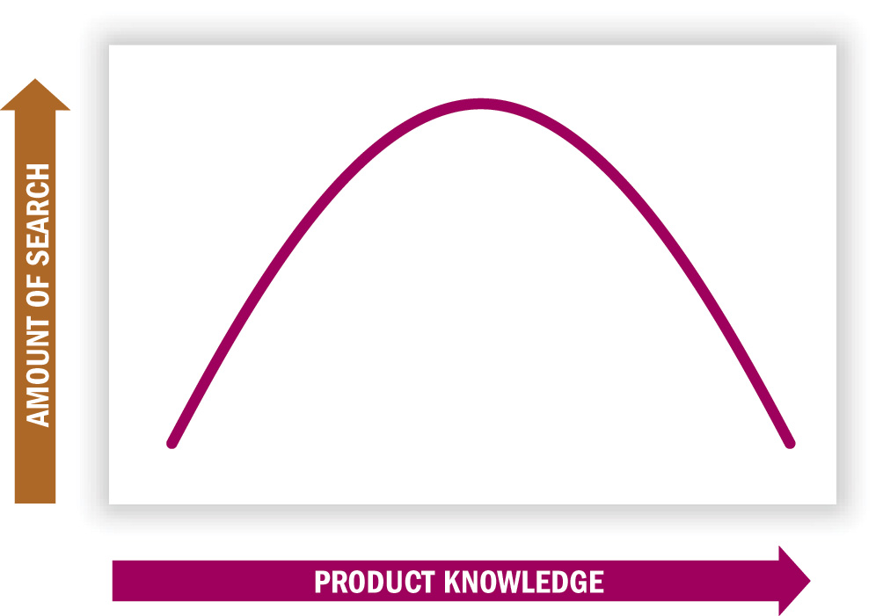
Amount of Information Search and Product Knowledge
PROGRAM STUDI
DESAIN KOMUNIKASI VISUAL
MATA KULIAH
PEMASARAN DAN PRILAKU KONSUMEN

Slide 20
How Much Search Occurs?
PROGRAM STUDI
DESAIN KOMUNIKASI VISUAL
MATA KULIAH
PEMASARAN DAN PRILAKU KONSUMEN
Search activity is greater when…
Purchase is important
There is a need to learn more about purchase
Relevant info is easily obtained/utilized
One is younger, is better-educated, and enjoys shopping/fact-finding
One is female (compared to male)
One places greater value on own style/image

Slide 21
Consumer’s Prior Expertise
PROGRAM STUDI
DESAIN KOMUNIKASI VISUAL
MATA KULIAH
PEMASARAN DAN PRILAKU KONSUMEN
Moderately knowledgeable consumers tend to search more than product experts and novices
Experts: Selective search
Novices: others’ opinions, “nonfunctional” attributes, and “top down” processing

Slide 22
Perceived Risk
PROGRAM STUDI
DESAIN KOMUNIKASI VISUAL
MATA KULIAH
PEMASARAN DAN PRILAKU KONSUMEN
Perceived risk: Belief that product has negative consequences
Expensive, complex, hard-to-understand products
Product choice is visible to others (risk of embarrassment for wrong choice)
Risks can be objective (physical danger) and subjective (social embarrassment)
Think about it: Which is the greater problem for a consumer:
not having enough choices or having too many choices?

Slide 23
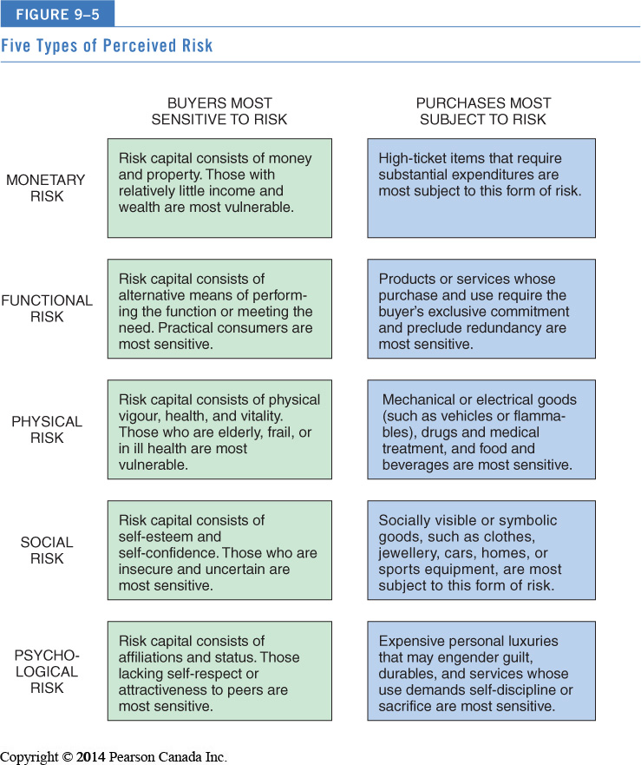
Five Types of Perceived Risk
PROGRAM STUDI
DESAIN KOMUNIKASI VISUAL
MATA KULIAH
PEMASARAN DAN PRILAKU KONSUMEN

Slide 24
Evaluation of Alternatives
PROGRAM STUDI
DESAIN KOMUNIKASI VISUAL
MATA KULIAH
PEMASARAN DAN PRILAKU KONSUMEN
Choosing from the often very many available alternatives
Extended problem solving
Occurs when choice conflicts arouse negative emotions (involving difficult trade-offs)
Habitual decision
Consider few/no brand alternatives

Slide 25
Evaluation of Alternatives
PROGRAM STUDI
DESAIN KOMUNIKASI VISUAL
MATA KULIAH
PEMASARAN DAN PRILAKU KONSUMEN
Evoked set versus consideration set
We usually don’t seriously consider every brand we know about.
In fact, we often include only a surprisingly small number of alternatives in our evoked set.
Marketers must focus on getting their brands in consumers’ evoked set.
We often do not give rejected brands a second chance.

Slide 26
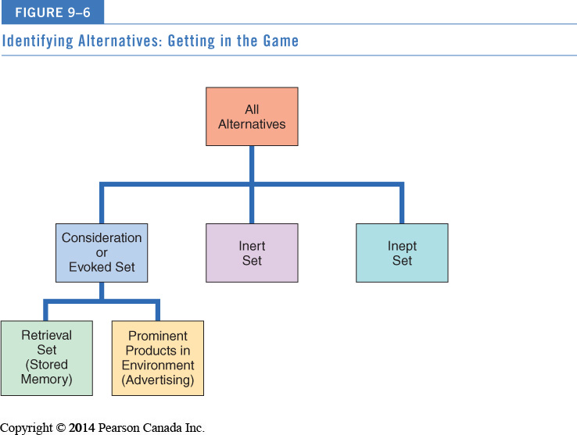
Identifying Alternatives
PROGRAM STUDI
DESAIN KOMUNIKASI VISUAL
MATA KULIAH
PEMASARAN DAN PRILAKU KONSUMEN

Slide 27
Product Categorization
PROGRAM STUDI
DESAIN KOMUNIKASI VISUAL
MATA KULIAH
PEMASARAN DAN PRILAKU KONSUMEN
We evaluate products in terms of what we already know about a (similar) product
Evoked-set products usually share similar features
When faced with a new product, we refer to existing product category knowledge to form new knowledge
Marketers want to ensure that their products are correctly grouped in knowledge structures

Slide 28
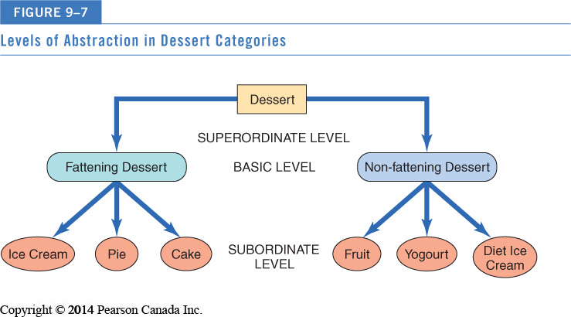
Levels of Categorization
PROGRAM STUDI
DESAIN KOMUNIKASI VISUAL
MATA KULIAH
PEMASARAN DAN PRILAKU KONSUMEN

Slide 29
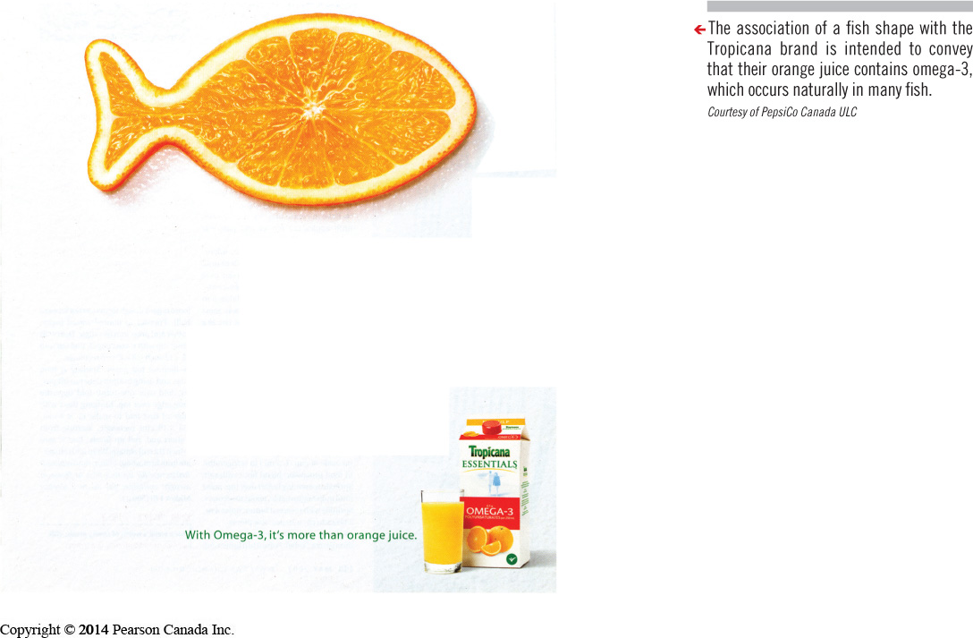
Strategic Implications of Product Categorization
PROGRAM STUDI
DESAIN KOMUNIKASI VISUAL
MATA KULIAH
PEMASARAN DAN PRILAKU KONSUMEN
Product positioning
Convincing consumers that product should be considered within a given category
Tropicana + Omega 3
Identifying competitors
Products/services different on the surface can actually compete on super-ordinate level

Slide 30
Selecting Among Alternatives
PROGRAM STUDI
DESAIN KOMUNIKASI VISUAL
MATA KULIAH
PEMASARAN DAN PRILAKU KONSUMEN
Exemplar products
Brands strongly associated with a category “call the shots” by defining evaluative criteria
But “moderately unusual” products stimulate more information processing and positive evaluations
Locating products
Products that do not fit clearly into categories confuse consumers (e.g., frozen dog food)

Slide 31
Product Choice
PROGRAM STUDI
DESAIN KOMUNIKASI VISUAL
MATA KULIAH
PEMASARAN DAN PRILAKU KONSUMEN
Selecting among alternatives
Once we assemble and evaluate relevant options from a category, we must choose among them
Decision rules for product choice can be very simple or very complicated
Prior experience with (similar) product
Present information at time of purchase
Beliefs about brands (from advertising)

Slide 32
Evaluative Criteria
PROGRAM STUDI
DESAIN KOMUNIKASI VISUAL
MATA KULIAH
PEMASARAN DAN PRILAKU KONSUMEN
Evaluative criteria: dimensions used to judge merits of competing options
Procedural Learning
Determinant attributes: Features we use to differentiate among our choices
Criteria on which products differ carry more weight
Marketers educate consumers about (or even invent) determinant attributes
Pepsi’s freshness date stamps on cans

Slide 33
Neuromarketing
PROGRAM STUDI
DESAIN KOMUNIKASI VISUAL
MATA KULIAH
PEMASARAN DAN PRILAKU KONSUMEN
Neuromarketing: uses functional magnetic resonance imaging, fMRI, a brain-scanning device that tracks blood flow as we perform mental tasks
Marketers measure consumers’ reactions to movie trailers, choices about automobiles, the appeal of a pretty face, and loyalty to specific brands

Slide 34
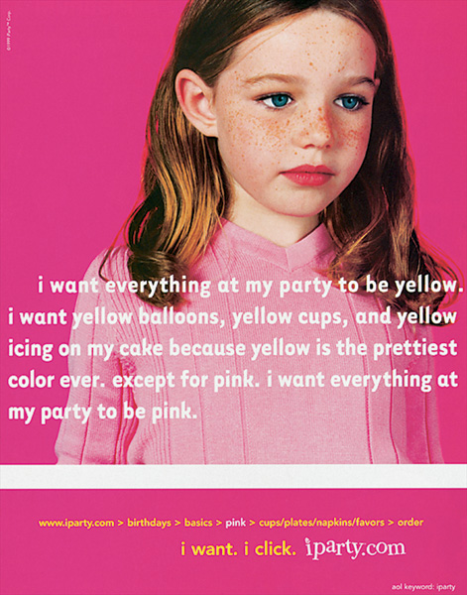
Heuristics: Mental Shortcuts
PROGRAM STUDI
DESAIN KOMUNIKASI VISUAL
MATA KULIAH
PEMASARAN DAN PRILAKU KONSUMEN
Heuristics: Mental rules-of-thumb that lead to a speedy decision
Examples: Higher price = higher quality, buying the same brand your mother bought
Can lead to bad decisions due to flawed assumptions (especially with unusually named brands)

Slide 35
SUMBER PUSTAKA
PROGRAM STUDI
DESAIN KOMUNIKASI VISUAL
MATA KULIAH
MANAJEMEN DESAIN
Mowen, John C dan Michael Minor. (2001). Perilaku Konsumen Jilid 1. Jakarta: Erlangga.
Mowen, John C dan Michael Minor. (2002). Perilaku Konsumen Jilid 2. Jakarta: Erlangga.
Mothersbaugh, Hawkins. (2010). Consumer Behavior: Building Marketing Strategy. New York: McGraw Hills
Sumber gambar:
iparty.com
Courtesy of PespsiCo Canada ULC

Slide 36
THANKS
ANY QUESTIONS?

