Slide 1
PHONETICS & PHONOLOGY
Anisa Larassati, M.Ling
Email: anisa.larassati@dsn.dinus.ac.id
WA : 081914332777
Tlp : 08112991777

Slide 2
Chapter i
Introduction: Phonetics and phonology
There are 2 fields in linguistics concerned with pronunciation and sound, phonetics & phonology:
Phonetics:
  Describing and analysing the sounds humans use in language in an objective way. It studies speech sounds as sounds, without regard to their function as signaling units of language.
  Deals with the production, properties, an percetption of the speech sounds of human languages.
  Articulatory phonetics: analyses which organs and muscles are used by speakers to produce speech. It is related with ‘physiology’
  Acoustic phonetics: concerns with the physical properties of speech sounds as they travel in the air between a speaker’s mouth and listener’s ear. It deals among others with measuring the loudness, pitches and other natural characteristics of sounds. It is related with ‘physics’.
  Auditory phonetics: focuses on the effect those sounds have when they reach the listener’s ear and brain.

Slide 3
Chapter i
Introduction: Phonetics and phonology
Phonology:
  Concerns with how speech sounds form patterns in particular language.
  Pneumonoultramicroscopicsilicovolcanoconiosis
  /ˌnjuːmə(ʊ)nəʊˌʌltrəˌmʌɪkrə(ʊ)ˈskɒpɪkˌsɪlɪkəʊvɒlˌkeɪnəʊˌkəʊnɪˈəʊsɪs/
  Kipikikusikitishacho
  Segmental: deals with spech sounds
  Suprasegmental: concerns with larger units such as syllables, words, and intonation phrases.

Slide 4
PRONUNCIATION PROBLEMS

Slide 5
Chapter 2:
PRONUNCIATION PROBLEMS
2.1 SPEAKING IS A MATTER OF HABBIT
  Learning the new sound system
  Learning the new vocabulary items
  Learning the ways of arranging foreing words into sntences
  ‘Habit interference’ :
  people who learn a new language will meet with strong opposition from their old established habit. In trying to produce the foreign sounds, they tend to replace them with similar sounds they find in their native language.
  Example:
  Indonesian student
  bow /bəʊ/ → /b/ as in Kerbau

Slide 6
CHAPTER 2:
Pronunciation problems
2.2. REASONS FOR PRONUNCIATION PROBLEMS
In English, it is obvious that the spelling and pronunciation of words do not match.
It is therefore very confusing and misleading to se the spelling symbols of the Roman alphabet.

Slide 7
PRONUNCIATION PROBLEMS
CHAPTER 2:
The same spelling, different pronunciations
The diferent spellings, same pronunciation
Bone /bəʊn/, ryhmes with tone /təʊn/
Done /dʌn/, ryhmes with fun /fʌn/
Gone /ɡɒn/, ryhmes with rock /rɒk/
The spelling <one> can be pronounced as /əʊn/, /ʌn/, /ɒn/
Riff /rɪf/
Loaf /ləʊf/
Tough /tʌf/
Diferent spellings <ff>, <f>, <gh> are all pronounced as /f/

Slide 8
CHAPTER 2:
Pronunciation problems
2.2.a. The existence of a given sound in the latter, which is not found in the former.
For instance, the word “thigh”
Thigh /θʌɪ/ /t/ or /s/ instead of pronouncing /ðaI/ or /saI/.
Other English sounds which are not found in Indonesian are, for instance, veal /viːl/, then /ðɛn/, joke /dʒəʊk/, she /ʃiː/, pleasure /ˈplɛʒə/, etc.

Slide 9
CHAPTER 2:
Pronunciation problems
2.2.b. Sounds which have the same phonetics feature in both languages (English and Indonesia) but differ in their distributions.
For ex: /b/, /d/, /g/ voiced stop consonants
in English those stops occur at utterance initial, medial, and finial position.
for example: book, ago, sad
In Indonesian, however, they occur only at word initial and medial position, never at word final position.
For example: beras, kabar,.
In Indonesian orthography, the letters b, d, g are sometimes found at word final position.
For ex: Sebab, abad, grobag, but they pronounced voiceless stops, that is /p/, /t/, and /k/ respectively.

Slide 10
CHAPTER 2:
Pronunciation problems
2.2.c. Similar sounds in the two languages, which have different variants or ‘allophones’.
Allophone is conditioned variant of a significant group of sounds which occurs in a fixed and predictable environment.
Both Indonesian and English have ‘voiceless stop consonants’ /p; t; k/.
The Indonesian stops have one variants
for ex:
/p/ in Pintu, apa, and sedap.

Slide 11
CHAPTER 2:
Pronunciation problems
The English stop consonants have more than one variant. There are 2 variants in English:
  Aspirated pronounced with a slight puff of breath as in
  /phIl/, /theIk/, /khu:l/
  Un-aspirated as in the words upper, better, and beckon.
2.2.d. Similar sounds in the two languages which differ only slightly in their phonetic features.
for example: no, may, bad, tie, now, she, chain, Jane, very, hard, etc.

Slide 12
CHAPTER 2:
Pronunciation problems
2.2.e. Sounds that have the same qualities in both languages may constitute some learning problem if they occur in a cluster or sequence of sounds.
For example: speak, spring, stand, street, sky, scream, twelfths, worlds.

Slide 13
CHAPTER 2:
Pronunciation problems
2.3. NATURE OF PRONUNCIATION PROBLEMS
It concerns with the identification of the foreign sounds.
It has to do with the production of the foreign sounds by his organs of speech.
Ability in identifying and producing the foreign sounds involves not only sounds in isolation, but also sounds occurring in connected speech.
It concerns with the production of the so-called suprasegmental features (stress, length, pitch, and intonation).

Slide 14
CHAPTER 2:
PRONUNCIATION PROBLEMS
< > pointed brackets used to refer to a spelling
/ / slashes indicate that a speaker’s knowledge or mental representation is referred to; this is what phonology deals with.
[ ] square brackets indicate that an actual soud is being talked about, which is what phonetics is concerned with.
Italics are used when linguists write about words.
Example: “oh”

Slide 15
CHAPTER 2:
PRONUNCIATION PROBLEMS

Slide 16
PHONETIC TRANSCRIPTION

Slide 17
CHAPTER 3:
PHONETIC TRANSCRIPTION
3.1 Roman Alphabets vs International Phonetic Alphabets (IPA)
One symbol sometimes represents more than one sound, such as the letter a in English, which represents different sounds in different words.
Conversely, one sound may be represented by several symbols in orthographic writing.
For ex: can, key, chemistry, technique.
Phonetic writing represents speech sounds to show clearly and consistently the pronunciation of a given word.
for ex: /i:/ represents the vowel sound of the word ‘see’.

Slide 18
CHAPTER 3:
PHONETIC TRANSCRIPTION
3.2. The use of Phonetic Transcription
Phonetic transcription represents speech sound consistently.
Many exercises must be done in order to get familiar with phonetic symbols.

Slide 19
Ipa learning tools
Click the following websites to learn IPA Symbols
English sounds symbols (IPA), check this link
  http://www.stuff.co.uk/calcul_nd.htm
IPA all languages
  http://web.mit.edu/6.mitx/www/24.900%20IPA/IPAapp.html
Transcribing English orthographic writing to IPA and vice versa
  https://tophonetics.com/
Click the following website to download IPA Unicode Symbol for your Microsof if you don’t have one
http://www.phon.ucl.ac.uk/home/wells/phoneticsymbols.htm

Slide 20
Speech organs & speech production

Slide 21
CHAPTER 4
THE ORGANS OF SPEECH
4.1 Production of Speech Sounds
  Speech sounds are sounds produced by the speech/ vocal organs, which include the mouth and respiratory organs.
  Respiratory organs
  Parts of respiratory organs
  Speech sounds are produced by a moving air column. Those are
  in-going air ingressive sounds
  out-going air egressive sounds

Slide 22
CHAPTER 4
THE ORGANS OF SPEECH
Speech sounds used by human beings in speaking are mostly latter type, instead of ingressive sounds.
Speech sounds are produced only when there is some interruption of the out-going air. The part of vocal organ which carries out of this interruption is called articulators.
We we breathe restfully, the air goes in and out uninterupptedly, and thus no speech sound is produced.

Slide 24
CHAPTER 4
THE ORGANS OF SPEECH
Sub-division of Speech Organs
Initiator/Respiratory system : the speech organ that sets the air into motion for the production of speech sounds.
  The main initiator is lungs because most speech sounds are produced by pulmonic air. i.e. air set into motion by the lungs.
Phonator refers to the vocal cords in the larynx, which are used to produced speech sound called ‘voice’.
Articulatory System: refers to the speech organs used to obstruct the out going air

Slide 26
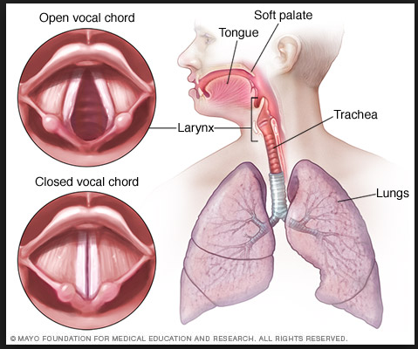

Slide 27
CHAPTER 4
THE ORGANS OF SPEECH
Articulators: the speech organs that are used to obstruct the out-going air in the production of speech sounds.
  Articulators are segmented into 2 types:
  Movable articulators: the lips, the tongue, the uvula, and the vocal cords.
  Unmovable articulators: the teeth, the teeth ridge, and the hard palate.

Slide 28
CHAPTER 4
THE ORGANS OF SPEECH
There are 2 positions of the articulators in the mouth:
Upper margin : the upper lip, the upper-teeth, the teeth ridge, the hard palate, the soft palate, and the uvula.
Lower margin: the lower lip, the lower teeth, and the tongue.
  For the sake easy reference the tongue is divided Into the following parts: the tip or apex, the blade, the front and the back of the tongue, the central part of the tongue includes a small part of the front and the back of the tongue.

Slide 29
CHAPTER 4
THE ORGANS OF SPEECH
Glottal stop is produced by passing the air out through the larynx . This completely closed position of the vocal cords produces a plosive sound, called ‘glottal stop’. Meanwhile, when the air is forced to go out through the small opening between the two vocal cords, it causes them to open and close successively; in other words, it causes them to vibrate. It is this successive opening and closing or the vibration of the two vocal cords that produces the sound called “voice”.
for example: sound /k/ in katak the initial k represents a velar stop, while the final k represents a glottal stop //.
  Button /ˈbʌt(ə)n/ → /ˈbʌ(ə)n/

Slide 30
Articulatory

Slide 31
ARTICULATORY PHONETICS
The production of any sound involves the movement of air.
Differing vocal tract shapes result in the differing sounds of language.
The sounds of all languages fall into two classes: consonants and vowels.
In phonetics, the terms consonant and vowel refer to types of sounds, not to the letters that represent them.
Consonants are always produced with some closure to the vocal tract. The nature and location of this closure determines what type of consonant that is produced.
Vowels are produced mainly when the airflow from the lungs to the lips is relatively unrestricted.

Slide 32
consonants
CLASIFICATION OF CONSONANTS

Slide 33
consonants
We classify consonants according to
where in the vocal tract the airflow restriction occurs, called the place of articulation
the way the airstream is affected as it flows from the lungs up and out of the mouth and nose, called the manner of articulation.
The activity of vocal cords: whether the sound is voiced or voiceless (whether the vocal cords vibrate or not (voiced & voiceless).

Slide 34
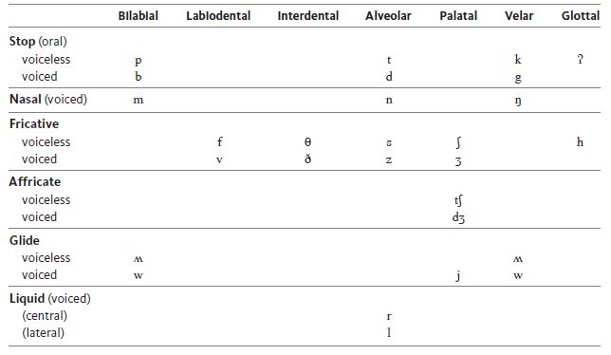
English Consonants Chart

Slide 35
PLACE OF ARTICULATION
Bilabials [p] [b] [m] When we produce a [p], [b], or [m] we articulate by bringing both lips together.
Labiodentals [f] [v] We also use our lips to form [f] and [v]. We articulate these sounds by touching the bottom lip to the upper teeth.
Interdentals [θ] [ð] These sounds, both spelled th, are pronounced by inserting the tip of the tongue between the teeth. However, for some speakers the tongue merely touches behind the teeth, making a sound more correctly called dental.

Slide 36
PLACE OF ARTICULATION
Alveolars [t] [d] [n] [s] [z] [l] [r] All seven of these sounds are pronounced with the tongue raised in various ways to the alveolar ridge.
  For [t,d,n] the tongue tip is raised and touches the ridge, or slightly in front of it.
  For [s,z] the sides of the front of the tongue are raised, but the tip is lowered so that air escapes over it.
  For [l] the tongue tip is raised while the rest of the tongue remains down, permitting air to escape over its sides. Hence, [l] is called a lateral sound. You can feel this in the “l’s” of Lolita.
  For [r] [IPA ɹ] most English speakers either curl the tip of the tongue back behind the alveolar ridge, or bunch up the top of the tongue behind the ridge. As opposed to [l], air escapes through the central part of the mouth when [r] is articulated. It is a central liquid.

Slide 37
PLACE OF ARTICULATION
Palatals [ʃ] [ʒ] [tʃ] [dʒ] [j] For these sounds, which occur in mission [mɪʃən], measure [mɛʒər], cheap [tʃip], judge [dʒʌdʒ], and yoyo [jojo], the constriction occurs by raising the front part of the tongue to the palate.
Velars [k] [g] [ŋ] Another class of sounds is produced by raising the back of the tongue to the soft palate or velum. The initial and final sounds of the words kick [kɪk] and gig [gɪg] and the final sounds of the words back [bӕk], bag [bӕg], and bang [bӕŋ] are all velar sounds.
Uvulars [ʀ] [q] [ɢ] Uvular sounds are produced by raising the back of the tongue to the uvula, the fleshy protuberance that hangs down in the back of our throats. The r in French is often a uvular trill symbolized by [ʀ]. The uvular sounds [q]and [ɢ] occur in Arabic. These sounds do not ordinarily occur in English.
Glottals [h] [ʔ] The sound of [h] is from the flow of air through the open glottis, and past the tongue and lips as they prepare to pronounce a vowel sound, which always follows [h].

Slide 38
MANNER OF ARTICULATION
Nasal and Oral Sounds
Sounds produced with the velum up, blocking the air from escaping through the nose, are oral sounds, because the air can escape only through the oral cavity.
When the velum is not in its raised position, air escapes through both the nose and the mouth. Sounds produced this way are nasal sounds.

Slide 39
MANNER OF ARTICULATION
Stops [p] [b] [m] [t] [d] [n] [k] [g] [ŋ] [tʃ] [dʒ] [ʔ] We are seeing finer and finer distinctions of speech sounds.
Fricatives [f] [v] [θ] [ð] [s] [z] [ʃ] [ʒ] [x] [ɣ] [h] In the production of some continuants, the airflow is so severely obstructed that it causes friction, and the sounds are therefore called fricatives.
Affricates [] [] These sounds are produced by a stop closure followed immediately by a gradual release of the closure that produces an effect characteristics of fricatives.
Liquids [l] [r] In the production of the sounds [l] and [r], there is some obstruction of the airstream in the mouth, but not enough to cause any real constriction or friction. These sounds are liquids.

Slide 40
Glides [j] [w] The sounds [j] and [w], the initial sounds of you [ju] and we [wi], are produced with little obstruction of the airstream.
Trills and flaps The “r”-sound of many languages may be different from the English [r]. A trilled “r” is produced by rapid vibrations of an articulator. An alveolar trill, as in the Spanish word for dog, perro, is produced by vibrating the tongue tip against the alveolar ridge. Its IPA symbol is [r], strictly speaking, though we have co-opted [r] for the English “r.”

Slide 41
VOWELS
CLASSIFICATION OF VOWELS

Slide 42
Vocalizing Vowels
There are several ways in which speakers can change the shape of the vocal tract and thus change vowel quality. They do this by:
Raising or lowering the body of the tongue – high, mid, low
Advancing or retracing the body of the tongue – front, central, back
Rounding or not rounding the lips
Making these movements with a tense of a lax gesture

Slide 43
CHAPTER 7
Classification of Vowels
All vowel sounds are principally produced by the vibration of the vocal cords, which are situated in the larynx.
Three variables for describing vowels
  Which part of the tongue is raised (tip, center, back).
  The degree of raising the tongue (high, mid, low).
  The position of the two lips (rounded, unrounded).

Slide 44
CHAPTER 7
Classification of Vowels
FRONT, CENTRAL, AND BACK VOWELS
Tongue is conveniently divided into three parts:
the front, the center, and the back of the tongue.
Front vowel is when the front of the tongue is raised to modify the sound already produced in the larynx, the vowel sound so produced is called a front vowel.
Central vowel is when the central part of the tongue is raised, the vowel sound so produced.
Back vowel is when the back of the tongue is raised, the vowel sound so produced. Back vowels are /u/, /U/, /ͻ:/, /ͻ/

Slide 45
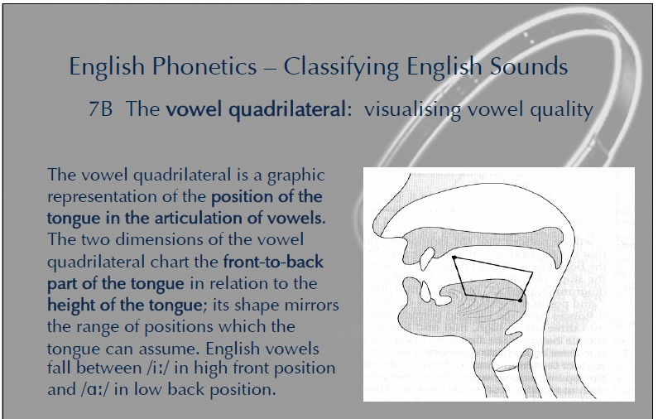

Slide 47
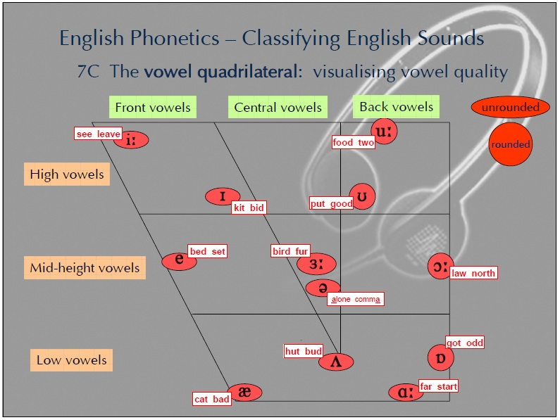

Slide 48
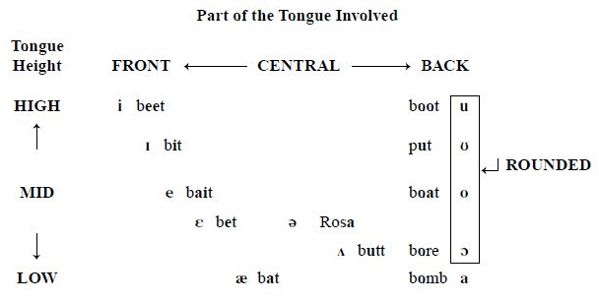
American English Vowels

Slide 50
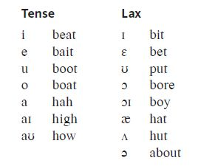
Tense & Lax Vowels

Slide 51
Your full name, please
A full description of a speech sound describes at least the state of the vocal folds, the manner of articulation, and the place of articulation.
[p] = voiceless bilabial stop
In vowels, the sounds are described by the tongue height, part of the tongue involved, and the lip rounding/unrounding
[i] = high front unrounded

Slide 52
Diphtongs
Diphthongs: Vowels that change in quality as they are produced
[aɪ] as in bite, sight, by, buy, die, dye, choir, liar, island, height, sign
[aʊ] in about, brown, doubt, coward, sauerkraut
[ɔɪ] in boy, oil

Slide 53
Write the following phonetic transcription in regular English spelling.
nom tʃamski ɪz e lɪngwɪst hu titʃəz æt ɛm aɪ ti
fənɛtɪks ɪz ðə stʌdi əv spitʃ saʊndz
sʌm pipəl θɪŋk fənɛtɪks ɪz vɛri ɪntərɛstɪŋ

Slide 54
Write the following words in phonetic transcription.
bags
scream
thank
then
short

Slide 55
VIDEOS
Taken from youtube chanel : UBC Visible Speech
by Evan Ashworth, Ph.D
Consonants : https://www.youtube.com/watch?v=dfoRdKuPF9I&t=172s
Vowels : https://www.youtube.com/watch?v=u7jQ8FELbIo&t=100s
Navigating IPA : https://www.youtube.com/watch?v=g_SHfoUDj8A&t=138s

Slide 56

 

