Slide 1

S&OP PROCESS & CHALLENGES IN BEVERAGE INDUSTRY

Slide 2
Agenda
Introduction
Complexities in Beverage Business
SC planning before S&OP
Business Impacts
S&OP Process-
  Need/Challenges/Reasons
S&OP Meeting Agenda
S&OP Benefits
Pepsico S&OP process
Benefits to SCM
Conclusion

Slide 3

Recent ‘IDC Manufacturing Insights’ survey indicate that companies are identifying S&OP process
as a Top Priority

Slide 4
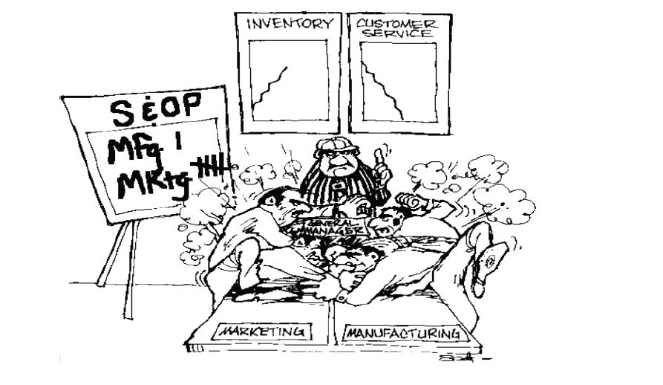
Traditional S&OP

Slide 5

“To live through impossible situation, you don’t need the reflexes of a Grand Prix driver, the muscles of Hercules, or the mind of Einstein.
You simply need to know what do (Next).”
- Anthony Greenback, The Book of Survival

Slide 6
Sales and Operations Planning(S&OP)
Definition:
A formal process, consisting of series of meetings, where data from various areas of business is discussed and decisions are made.
The goal is agreement between various departments on the best course of action to achieve the optimal balance between supply and demand and to meet profitability goals.

Slide 7



Global Companies and S&OP
Brown-Forman Corporation believes its approach to S&OP is a better way to align supply and demand with the company’s business requirements, build better internal communications, and plan activities to meet customers’ needs.
ExxonMobil Chemical leverages sales and operations planning to improve customer service while controlling costs.
  Procter & Gamble credits its own version of S&OP with creating a single set of sales and supply plans to optimize resources to support the company’s business objectives – assessing the financial implications of the plan as well as its impact on both supply and demand.

Slide 8
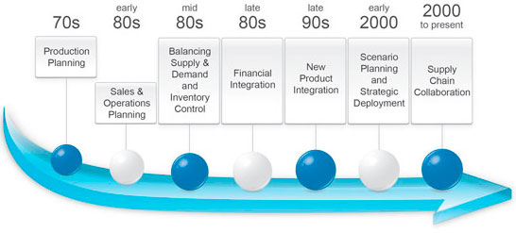
Evolution of S&OP
Sales and Operations Planning (S&OP) was originated by Oliver Wight more than twenty-five years ago

Slide 9
Why S&OP- Competitive Business Environment
Customers are demanding:
Increasing business risks of :
Accurate and timely commitments
Shorter lead times
Flexibility
Product differentiation
Dedicated inventory
Visibility into the supply chain
High quality
Automation
Lowest costs
Too much inventory
Inventory in the wrong place
Ordering the wrong inventory
Missing delivery dates
Losing orders
Shipping the wrong products
Increased expediting costs
Losing customers
Increased obsolescence
Forcing businesses to better manage:
Inventories
Ability to promise
Global suppliers
Supply/Demand
Forecasts
Cycle time
Stocking policies
VMI/SMI processes
Replenishment

Slide 10

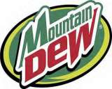








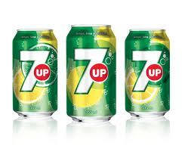
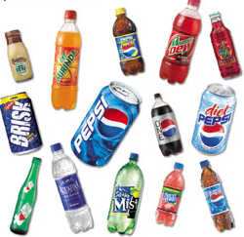
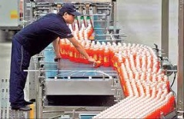

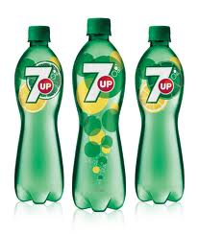

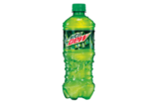
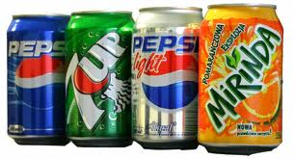

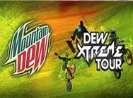


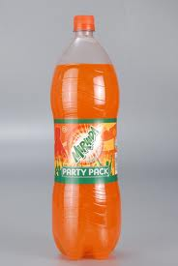
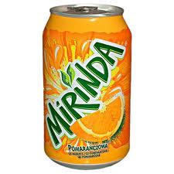
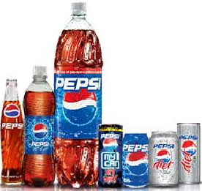

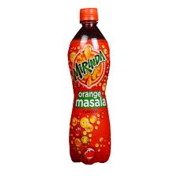


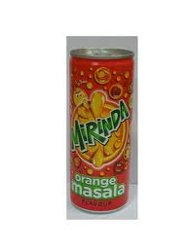


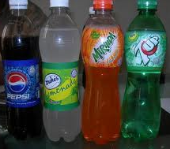




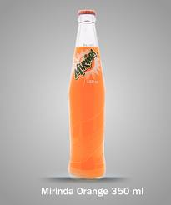
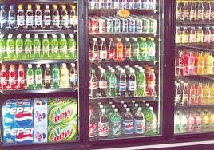

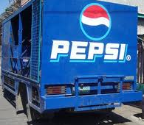
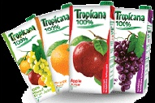

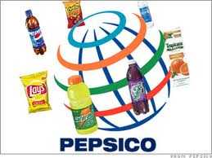
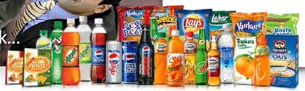
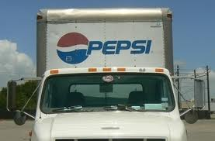
Over 400 skus, 15 brands & 19 pack size
Brand Promotion Activities
Limited time offer product launch
Frequent Pack & MRP Play
Location wise MRP variance

Slide 11
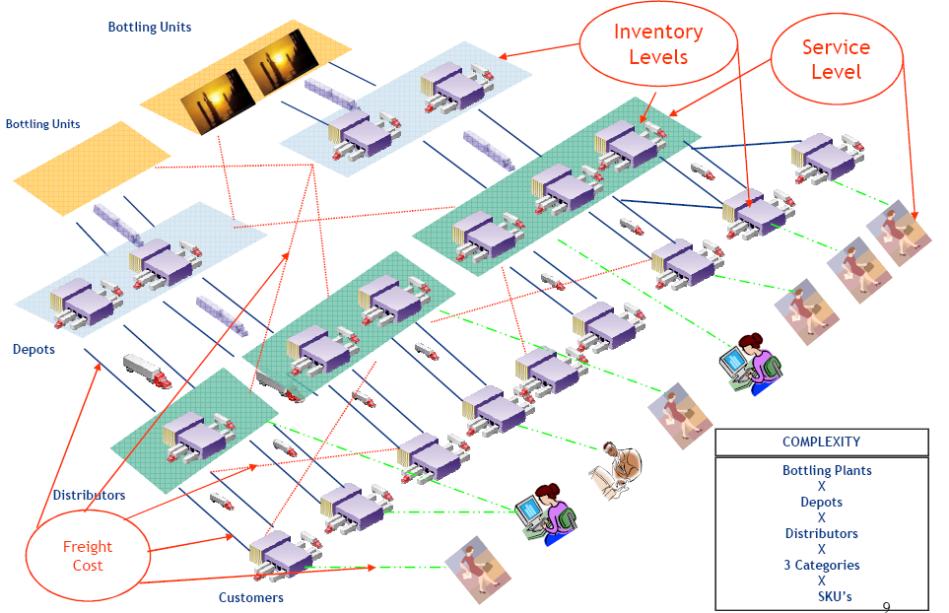
Supply Chain Complexity
Consumers
400+

Slide 12





Process MAP
Management Annual growth Targets
RSA Data
Industry Trends
Growth Expectations
Annual/ Quarter
Regional /Geographical Targets
State/City Targets
RM Availability
Line Capacity
Shut down
Monthly/ Weekly
ASM Targets
Primary / Secondary Demand
Float Glass
Distribution Cost
Direct Route Targets
Indirect/ Distributor Targets
Capacity
Trade Promo
Trade Scheme
Weekly/ Fortnightly
Channel Demand
Catchment
Cost
Retail Channel: IC/FC etc
Consumer Demand
seasonality
ATL Campaign
New Launches
Weekly/ Bi weekly
CONSUMER
Store Location
Competition
Consumer Promo

Slide 13
Supply Chain Functional Workflow
Master Data Management & Workflows
Statistical Forecast
Consensus Forecast
SAP / Order Management
Demand
Planning
Updated Forecast
Forecast Netting
Master
Planning
Inventory Planning
Netted
forecast
Master Planning
Manufacturing
Planning & Scheduling
Sourcing Rules
Production Planning & Scheduling
Distribution
(Deployment)Planning
Deployment Planning
Transportation Planning & Execution
Transportation Management System
Secondary
Shipment Consolidation
Tertiary
Route Planning Optimization
Fleet Management
Notes:
13

Slide 14



Business Impacts
Absence of Scientific Demand Management Process
  Under/over estimations
  Target v/s Actual Sales
  Tracking Customer Service levels
  Difficult growth and revenue performance measurement
Non-Synchronized Supply and Logistics Planning
  Fill Rate Management Challenge especially during Seasons
  Costly Product-Mix Decisions
  Capacity Under/Over Utilization
  Inter-Warehouse Movements
  Premium Freights at times
  FG Inventory mismatches with Norms

Slide 15

S&OP
Its all about collaboration

Slide 16
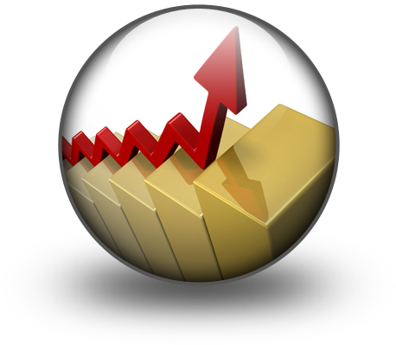
The purpose of the S&OP process
To develop a cross-departmental consensus business plan that is achievable, given the business aspirations and constraints, and ensures that every function and sub-function within the business is working to achieve the same goal.
Leading companies do this most effectively by involving as many areas of the business as is practical.

Slide 17
Sales and Operations Planning
Sales Forecast Adjustment
Directors
Executives
Baseline Forecasting
Demand Review Meeting
Operations Planning
Pre S&OP Meeting
S&OP Meeting
Sales Forecast Adjustment
Performance Management
Forecasting Team
Sales Department
Marketing Department
S&OP Manager
Operations Department

Slide 18
Need for S&OP
Supply interruption, leading to production delays, on time delivery issues, lower profits and /or customer loss
Excessive in hand inventories and obsolescence
Absence of teamwork & shared risk management among internal functions
Lack of confidence in planning system
Material / Product shortages increased expediting $
To manage
Ineffective utilization of resources, and / or lack of resources when needed
Unacceptable lead time
Ineffective bottleneck and constraints management on the supply side
Poor collaboration among stake holders – internal or external (finger pointing

Slide 19
Demand & Supply Challenges Before S&OP
Lack or no technology/ systems to do the “what if” modeling and gaining agreement
Limitation of the processes to manage new product development, innovation and /or feasibility
Poor coordination of demand and supply: lost sales: Incorrect Inventories: Loss/ lower profitability
Breakdown in communication due to the lack of quality and availability of data
Challenges
Internal business processes does not facilitate delivery of right – product/price/ qty/ qlty, at the right time, to the right customer
Leadership support in getting agreement on S&OP plans
Lack of coordination of multisite/ cultural teams
Lack of integration with the financial budgeting process
Lack of right metrics to drive value or to determine same

Slide 20
S&OP – Relationship with other Plans
Business or annual plan
Operations strategy
Sales and Operation Plan
Forecasting
Constraint Management
Sales Plan
Operations Plan
Resource Planning (services)
Workforce schedule
Material and facility resources
Resource Planning (manufacturing)
Master production schedule
Material requirements planning
Scheduling
Employee schedule
Facility schedules
Customer schedules
Scheduling
Employee & equipment schedules
Production order schedules
Purchase order schedules

Slide 21
Why S&OP
Review done as part of an Integrated Business Management Process
Align all stakeholders towards meeting customer demand/ profitability & ensure delivery of the company’s strategic agenda
Formalizes the generation and adoption of a company demand plan through the demand review
Clearly identifies the product domain in which the company competes through Product Management
Reasons
Provides a transparent view of the company’s response from demand through to the supply review
Ensures that the Supply & Demand are reconciled & evaluated against financial targets in the management Review
Delivers one clear plan that answers all the customer demand questions that the organization faces

Slide 22
Planning Hierarchy
Planning Cycle
Planning Output
Sales Profit ROI
Annually
Business Plan
Monthly
S&OP
Product Group
Product Models & Options
Weekly
Master Scheduling
Components & workload
Daily
Material & Service Planning

Slide 23
S&OP Meeting Agenda
What has changed since last month?
Are we on plan financially?
How are we performing to performance metrics?
What new risk do we need to consider?
What decision do we need to made now?
What decision need to be made in the near future?
How are product families performing?
Are we on track with product development?
Do we have any critical constraints?
Is there any need to revise long term plans?
Review Revenue/ Profit Performance
Review new product development
Review manufacturing performance
Review Inventory levels
Review External Factors
Review Future plans
Orders booked
Sales & shipment
Backlogs
Finished goods Inventory
Production
Performance measures by product Group

Slide 24
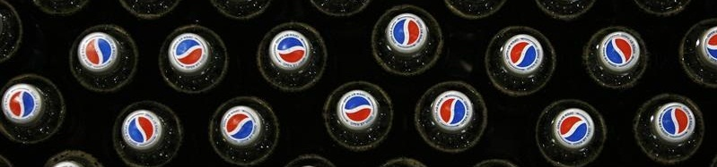
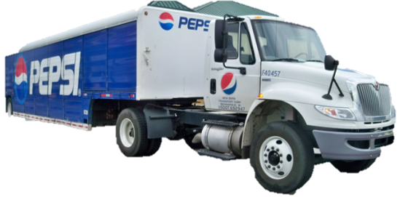
Type of Data considered
Current plan for each product group
Current finished goods inventory
Sales forecasts
Purchase Orders received
Materials available
Manufacturing plans and capacity
Distribution capacity
Shipping capacity
Performance measures
Customer Service

Slide 25
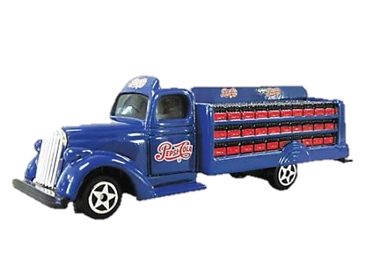
Matured S&OP process Implementation Benefits
Forecast error reduction…………..20-25%
Inventory reduction…………………..5-10%
Inventory turn increase……………..5-10%
Service Level Increase………………..5-10%
Top line revenue growth……………2-5%
SKU rationalization……………………10-20%

Slide 26
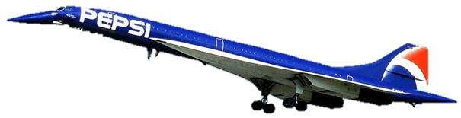
S&OP KPI
Forecast Accuracy (%)
Production Plan Adherence (%)
Inventory – Days of Supply (DOS)
Inventory Turns
Financial forecast Accuracy

Slide 27
S&OP Benefits
Benefits for | Solution | Benefits
Sales Team | Demand forecasting and management. Analysis of historical data, applies multiple models, and adds promotions and other causal factors to come out with proper demand forecast numbers. | Increased forecast accuracy Increased customer service Right product mix planning in distribution centers. Better Customer Predictabilit Understanding the promotional, seasonality and other events impacts Management of Targets across all geography, product structure and sales hierarchy level

Slide 28
S&OP Benefits
Benefits for | Solution | Benefits
Production Team | Production Planning and Optimization Arrive at the Demand driven Production Plan that is synchronized with Distribution Plan. | Quick generation of robust and optimized rough cut production plan considering all capacity constraints, changeovers, campaigns, seasonal pre builds etc. Increased capacity utilization Increased productivity by better resource planning and utilization Optimized product-location mix decisions to service effective distribution Quickly review and adjust master plans to resolve any exceptions

Slide 29
S&OP Benefits
Benefits for | Solution | Benefits
Supply Chain Team | Optimized Distribution Plan While balancing Demand-Supply dynamics arrive at distribution and dispatch plan that optimizes the logistics costs and various service level constraint. | Most optimal distribution plan Lower logistics service costs Maintaining service levels and dispatch priorities Increased OTIF(on time in full) and decreased Inventory Improved overall fleet capacity and overall asset utilization Optimized product-location mix dispatch decisions to service effective distribution Decreased costs of premium freights, cross depot movements, obsolesces, handling etc

Slide 30
S&OP Benefits
Benefits for | Solution | Benefits
Management | Exception Management Provide end to end supply chain performance visibility and levers to control the plans by exceptions | Enablement of Human Independent Planning System that provides the complete visibility on company performance against customer demands with graphical and enriched presentation Smart workflow that spots the un-tolerable exceptions within existing plans and provides easy and user-friendly resolution that balances the conflicts and lead to consensus plans Provides KPI Measurements and analysis views on various supply chain performance aspects like OTIF, Production Compliance, Service Costs, Inventory Days, Asset Utilization, PCR Accuracy etc.

Slide 31
World Class SCM
Old Model: Push
(Linear Supply Chain)
New Model: Pull
(Integrated Networks)
Supply-Centric
Internally Focused
Vertically Integrated
Physical Asset Based
Mass Momentum
Demand-Driven
Global
Virtual Supply Chains
Decision Based
Lean Practices
Automation
Information
Supply Chain Transformation

Slide 32
Pepsico S&OP Process
Supply
Demand Planning
Supply Planning
Pre-S&OP
Meeting
Executive Meeting
Demand
Access last period
Incorporate sales and customer inputs
Build new baseline demand plan
Access SC Capabilities against Forecast
Develop feasible supply Plan
Develop P&L projections
compare projections against targets
Identify gaps
Gap conflict resolution
Recommendations and Agenda for executive meeting
Review recommendations & make decisions
Resolve remaining issues
Review KPI’s
Review PLM plans
Issue consensus plan
End of Month
Week 1
Week 2
Week 3
Week 4

Slide 33
S&OP process- M0/M01
Mid month review process
Only info given, discussion only if needed
Area | Position / Dept | 1st – 8th | 9th to 15th | 16th to 23rd | 24th to End
BU SCM | BU DP
 | BU Supply Planning
BU Mrktng / BU - OTSales | BU Marketing (BMs, ABMs)
 | BU Sales
MU | MU DP
 | MU SCM
 | Plants / operations
 | MUMMs / MDMs
 | MUGM
Units | UMs
 | TDMs / BDMs
Collate forecast and send to BU-M
Discuss with BUM and send to MU DPs
Discuss, if needed
Analyze forecast for exceptions, discuss with BU-M if needed
National S&OP
PoC meeting
I2 RCCP run
Inputs to statistical forecast
Clarify, if needed
Discuss, if needed
Check current month sales vs forecast, discuss with Ums, revise for the P3/P4
MU pre-S&OP and S&OP
Generate
statistical forecast
Discuss with MUMMs / MDMs, clarify with BU-M and BU-S, if needed
Send latest forecast to TDMs
Discuss forecast received from TDMs with UMs
Send for MUGM’s approval
Send final forecast to all, generate RCCP in i2
Demand / Supply review and approval
MRP plan
Discuss forecast
Analyze forecast
Approve forecast
Discuss, if needed
Discuss forecast
Validate forecast, give inputs
Page 33

Slide 34
Tangible Benefits for Supply Chain
No longer Victim mentality, use visibility as strategic weapon.
Integrated Supply Chain (ISC) cutting across traditional job description, Data sharing within company and breaking of silos.
Centralized MIS, Collaborative S&OP process, one version of truth.
Incorporate inputs from all aspects of supply chain including finance, sales, marketing, purchasing, forecasting and supplier management.
Harmonize incentives and avoid independent incentives.
Can result in reduction of inventory/ obsolete inventory, backlogs, expedited shipments and improved forecast accuracy.
More control on product life cycle.
Process instrumentation

Slide 35
CONCLUSION
The right combination of People , Process and Technology can spell success for organization aiming to drastically improve their supply chain planning practices.

