Slide 1
Object Oriented Programming
(OOP)
By: Junta Zeniarja, M.Kom, M.CS

Slide 2


Introduction
Name : Junta Zeniarja, M.Kom, M.CS
Address : Permata Tembalang
Contact
  Phone : 085727181701
  E-mail : junta@dsn.dinus.ac.id
  Room : lecture room, D Building
Background of Education
  Undergraduate => Computer Science in UDINUS.
  Postgraduate Master => Computer Science in UDINUS.
  Postgraduate Master => Computer Science in UTeM (Universiti Teknikal Malaysia Melaka).
Sharing
  Tuesday, Wednesday, Thursday => 13.00 – 16.00 WIB
  Appointment via sms or phone.

Slide 3
Outline (Before MidTerm)
Basic Concept of OOP
Object and Class
Interaction between Object
Collection Object
Package Library
Inheritance

Slide 4
Outline (After MidTerm)
Polymorphism
Exception
Abstract Concept and Interface
GUI
GUI database
Unit Testing
Application Design (Supplement)

Slide 5
Lecture Contract
Component Assessment | Percentage
Assignment and Responsibility | 40 %
MidTerm | 25 %
Final | 25 %
Attendance | 10 %
Total | 100 %

Slide 6
Lecture Contract (2)
The spirit of learning and honesty in college.
Discipline, delay time limit: 30 minutes.
Collecting the task on time.
Clothing polite and shod.
Permit for those who are unable to attend.
Asking if something is missing or not understood.
There is no tolerance if troubled and dishonest.

Slide 7
Theory

Slide 8
Java
Compiler (Interpreter):
Java Standard Edition (JSE)
Code Editor:
  Text Editor:
  TextPad, Notepad++
  Integrated Development Environment (IDE):
  Netbeans, Eclipse, JCreator

Slide 9
Java SE dan Netbeans IDE
Java SE:
jdk-7u51-windows-i586.exe (32 bit)
jdk-7u51-windows-x64.exe (64 bit) (download dari: http://java.sun.com/javase/downloads)
Instalasi : netbeans-7.4-windows.exe
(download dari: http://netbeans.org)

Slide 10
Steps Instalation JDK 1.7.0 and Set Path in Windows 7 (Details)

Slide 11
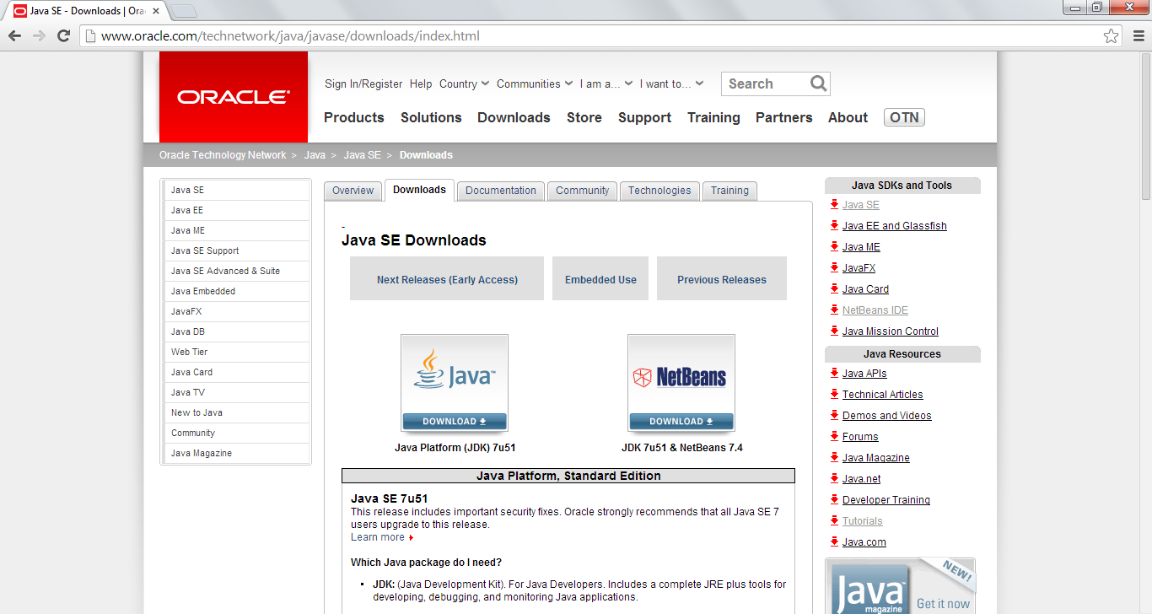
1st
Go to http://www.oracle.com/technetwork/java/javase/downloads/index.html

Slide 12
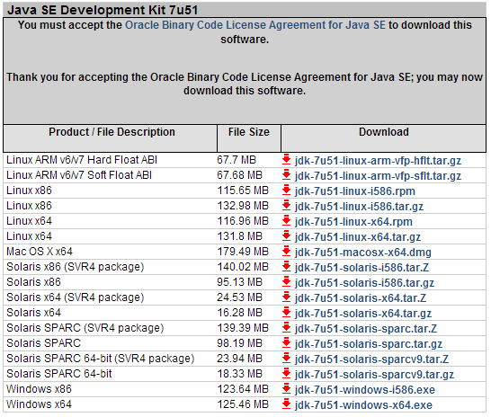
2nd
Accept License Agreement, download jdk

Slide 13
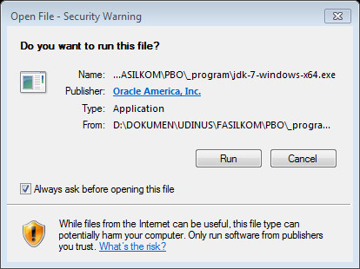
3rd
Install jdk-7-windows-x64.exe for 64 bit architecture or jdk-7-windows-i586.exe for 32 bit architecture
Note: from step 3 until end we use jdk-7-windows-x64.exe in Windows 7 64 bit

Slide 14
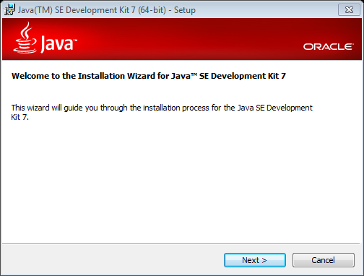
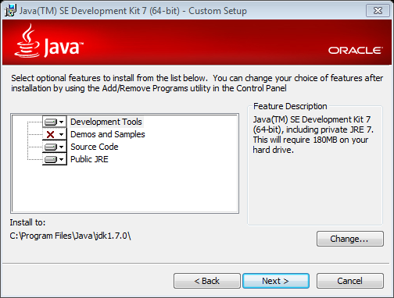
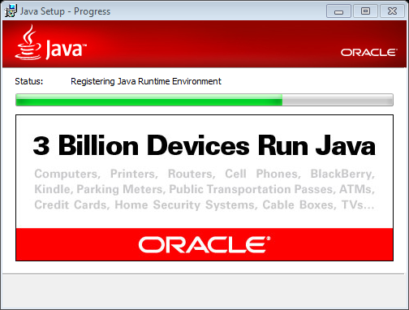
4th
Installation process

Slide 15
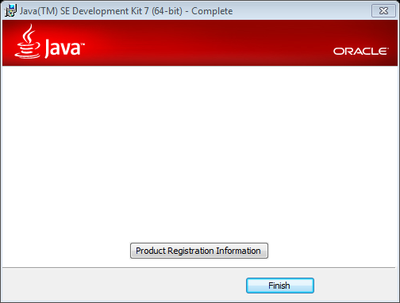
5th
Finish Installation

Slide 16
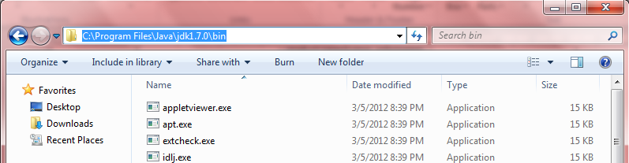
6th
Open folder C:\Program Files\Java\jdk1.7.0_51\bin and copy this path

Slide 17
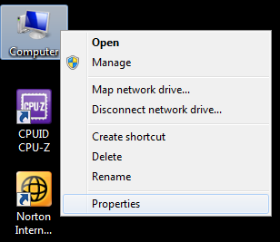
7th
Right click computer → properties

Slide 18
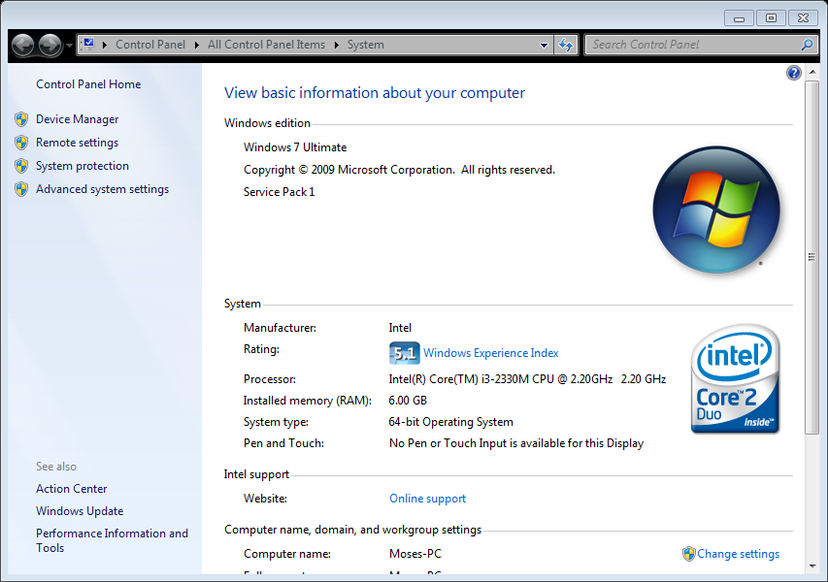
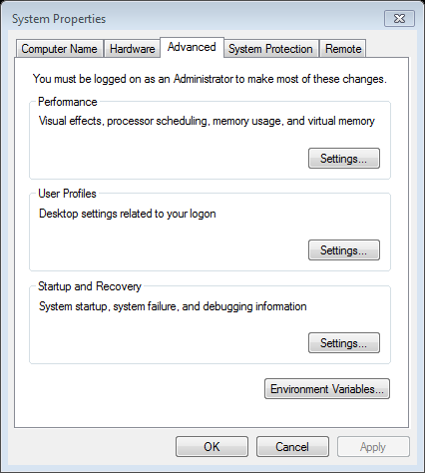
8th
Click “Advanced system setting”

Slide 19
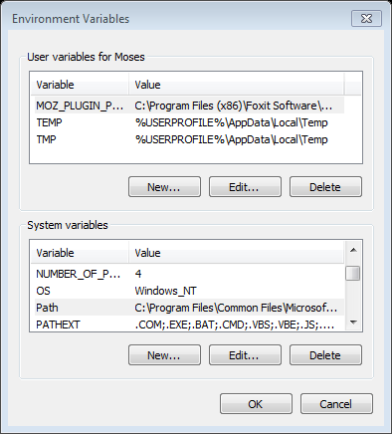
9th
Click “Environment Variable”

Slide 20
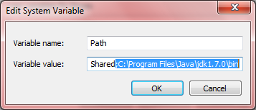
10th
Choose Path and click “edit” → put semicolon(;)paste path → Ok

Slide 21
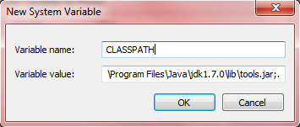
11st
Click “new…” → paste in variable value“C:\Program Files\Java\jdk1.7.0_51\lib\tools.jar;.” and variable name = CLASSPATH → Ok

Slide 22
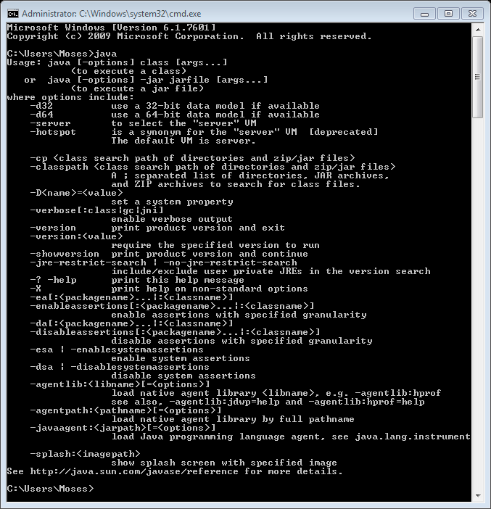
Check Java is Active
Open cmd (command promt) → type “java” → enter
If java active, command promt will display like beside

Slide 23








How Java Works …
Jalankan dengan:
C:\>java Hello (Application)
Web Browser (Applet)
public class Hello
public static void main(String[] args){
System.out.println("Hello World!");
}
}
Hello.java
javac (java compiler)
Interpreter
Interpreter
Interpreter
Interpreter
Kompiler memproduksi
Bytecode (Class)
Hello.class
Write Once Run Everywhere !
Web Server
Notes:
Typical Java environment

Slide 24
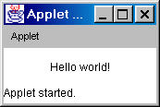
Compile and Run Java Applet
  import java.applet.*;
  import java.awt.*;
  public class HelloWorld extends Applet {
  public void paint(Graphics g) {
  g.drawString("Hello world!",50,25);
  }
  }
C:\appletviewer Hello.html
<HTML>
<HEAD>
<TITLE>A Simple Program</TITLE>
</HEAD>
<BODY>
Here is the output of my program:
<APPLET CODE="HelloWorld.class" WIDTH=150 HEIGHT=25>
</APPLET>
</BODY>
</HTML>
C:\javac HelloWorld.java

Slide 25
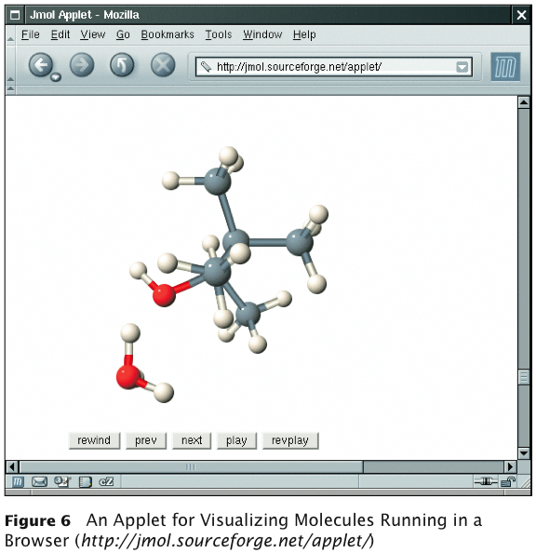
Applet on a Web Page

Slide 26
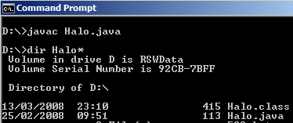
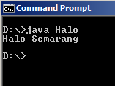
Compile Halo.java
public class Halo{
public static void main(String[] args){
System.out.println(“Halo Semarang”);
}
}

Slide 27
Sample Program
public class HaloSemarang{
public static void main(String[] args){
System.out.println(“Halo Semarang”);
}
}

Slide 28
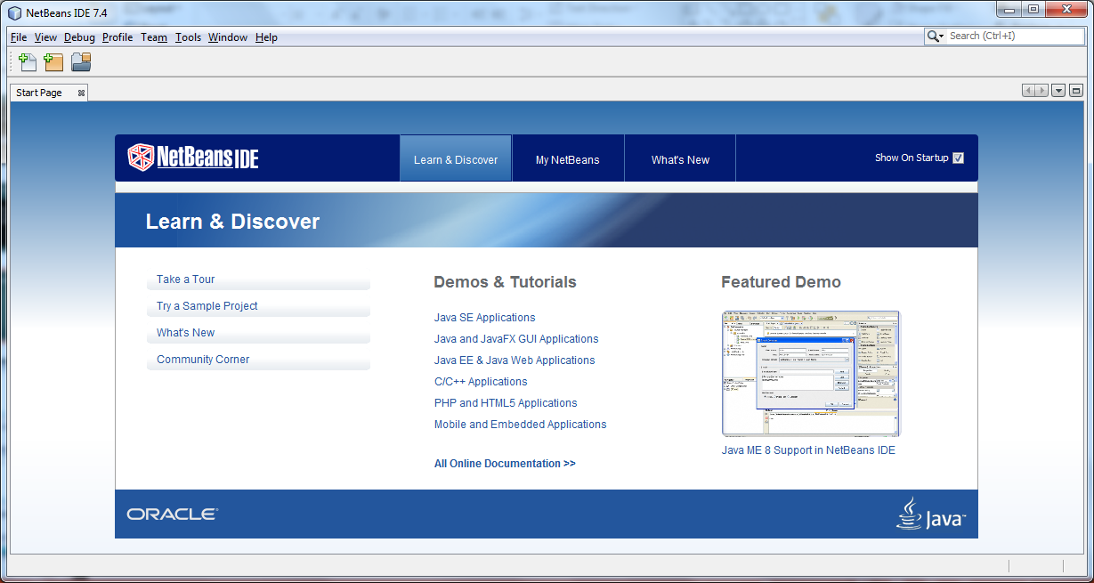
Netbeans IDE 7.4

Slide 29
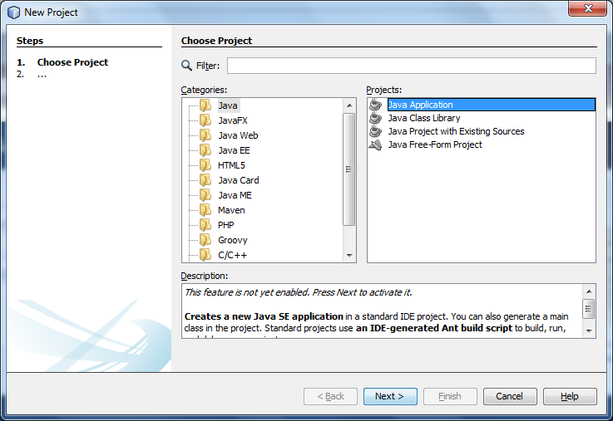
Create New Project

Slide 30
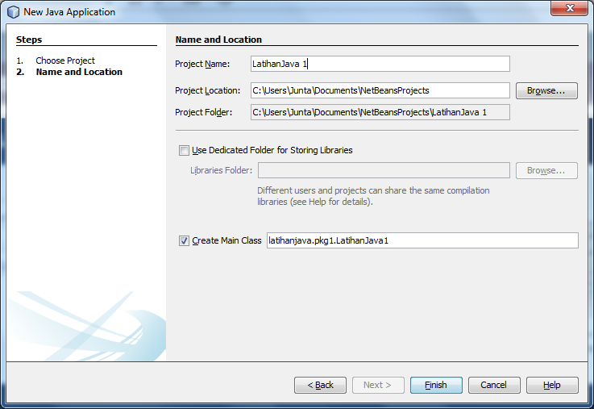
Setting Name and Location of Project

Slide 31
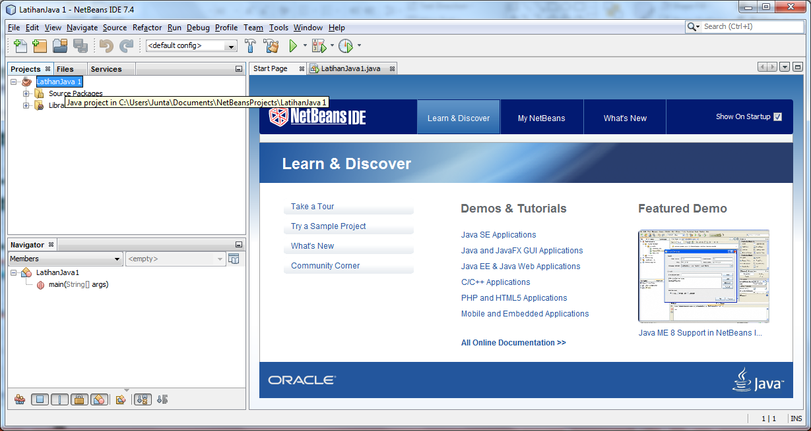
Project – LatihanJava 1

Slide 32
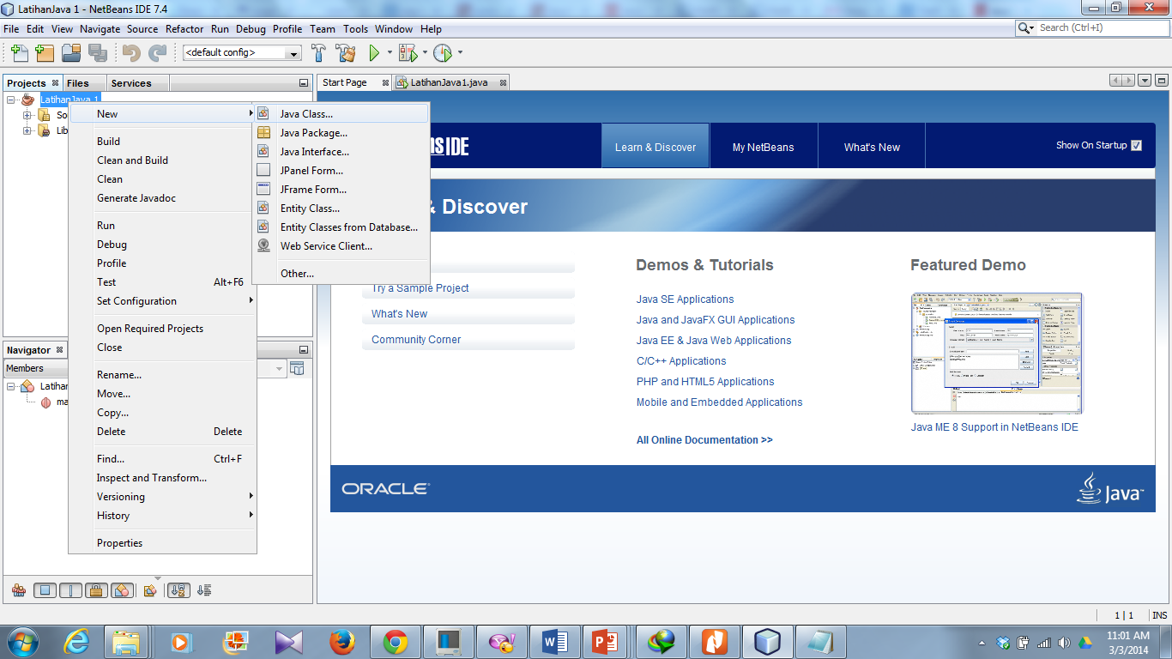
Create New Class of Java

Slide 33
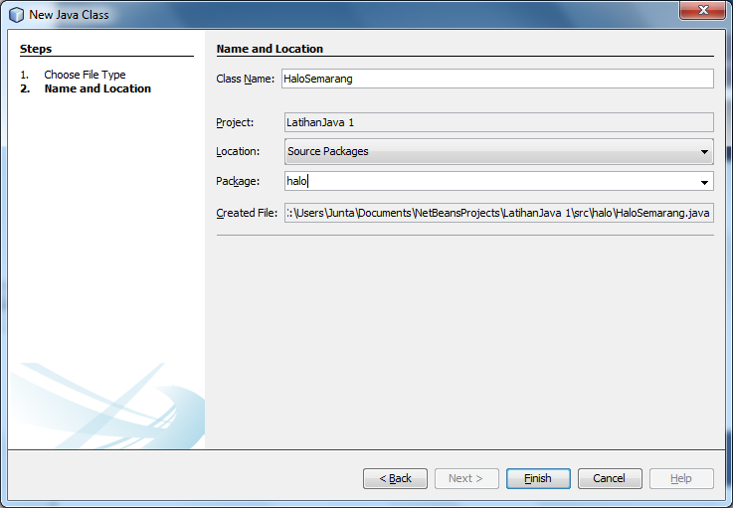
Setting Name and Location of Class

Slide 34
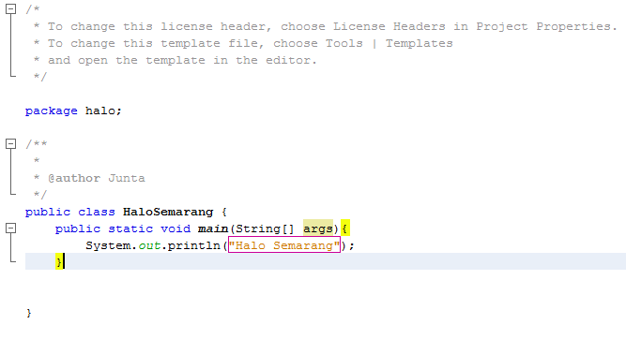
Source Code - Hallo Semarang

Slide 35
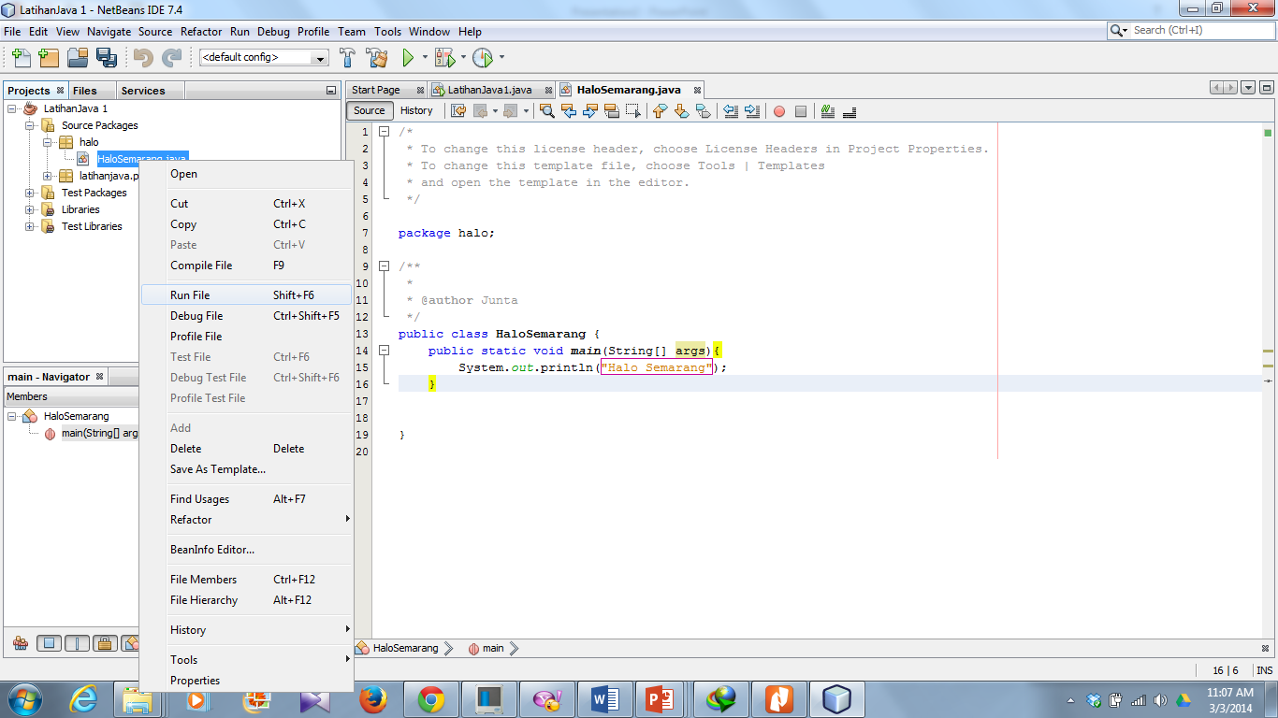
Run File

Slide 36
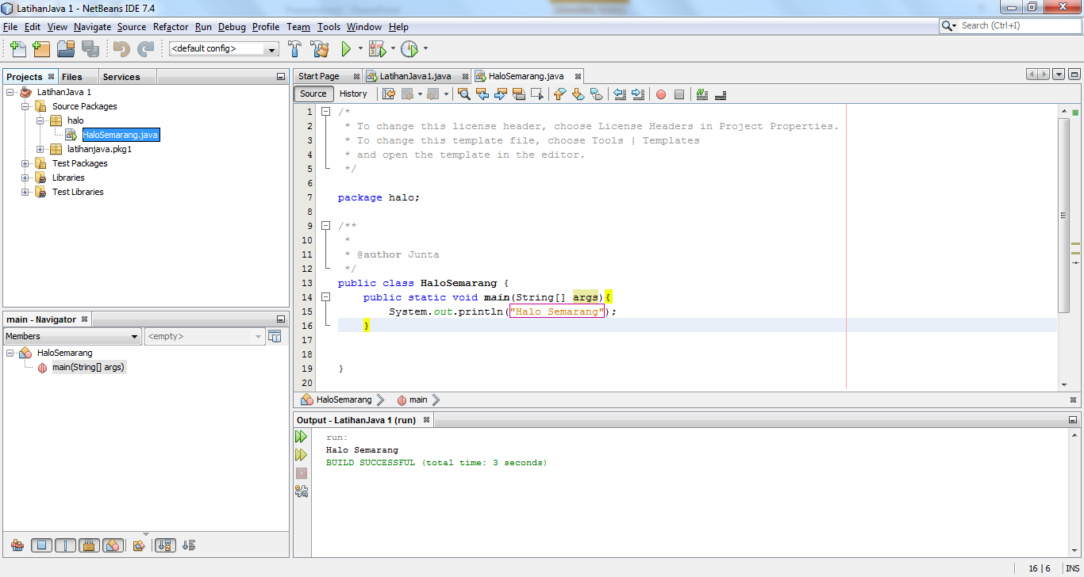
Output

Slide 37
Thanks . . .

Slide 38
Reference
http://romisatriawahono.net/lectures/
Object First With Java, Fifth edition, David J. Barnes & Michael Kölling, Prentice Hall / Pearson Education, 2012.
The JavaTM Tutorial, http://docs.oracle.com/javase/tutorial/java/nutsandbolts/, Oracle, 1995-2014.
Java SE Tutorial, http://www.oracle.com/technetwork/java/javase/downloads/java-se-7-tutorial-2012-02-28-1536013.html, Oracle, 2014.
SCJP Sun Certified Programmer for JavaTM 6 Study Guide Exam (310-065), Kathy Sierra & Bert Bates, Mc Graw Hill, 2008.

