Slide 1
Object-Oriented Programming Concepts
By: Junta Zeniarja

Slide 2
Content
Evolution of Programming Languages
Class VS Object
What is a Class?
What is a Object?
State
Behavior
OOP Advantages

Slide 3
Evolution of Programming Languages

Slide 4
Recognizing the Differences Between Objects and Classes
(A) (B)

Slide 5
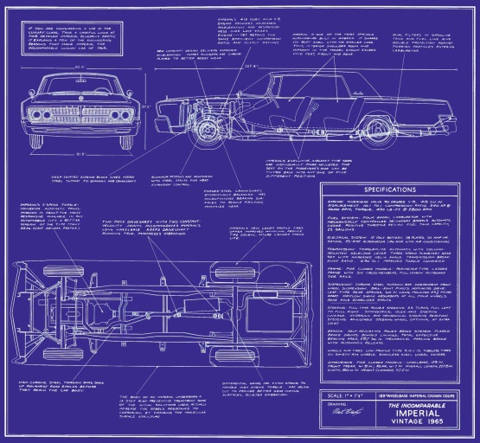
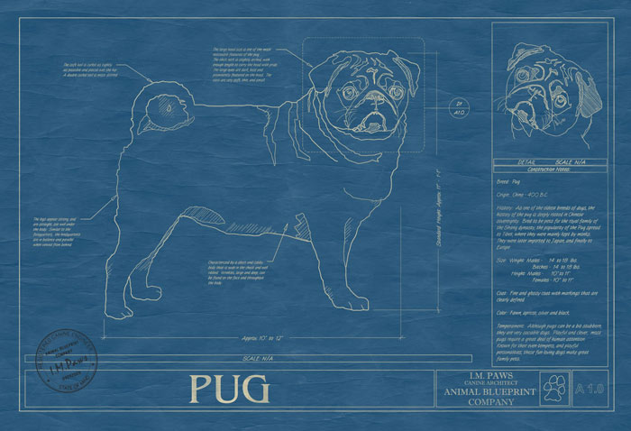
What is a Class?
A class is the blueprint from which individual objects are created.
They all have state and behavior.

Slide 6
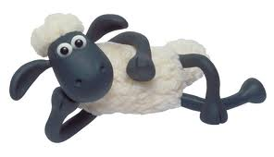
What is a Object?
Objects are key to understanding object-oriented technology.
They all have behavior and state with value.
Example of object:

Slide 7
State
Dogs have state :
name,
type,
color,
age,
eye
Cars have state :
merk,
type,
color,
years of production,
width,
height

Slide 8
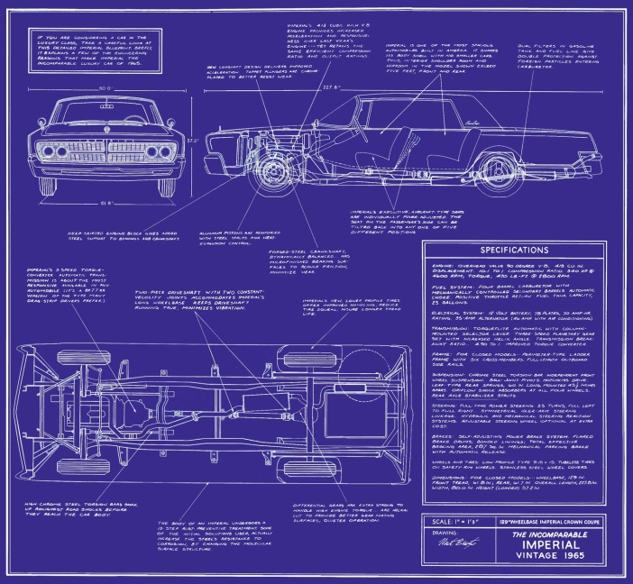
Behavior
Dogs have behavior:
barking,
fetching,
running,
sleeping
Cars have behavior :
change gear,
speed up,
applying brakes

Slide 9
Class = behavior + state
Class dog
age
State
color
barking
behavior
running

Slide 10
Object= behavior + state with value
Object coco (dog)
age=3
Instance State
color=white
barking
Instance behavior
running

Slide 11
State
Variable surrounding the class, with the value of the data in the object can be determined.
Name, age, dan color are state of class Dog
Obj Dog
Coco 3 white
Class Dog
Name: string Age: integer Color: String
Obj Dog
Bubu 4 brown

Slide 12
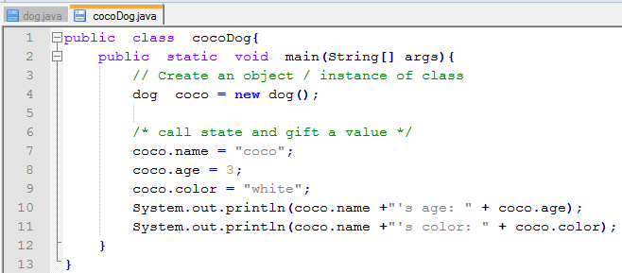
Make class, object and insert state in Java
Class
Object

Slide 13
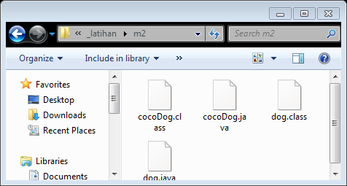
Result
By: De Rosal, Ign. Moses S.

Slide 14
Behavior
Behavior is implementation of how to class work.
Bahavior can:
Manipulating data
Perform mathematical calculations
Monitoring an event

Slide 15
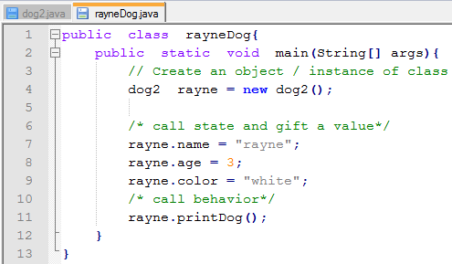
Make class, object and insert behavior in Java
Class
Object

Slide 16
Result

Slide 17
OOP Advantages
Abstraction
Encapsulations
Inheritence
Polymorfism

Slide 18
Abstraction concept

Slide 19
What is your opinions?

Slide 20
Encapsulation concept

Slide 21
What is your opinions?

Slide 22
Next meeting we will learn about Inheritance & Polymorphism concept….

Slide 23
Assignment
Search on google about OOP Advantages (Abstraction and Encapsulation)
Make a summary of Class, Object, OOP Advantages (Abstraction and Encapsulation) with your sentences.
Give an example.
Write in an paper/folio with handwriting.

Slide 24
THANKS

