Slide 1
Starting JavaProgramming
http://docs.oracle.com/javase/

Slide 2
Content
Java Structure
Compile & Running Program
Escape Sequence Character
Method printf()
Language Basics
Variables
Operators
Control Flow Statements
http://docs.oracle.com/javase/

Slide 3
Java Program Structure
Java must have a public class
Start with ‘public static void main(String[]args) ’
There are two kinds of java programming:
GUI-based
Text-based
Syntax to declare class:
[modifier] [class] class_name{
…….
}

Slide 4
Example
modifier
class_name
main program

Slide 5
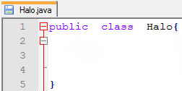
Details Halo.java
Define class and modifier
That can be compiled and executed by the JVM

Slide 6
Details (2) Halo.java
Main program and first time it is run by JVM
Public : one of modifier
Static : type of method
Void : no return value
Main : main method
String : type of argumen
Args : Array of argumen which can be added while running

Slide 7
Details (3) Halo.java
Function to display text in console
“println” → after display text produce a new line
“print” → just display text

Slide 8
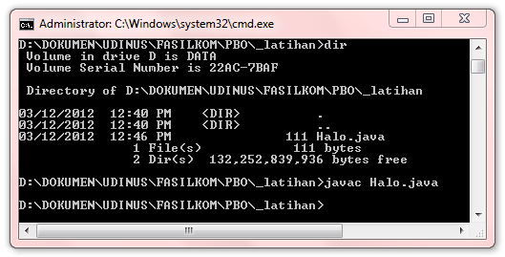
Compiling Program
Compile → with command “javac name_file.java”

Slide 9
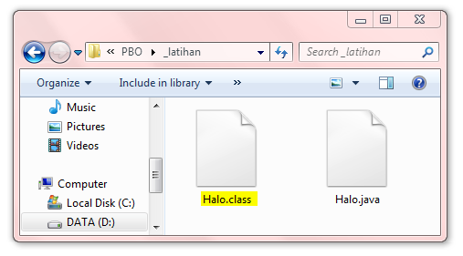
Compiling Program
Compile will produce class file

Slide 10
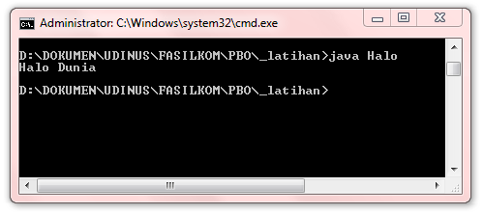
Running Program
Running → with command “java class_file” without .class

Slide 11
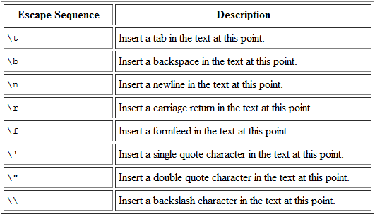
Escape Sequence Character
A character preceded by a backslash (\) is an escape sequence and has special meaning to the compiler. The following table shows the Java escape sequences:

Slide 12
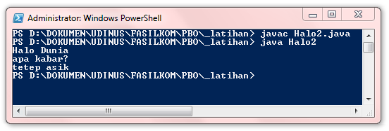
Ex: Escape Sequence Character

Slide 13
Method printf()
The printf( ) method automatically uses Formatter to create a formatted string.
String format
Object … args

Slide 14
Method printf() Result

Slide 15
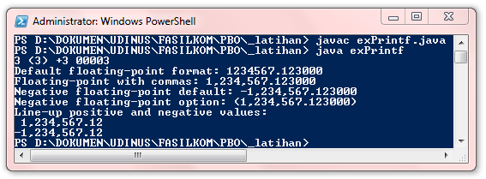
Another Ex: printf()

Slide 16
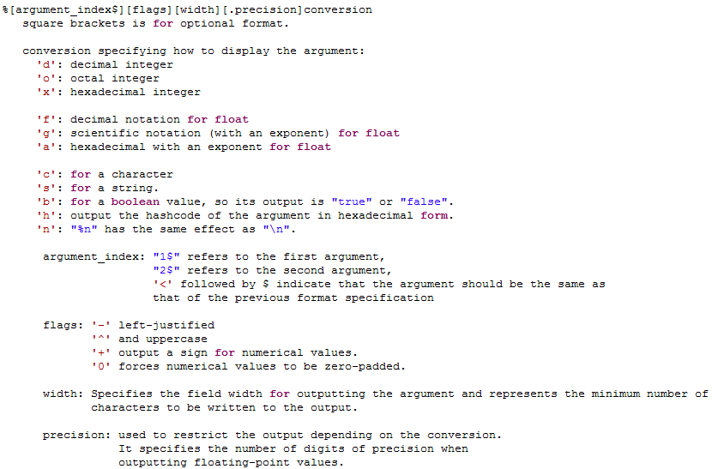
Printf() to command line summary
Source : http://www.java2s.com/Tutorial/Java/0120__Development/printftocommandlinesummary.htm

Slide 17
Variables
The Java programming language is statically-typed, which means that all variables must first be declared before they can be used.
The Java programming language defines the following kinds of variables:
Instance Variables (Non-Static Fields)
Class Variables (Static Fields)
Local Variables
Parameters

Slide 18
Naming Variables
Variable names are case-sensitive
Must start with a letter (a-z, A-Z), the dollar sign "$", or the underscore character “_“, after the first character, can be followed by numbers(0-9).
Variable names can’t contain dash (-) or space (“ “).
Beginning with lowercase on the first word and uppercase letters in the second and subsequent words.
Also keep in mind that the variable names you choose must not be a keyword or reserved word.

Slide 19
Java Language Keywords
abstract | continue | for | new | switch
assert*** | default | goto* | package | synchronized
boolean | do | if | private | this
break | double | implements | protected | throw
byte | else | import | public | throws
case | enum**** | instanceof | return | transient
catch | extends | int | short | try
char | final | interface | static | void
class | finally | long | strictfp** | volatile
const* | float | native | super | while
* | not used
** | added in 1.2
*** | added in 1.4
**** | added in 5.0

Slide 20
Instance Variables
Can be access with instance class

Slide 21
Class/Static Variables
Can be access with static class

Slide 22
Local Variables
declare local variable within method

Slide 23
Parameters

Slide 24
Primitive Data Types
Data type | Length | range of values | Example
boolean | 1 bit | 0 and 1 | 0; 1
byte | 8 bit | -128 to 127 (-2⁷ to 2⁷) | -5; 10
short | 2 byte / 16 bit | -32,768 to 32,767 (-2¹⁵ to 2¹⁵) | -12,777; 31,578
int | 4 byte / 32 bit | -2,147,483,648 to 2,147,483,647 (-2²¹ to 2²¹) | -2,107,483,448 ; 2,145,483,638
long | 8 byte / 64 bit | -9,223,372,036,854,775,808 to +9,223,372,036,854,775,807. (-2⁶³ to 2⁶³) | 9,103,372,036,854,775,807
float | 4 byte / 32 bit | 1.40129846432481707e-45 to 3.40282346638528860e+38
double | 8 byte / 64 bit | 4.94065645841246544e-324d to 1.79769313486231570e+308d
char | 2 byte / 16 bit | 0 to 65,535 (unsigned)

Slide 25
Default Values
Data Type | Default Value (for fields)
byte | 0
short | 0
int | 0
long | 0L
float | 0.0f
double | 0.0d
char | '\u0000'
String (or any object) | null
boolean | false

Slide 26
Integer Literals

Slide 27
Floating-Point Literals

Slide 28
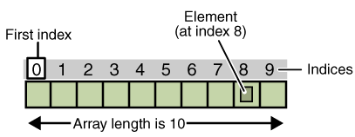
Arrays
An array is a container object that holds a fixed number of values of a single type.

Slide 29
Creating and Initializing an Array

Slide 30
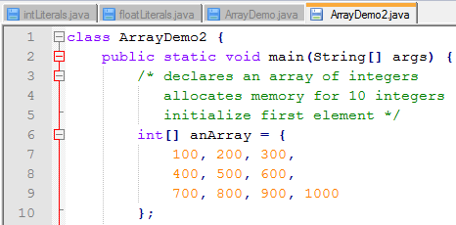
Creating and Initializing Array (2)

Slide 31
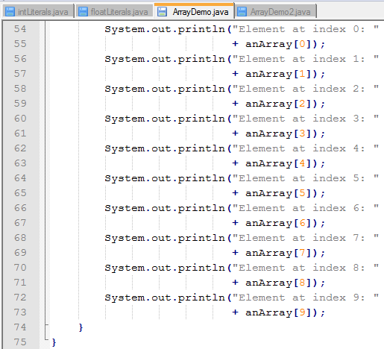
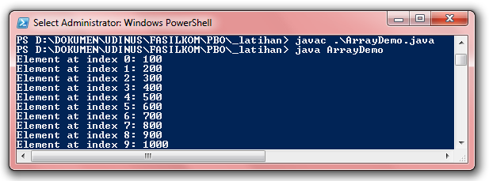
Accessing an Array

Slide 32
Multi Dimesion Array
 | 0 | 1 | 2
0 | 0,0 | 0,1 | 0,2
1 | 1,0 | 1,1 | 1,2
2 | 2,0 | 2,1 | 2,2

Slide 33
Ex: Multi Dimesion Array

Slide 34
Copying Arrays

Slide 35
Operators
Operators are symbols and special characters (mathematics) used in an expression
Example:
int x = 3;
int y = x;
int z = x * y;
boolean status = true;

Slide 36
Operators (2)

Slide 37
Operators (3)
Arithmetic Operators
perform addition, subtraction, multiplication, division, and modulo.
Unary Operators
require only one operand
perform incrementing/decrementing a value by one, negating an expression, or inverting the value of a boolean.
The Equality and Relational Operators
determine if one operand is greater than, less than, equal to, or not equal to another operand.

Slide 38
Operators (4)
Conditional Operators
perform Conditional-AND and Conditional-OR operations on two boolean expressions.
Bitwise and Bit Shift Operators
To manipulated bit pattern
less commonly used.

Slide 39
Ex: Unary Operator

Slide 40
Ex: Bitwise and Bit Shift Operators

Slide 41
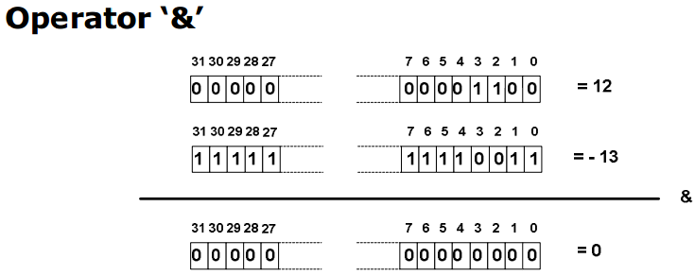
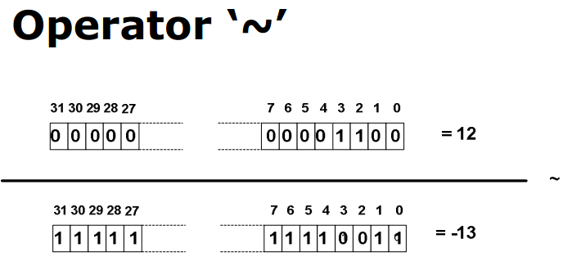
Ex: Bitwise and Bit Shift Operators(2)

Slide 42
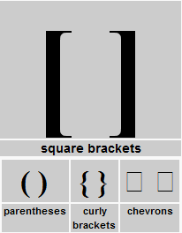
Operator Priority
Operator in bracket or parentheses "(...)"
Increment and decrement operators
Multiplication and division operators
Addition and subtraction operators
Bitwise operators

Slide 43
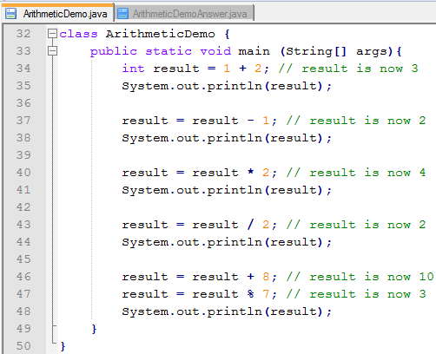
Try Out Operator
Change the following program to use assignments operator!!!

Slide 44
Try Out Operator answer

Slide 45
Control Flow Statements
Control Flow Statements consist of:
Decision making statements,
if-then → executed only if a particular test evaluates to true
if-then-else
Switch → the switch statement can have a number of possible execution paths.
Looping statements, and
For
While
do-while
Branching statements
Break
Continue
return

Slide 46
Ex: IF ELSE

Slide 47
Ex: Switch

Slide 48
Try Out Decision Making Statements
Calculates the number of days in a particular month:
Number of Days in February 2012= 29
Number of Days in February 2011= 28
Number of Days in January, March, May, July, August, October, December = 31
Number of Days in April, June, September, November = 30
Clue: use if else and switch statement

Slide 49
While Statement
The while statement continually executes a block of statements while a particular condition is true.
Its syntax can be expressed as:

Slide 50
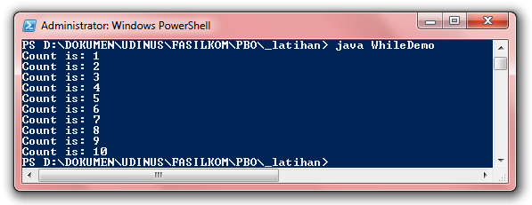
Ex: While Statement

Slide 51
Do-While Statement
The difference between do-while and while is that do-while evaluates its expression at the bottom of the loop instead of the top.
Therefore, the statements within the do block are always executed at least once.

Slide 52
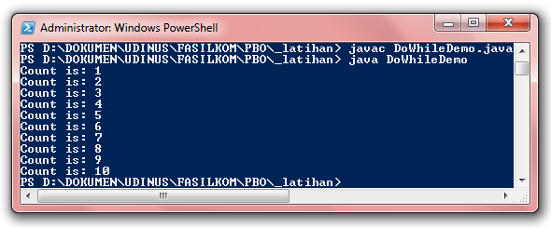
Ex: Do-While Statement

Slide 53
The for Statement
The for statement provides a compact way to iterate over a range of values.
Programmers often refer to it as the "for loop“.
The general form of the for statement can be expressed as follows:

Slide 54
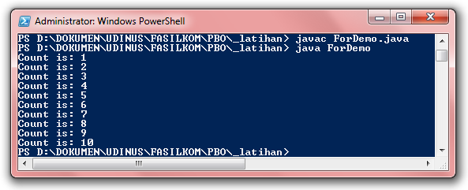
Ex: For Statement

Slide 55
Ex (2): For Statement

Slide 56
The break Statement
The break statement has two forms: labeled and unlabeled.
You can use unlabeled in switch statement, or to terminate a for, while, or do-while loop.
You can use labeled for loops to search for a value in a two-dimensional array.

Slide 57
Ex: unlabeled break Statement

Slide 58
Ex: labeled break Statement

Slide 59
The continue Statement
The continue statement skips the current iteration of a for, while , or do-while loop.
The unlabeled form skips to the end of the innermost loop's body and evaluates the boolean expression that controls the loop
A labeled continue statement skips the current iteration of an outer loop marked with the given label.

Slide 60
Ex: unlabeled continue Statement

Slide 61
Ex: labeled continue Statement

Slide 62
The return Statement
Return value

Slide 63
Class Scanner
Import: java.util.Scanner;
A simple text scanner which can parse primitive types and strings using regular expressions.
For example, this code allows a user to read a number from System.in:

Slide 64
Class Scanner (2)
Import: java.util.Scanner;
nextInt(): to receive integer data type
nextShort(): to receive short data type
nextLong(): to receive long data type
nextDouble(): to receive double data type
nextFloat(): to receive float data type
nextLine(): to receive string data type
nextBoolean(): to receive boolean data type

Slide 65
Ex: Class Scanner

Slide 66
Result Ex: Class Scanner

Slide 67
Ex: Class Scanner (2)

Slide 68
Result Ex: Class Scanner (2)
Any Question?

Slide 69
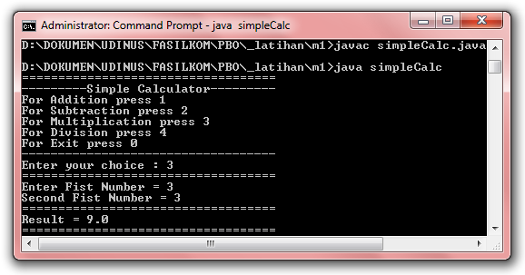
Assignment
Make a simple calculator to:
addition,
substraction,
multiplication,
division
Use Class Scanner

Slide 70
THANKS

