Slide 1
KONSEP SISTEM KOMPUTER
<<Nama Dosen>>
<<email dosen>>
<<no kontak>>

Slide 2
RENCANA KEGIATAN PERKULIAHAN SEMESTER
W | Pokok Bahasan
1 | Pengenalan Teknologi Informasi
2 | Konsep Sistem Komputer & Pengenalan Perangkat Keras
3
4 | Data Storage
5 | Perangkat Lunak
6
7 | Data dan Informasi
8 | Ujian Tengah Semester
W | Pokok Bahasan
9 | Komputasi Pemrograman
10
11 | Rekayasa Perangkat Lunak
12 | Komunikasi data & Jaringan Komputer
13
14 | Etika dan dampak sosial teknologi informasi
15 | Teknologi Terkini / Advance Topik
16 | Ujian Akhir Semester

Slide 3
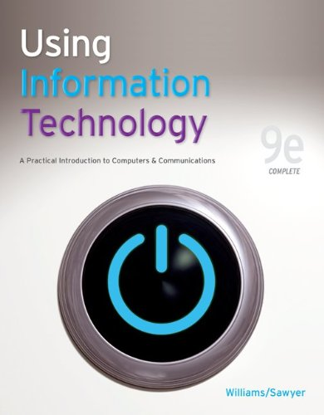
Reference
Bruce K William, Stacey C. Sawyer – Using Information Technology : A Practical Introduction to Computers & Communications 9th Edition (2010)
J. Glenn Brookshear – Computer Science : An Overview 11th Edition (2011)

Slide 4
Review Last Week
First Generation
Second Generation
Third Generation
Fourth Generation
Fifth Generation
Von Neumann Architecture

Slide 5
Review Last Week
 | History
First Generation | Using vacuum tube technology Produce more heat Easy to break down Difficult to identify the problem whenever the computer becomes malfunction Expensive Data Processing not accurate
Second Generation | Using transistor Small size Low power usage More efficient Easy to use Cheapest Assembly Language

Slide 6
Review Last Week
 | History
Third Generation | Using Integrated Circuit Start implement multiprogramming concept and time sharing Small size Low power usage More efficient BASIC, PASCAL
Fourth Generation | Using Microprocessor Using LSI technology (Large Scale Integration) Main memory becomes more efficient, faster, and large
Fifth Generation | More sophisticated Cheapest Faster have ability to see, listen, talk, think like human Have AI

Slide 7
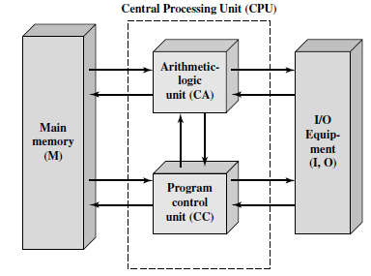
Review Last Week
Von Neumann Architecture
Main memory storing program and data
ALU operating on binary data
Control Unit interpreting instructions from memory and executing
I/O equipment operated by Control Unit

Slide 8
Outline
Konsep Sistem Komputer
Hardware
Software

Slide 9
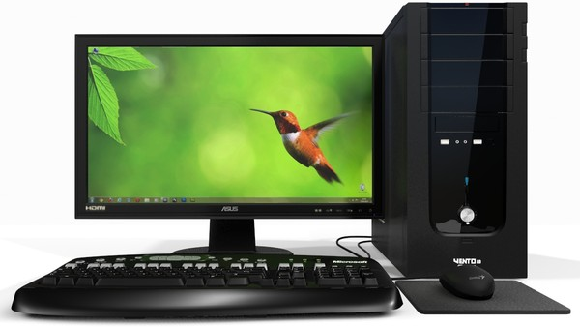
Konsep Sistem Komputer
Hardware
Proses unit
Media penyimpanan
Perangkat masuk dan keluar
Software
Aplikasi
Sistem

Slide 10
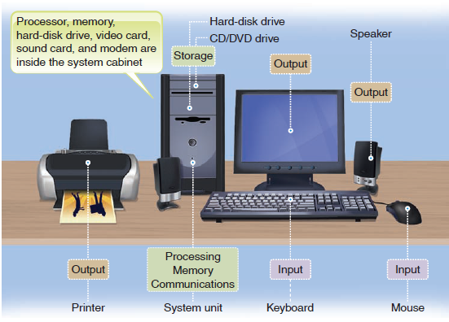
Konsep Sistem Komputer

Slide 11
How Computer Work ?
[Williams & Sawyer, 2010]
Three Key Concept
Purpose of a computer
Difference between hardware and software
The basic operation of computer

Slide 12
Purpose of a Computer
Data
Information

Slide 13
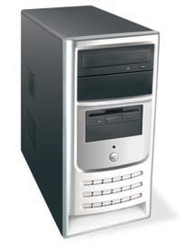
Difference between Hardware and Software
Hardware :
Consist of all the machinery and equipment in a computer system
The hardware include among other devices, the keyboard, the screen, the printer and the box (the computer or processing devices itself)
Hardware is useless without software
[Williams & Sawyer, 2010]

Slide 14
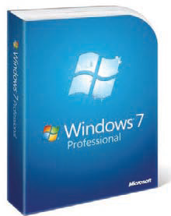
Difference between Hardware and Software
Software :
Consist of all the electronic instructions that tell the computer how to perform a task
Example : Microsoft Windows and Office XP/Vista/7
[Williams & Sawyer, 2010]

Slide 15
The Basic Operation of Computer
Input Operation
Processing Operation
Communication Operation
Output Operation
Storage Operation

Slide 16
The Basic Operation of Computer
Input Operation
Input can be nearly any kind of data
Example : letters, numbers, symbols, shapes, colors, temperatures, sounds, pressure, light beams or whatever raw material needs processing

Slide 17
The Basic Operation of Computer
Processing Operation
The manipulation a computer does to transform data into information
The processing is done by CPU (Central Processing Unit)

Slide 18
The Basic Operation of Computer
Storage Operation
Primary Storage
The internal computer circuitry that temporarily holds data waiting to be processed
The device ad media that store data or information permanently
Secondary Storage
Example : Hard disk, CD/DVD

Slide 19
The Basic Operation of Computer
Output Operation
The result of processing, usually information
Example : Output are numbers or pictures displayed on a screen, word printed out on paper by printer

Slide 20
The Basic Operation of Computer
Communication Operation
Wireless communications connections
Data may be input from afar
Processed in a remote area
Store in different locations
Output in yet other place

Slide 21
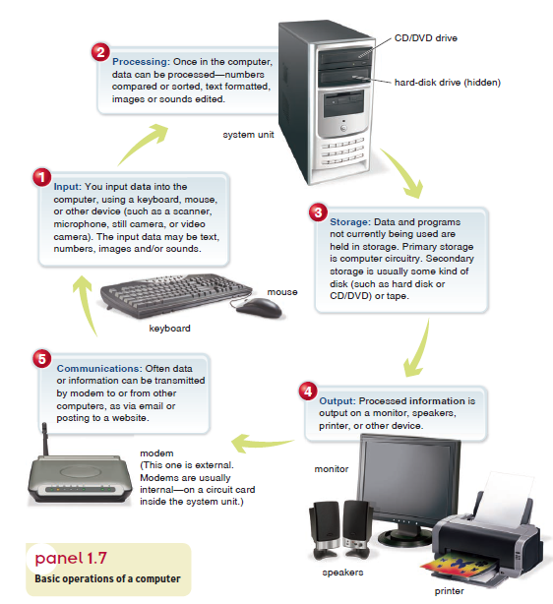

Slide 22
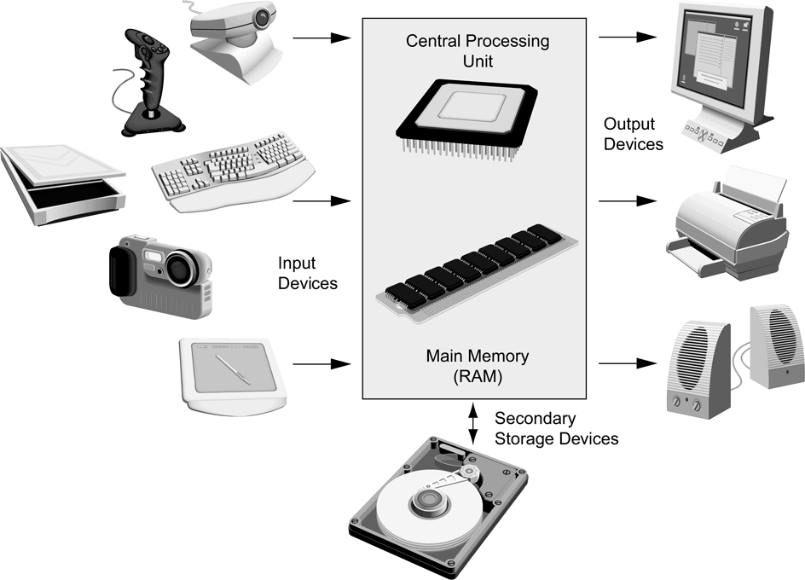
Hardware
Sistem Komputer :
CPU
Main Memory
I/O Devices
Secondary Storage

Slide 23
Hardware
Input Hardware
Processing & Memory Hardware
Storage Hardware
Output hardware

Slide 24
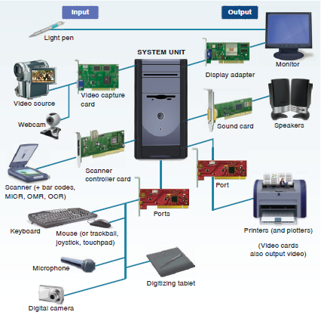
Input / Output Hardware
Input Hardware consists of device that translate data into a form the computer can process
Output Hardware consists of devices that translate information processed by the computer into a form that humans can understand

Slide 25
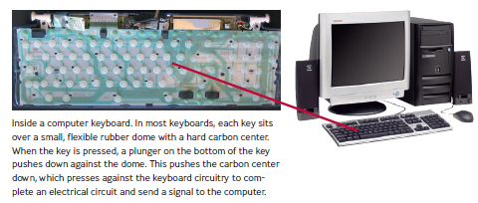
Input Hardware
Keyboard is an input device that converts letters, numbers, and other characters into electrical signals readable by the processor

Slide 26
Input Hardware
Pointing devices control the position of the cursor or pointer on the screen and allow the user to select options displayed on the screen
Example : Mouse, trackball, touchpad

Slide 27
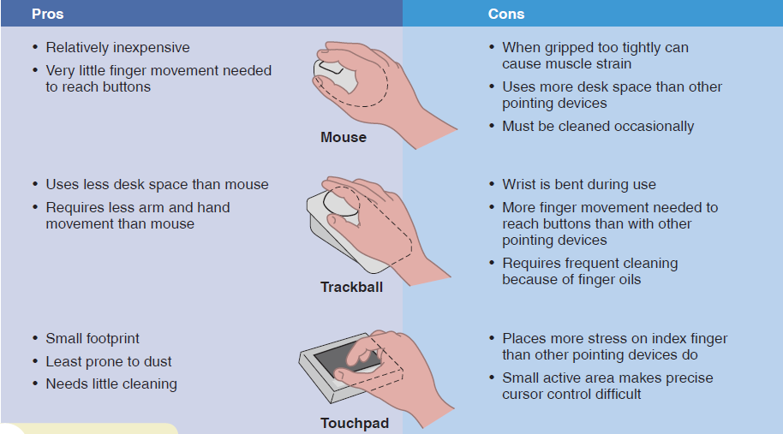
Input Hardware

Slide 28
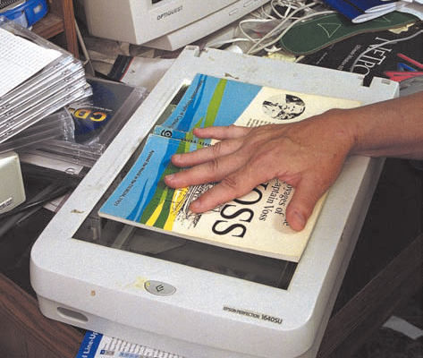
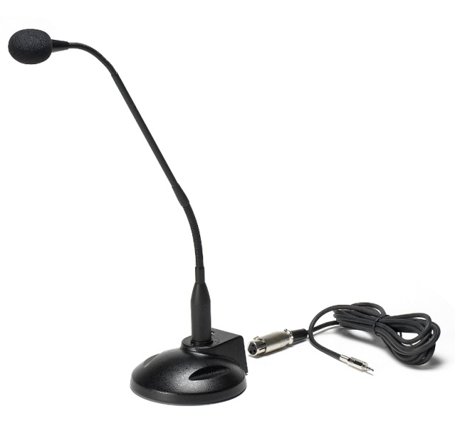
Input Hardware
Source data entry devices create machine readable data on magnetic media or paper or feed it directly into the computer’s processor
Example : Scanner, Microphone, Digital Camera, Sensor

Slide 29
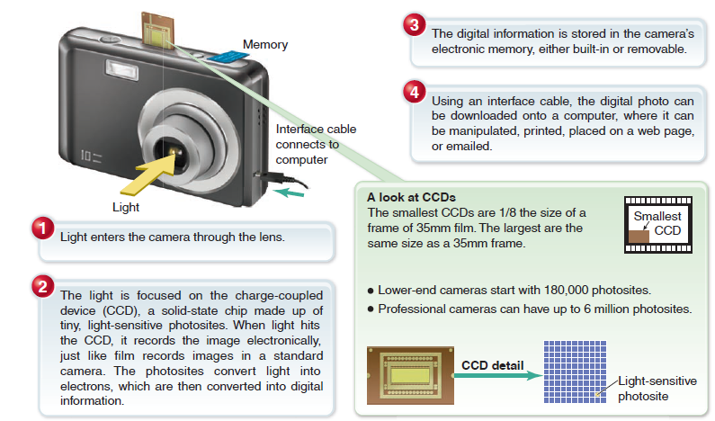
Input Hardware

Slide 30
Output Hardware
Type of output devices [Williams & Sawyer, 2010]

Slide 31
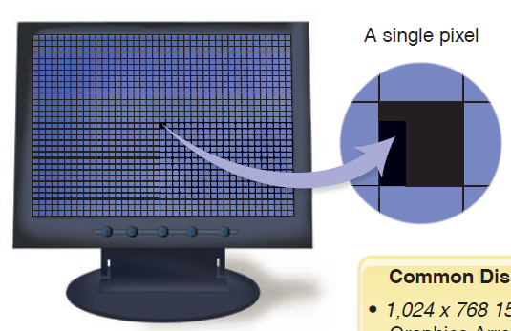
Output Hardware
Softcopy is data that is shown on a display screen or is in audio or voice form; it exists only electronically
Example :
display screen

Slide 32
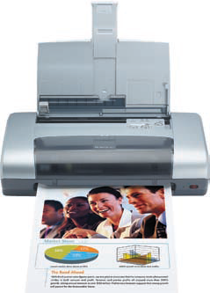
Output Hardware
Hardcopy is printed output
Example :
Printer

Slide 33
Processing and Memory Hardware
A processor is also called the CPU
The CPU is the brain of the computer
CPU works with other circuits known as main memory to carry out processing
Main component of CPU :
Control Unit
ALU
Registers
Buses

Slide 34
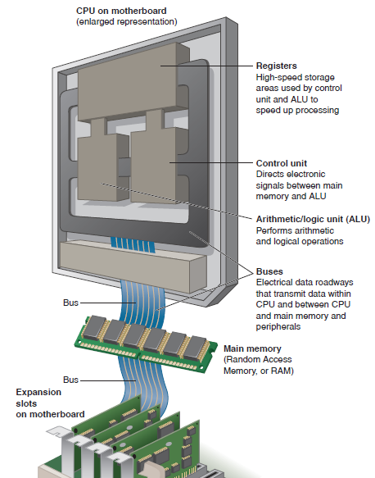
Processing and Memory Hardware
Control Unit control the operation of CPU
Register provides storage internal to the CPU
ALU perform data processing function
Buses provides communication among ALU, Registers, and Control Unit

Slide 35
Machine Cycle
Control unit carries out four basic operations :
Fetch
Decode
Execute
Store

Slide 36
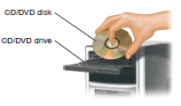
Storage Hardware
Hard Drive
CD/DVD Drive

Slide 37
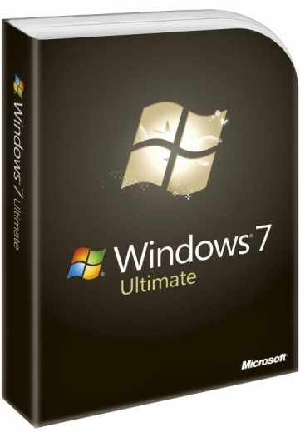
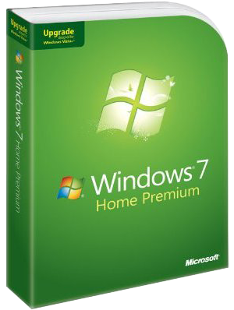
Software
System Software
System software helps the computer perform essential operating tasks and enables the aplication software to run
Example : Windows XP, Vista, 7

Slide 38
Software
Application Software
Perform specific tasks , solve problems, perform work or entertain yourself
Example : Microsoft Word, Excel, Powerpoint

Slide 39
TERIMA KASIH

