Slide 1
Context Free Grammar: Parse Tree
Erwin Yudi Hidayat
erwin@dsn.dinus.ac.id

Slide 2
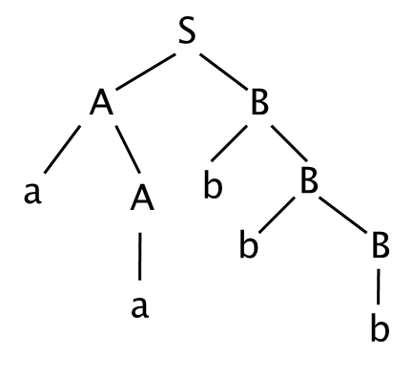
Parse Tree
Parse tree (derivation tree) → obtain a string by parsing variable symbol into terminal symbol.
Every variable symbol is parsed until no more variable available.
example:
S → AB
A → aA | a
B → bB | b
Create a parse tree to obtain
string ‘aabbb’

Slide 3
Leftmost / Rightmost Derivation
Leftmost derivation: if the leftmost variable is parsed first
Rightmost derivation: if the rightmost variable is parsed before all
example:
S → AB
A → aA | a
B → bB | b
Although process to parsing is different, but both have same derivation tree.

Slide 4
Ambiguity
Ambiguity occurs when more than one different parse tree available to acquire a string.
Example:
S → SbS | ScS | a
To obtain string ‘abaca’:
S ⇒ SbS ⇒ SbScS ⇒ SbSca ⇒ Sbaca ⇒ abaca
S ⇒ ScS ⇒ SbScS ⇒ abScS ⇒ abacS ⇒ abaca

Slide 5
Ambiguity
To obtain the same string (‘abaca’) can be found two different parse tree (ambiguous).
S
S ⇒ ScS ⇒ SbScS ⇒ abScS ⇒ abacS ⇒ abaca
S
b
S
S
a
S
c
S
S
c
S
a
a
S
b
S
a
S ⇒ SbS ⇒ SbScS ⇒ SbSca ⇒ Sbaca ⇒
abaca
a
a

