Slide 1
Understanding the Supply Chain
1

Slide 2
Learning Objectives
Discuss the goal of a supply chain and explain the impact of supply chain decisions on the success of a firm.
Identify the three key supply chain decision phases and explain the significance of each one.
Describe the cycle and push/pull views of a supply chain.
Classify the supply chain macro processes in a firm.

Slide 3
What is a Supply Chain?
All stages involved, directly or indirectly, in fulfilling a customer request
Includes manufacturers, suppliers, transporters, warehouses, retailers, and customers
Within each company, the supply chain includes all functions involved in fulfilling a customer request (product development, marketing, operations, distribution, finance, customer service)

Slide 4
What is a Supply Chain?
Customer is an integral part of the supply chain
Includes movement of products from suppliers to manufacturers to distributors and information, funds, and products in both directions
May be more accurate to use the term “supply network” or “supply web”
Typical supply chain stages: customers, retailers, distributors, manufacturers, suppliers
All stages may not be present in all supply chains (e.g., no retailer or distributor for Dell)

Slide 5
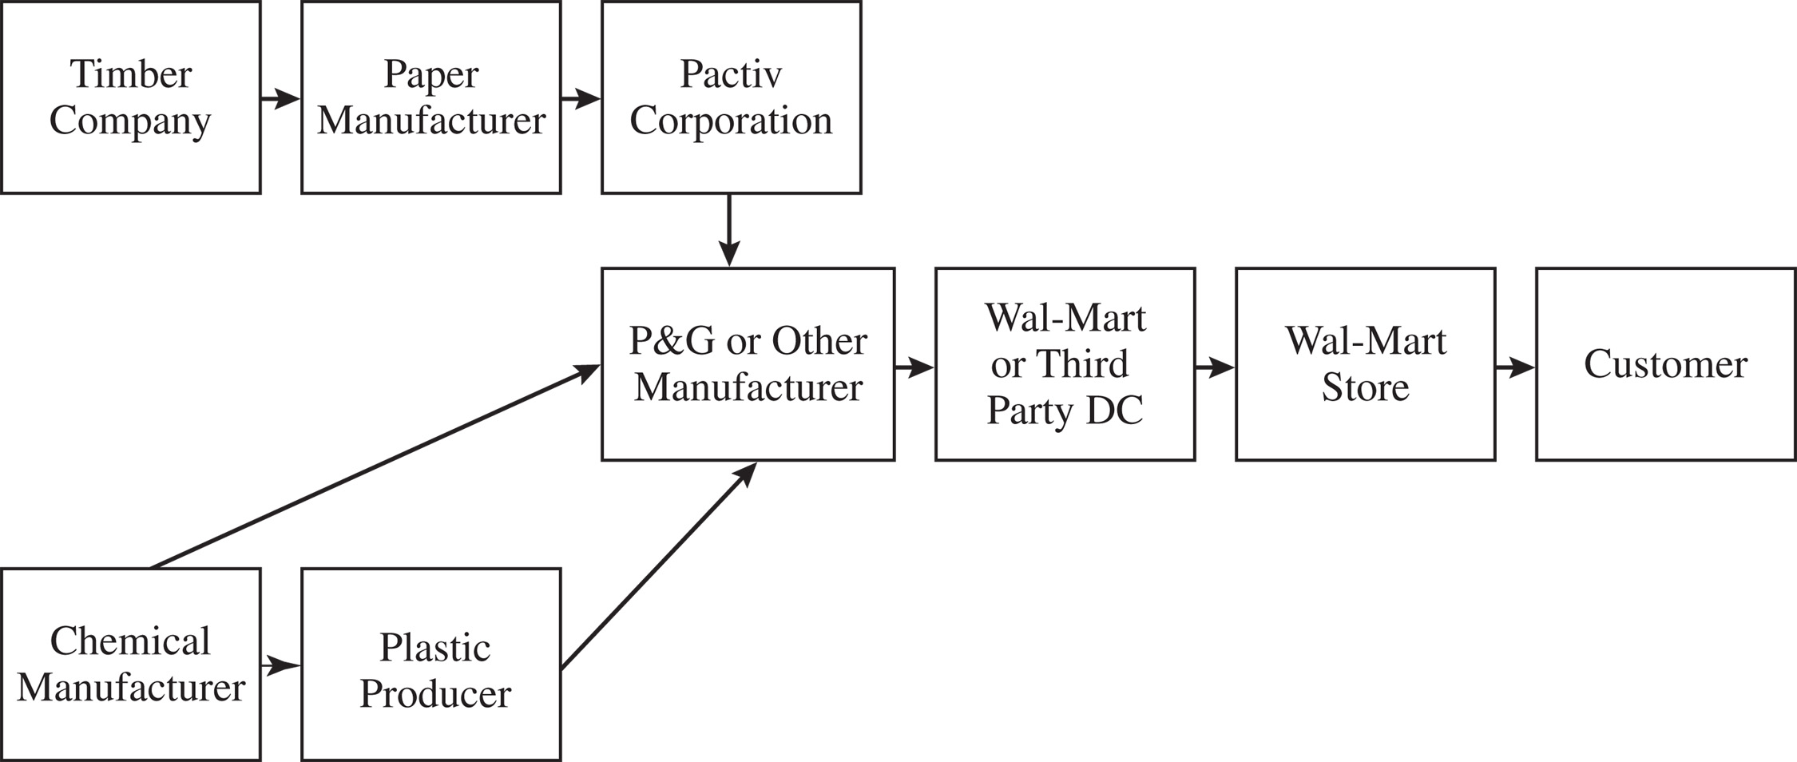
What is a Supply Chain?
Figure 1-1
Notes:
Notes:
Supply chain involves everybody, from the customer all the way to the last supplier.
Key flows in the supply chain are - information, product, and cash. It is through these flows that a supply chain fills a customer order. The management of these flows is key to the success or failure of a firm. Give Dell & Compaq example, Amazon & Borders example to bring out the fact that all supply chain interaction is through these flows.

Slide 6
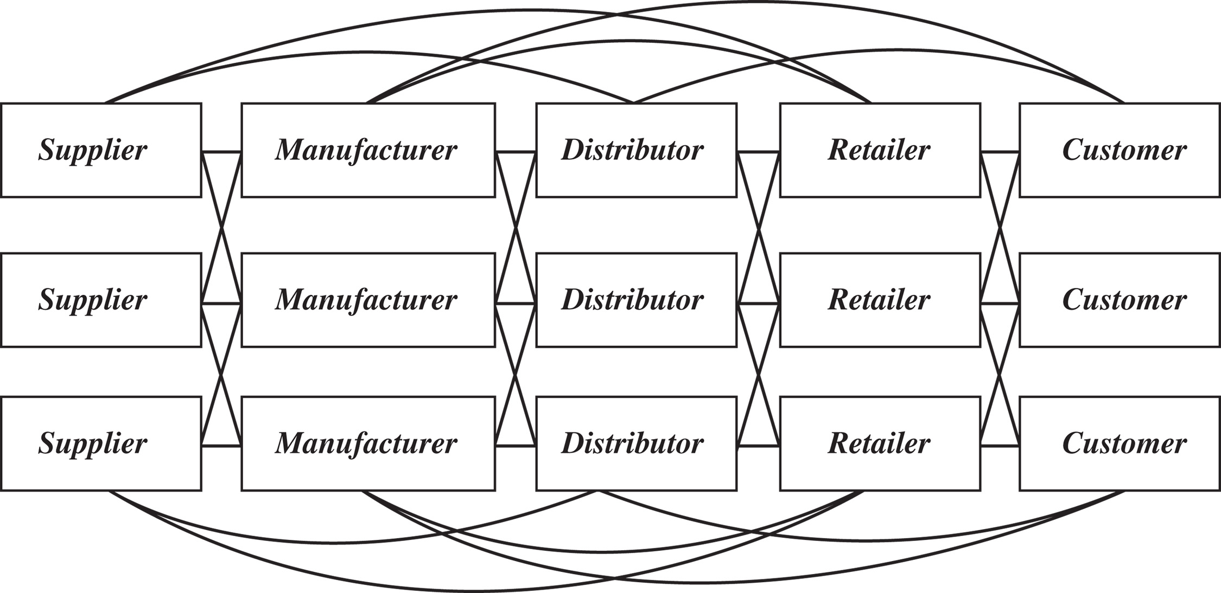
Flows in a Supply Chain
Figure 1-2

Slide 7
The Objective of a Supply Chain
Maximize overall value created
Supply Chain Surplus
= Customer Value – Supply Chain Cost

Slide 8
The Objective of a Supply Chain
Example: a customer purchases a wireless router from Best Buy for $60 (revenue)
Supply chain incurs costs (information, storage, transportation, components, assembly, etc.)
Difference between $60 and the sum of all of these costs is the supply chain profit
Supply chain profitability is total profit to be shared across all stages of the supply chain
Success should be measured by total supply chain profitability, not profits at an individual stage

Slide 9
The Objective of a Supply Chain
Customer the only source of revenue
Sources of cost include flows of information, products, or funds between stages of the supply chain
Effective supply chain management is the management of flows between and among supply chain stages to maximize total supply chain surplus

Slide 10
Importance of
Supply Chain Decisions
Wal-Mart, $1 billion sales in 1980 to $408 billion in 2010
Seven-Eleven Japan, ¥1 billion sales in 1974 to ¥3 trillion in 2009
Webvan folded in two years
Borders, $4 billion in 2004 to $2.8 billion in 2009
Dell, $56 billion in 2006, adopted new supply chain strategies

Slide 11
Decision Phases of a Supply Chain
Supply chain strategy or design
  How to structure the supply chain over the next several years
Supply chain planning
  Decisions over the next quarter or year
Supply chain operation
  Daily or weekly operational decisions

Slide 12
Supply Chain Strategy or Design
Decisions about the structure of the supply chain and what processes each stage will perform
Strategic supply chain decisions
  Locations and capacities of facilities
  Products to be made or stored at various locations
  Modes of transportation
  Information systems
Supply chain design must support strategic objectives
Supply chain design decisions are long-term and expensive to reverse – must take into account market uncertainty

Slide 13
Supply Chain Planning
Definition of a set of policies that govern short-term operations
Fixed by the supply configuration from previous phase
Starts with a forecast of demand in the coming year

Slide 14
Supply Chain Planning
Planning decisions:
  Which markets will be supplied from which locations
  Planned buildup of inventories
  Subcontracting, backup locations
  Inventory policies
  Timing and size of market promotions
Must consider in planning decisions demand uncertainty, exchange rates, competition over the time horizon

Slide 15
Supply Chain Operation
Time horizon is weekly or daily
Decisions regarding individual customer orders
Supply chain configuration is fixed and operating policies are determined
Goal is to implement the operating policies as effectively as possible
Allocate orders to inventory or production, set order due dates, generate pick lists at a warehouse, allocate an order to a particular shipment, set delivery schedules, place replenishment orders
Much less uncertainty (short time horizon)

Slide 16
Process View of a Supply Chain
Cycle View: processes in a supply chain are divided into a series of cycles, each performed at the interfaces between two successive supply chain stages
Push/Pull View: processes in a supply chain are divided into two categories depending on whether they are executed in response to a customer order (pull) or in anticipation of a customer order (push)

Slide 17
Cycle View of Supply
Chain Processes
Figure 1-3
Notes:
The supply chain is a concatenation of cycles with each cycle at the interface of two successive stages in the supply chain. Each cycle involves the customer stage placing an order and receiving it after it has been supplied by the supplier stage.
One difference is in size of order. Second difference is in predictability of orders - orders in the procurement cycle are predictable once manufacturing planning has been done.
This is the predominant view for ERP systems. It is a transaction level view and clearly defines each process and its owner.

Slide 18
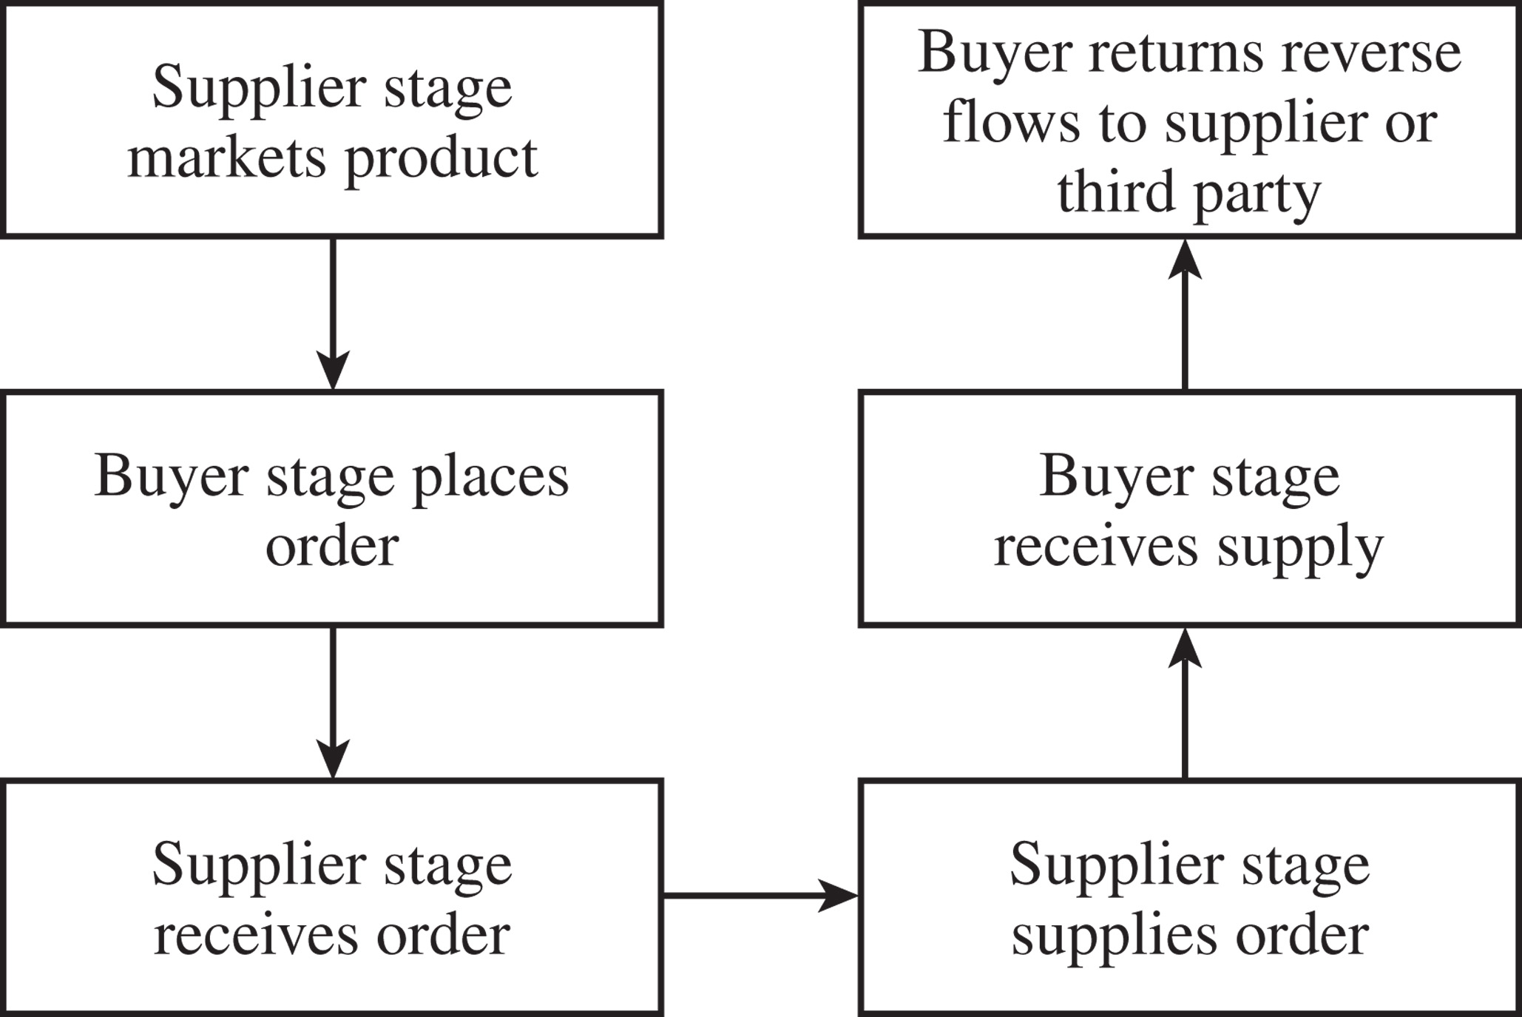
Cycle View of
Supply Chain Processes
Figure 1-4

Slide 19
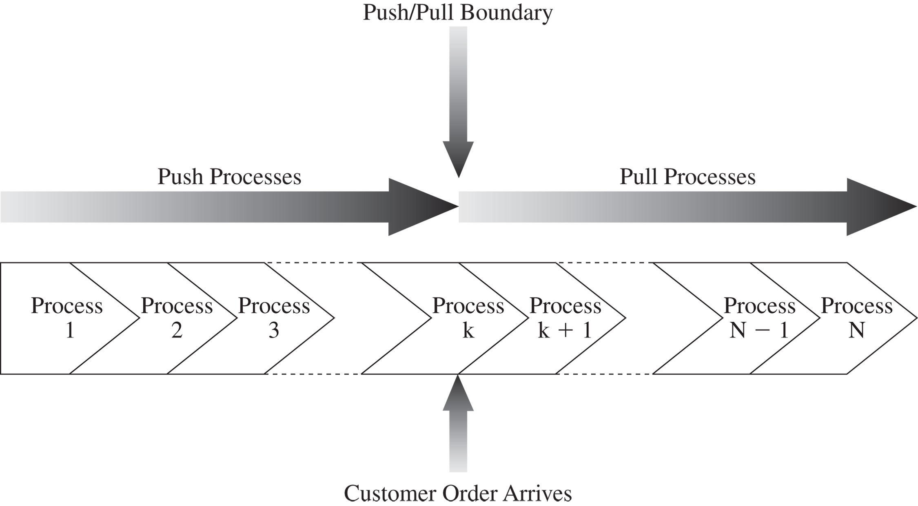
Push/Pull View of Supply Chains
Figure 1-5
Notes:
In this view processes are divided based on their timing relative to the timing of a customer order. Define push and pull processes.
They key difference is the uncertainty during the two phases.
Give examples at Amazon and Borders to illustrate the two views

Slide 20
Push/Pull View of
Supply Chain Processes
Supply chain processes fall into one of two categories depending on the timing of their execution relative to customer demand
Pull: execution is initiated in response to a customer order (reactive)
Push: execution is initiated in anticipation of customer orders (speculative)
Push/pull boundary separates push processes from pull processes

Slide 21
Push/Pull View of
Supply Chain Processes
Useful in considering strategic decisions relating to supply chain design – more global view of how supply chain processes relate to customer orders
Can combine the push/pull and cycle views
  L.L. Bean
  Dell
The relative proportion of push and pull processes can have an impact on supply chain performance

Slide 22
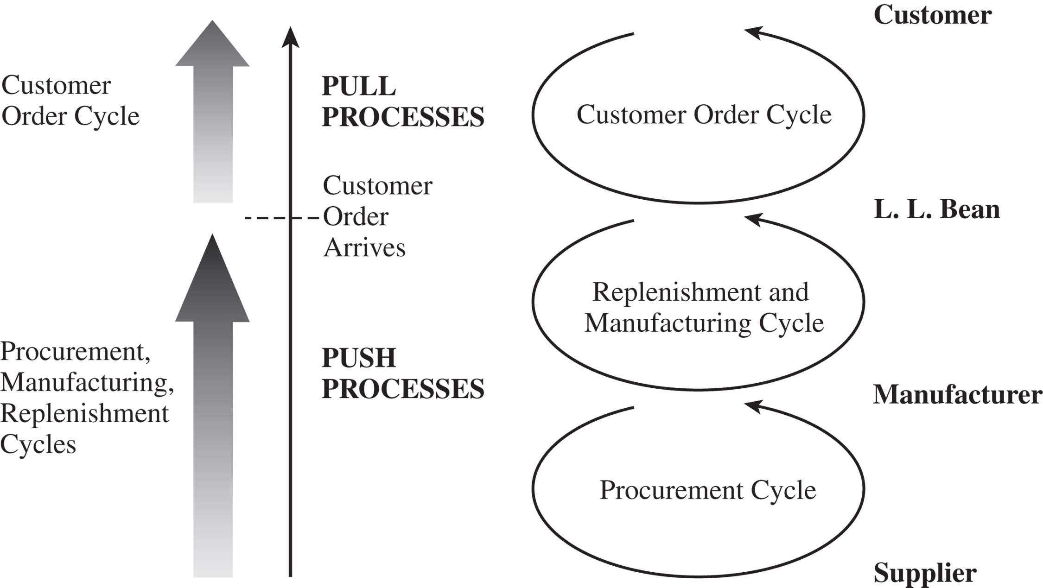
Push/Pull View of – L.L. Bean
Figure 1-6

Slide 23
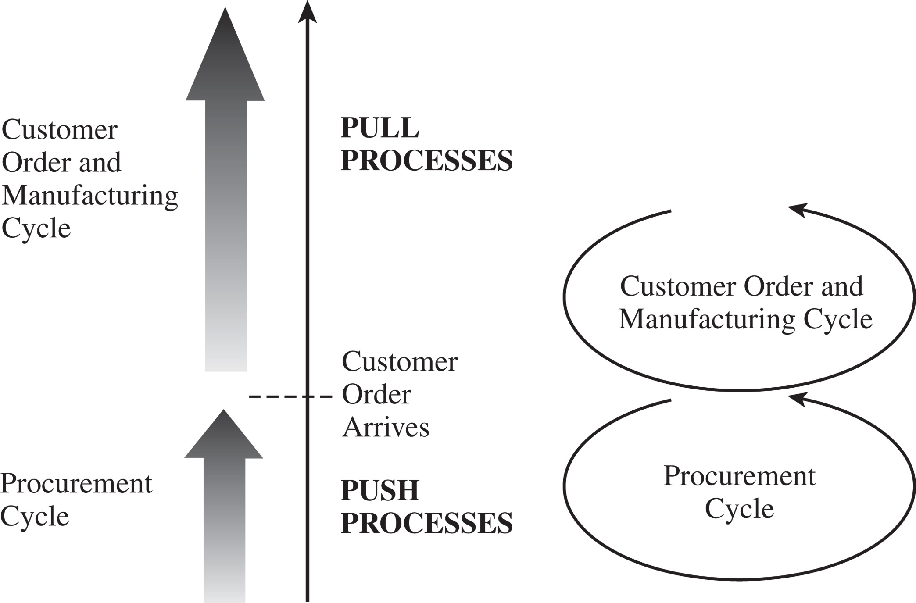
Push/Pull View – Dell
Figure 1-7

Slide 24
Supply Chain Macro Processes
Supply chain processes discussed in the two views can be classified into
  Customer Relationship Management (CRM)
  Internal Supply Chain Management (ISCM)
  Supplier Relationship Management (SRM)
Integration among the above three macro processes is critical for effective and successful supply chain management

Slide 25
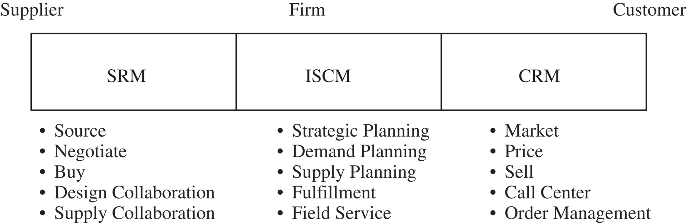
Supply Chain Macro Processes
Figure 1-8

Slide 26
Examples of Supply Chains
Gateway and Apple
Zara
W.W. Grainger and McMaster-Carr
Toyota
Amazon
Notes:
Dell has three production sites worldwide and builds to order. Compaq does both. Consider some decisions involved - where to locate facilities? How to size them? Where is the push/pull boundary? What modes of transport to use? How much inventory to carry? In what form? Where to source from?

Slide 27
Gateway and Apple
Why did Gateway choose not to carry any finished-product inventory at its retail stores? Why did Apple choose to carry inventory at its stores?
Should a firm with an investment in retail stores carry any finished-goods inventory? What are the characteristics of products that are most suitable to be carried in finished-goods inventory? What characterizes products that are best manufactured to order?
How does product variety affect the level of inventory a retail store must carry?
Is a direct selling supply chain without retail stores always less expensive than a supply chain with retail stores?
What factors explain the success of Apple retail and the failure of Gateway country stores?

Slide 28
Zara
What advantage does Zara gain against the competition by having a very responsive supply chain?
Why has Inditex chosen to have both in-house manufacturing and outsourced manufacturing? Why has Inditex maintained manufacturing capacity in Europe even though manufacturing in Asia is much cheaper?
Why does Zara source products with uncertain demand from local manufacturers and products with predictable demand from Asian manufacturers?
What advantage does Zara gain from replenishing its stores multiple times a week compared to a less frequent schedule? How does the frequency of replenishment affect the design of its distribution system?
Do you think Zara’s responsive replenishment infrastructure is better suited for online sales or retail sales?

Slide 29
W.W. Grainger and McMaster-Carr
How many DCs should be built and where should they be located?
How should product stocking be managed at the DCs? Should all DCs carry all products?
What products should be carried in inventory and what products should be left with the supplier to be shipped directly in response to a customer order?
What products should W.W. Grainger carry at a store?
How should markets be allocated to DCs in terms of order fulfillment? What should be done if an order cannot be completely filled from a DC? Should there be specified backup locations? How should they be selected?
How should replenishment of inventory be managed at the various stocking locations?
How should Web orders be handled relative to the existing business? Is it better to integrate the Web business with the existing business or to set up separate distribution?
What transportation modes should be used for order fulfillment and stock replenishment?

Slide 30
Toyota
Where should plants be located, what degree of flexibility should each have, and what capacity should each have?
Should plants be able to produce for all markets?
How should markets be allocated to plants?
What kind of flexibility should be built into the distribution system?
How should this flexible investment be valued?
What actions may be taken during product design to facilitate this flexibility?

Slide 31
Amazon.com
Why is Amazon building more warehouses as it grows? How many warehouses should it have and where should they be located?
What advantages does selling books via the Internet provide over a traditional bookstore? Are there any disadvantages to selling via the Internet?
Should Amazon stock every product it sells?
What advantage can bricks-and-mortar players derive from setting up an online channel? How should they use the two channels to gain maximum advantage?
What advantages/disadvantages does the online channel enjoy in the sale of shoes (diapers) relative to a retail store?
For what products does the online channel offer the greater advantage relative to retail stores? What characterizes these products?

Slide 32
Summary of Learning Objectives
Discuss the goal of a supply chain and explain the impact of supply chain decisions on the success of a firm.
Identify the three key supply chain decision phases and explain the significance of each one.
Describe the cycle and push/pull views of a supply chain.
Classify the supply chain macro processes in a firm.

Slide 33

All rights reserved. No part of this publication may be reproduced, stored in a retrieval system, or transmitted, in any form or by any means, electronic, mechanical, photocopying, recording, or otherwise, without the prior written permission of the publisher.
Printed in the United States of America.

