Slide 1
Enterprise Resource Planning
Ika Novita Dewi|2013|UDINUS|ikadewi@dinus.research.dinus.ac.id

Slide 2
Enterprise resource planning systems or enterprise systems are software systems for business management, encompassing modules supporting functional areas such as planning, manufacturing, sales, marketing, distribution, accounting, financial, human resource management, project management, inventory management, service and maintenance, transportation and e-business

Slide 3
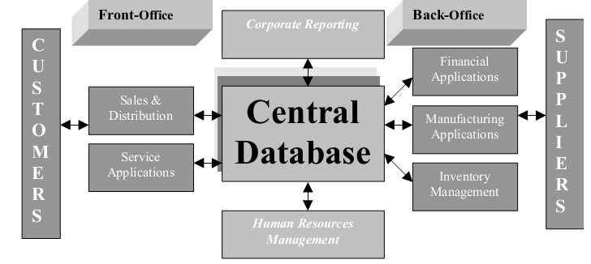
ERP system concept

Slide 4
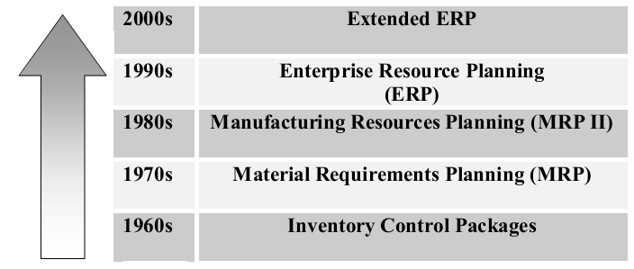
ERP evolution

Slide 5
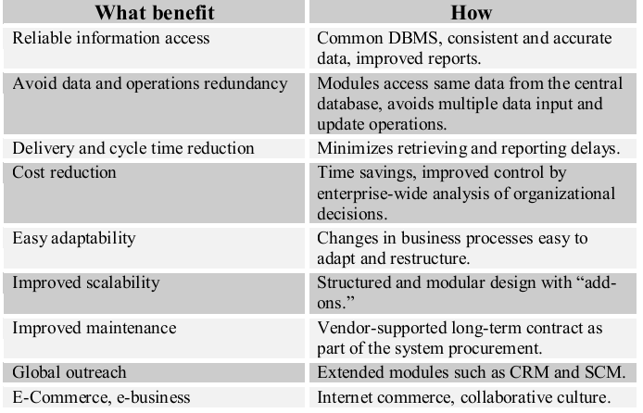
Advantages

Slide 6
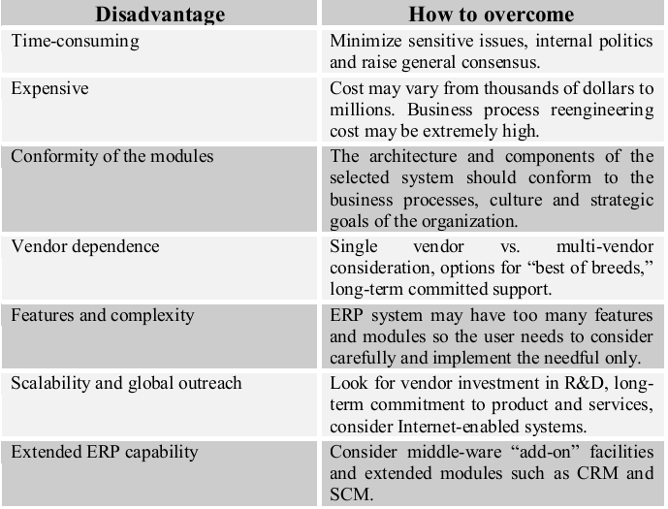
Disadvntages

Slide 7
Enterprise systems employ thin client/server (C/S) technology or client/fat server (C/FS) architecture, creating a decentralized computing environment
In a C/S system a number of client devices operated by end users such as desktop PCs request services from application servers, which in turn get the requested service-related information from the database servers
The requests may be simple data files, data values, communication services, transaction processing or master file updates

Slide 8
The client/server system functions are performed following three layers of logic:
Presentation Layer: Graphical user interface (GUI) or browser for data entry or accessing system functions
Application Layer: Business rules, functions, logic, and programs acting on data received/transferred from/to the database servers
Database Layer: Management of the organization’s operational or transactional data including metadata; mostly employs industry standard RDBMS with structured query language (SQL) provisions

Slide 9
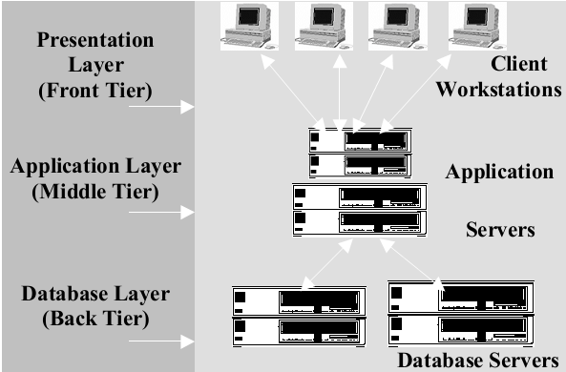
3-tier ERP system architecture
This logical arrangement helps the ERP user interface to run on the clients, the processing modules to run on the middle-tier application servers, and the database system to run on the database servers

Slide 10
Building the Business Case for ERP
Describe the business challenge
Assess the potential benefits of the ERP investment
Assess the potential costs of each ERP option
Assess risks and issues that might arise during the implementation
Recommend the preferred solution
Describe the implementation approach
Measure potential and actual ROI

Slide 11
Common challenges that cause companies to consider ERP solutions include:
A desire to grow the business
Inefficient Business Processes
A Need to Reduce Costs
Obsolete Systems
Notes:
Obsolete Systems = sistem yang kuno

Slide 12
The types of benefits organizations can expect to achieve by implementing an ERP:
Grow the Business
Improve Efficiency
Integration Provides Coherent Business Information
Automation Eliminates Manual Processes
Business Intelligence Improves Decisions and Efficiency
Better Collaboration

Slide 13
Typical costs for an ERP implementation include:
Acquisition
Cost of Expanding the Solution
Training
Implementation
Customization
Administration/Maintenance
Future Requirements

Slide 14
Potential risks and issues to consider include:
Operational Risks
IT Risks
Financial Risks

Slide 15
When looking to a vendor’s professional services arm or systems integration partner to help with the implementation, consider factors that include:
Skills and knowledge delivering solutions for your line of business and industry
The longevity of the business providing the service
Use of an implementation methodology that standardizes software implementations by
providing a critical path for all the steps that must occur
How well they document the implementation process, milestones, and deliverables

Slide 16
Calculate ROI using this simple equation:
ROI = [(Payback - Investment)/Investment)]*100
When determining payback, be sure to consider all business processes that are impacted by the new ERP system
Look at all time savings, cost savings, and increased revenues that can be attributed to the new system
Similarly, when calculating investment, consider all costs detailed, including acquisition, training, implementation, maintenance and so on

