Slide 1
Diffusion of Innovation Theory

Slide 2
Diffusion of Innovations by Everett Rogers
Diffusion is the process by which an innovation is communicated through certain channels over time among the members of a social system.
RANKING MUNDIAL DE USUÁRIOS DE INTERNET
1º
2º
3º
4º
5º
6º
Innovation is any new idea, new behavior, new product, new message i.e., a new thing that one brings to you for your adoption.
Notes:
2
2

Slide 3
ROGERS
Adoption of innovation step process
Knowledge
Person becomes aware of an innovation and has some idea of how it functions
Persuasion
Person forms a favorable or unfavorable attitude toward the innovation
Decision
Person engages in activities that lead to a choice to adopt or reject the innovation
Implementation
Person puts an innovation into use
Confirmation
Person evaluates the results of an innovation-decision already made
Notes:
3

Slide 4
RANKING MUNDIAL DE USUÁRIOS DE INTERNET
1º
2º
3º
4º
Basic on
advant./disadv.
Exposed,
not inspired to find
more information
Seek information,
details about
innovation
Notes:
4
4

Slide 5
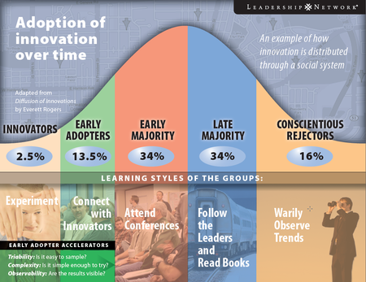
Adoption of innovation over time
Innovations do not spread equally over different society segments (social groups) but through 5 stages with particular profile of reaction
RANKING MUNDIAL DE USUÁRIOS DE INTERNET
1º
2º
3º
4º
5º
6º
Notes:
5

Slide 6
5 particular profile
Adopt new ideas (technologies, concepts, and behaviors in early stages
Innovators
RANKING MUNDIAL DE USUÁRIOS DE INTERNET
1º
2º
3º
4º
5º
6º
Early Adopters
Still have some traits of innovation (risk concern)
Early Majority
First sign of diffusion
Late Majority
Delay its adoption, must be clearly its advantages
Laggards
Mature implementation and risks involved are smaller
Notes:
6

Slide 7
ROGERS
Affecting the diffusion of an innovation
Powerful way for change agents to affect the diffusion of an innovation is to affect opinion leader attitudes.
Persuading opinion leaders is the easiest way to foment positive attitudes toward an innovation.
RANKING MUNDIAL DE USUÁRIOS DE INTERNET
1º
2º
3º
4º
5º
6º
Leaders have the knowledge and the social skill to start word-of-mouth epidemics
Notes:
7

Slide 8
Rogers model evolution
RANKING MUNDIAL DE USUÁRIOS DE INTERNET
Regardless the “experts” opinion, individual before making a decision takes into account the function that indicates how much he can lose with that decision
“Rate of Adoption”
1º
2º
3º
4º
5º
6º
integrating profiles
There is a huge range of different behaviors between each profile described (continuous model)
Notes:
8

Slide 9
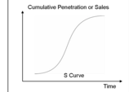
ADOPTER TYPES
1 2 3 4
INOVATORS
EARLY ADOPTERS
EARLY MAJORITY)
LATE MAJORITY
LAGGARDS

Slide 10
Innovation processes follow a normal distribution curve
MAJORITY
RANKING MUNDIAL DE USUÁRIOS DE INTERNET
1º
2º
3º
4º
5º
6º
INNOVATORS
LAGGARDS
CONTINUOUS PROCESS
Notes:
10

Slide 11
5 critical factors influencing innovation diffusion
Relative advantage
RANKING MUNDIAL DE USUÁRIOS DE INTERNET
Adoption probability grows if innovation has clear advantages for product, service or current behavior
1º
2º
3º
4º
5º
6º
Compatibility
The more innovation is consistent with pre-existing higher the adoption probability
Complexity of transition
Complex changes involved in innovation, reduce adoption likelihood
Possibility of testing
A chance to try an innovation before making a final decision increase adoption likelihood
Visibility of benefits
The more obvious innovation benefits the greater adoption likelihood
Notes:
11

Slide 12
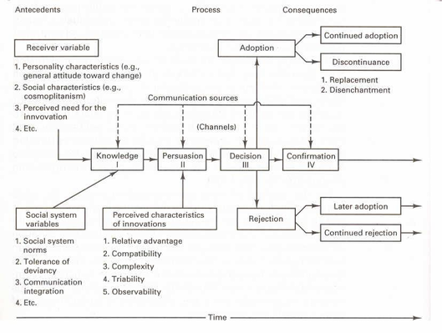
The Process of Diffusion Innovation

Slide 13
Stage of Adoption by Rogers’ (1995)
1
Awareness - the individual is exposed to the innovation but lacks complete information about it
2
Interest - the individual becomes interested in the new idea and seeks additional information about it
3
Evaluation - individual mentally applies the innovation to his present and anticipated future situation, and then decides whether or not to try it
4
Trial - the individual makes full use of the innovation
5
Adoption - the individual decides to continue the full use of the innovation

Slide 14
Factors affecting diffusion
1
2
Individual characteristics
3
Social network characteristics
4
Others…
Innovation characteristics

Slide 15
Innovation characteristics
Observability
The degree to which the results of an innovation are visible to potential adopters
Relative Advantage
The degree to which the innovation is perceived to be superior to current practice
Compatibility
The degree to which the innovation is perceived to be consistent with socio-cultural values, previous ideas, and/or perceived needs
Trialability
The degree to which the innovation can be experienced on a limited basis
Complexity
The degree to which an innovation is difficult to use or understand.

Slide 16
Individual characteristics
Innovativeness
Originally defined by Rogers: the degree to which an individual is relatively earlier in adopting an innovation than other members of his social system
Modified & extended by Hirschman (1980):
Inherent / actualized novelty seeking
Creative consumer
Adoptive / vicarious innovativeness

Slide 17
Other individual characteristics
Reliance on others as source of information (Midgley & Dowling)
Adopter threshold (e.g. Valente)
Need-for-change / Need-for-cognition (Wood & Swait, 2002)

Slide 18
Network characteristics
Opinion leadership: number of nominations as source of information
Number of contacts within each adopter category
Complex structure

Slide 19
Other possible factors:
Lyytinen & Damsgaard (2001)
Social environment of diffusion of innovation
Marketing strategies employed
Institutional structures (e.g., government)

Slide 20
SUCCESS FACTORS AFFECTING THE AGENT:
vigorous promotion
Client Oriented
Partnership with Community Leader
Credibility of the agent

Slide 21
Make the Application of Diffusion Innovation on your own case !

