Slide 1
E-Marketing
Presented by Ika Novita Dewi, MCS

Slide 2
E-marketing
Marketing is the management process responsible for identifying, anticipating and satisfying customer requirements profitably
Electronic marketing has been described simply as ‘achieving marketing objectives through applying digital technologies’
Identifying – how can the Internet be used for marketing research to find out customers’ needs and wants?
Anticipating – the online revenue contribution is key to governing the resource allocation to e-business
Satisfying – a key issue for e-marketing is how to achieve customer satisfaction through the electronic channel

Slide 3
e-marketing, e-business and e-commerce
if e-commerce is best considered as a subset of e-business and e-marketing is also a subset of e-business, is the relationship between e-commerce and e-marketing?
The implication is that they are similar, but e-commerce is perhaps broader than e-marketing since it involves both buy-side and sell-side transactions, whereas e-marketing concentrates on sell-side transactions and communications.

Slide 4
E-marketing operational processes
E-marketing is focused on how a company and its brands use the web and other digital media such as e-mail and mobile media to interact with its audiences in order to meet its marketing goals
three main operational processes involved in e-marketing
Customer acquisition
Attracting visitors to a web site or promoting a brand through reaching them via search engines or advertising on other sites
Customer conversion
Engaging site visitors to achieve the outcomes the site owner seeks such as leads, sales or browsing of other content. Developing a satisfactory customer experience is vital to this.
Customer retention and growth
Encouraging repeat usage of digital channels and for transactional sites, repeat sales.

Slide 5
E-marketing strategic objectives
Cost reduction and value chain efficiencies
Revenue generation
Channel partnership
Communications and branding

Slide 6
E-marketing plan
A plan to achieve the marketing objectives of the e-business strategy
The stages involved can be summarized as:
Situation – where are we now?
Objectives – where do we want to be?
Strategy – how do we get there?
Tactics – how exactly do we get there?
Action – what is our plan?
Control – did we get there?

Slide 7
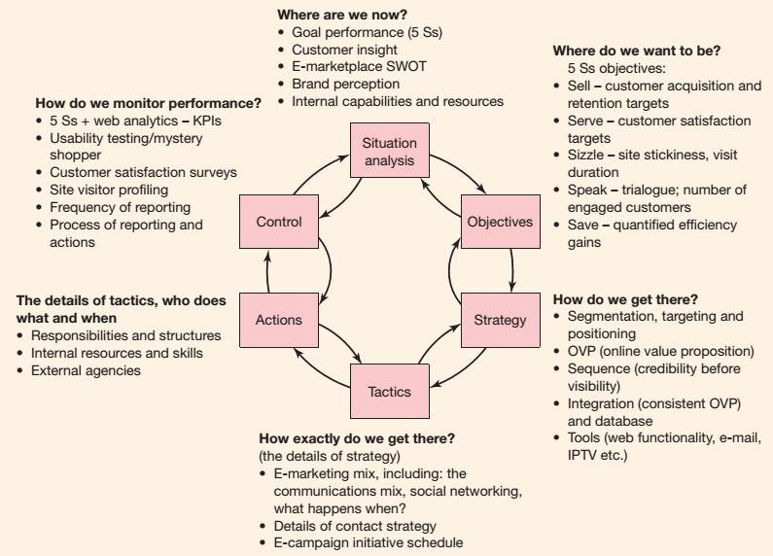

Slide 8
E-marketplace SWOT
The organization | Strengths – S 1 Existing brand 2 Existing customer base 3 Existing distribution | Weaknesses – W 1 Brand perception 2 Intermediary use 3 Technology/skills (poor web experience) 4 Cross-channel support 5 Churn rate
Opportunities – O 1 Cross-selling 2 New markets 3 New services 4 Alliances/co-branding | SO strategies Leverage strengths to maximize opportunities = attacking strategy Examples: 1 Migrate customers to web strategy | WO strategies Counter weaknesses through exploiting opportunities = build strengths for attacking strategy Examples: 1 Counter mediation strategy (create or acquire)
Threats – T 1 Customer choice (price) 2 New entrants 3 New competitive products 4 Channel conflicts 5 Social network | ST strategies Leverage strengths to minimize threat = defensive strategy Examples: 1 Introduce new Internet-only products | WT strategies Counter weaknesses and threats = build strengths for defensive strategy Examples: 1 Differential online pricing Strategy

Slide 9
Target market strategies
Evaluation and selection of appropriate segments and the development of appropriate offers

Slide 10
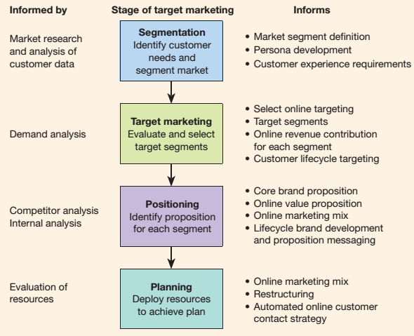
Stages in target marketing strategy development

Slide 11
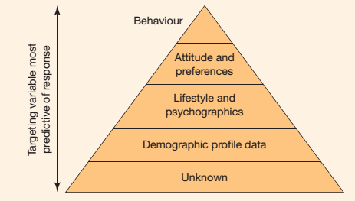
The extent to which different types of segmentation variables tend to be predictive of response

Slide 12
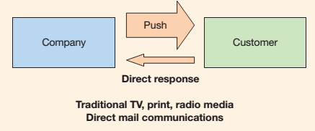
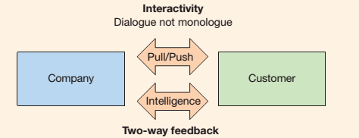
Characteristics of new-media marketing communications
Interactivity
communication models for traditional media
communication models for new media

Slide 13
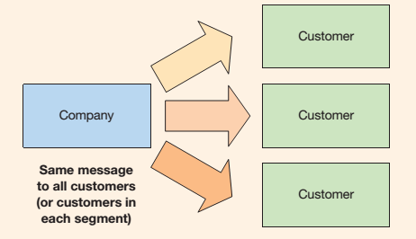
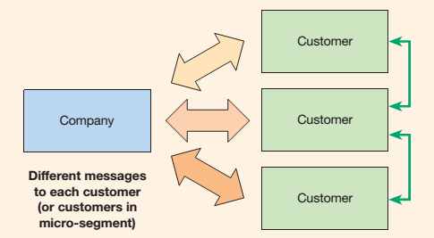
Intelligence
Summary of degree of individualization for traditional media (same message)
Summary of degree of individualization for new media (unique messages and more information exchange between customers)

