Slide 1
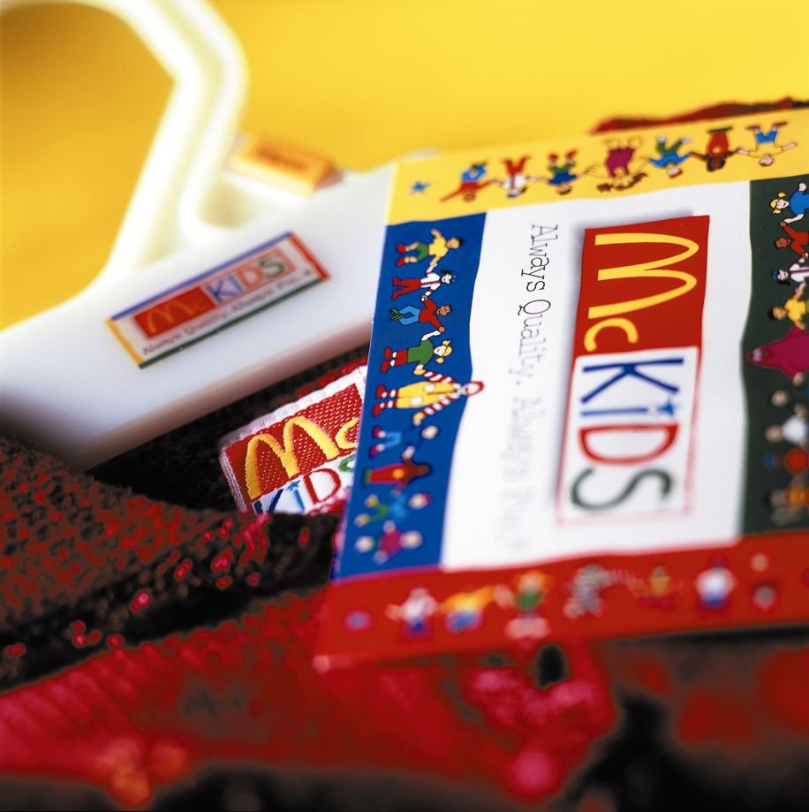
Product Concepts
9
Prepared by
Deborah Baker
Texas Christian University
Guruh Taufan Hariyadi
Dian Nuswantoro University
chapter

Slide 2
Gillette’s Product Lines and Mix
3
Width of the product mix
Blades and Writing
razors Toiletries instruments Lighters
Mach 3 Series Paper Mate Cricket
Sensor Adorn Flair S.T. Dupont
Trac II Toni Atra Right Guard
Swivel Silkience
Double-Edge Soft and Dri
Lady Gillette Foamy
Super Speed Dry Look
Twin Injector Dry Idea
Techmatic Brush Plus
Depth of the product lines

Slide 3
Product Line
A set of related products or services offered by a single firm.
COCA-COLA
1886 COCA-COLA
1960 FANTA
1961 SPRITE
1963 TAB
1966 FRESCA
1972 MR. PIBB
1974 SUGAR-FREE SPRITE
1982 DIET COKE
1992 "NEW" COKE, RENAMED COKE II NESTEA
1994 FRUITOPIA
1995 BARQ'S
1997 SURGE CITRA
Source: Coca-Cola Web Site march 2000

Slide 4
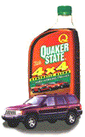
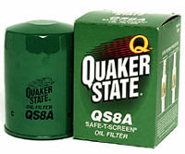
Product Mix
Product Mix
The assortment of products offered by a firm.

