Slide 1
Thinking in Systems
Introduction

Slide 2
Systems Thinking
The only way to fully understand why a complex problem occurs and persists is to understand the part in relation to the whole (O'Connor & McDermott, The Art of Systems Thinking: Essential Skills for Creativity and Problem-Solving)
Traditional scientific approach = isolating small parts of the system
Systems thinking = taking many interactions into account

Slide 3
Systems thinking is needed for problems that are:
Complex problems that involve helping many actors see the "big picture" and not just their part of it
Recurring problems or those that have been made worse by past attempts to fix them
Issues where an action affects (or is affected by) the environment surrounding the issue, either the natural environment or the competitive environment
Problems whose solutions are not obvious
http://www.thinking.net/Systems_Thinking/Intro_to_ST/intro_to_st.html

Slide 4
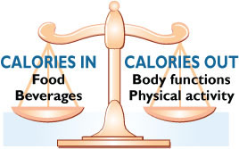
Example: Obesity

Slide 5
Societal policies and processes influencing the population prevalence
of obesity
INTERNATIONAL
NATIONAL/
COMMUNITY
LOCALITY
WORK/
INDIVIDUAL
POPULATION
FACTORS
REGIONAL
SCHOOL/
HOME
Transport
Public
Transport
Leisure
Activity/
Facilities
Globalization
of
markets
Urbanization
Public
Safety
Energy
Expenditure
S
Labor
I
T
Y
O
Health
Health
Care
Infections
%
OBESE
OR
UNDERWT
P
Development
Worksite
Food &
Activity
R
E
Social security
Sanitation
V
Food
intake :
Nutrient
density
A
Media &
Culture
L
Media
programs
& advertising
System
E
Manufactured/
Imported
Food
Family &
Home
N
Media
Education
E
School
Food &
Activity
Food &
Nutrition
Agriculture/
Gardens/
Local markets
National
perspective
Modified from Ritenbaugh C, Kumanyika S, Morabia A, Jeffery R, Antipathies V. IOTF website 1999: http://www.iotf.org

Slide 6
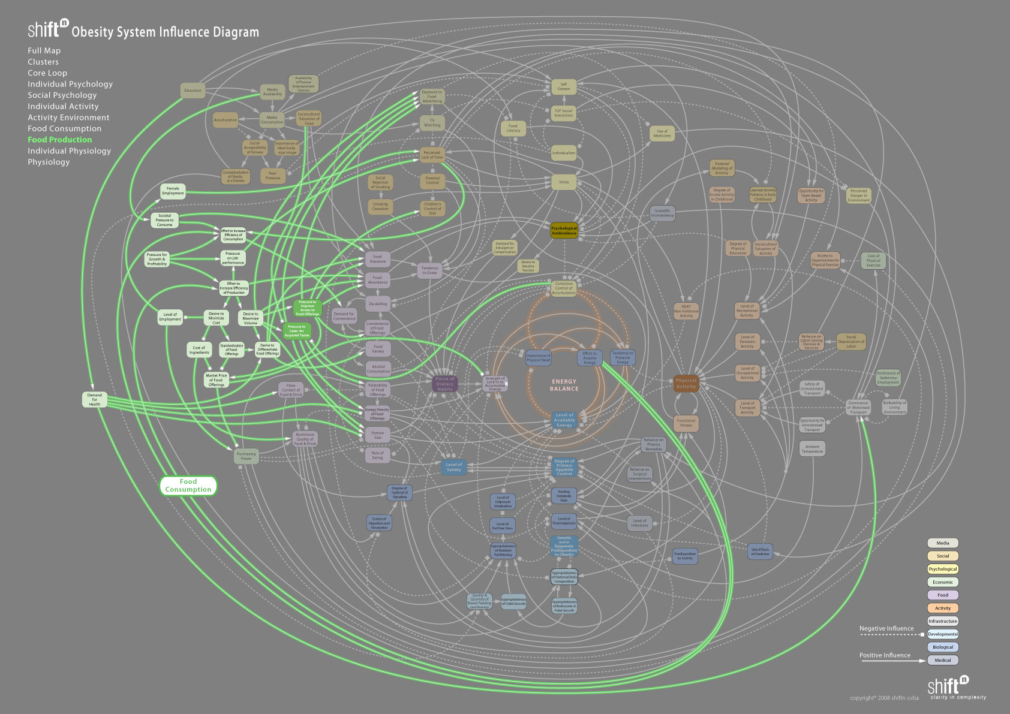

Slide 7
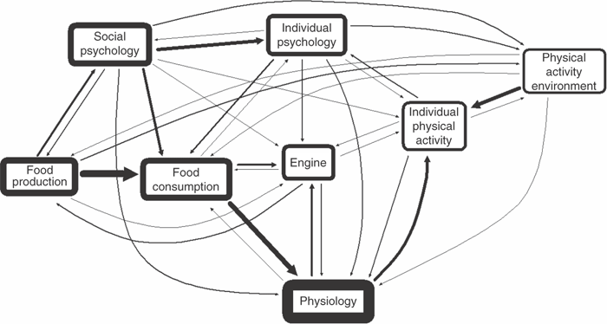
Diane T. Finegood, Thomas D.N. Merth and Harry Rutter Implications of the Foresight Obesity System Map for Solutions to Childhood Obesity.. Obesity (2010) 18, S13–S16. doi:10.1038/oby.2009.426

Slide 8
Example: Policy Development
Agenda setting (Problem identification)
Policy Formulation
Adoption
Implementation
Evaluation
http://en.wikipedia.org/wiki/Policy

Slide 9
Policy Subsystem
Relatively Stable Parameters
System-wide with enduring/constraining effect
Constraints & Resources
Coalition A
Policy beliefs
Resources
Strategy
Coalition B
Policy beliefs
Resources
Strategy
Decisions by Governmental Authorities
External Events
- Change in socioeconomic conditions,
public opinion, leaders
- Policy decisions/impacts from other
subsystems
Policy Outputs & Impacts
Adapted from: Breton E, Richard L, Gagnon F, Jacques M, Bergeron P. Health promotion research and practice require sound policy analysis models: The case of Quebec’s Tobacco Act. Social Science & Medicine 2008; 67:1679-1689.⁵
The Advocacy Coalition Framework
Notes:
The
The Advocacy Coalition Framework (ACF) developed by Sabatier and Jenkins-Smith (1988) provides a theoretical tool for policy analysis and assessment, particularly relating the policy development process to outcomes. This type of policy analysis may facilitate developing awareness and capacity within public health to influence the policy process (Breton et al. 2008). The ACF adapts constructs from several disciplines and includes several specific components; some will be described here (figure one). The AFC can be combined with other policy frameworks including multiple streams models (Kingdon) and stages heuristic (Weible) Over 80 studies in diverse policy arenas have been conducted using the AFC. We chose the AFC for this analysis because of its inclusion of the impact of external influences, the important of policy beliefs and its non-linear perspectives on policy learning. Some key concepts are:
Relatively Stable Parameters: As set forth by the ACF, there are relatively stable parameters, attributes over which the policy actors have little control. In the case of restaurants these include the need for restaurants to remain profitable and the frequency with which American’s eat away from home.
External Events: dynamic elements effecting policy change, including public opinion, legislation, elections, outcome of other policies. These events can influence whether an issue gets on the policy agenda. In the ACF external events are seen as necessary, but not sufficient to change policy
Constraints and Resources: external factors (stable and dynamic) impact the constraints and resources of a policy subsystem. For example, elections can result in changes in leadership and/or funding.
Policy Subsystems: the set of actors involved in a policy issue, including policy advocacy coalitions that form based on core beliefs or values shared by coalition members.
Beliefs: The ACF identifies beliefs as the overarching driver for policy actors (chapter on policy oriented belief systems from the Sabatier book). These are categorized as (1) Deep core beliefs - basic personal philosophical beliefs that are very difficult to change; (2) Policy core beliefs – fundamental policy positions concerning the strategies for achieving core beliefs; and (3) Secondary beliefs that are specific to the topic and may be changed by interactions and learning within the policy sub-system. In some situations, policy-oriented learning can take place across coalitions and lead to changes in secondary beliefs.
Policy-Oriented Learning: policy change occurs through 2 processes- changes in external events and policy-oriented learning. Policy-oriented learning occurs as a result of experience and involves changes in a coalition’s approach to attain policy outcomes consistent with the coalition’s core beliefs. Many policy processes take up to 10 years to mature.

Slide 10
Problem stream
No policy adoption
Policy Stream
Policy stream
B
Politics Stream
Politics stream
Scenario 1: No Coupling of Streams or Window Closed > Policy Proposal Not Adopted
Problem stream
2
Policy
Adoption
Policy Stream
Policy stream
Politics Stream
Politics stream
Scenario 2: Coupling of Streams and Window of Opportunity Open > Policy Proposal Adopted
Kingdon’s Multiple Streams Model

Slide 11
Solutions to Complex Problems
Consider that individuals matter
Match capacity to complexity
Set functional goals & directions for improvement
Distribute decision, action and authority
Form cooperative teams
Create competition& feedback loops
Assess effectiveness
Diane T. Finegood, Thomas D.N. Merth and Harry Rutter Implications of the Foresight Obesity System Map for Solutions to Childhood Obesity.. Obesity (2010) 18, S13–S16. doi:10.1038/oby.2009.426

Slide 12
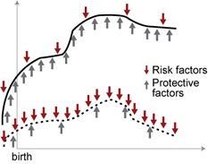
Many Forms of System “Maps”
Environmental Risk Factors
Food Access:
  Physical
Financial
Nutritional
Cultural
Mixed Income Housing
Social Networks
Food Security
Demographic Risk Factors

Slide 13
Healthy People 2020

Slide 14
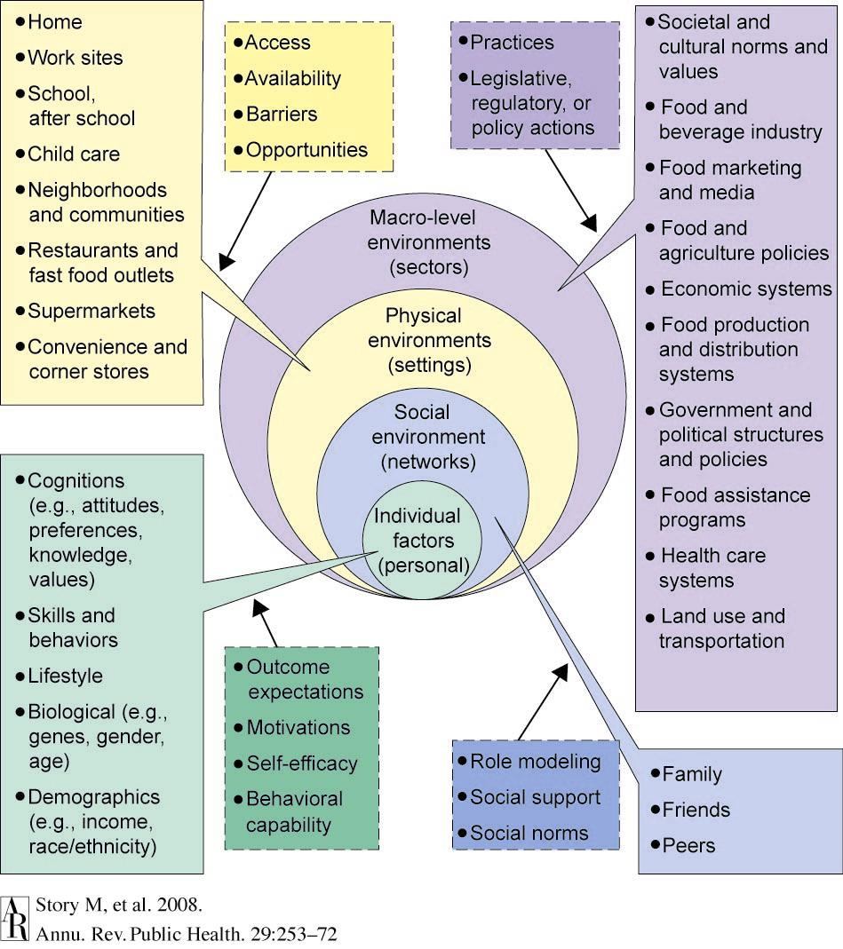
Ecological Framework for Influences on What People Eat

Slide 15
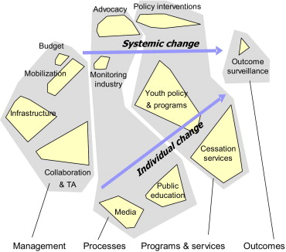
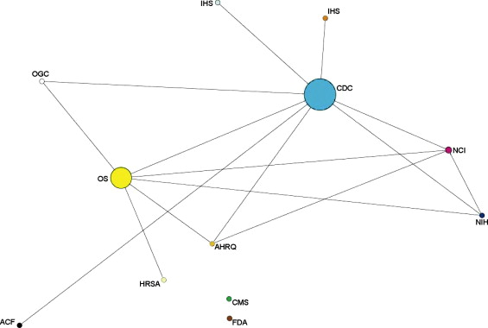
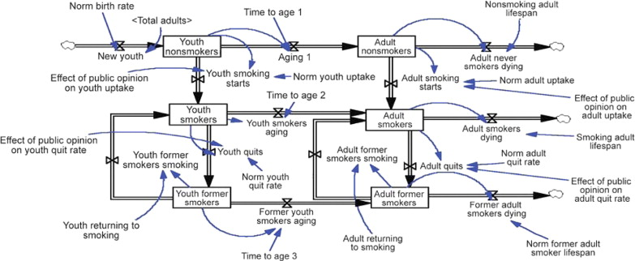
Examples from Leischow Paper

Slide 16
Today’s Work
List
  Ways in which public health nutrition can help to reach HP 2020 goals
Analyze one nutrition problem that is related to both healthy food access and HP goals.
  Draw a picture of the system that influences that problem.
  Indicate at least 4 potential places in the system where public health might make a difference.

Slide 17
Do Exercise
Make System Maps for your specific case

