Slide 1
THE HEALTH BELIEF MODEL

Slide 2
DESCRIPTION
This chapter will discuss The Health Belief Model, Protection Motivation Theory and how to use the model in the behavior case analysis

Slide 3
OBJECTIVES
General
The student able to analyze the health behavior problem with the theory of Health Belief Model and the Protection Motivation Theory
Specific
Student can explain the frame of health belief model and all variables (Percieved of Susceptibility, Percieved of Seriousness, Percieved of benefits, Percieved of barriers, Cues to action)
Student can explain the frame of protection motivation theory and all variables (Perceived of seriousness, Perceived of vulnerability , Self efficacy, Response effectiveness,
Student can use the frame in the behavior case analysis

Slide 4
Historical Origins of the Model
Lewin’s Field Theory (1935)
Introduced the concept of barriers to and facilitators of behavior change
U.S. Public Health Service (1950’s)
Group of social psychologists trying to explain why people did not participate in prevention and screening programs.
Two major influences from learning theory:
Stimulus Response Theory
Cognitive Theory

Slide 5
Stimulus Response Theory
Learning results from events which reduce the psychological drives that cause behavior (reinforcers)
In other words, we learn to enact new behaviors, change existing behaviors, and reduce or eliminate behaviors because of the consequences of our actions.
Reinforcers, punishments, rewards

Slide 6
Cognitive Theory
Emphasize the role of subjective hypotheses and expectations held by the individual.
Beliefs, attitudes, desires, expectations, etc.
Influencing beliefs and expectations about the situation can drive behavior change, rather than trying to influence the behavior directly.

Slide 7
Value-Expectancy Theory
Expectancy: person believes that increased effort leads to improved performance
Instrumentality: person believes that improved performance leads to a certain outcome or reward
Outcomes: person values that reward or outcome

Slide 8
HBM
HBM is a value-expectancy theory
Based on these assumptions:
People desire to avoid illness or get well
People believe that a specific health action that is available to him or her will prevent illness
Initial development based on probability-based studies of 1200 adults
People who believed they were susceptible AND believed in the benefits of early detection were much more likely to be screened for TB.

Slide 9
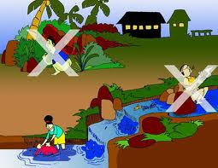
HEALTH BELIEF MODEL (HBM) Rosenstock 1966, Becker 1970, 1980
HBM first proposed by Rosenstock, 1966 and then refined by Becker, et al 1970 and 1980
HBM is used to predict preventive health behavior and behavioral responses to the treatment of patients with acute and chronic diseases
But lately HBM is used to predict various health-related behaviors

Slide 10
Basics of Health Belief Model
Cues to action
Susceptibility
Demographic
Variable
Severity
Likelihood of
Behaviour
Benefits
Costs

Slide 11
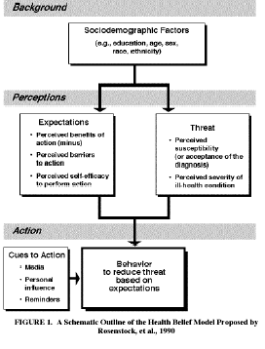

Slide 12
Individual Perceptions
Modifying Factors
Likelihood of Action
Demographics
Personality
SES
Knowledge
Perceived Benefits
minus
Perceived Barriers
Perceived Susceptibility
Perceived Severity
Perceived threat
Likelihood of
Behavior change
Cues to Action
Education
Symptoms
Media

Slide 13
Components of HBM
Perceived Susceptibility: how likely do you think you are to have this health issue?
Perceived Severity: how serious a problem do you believe this health issue is?
Perceived Benefits: how well does the recommended behavior reduce the risk(s) associated with this health issue?
Perceived Barriers: what are the potential negative aspects of doing this recommended behavior?

Slide 14
Additional Components of HBM
Cues to Action: factors which cause you to change, or want to change. (not systematically studied)
Self-Efficacy: one’s “conviction that one can successfully execute the behavior required to produce the outcomes” (Bandura, 1977).
As the health concerns of the nation have shifted to lifestyle-related conditions, self-efficacy has taken on greater importance, both as an independent construct, and as a component of HBM

Slide 15
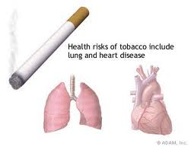
Susceptibility to illness
People perception of risk of disease
Someone who feels affected by the disease may be more to feel threatened
“My chances of getting lung cancer are high”

Slide 16
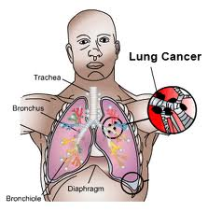
The severity of the illness
People perception of the severity of an illness due to certain behaviors
If someone believes the more severe disease as a result it will be increasing threat
“Lung cancer is a serious illness”

Slide 17
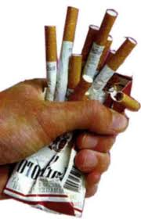
The cost involved in carrying out the behaviour
The cost is not only financially but also things that are psychological such as worry, shame, pain, etc.
“Stopping smoking will make me irritable”

Slide 18
Susceptibility to illness
The severity of the illness
The cost
Percieved of Threats
(Persepsi tentang Ancaman)

Slide 19
Threats
The threat of encouraging individuals take action to prevent disease
But if the threats are too great even to put fear that inhibits the action because they feel helpless/hopeless.

Slide 20
How to reduce belief of threat
In order to reduce the threat, offered an alternative action by health workers
Whether individuals agree or not with alternative behavior depending on the perception of the benefits and barriers to implementation

Slide 21
The Benefits Involved in Carrying Out the Behaviour
A person will not receive the health behavior recommended unless he is convinced that these behavior could reduce the threat or profitable.
“Stopping smoking will save me money”

Slide 22
Cues to action
Affects a person in getting a correct understanding challenged vulnerability, severity, and loss of prevention and treatment performed, can come from internal and external factors.
Cues to action
Internal ( The symptom of breathlessness)
External ( Information from leaflet)

Slide 23
Individual Readiness to do the bahavior
Individual readiness is high when Benefits> barriers
Individual Readiness low when Benefits <barriers
If benefits and barriers are high →the conflict →will be difficult to resolve

Slide 24
Other variables: Demographic, Social Psychology and the Structural
→Preparing conditions : the individual's perception and the perceived of benefits of preventive action.

Slide 25
Do other application of HBM on your own case!

Slide 26
PROTECTION MOTIVATION THEORY (PMT)

Slide 27
Protection Motivation Theory (Rogers, 1984)
Extension and re-working of HBM
Intention to protect oneself is the proximal determinant of health behavior

Slide 28
INTRODUCTION
Rogers (1975, 1983, 1985) developed a PMT which is a continuation of the HBM theory by incorporating several additional factors.

Slide 29
Protection Motivation Theory
Intention is dependent on four components:
1) perceived susceptibility
2) perceived severity
3) Self-efficacy
4) Response efficacy (benefits versus barriers)
Susceptibility and severity are considered “perceived threat”
Response efficacy and self-efficacy are considered “coping efficacy”

Slide 30
Where Do We Intervene?
Educate about threat (vulnerability, susceptibility)
Fear appraisals
Educate about coping (response efficacy, self-efficacy)
Health education

Slide 31
Application Exercise
Please choose a health behavior and population
Assume you are an advertising specialist contracted to develop a persuasive communication (poster, news advertisement etc.) to improve the health behavior for the population
Create a message that includes severity, susceptibility, response efficacy, and self-efficacy for the target population

Slide 32
PMT concept
PMT is a process of threat assessment and response evaluation process that resulted in the intention to implement the adaptive response (protection motivation) or maladaptive (putting someone at risk)
PMT is a theory of behavior that serves to develop interventions to reduce the threat in individuals with research and integrate the concept of psychological, sociological and other related fields.

Slide 33
PMT Model
Explain why people do not live healthy behaviors (threat and vulnerability)
Offers to health behavior change to the prevention and motivation
Offering the effectiveness of behavioral assessment is recommended
Increasing confidence in the ability of self- consider other factors that support (eg, cost)

Slide 34
PMT shows that health-related behaviors is formed from four components:
Severity
Vulnerability
Response effectiveness
Self-efficacy
+ fifth component : Fear

Slide 35
THE BASIC OF PROTECTION MOTIVATION THEORY
Severity
Vulnerability
Behavioural
intentions
Behaviour
Response effectiveness
Self-efficacy

Slide 36
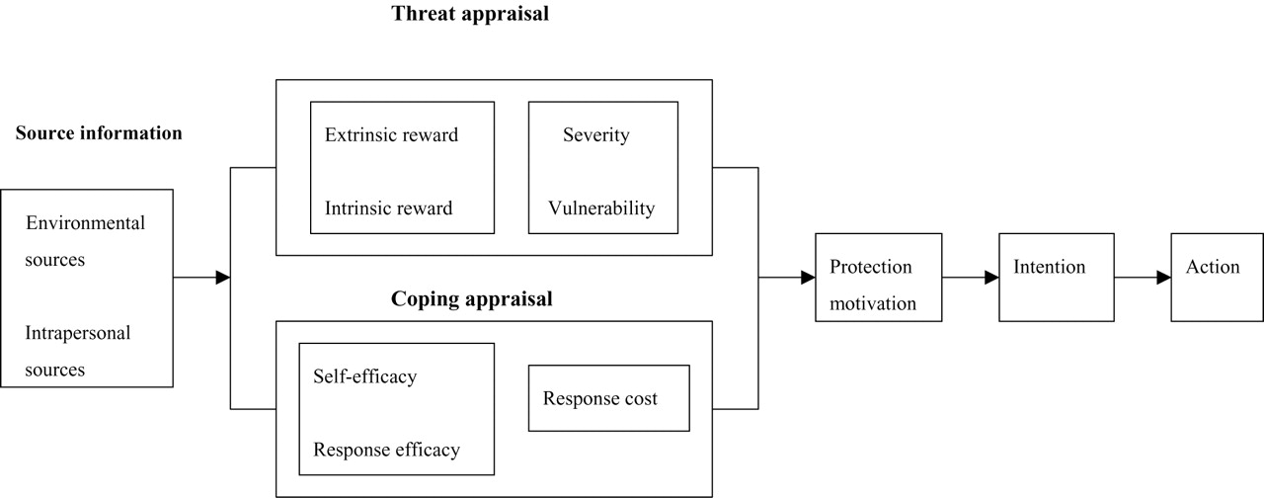
Protection motivation theory
Wu, Y. et al. J. Pediatr. Psychol. 2005 30:127-137; doi:10.1093/jpepsy/jsi001

Slide 37
Protection motivation theory
PMT explain :
Severity, vulnerability, fear → threat appraisal
Response effectiveness, self efficacy → coping appraisal

Slide 38
Resources of Information
Environment (eg, verbal persuasion, observation learning)
Intrapersonal: (eg important experience)

Slide 39
PROTECTION MOTIVATION THEORY
Application on Diet behaior
Severity
Colon cancer is serious illness
Vulnerability
Perception of possibility of get
Colon cancer is high"
intention to change into a healthy diet
Healthy diet
behavior
Response effectiveness
Belief that changing the diet will improve health
Self-efficacy
The belief that I can change
my the diet

Slide 40
Do other application of PMT on your own case!

Slide 41
References
Glanz, et all. Health Behavior & Health Education; Theory Research and Practice. Jossey-Bass Publishers. San Fransisco. Oxford. 1990
Ogden, Jane. Health Psychology. Open University Press. Buckingham-Philadelphia. 1996
Smet, Bart. Psikologi Kesehatan. Grasindo. Jakarta 1994

Slide 42
Thank You…

