Slide 1
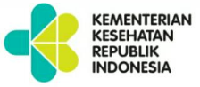
HEALTH PROMOTION STRATEGIES FOR HEALTH-RELATED SUSTAINABLE DEVELOPMENT GOALS
ANUNG SUGIHANTONO
Director General of Public Health
Ministry of Health RI
Seminar dan Temu Alumni Program Studi Magister Promosi Kesehatan
Fakultas Kesehatan Masyarakat Universitas Diponegoro
Semarang, 2 Desember 2016

Slide 2
OUTLINE
1. Transforming from MDGs to SDGs
2. Health in Indonesia
3. Health Promotion Strategies to achieve SDGs
4. Closing

Slide 3
TRANSFORMING FROM MDGs TO SDGs

Slide 4
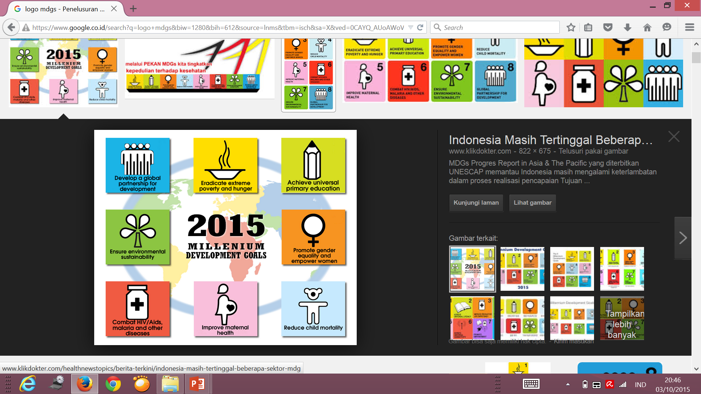
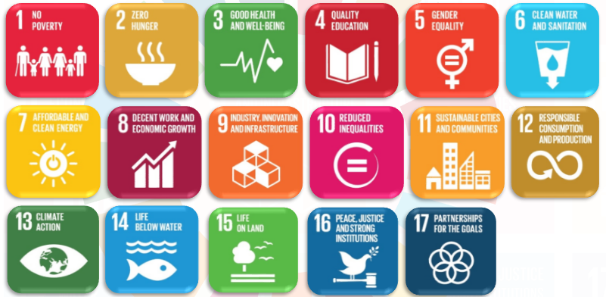
TRANSFORMATION FROM MDGs TO SDGs
SDGs | Goals | Targets | Indicators
TOTAL | 17 | 169 | 240
HEALTH | 5 | 20 | 34
MDGs | Goals | Targets | Indicators
TOTAL | 8 | 18 | 63
HEALTH | 5 | 9 | 32
ACCENTUATION OF SDGs:
5P : PEOPLE, PLANET, PEACE, PROSPERITY AND PARTNERSHIP
  POSITIF IMPACT OF MDGs ON HEALTH SECTORS:
  Increase the awareness of health issues
  Increase the allocation to health
  Mainstreaming of health development
  Integration of monitoring and evaluation for priority issues

Slide 5
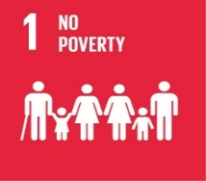
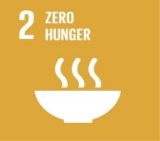



SDGs = UNFINISHED BUSINESS + NEW ISSUES
UNFINISHED BUSINESS:
1. Decreased the prevalence of underweight children under five years of age (malnutrition and undernourishment)
2. Decreased the infant mortality rate (AKB) and children under five years of age mortality rate (AKBa)
3. Decreased the maternal mortality rate (AKI)
NEW ISSUES:
1. Nutritional problems, Integration with improvement of food access and agricultural production
2. Universal Health Coverage
3. Death due to non-communicable disease and tobacco control
4. Decreased the prevalence of HIV and AIDS (%) from total population
5. Increased comprehensive knowledge about HIV and AIDS at the population aged 15-24 years
6. Discrepancy in the access to drinking water and adequate sanitation (in the context of PHBS)
4. Drugs abuse and alcohol
5. Death and injury due to traffic accidents
6. Contamination and pollution of water, air, and soil
7. Handling crisis and emergencies
8. Gender equality as a cross-cutting issue
9. Adolescent girls as an important actor of sexual and reproductive health

Slide 6

















WHAT ARE EXPECTED FROM SDGs?
POVERTY REDUCTION, EQUAL SUSTAINABLE DEVELOPMENT, LIVELIHOODS AND DECENT WORK
1
2
EQUAL ACCESS TO SERVICES AND SOCIAL SECURITY
3
ENVIRONMENTAL SUSTAINABILITY AND ENHANCING RESILIENCE TO DISASTERS
4
UPGRADE THE QUALITY OF GOVERNMENT AND EQUAL ACCESS TO JUSTICE FOR EVERYONE
Cross-cutting area:
Human Rights, Youth, Gender Equality, HIV/AIDS, Data Management and Statistics
(United Nations Partnership for Development 2016-2020)

Slide 7
SDGs IN HEALTH SECTOR

Slide 8
INDONESIA HEALTHY PROGRAM
SDGs
SDGs
STRATEGIC PLAN
2015-2019
Pillar 1.
Health Paradigm
Pillar 2.
Healthcare Strengthening
Pillar 3.
National Health Insurance
Program
  Health mainstreaming in the development
  Promotive – Preventive as the main pillar in health programmes
  Community Empowerment
Program
  Improving access, particularly at primary level
  Referral system optimization
  Quality improvement
Program
Benefits
Financing system: insurance–gotong royong principle
Quality Control & Cost Control
Objects: Support Recipient and Non Support Recipient
Health paradigm will change the mind set (mental revolution) so there will be mainstreaming in health in any decision making in Indonesia Development.
Implementation continuum of care approach
Policy Makers
Community
Interventions based health risk
Membership →KIS
Health Workers
Health Institutions
Notes:
Kita telah memiliki Renstra 2015-2019
Pilar pertama, Paradigma Sehat, telah selaras dengan Gerakan Hidup Sehat yang dikordinasikan oleh Bappenas

Slide 9


















THE POSITION OF HEALTH IN
SDGs’ FRAMEWORK
“ HEALTH as a contributor as well as a beneficiary of the development impact.”
(WHO, 2012)
Notes:
Hadirin sekalian,
Kesetaraan gender dan pemberdayaan perempuan merupakan aspek yang masuk ke dalam seluruh elemen pembangunan karena selama masih ada kesenjangan dan ketimpangan gender, pembangunan berkelanjutan seutuhnya tidak akan tercapai.

Slide 10




HEALTH AS AN INPUT FOR SUSTAINABLE DEVELOPMENT
INPUT
3.8. Achieving UNIVERSAL HEALTH COVERAGE, including financial risk protection, access to qualified basic health care and access to basic medicines and vaccines that are safe, effective, and qualified for everyone.
PROSES
8.5 By 2030, achieve the decent condition of work for productive and permanent workers for all women and men, including young people and people with disabilities, and equal pay for work of equal value.
OUTPUT
1.1. In 2030, poverty reduction in all people, everywhere, the current size is the people whose livelihoods are less than USD 1.25/day
1.2. By 2030, reduce at least half the number of men, women, and children of all ages living in poverty in all dimensions according to national definitions
OUTCOME
10.1 by 2030 progressively achieve and sustain income
growth of the bottom 40% of the population at a rate
higher than the national average
10.2 by 2030 empower and promote the social, economic
and political inclusion of all irrespective of age, sex,
disability, race, ethnicity, origin, religion or economic or
other status

Slide 11




HEALTH AS AN OUTCOME FOR SUSTAINABLE DEVELOPMENT
INPUT
9.1 Developing quality, reliable infrastructure, sustainable and resilient, including regional and cross-border infrastructure, to support economic development and human well-being, with a focus on access that is acceptable to everyone and equally for all
PROSES
6.1. Achieving universal and equitable access to safe drinking water
6.2 Achieving adequate and equitable access to sanitation and hygiene for all people and put an end to open defecation, giving special attention to the needs of girls and women as well as people who are in vulnerable situations
OUTPUT
2.2. In 2030, put an end to all forms of malnutrition, including achieving international targets in 2025 for the reduction in stunting and wasting among children under five and addressing the nutritional needs of adolescent girls, pregnant and lactating women, and the elderly.
OUTCOME
3.2. In 2030, put an end to preventable infant and child mortality, with all countries trying to reduce neonatal mortality by at least 12 per 1,000 live births and the Infant Mortality Rate 25 per 1,000 live births

Slide 12
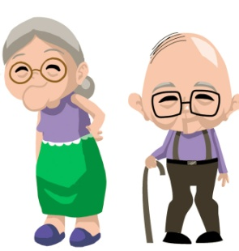


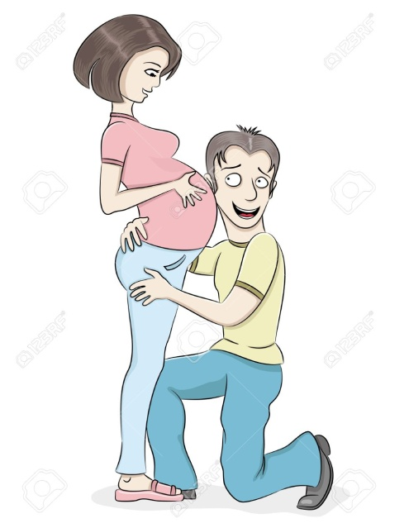


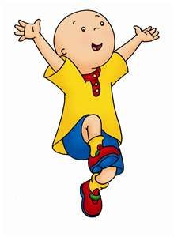

3.4. Promote mental health and wellbeing
3.5. Strengthen prevention and treatment of substance abuse, including narcotic drug abuse and harmful use of alcohol
OUTCOME
2.2. Meet the nutritional needs of adolescent girls
3.1. Reducing the maternal mortality rate (MMR) to below 70 per 100,000 live births
3.2. Reducing Neonatal Mortality Rate (AKN) at least up to 12 per 1000 live births and Infant Mortality Rate (CMR) 25 per 1,000 live births
3.4. Reduces overall premature mortality due to non-communicable diseases through prevention and treatment
3.6. Reduce by half the global number of deaths and injuries caused by traffic accidents.
3.9 In 2030, substantially reduce mortality and morbidity due to hazardous substances as well as contamination and pollution of air, water, and soil.
2.2. Meet the nutritional needs of elderly
3.7. dan 5.6:
Universal access to sexual and reproductive health services and reproductive rights, including family planning, information and education, and the integration of reproductive health into national programs and strategies.
INPUT
2.1. End hunger and ensure access to food that is safe, nutritious and sufficient for all people
3.8. Achieve UNIVERSAL HEALTH COVERAGE, including financial risk protection, access to qualified basic health care and access to basic medicines and vaccines that are safe, effective, and qualified for everyone.
3. b. Support research and development of vaccines and drugs of infectious diseases as well as non-communicable diseases, provide access to drugs and vaccines that are affordable, and, in particular, provide access to medicine for all.
3.c. Substantially improve health financing and the recruitment, development, training and retention of health workers
6.1. Achieve universal and equitable access to safe and affordable drinking water
6.2 Achieve adequate and equitable access to sanitation and hygiene for all people and put an end to open defecation
5.3. Eliminate all forms of harmful practices, such as child, early age and forced marriage as well as female circumcision.
PROCESS
2.2. Meet the nutritional needs of pregnant women
3.3. Combat hepatitis, water-related diseases and other infectious diseases.
LIFE CYCLE
3.3. Ending the AIDS epidemic, tuberculosis, malaria and neglected tropical diseases
2.2 . Decrease stunting and wasting among children under five
OUTPUT
1000 First days of life
2.2. Meet the nutritional needs of breastfeeding women

Slide 13
HEALTH RELATED GOALS
Goal 2. End hunger, achieve food security and improved nutrition and promote sustainable agriculture
Goal 5. Achieve gender equality and empower all women and girls
Goal 6. Ensure availability and sustainable management of water and sanitation for all
Goal 1. End poverty in all its forms everywhere
Goal 3. Ensure healthy lives and promote well-being for all at all ages

Slide 14
HEALTH IN INDONESIA

Slide 15
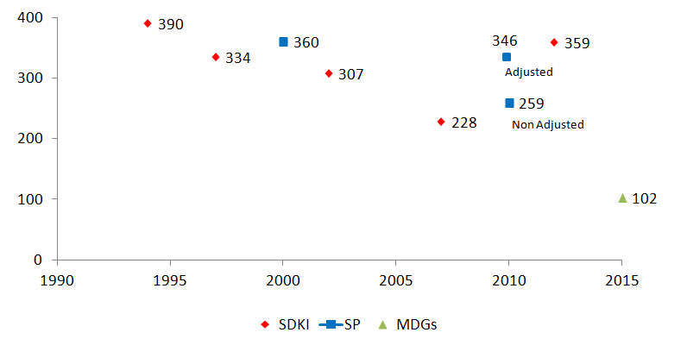
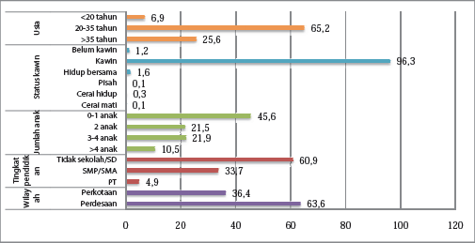
MATERNAL MORTALITY RATE
SUPAS 2015 = 305
(Kajian Lanjut hasil SP 2010)

Slide 16
UNDERWEIGHT CHILDREN UNDER FIVE
Severe underweight
(PSG 2015)
Underweight

Slide 17
STUNTING CHILDREN UNDER FIVE
Severe stunting
Stunting
(PSG 2015)

Slide 18
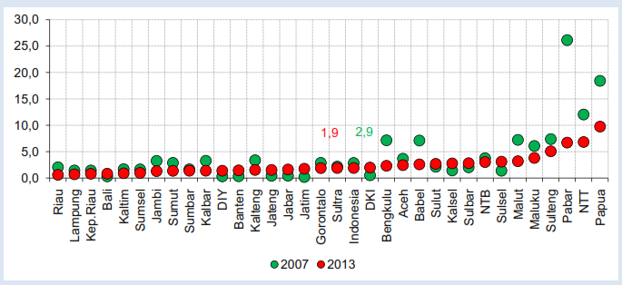
MALARIA INCIDENCE RATE^{*)} 2007-2013
*) malaria incidence ≤ 1 month
Sumber : Riskesdas

Slide 19
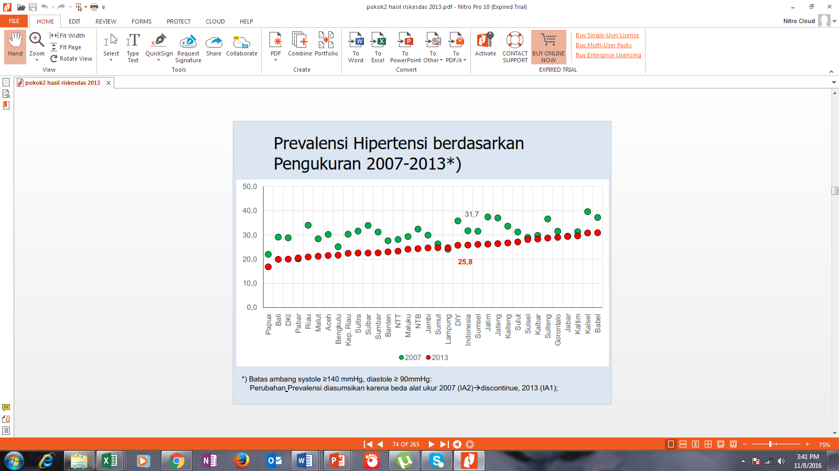
PREVALENCE OF HYPERTENSION 2007-2013
(Riskesdas, 2013)

Slide 20
EPIDEMIOLOGY TRANSITION
Mortality rate attributed to non-communicable diseases are increasing
This trend is likely to continue in line with changes in behavior/lifestyle (un-balanced diet and nutrition, lack in physical activity, smoking, etc)
The causal of burden of diseases, 1990-2015
1990
2000
2010
2015
Sumber : Double Burden of Diseases & WHO NCD Country Profiles (2014)
Note: Burden of diseases measurement with Disability-adjusted Life Years (DALYs) → loss of live in the year due to illness and premature death

Slide 21
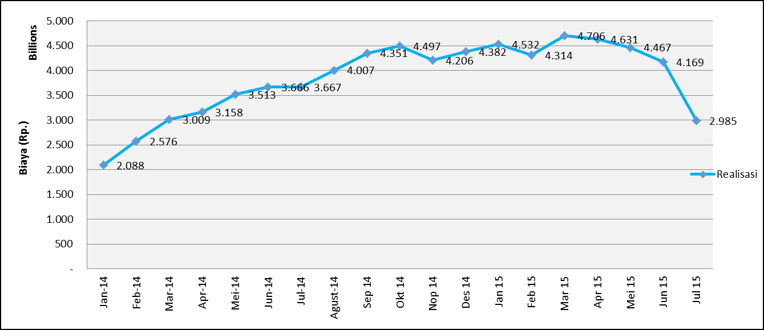

IMPACT: ECONOMIC BURDEN DUE TO NCDs
COST IN CATASTROPHIC DISEASE from Jan 2014 s/d Agustus 2015
Prevented by changes in behavior/lifestyle
Source: BPJS Kesehatan 2015
5 diseases with the highest cost are NCDs
Without significant intervention, the health expenditure in Indonesia is projected to continue to rise.
Total cost in 2014 is Rp 42,6 T
And in 2015 until Agustus is Rp 36,4 T

Slide 22
BEHAVIOR RISK FACTORS OF NCDs
(26,1%) population lack in physical activity**
(36,3%) population >15 years of age are smoking**
Women >10 years of age (1,9%)
(93,5%) Population >10 years of age are lack in fruits and vegetables consumption**
(4,6%) Population >10 years of age are drinking alcohol*
*Riskesdas 2007 & **Riskesdas 2013
Notes:
Beberapa faktor resiko perilaku penyebab terjadinya PTM yang harus diperbaiki.

Slide 23
POLICIES AND STRATEGIES TO ACHIEVE SDGs

Slide 24
PRINCIPLES OF SDGs IMPLEMENTATION
Integrated development in all human being aspect (people centered development)
Focus on 4 development pillars: social, economic, environment, and means of implementation
Multisectoral collaboration with all the development actors and all stakeholders
The same responsibility of every country, through the differentiated activities
Note the condition, capacity, and national priority
Strengthening the function of means of implementation
No one leave behind in achieving SDGs
Avoid the gap between community groups and region
Sharpen the accountability for reporting through strong institutional, qualified data management, followed by evidence-based innovation strategy
(Modified from the CBS at Workshop SDGs Bappenas, 2015 and document Transforming Our World, UN 2015)

Slide 25
MEANS OF IMPLEMENTATION
Keys to the successful implementation, to achieve SDGs.
Including:
  Partnership
  Finance
  Technology and science
  National capacity building (collaboration inter nations)
  Marketing systems
  Policies and institutional framework
  Availability, quality, and information systems
  Accountability
PARTNERSHIP
STRATEGY
DATA RESOURCES
IMPLEMENTATION

Slide 26
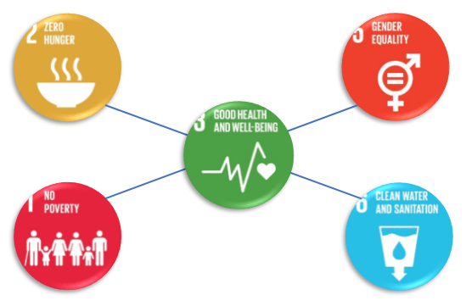
NATIONAL HEALTH SYSTEM
SUBSYSTEM OF COMMUNITY EMPOWERMENT
SUBSYSTEM OF HEALTH SERVICES
SUBSYSTEM OF HEALTH MANAGEMENT, INFORMATION, AND REGULATION
SUBSYSTEM OF RESEARCH AND HEALTH DEVELOPMENT
SUBSYSTEM OF PHARMACEUTICAL, HEALTH EQUIPMENT, AND FOOD SAFETY
SUBSYSTEM OF HEALTH FINANCE
SUBSYSTEM OF HEALTH WORKFORCE

Slide 27
MULTISECTOR ENGAGEMENT
CIVIL SOCIETY ORGANIZATIONS
Advocating for the improvement of initiation and strategic studies, reporting the implementation, and community empowerment
MASS MEDIA
Publication of information that support the sustainable health development
BUSINESS AND PRIVATE SECTORS
Product and program development (Sharing information about the resources, CSR)
HEALTH SECTORS
DEVELOPMENT
DEVELOPMENT PARTNERS
Strengthening the initiation, collaboration, monitoring, and evaluation
PARLIAMENTARY
Legislative function
PROFESSIONAL ORGANIZATIONS AND ACADEMICS
Think Tank
UN
Synergize the global and national agenda, facilitating the government for the health program
GOVERNMENT
Initiator, Fasilitator, and Motivator
Notes:
Pembangunan sektor kesehatan untuk SDGs, membutuhkan komitmen kuat dari berbagai pihak, baik dari pemerintah dan pemerintah daerah, lembaga sosial kemasyarakatan/CSOs, akademisi, organisasi profesi, media massa, dunia usaha dan mitra pembangunan. Unsur dari lembaga sosial kemasyarakatan/CSOs, diharapkan berkomitmen untuk melaksanakan advokasi untuk penyempurnaan inisiasi, kajian strategis dan pelaporan situasi pelaksanaan situasi pelaksanaan di lapangan/masyarakat, serta pemberdayaan masyarakat.

Slide 28

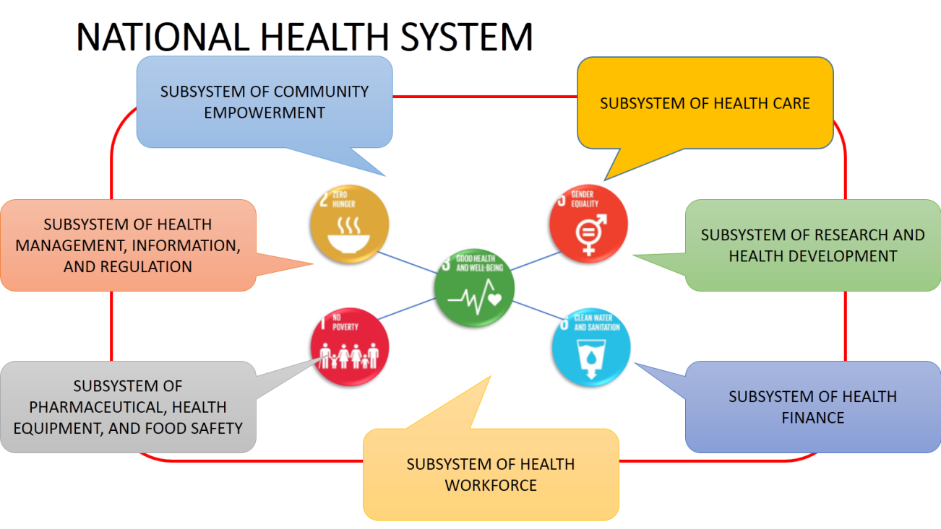
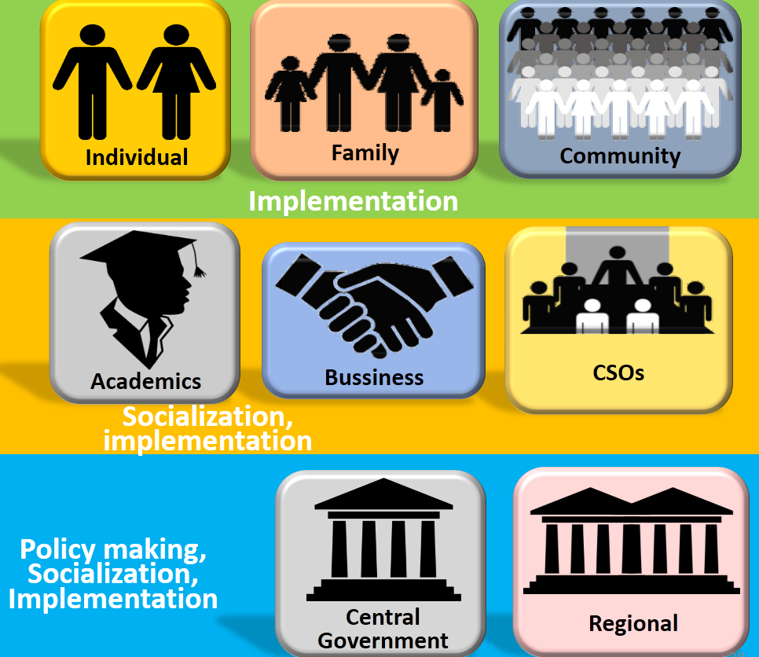
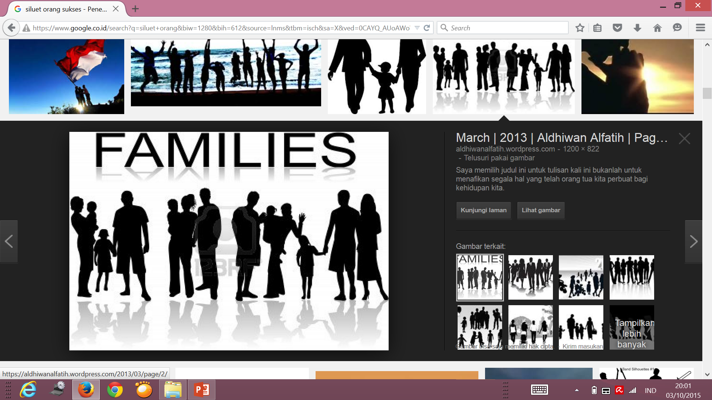
HEALTHY LIFE COMMUNITY MOVEMENT
FAMILY APPROACH-STRENGTHENING THE ROLE OF COMMUNITY HEALTH CENTER
Scope:
Physical activity
Balanced Nutrition intake
Improve healthy environment
Reduce tobacco and alcohol consumption
Stress management
Clean and Healthy Life Behaviour (PHBS)
Periodic medical check-up
Intervention in 1000 first days of life
Puskesmas as a primary health care
UKM and UKP
Achieving Healthy Family indicators:
1. Family planning
2. Delivery in health facilities
3. Exclusive breastfeeding
4. Immunization
5. Monitoring child growth
6. Treatment for TB
7. Routine check-up for hypentension
8. Treatment for mental disorders
9. No smoking
10. Clean water supply
11. Household toilets
12. Member of JKN
MULTI STAKE-HOLDERS
HEALTHY FAMILY

Slide 29
HEALTH PROMOTION STRATEGIES FOR HEALTH-RELATED SDGs

Slide 30
RATIONALE HEALTH IN ALL GOALS
Individual’s health and well-being are determined by social, environment and economic policies beyond control of the health sector.
Universal health care is a good entry point to reach population’s health needs, and embrace the whole spectrum of promotion and prevention.
Addressing health through all the SDGs will create healthier living conditions.
“Health in all Goals” approach could indirectly channel financial contributions of sectors other than health by influencing other policies to take into account the health concerns.
Promotion of collaboration between different sectors across the SDGs is key to maximizing health benefits and reduce health inequity. This offers win-wins situation.

Slide 31

HEALTH IN ALL GOALS
RELEVANT OF HEALTH IN OTHER SDGS
SDG1: prioritizing health needs of the poor
SDG2: addressing the causes and consequences of all forms of malnutrition
SDG4: supporting higher quality education for all to improve health and health equity.
SDG5: fighting gender inequities, including violence against women
SDG6: preventing disease through water and sanitation for all
SDG7 promoting sustainable energy for healthy homes and lives
SDG8 promoting health employment as a driver of inclusive economic growth
SDG9 promoting national R&D capacity and manufacturing of affordable essential medical products
SDG 10: ensuring equitable access to health services through universal health coverage based on stronger primary care
SDG11: fostering healthier cities through urban planning for cleaner air and safer and more active living
SDG12: promoting responsible consumption of medicine to combat antibiotic resistance
SDG13: protecting health from climate risks and through low carbon development
SDG14: supporting the restoration of fish stocks to improve safe and diversified healthy diets
SDG15: promoting health and preventing diseases through healthy natural environment
SDG 16: empowering strong local institutions to develop, implement, monitor and account for ambitious national SDG responses
SDG 17: mobilizing partners to monitor and attain the health related SDGs
HEALTH PROMOTION

Slide 32

INTEGRATION HEALTH PROMOTION INTO PROGRAMS TO ACHIEVE SDGs
Health promotion in the crisis and disaster management
Health promotion in the family health
Health promotion in the environment health
Health promotion in the hospital
Health promotion in the sport and work environment
Health promotion in the community health center
Health promotion in the improvement of nutrition
Health promotion in the membership of health insurance
Health promotion in the prevention of communicable diseases
Health promotion in the prevention of non-communicable diseases
Health promotion in the prevention of vector borne and zoonotic diseases
Health promotion in the mental health

Slide 33
HEALTH PROMOTION
Not only counseling
It covers :
a
Mainstreaming health promotion in all programs/policies (HiAP)
b
Increasing the capacity of health promotion workers
c
Creating the best environment that possible for healthy behavior in the health sectors
Ottawa Charter
2. Supportive Environment
3. Reorient Health Service
4. Personnel Skill
5. Community Action
1. Health Public Policy
d
Improving health information systems
e
Improving strategic partnerships, involving community and social mobilization
f
Increasing capacity of multidiscipline expertise to give input to the program

Slide 34
HEALTH PROMOTION STRATEGY AND SUPPORT
Healthy city/healthy community
Enhancing the role of leaders and local government
Health literacy
Health literacy for NCDs (warnings on cigarette packs)
Awareness of sexual and reproductive health
Cross-sectoral action through HiAP
Tobacco control
Prevention NCDs
Healthy cities and healthy communities which are smoke-free
The involvement of community in real action
The role of health workers in communication
Cross-sector financing for social protection
Social protection and mobilization
The synergy between health promotion and gender equality
The synergy between health promotion and climate change
Healthy city is a forum for cross-sectoral strategic coordination
Promoting healthy lifestyle
Raising cross-sectoral awareness about the importance of health impacts in policy making
Safety riding
Enhancing the role of communities and cross-sectoral to improve the community health and well-being

Slide 35
HEALTH PROMOTION (Ministerial Decree 74, 2015)
HEALTH PROMOTION STRATEGY
(Ministerial Decree 74, 2015)
Health promotion is a process to empower community through domain activity of informing, influencing and helping community to play an active role to support behavior changes and the environment as well as maintaining and improving the health towards optimal health status.
Advokasi (advocacy): health policies
Gerakan Pemberdayaan Masyarakat (empowerment) : capacity building in community
Kemitraan (partnership) : cooperation with the basic principles of equality, transparency, and mutual benefit

Slide 36
HEALTH PROMOTION
AT EACH LEVEL OF HEALTH SERVICES
HEALTH PROMOTION IN PROMOTIVE LEVEL Target → groups of healthy people Objective → being able to improve their health.
2. HEALTH PROMOTION IN PREVENTIVE LEVEL Target → groups of high risk, such as pregnant women, lactation women, smokers, obesity, etc. Objective → preventing these groups from getting ill or sick (primary prevention).
3. HEALTH PROMOTION IN CURATIVE LEVEL Target → people with diseases (patients), especially chronic diseases such as asthma, diabetes mellitus, tuberculosis, etc. Objective → being able to prevent the disease from getting worse (secondary prevention), the importance of PKRS (health promotion in the hospital)
4. HEALTH PROMOTION IN REHABILITATIVE LEVEL Target → groups of patients who are recovering from an illness Objective → recovering their health and limitation of disability In other words, health promotion at this stage is the recovery and limitation of disability due to the disease (tertiary prevention), the importance of PKRS

Slide 37
CLOSING

Slide 38
10 THINGS THAT ARE NEEDED TO BE STRENGTHENED IN THE ERA OF SDGs
(Bappenas, 2015)
1. Gap reduction in achieving health target among provinces and districts / cities and between socio-economic level
2. Mobilization of resources for health sector from the business community, public, including cooperation with development partners
3. Health sector data indicator availability which is integrated in the planning and budgeting system of short-term and medium-term
4. Database indicators of health sector in city and district level
5. Communication strategy strengthening and advocacy of health sector to all stakeholders
6. Understanding of operational definitions for each indicator in national or provinces level
7. Facilitation from national level to provinces especially cities and districts
8. Cross sectoral and cross programs cooperation in health sectors
9. Monitoring and evaluating health target achievement
10. Programs support and activities to achieve health target.

Slide 39
INFORMATION, EDUCATION, COMMUNICATION
INSTITUTION
2
Behavior Change through
Behavior Change Communication
HEALTH PROMOTION
Health Service Reorientation through Capacity Building
BUILD HEALTHY PUBLIC POLICY
REORIENT HEALTH SERVICES
1
INDIVIDUALS
DEVELOP PERSONAL SKILLS
COMMUNITY
3
CREATE SUPPORTIVE ENVIROMENTS
STRENGTHEN COMMUNITY ACTIONS
Empowered Community through Community Development
World Health Organization. The Ottawa Charter for Health Promotion. 1986.

Slide 40
LESSON LEARN HEALTH PROMOTION IN THE SDGs
The differences of intervention and activity (setting based and population based)
Health promotion in national policy
Multi-sectoral roles in the central and local government
Collaboration with the business and private sectors, changing CSR into Public Private Partnership
The role of academia in research and studies as means for advocacy on cross-sectoral and stakeholders
Determine the success indicators and how to monitoring continuously

Slide 41
CONCLUSION
The success of SDGs achievement is influenced by the national politics policy and synergize with the provinces and districts level;
Implementation of SDGs requires strong capacities (technical, financial, human resources);
Good quality and regularly updated data is a pre-requisite for SDGs accurate planning and implementation;
An accountable operational framework including monitoring and evaluation systems are needed in implementing SDGs;
Strong partnership frameworks: SDGs are indivisible thus can not be implemented separately
Health promotion strategies (advocacy, empowerment, and partnership) leads the way to achieve SDGs and its integration with other programs makes more comprehensive and inclusive strategies

Slide 42
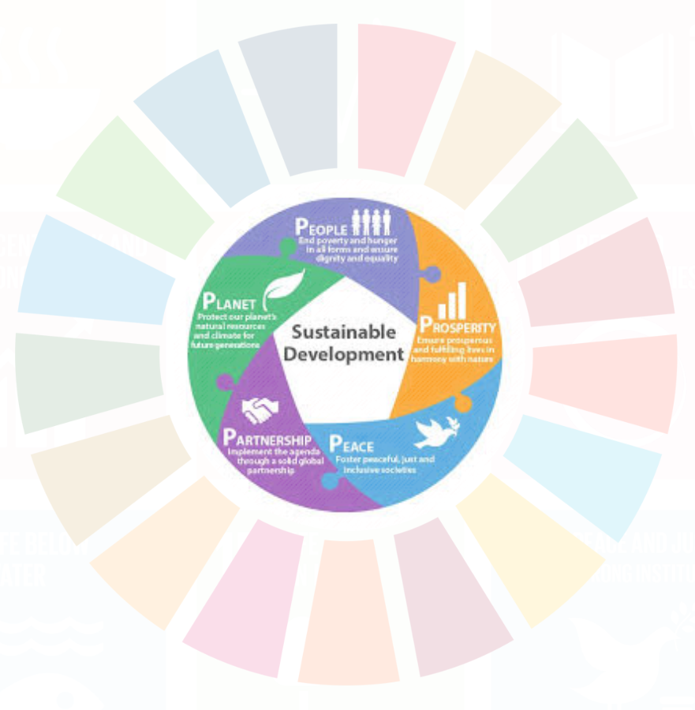

















THANK YOU
SDGs SECRETARIAT OF MOH
E-mail:
sekretariatpasca2015.kesehatan@gmail.com / post2015sdgs@kemkes.go.id

Slide 43
APPENDIX

Slide 44
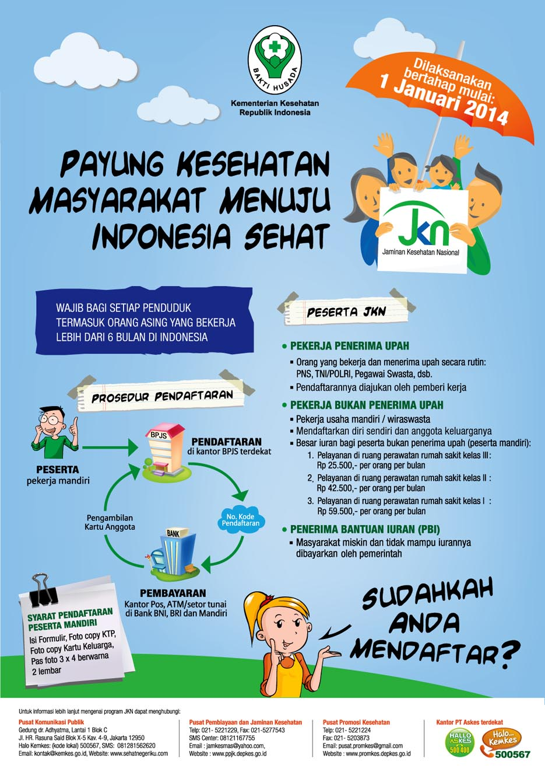

End poverty in all its forms everywhere

Slide 45
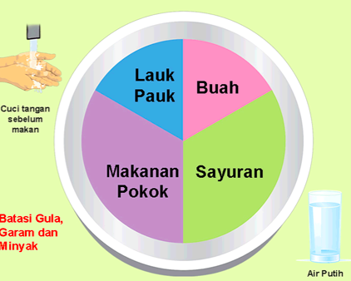




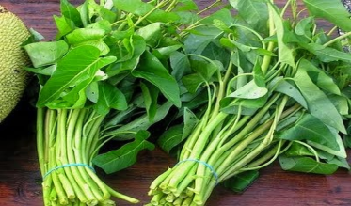


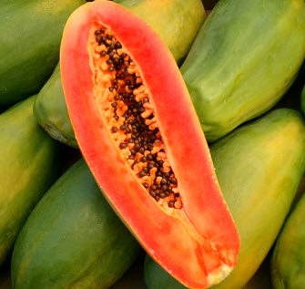
FRUITS AND VEGETABLES CONSUMPTION
End hunger, achieve food security and improved nutrition and promote sustainable agriculture

Slide 46

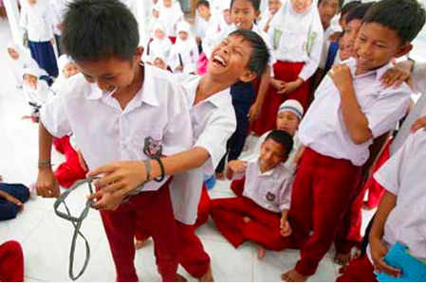



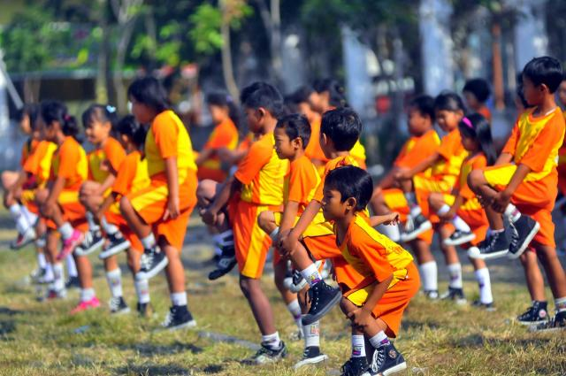


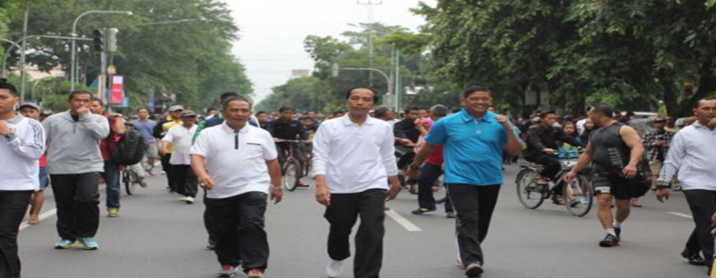
Ensure healthy lives and promote well-being for all at all ages
Limit sedentary activities
At school
At work places
Physical training
At home
On the way
At public places
Physical activity

Slide 47
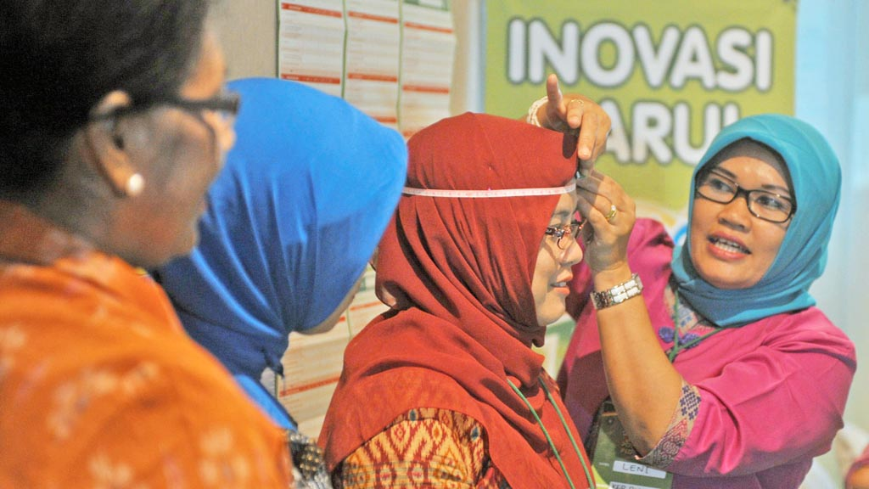
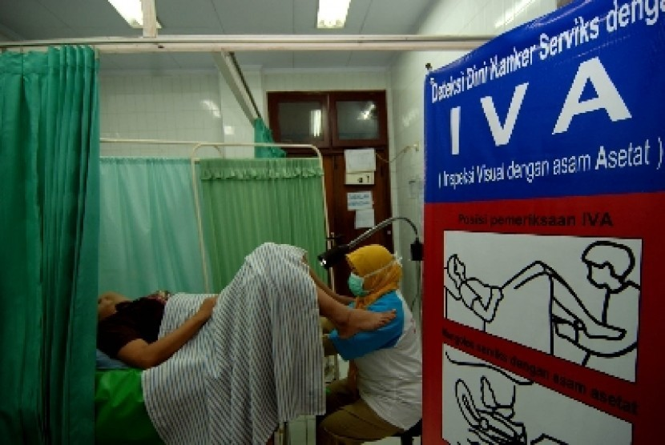
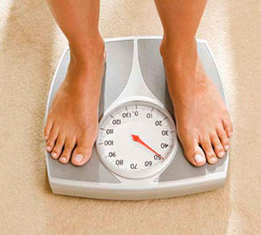
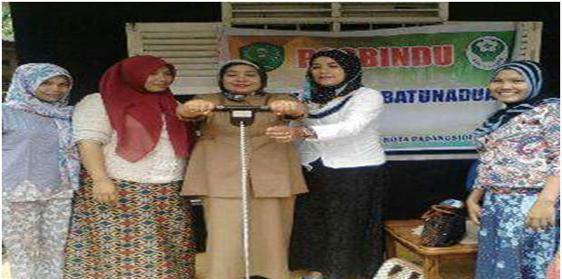
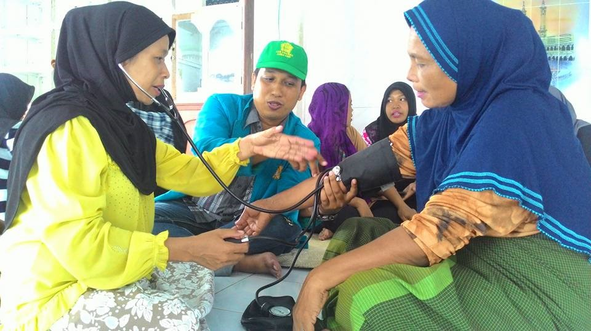
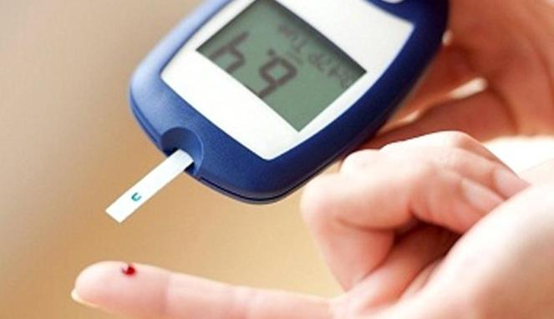
Ensure healthy lives and promote well-being for all at all ages
PERIODICALLY MEDICAL CHECK-UP

Slide 48



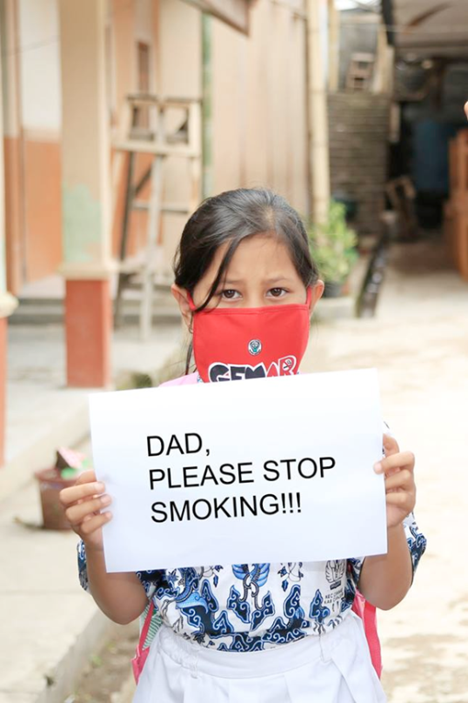
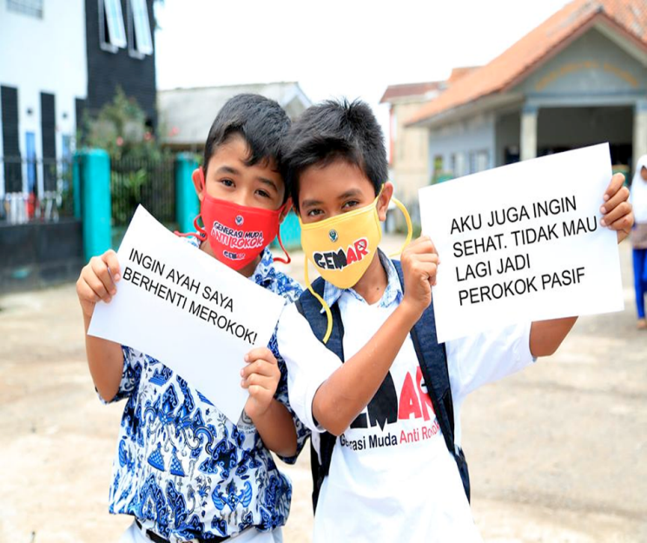
Ensure healthy lives and promote well-being for all at all ages

Slide 49



Ensure healthy lives and promote well-being for all at all ages

Slide 50


Achieve gender equality and empower all women and girls

Slide 51
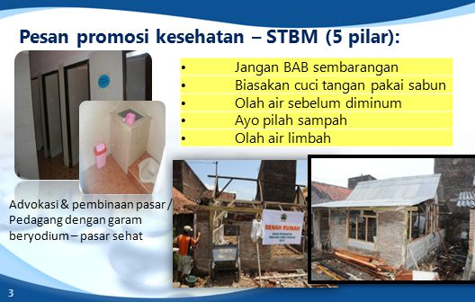

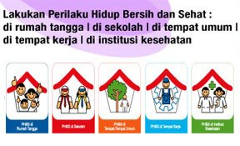
Ensure availability and sustainable management of water and sanitation for all

Slide 52
No | GOALs (Versi ENGLISH) | TUJUAN (Versi BAHASA INDONESIA) | GOALs in SHORT Version (Global ENG Version) | TUJUAN dalam Kalimat Pendek (Versi Bahasa Indonesia)
1 | Goal 1. End poverty in all its forms everywhere | Tujuan 1. Mengakhiri segala bentuk kemiskinan di mana pun. | Goal 1. No Poverty | Tujuan 1. Tanpa Kemiskinan
2 | Goal 2. End hunger, achieve food security and improved nutrition and promote sustainable agriculture | Tujuan 2. Menghilangkan kelaparan, mencapai ketahanan pangan dan gizi yang baik, serta meningkatkan pertanian berkelanjutan. | Goal 2. Zero Hunger | Tujuan 2. Tanpa Kelaparan
3 | Goal 3. Ensure healthy lives and promote well-being for all at all ages | Tujuan 3. Menjamin kehidupan yang sehat dan meningkatkan kesejahteraan seluruh penduduk semua usia. | Goal 3. Good health and well-being | Tujuan 3. Kehidupan Sehat dan Sejahtera
4 | Goal 4. Ensure inclusive and equitable quality education and promote lifelong learning opportunities for all | Tujuan 4. Menjamin kualitas pendidikan yang inklusif dan merata serta meningkatkan kesempatan belajar sepanjang hayat untuk semua. | Goal 4. Quality Education | Tujuan 4. Pendidikan Berkualitas
5 | Goal 5. Achieve gender equality and empower all women and girls | Tujuan 5. Mencapai kesetaraan gender dan memberdayakan kaum perempuan. | Goal 5. Gender Equality | Tujuan 5. Kesetaraan Gender
6 | Goal 6. Ensure availability and sustainable management of water and sanitation for all | Tujuan 6. Menjamin ketersediaan serta pengelolaan air bersih dan sanitasi yang berkelanjutan untuk semua. | Goal 6. Clean water and sanitation | Tujuan 6. Air Bersih dan Sanitasi Layak
7 | Goal 7. Ensure access to affordable, reliable, sustainable and modern energy for all | Tujuan 7. Menjamin akses energi yang terjangkau, andal, berkelanjutan, dan modern untuk semua. | Goal 7. Affordable and clean energy | Tujuan 7. Energi Bersih dan Terjangkau

Slide 53
No | GOALs (Versi ENGLISH) | TUJUAN (Versi BAHASA INDONESIA) | GOALs in SHORT Version (Global ENG Version) | TUJUAN dalam Kalimat Pendek (Versi Bahasa Indonesia)
8 | Goal 8. Promote sustained, inclusive and sustainable economic growth, full and productive employment and decent work for all | Tujuan 8. Meningkatkan pertumbuhan ekonomi yang inklusif dan berkelanjutan, kesempatan kerja yang produktif dan menyeluruh, serta pekerjaan yang layak untuk semua. | Goal 8. Decent work and economic growth | Tujuan 8. Pekerjaan Layak dan Pertumbuhan Ekonomi
9 | Goal 9. Build resilient infrastructure, promote inclusive and sustainable industrialization and foster innovation | Tujuan 9. Membangun infrastruktur yang tangguh, meningkatkan industri inklusif dan berkelanjutan, serta mendorong inovasi. | Goal 9. Industry, Innovation and Infrastructure | Tujuan 9. Industri, Inovasi, dan Infrastruktur
10 | Goal 10. Reduce inequality within and among countries | Tujuan 10. Mengurangi kesenjangan intra- dan antarnegara. | Goal 10. Reduced Inequalities | Tujuan 10. Berkurangnya Kesenjangan
11 | Goal 11. Make cities and human settlements inclusive, safe, resilient and sustainable | Tujuan 11. Menjadikan kota dan permukiman inklusif, aman, tangguh, dan berkelanjutan. | Goal 11. Sustainable Cities and Communities | Tujuan 11. Kota dan Permukiman yang Berkelanjutan
12 | Goal 12. Ensure sustainable consumption and production patterns | Tujuan 12: Menjamin pola produksi dan konsumsi yang berkelanjutan. | Goal 12. Responsible consumption and production | Tujuan 12. Konsumsi dan Produksi yang Bertanggung Jawab
13 | Goal 13. Take urgent action to combat climate change and its impacts | Tujuan 13: Mengambil tindakan cepat untuk mengatasi perubahan iklim dan dampaknya. | Goal 13. Climate action | Tujuan 13. Penanganan Perubahan Iklim

Slide 54
No | GOALs (Versi ENGLISH) | TUJUAN (Versi BAHASA INDONESIA) | GOALs in SHORT Version (Global ENG Version) | TUJUAN dalam Kalimat Pendek (Versi Bahasa Indonesia)
14 | Goal 14. Conserve and sustainably use the oceans, seas and marine resources for sustainable development | Tujuan 14. Melestarikan dan memanfaatkan secara berkelanjutan sumber daya kelautan dan samudera untuk pembangunan berkelanjutan. | Goal 14. Life below water | Tujuan 14. Ekosistem Lautan
15 | Goal 15. Protect, restore and promote sustainable use of terrestrial ecosystems, sustainably manage forests, combat desertification, and halt and reverse land degradation and halt biodiversity loss | Tujuan 15. Melindungi, merestorasi, dan meningkatkan pemanfaatan berkelanjutan ekosistem daratan, mengelola hutan secara lestari, menghentikan penggurunan, memulihkan degradasi lahan, serta menghentikan kehilangan keanekaragaman hayati. | Goal 15. Life on Land | Tujuan 15. Ekosistem Daratan
16 | Goal 16. Promote peaceful and inclusive societies for sustainable development, provide access to justice for all and build effective, accountable and inclusive institutions at all levels | Tujuan 16. Menguatkan masyarakat yang inklusif dan damai untuk pembangunan berkelanjutan, menyediakan akses keadilan untuk semua, dan membangun kelembagaan yang efektif, akuntabel, dan inklusif di semua tingkatan. | Goal 16. Peace, Justice and Strong Institutions | Tujuan 16. Perdamaian, Keadilan, dan Kelembagaan yang Tangguh
17 | Goal 17. Strengthen the means of implementation and revitalize the Global Partnership for Sustainable Development | Tujuan 17. Menguatkan sarana pelaksanaan dan merevitalisasi kemitraan global untuk pembangunan berkelanjutan. | Goal 17. Partnerships for the goals | Tujuan 17. Kemitraan untuk Mencapai Tujuan

Slide 55
DASAR PEMIKIRAN
Individual’s health and well-being are determined by social, environment and economic policies beyond control of the health sector. (Kesehatan dan kesejahteraan seseorang dipengaruhi oleh kebijakan sosial, lingkungan dan ekonomi yang dikendalikan oleh sektor kesehatan)
Universal health care is a good entry point to reach population’s health needs, and embrace the whole spectrum of promotion and prevention.(Pelayanan kesehatan universal merupakan pintu masuk yang baik dalam mencapai kebutuhan kesehatan masyarakat dan merangkul seluruh spektrum dari promosi dan pencegahan)
Addressing health through all the SDGs will create healthier living conditions.(Menempatkan kesehatan ke seluruh Tujuan Pembangunan Berkelanjutan akan menciptakan kondisi kehidupan yang lebih sehat)
“Health in all Goals” approach could indirectly channel financial contributions of sectors other than health by influencing other policies to take into account the health concerns.(Pendekatan “Kesehatan di semua SDGs” dapat secara langsung memberikan kontribusi finansial dari sector di luar kesehatan dengan mempengaruhi kebijakan lain untuk memperhatikan masalah kesehatan)
Promotion of collaboration between different sectors across the SDGs is key to maximizing health benefits and reduce health inequity. This offers win-wins situation.(Promosi kolaborasi antar sector yang berbeda dalam SDGs menjadi kunci untuk memaksimalkan manfaat kesehatan dan mengurangi kesenjangan dalam bidang kesehatan. Hal tersebut menawarkan sebuah kondisi yang saling menguntungkan)

Slide 56
PENGERTIAN PROMOSI KESEHATAN
HEALTH EDUCATION : any combination of learning experiences designed to facilitate voluntary actions conductive health.(Griffiths, 1972)
HEALTH PROMOTION : any combination of health education and related organizational, political and economic interventions designed to facilitate behavioral and environmental adaptation that will improve or protect health (Green and Kreuter, 1991).
Definisi Promosi Kesehatan berdasarkan Permenkes 74 tentang upaya peningkatan kesehatan dan pencegahan penyakit tahun 2015 Promosi Kesehatan adalah proses untuk memberdayakan masyarakat melalui kegiatan menginformasikan, mempengaruhi dan membantu masyarakat agar berperan aktif untuk mendukung perubahan perilaku dan lingkungan serta menjaga dan meningkatkan kesehatan menuju derajat kesehatan yang optimal.

