Slide 1
BISNIS START UP DI INDONESIA

Slide 2
WHAT WE NEED?
IDE
INOVASI
KERJA KERAS
NEVER GIVE UP

Slide 3
APA SIH START UP BISNIS ITU??
https://www.youtube.com/watch?v=SjdeoUK37MA
https://www.youtube.com/watch?v=_7ZksYkCLjA

Slide 4
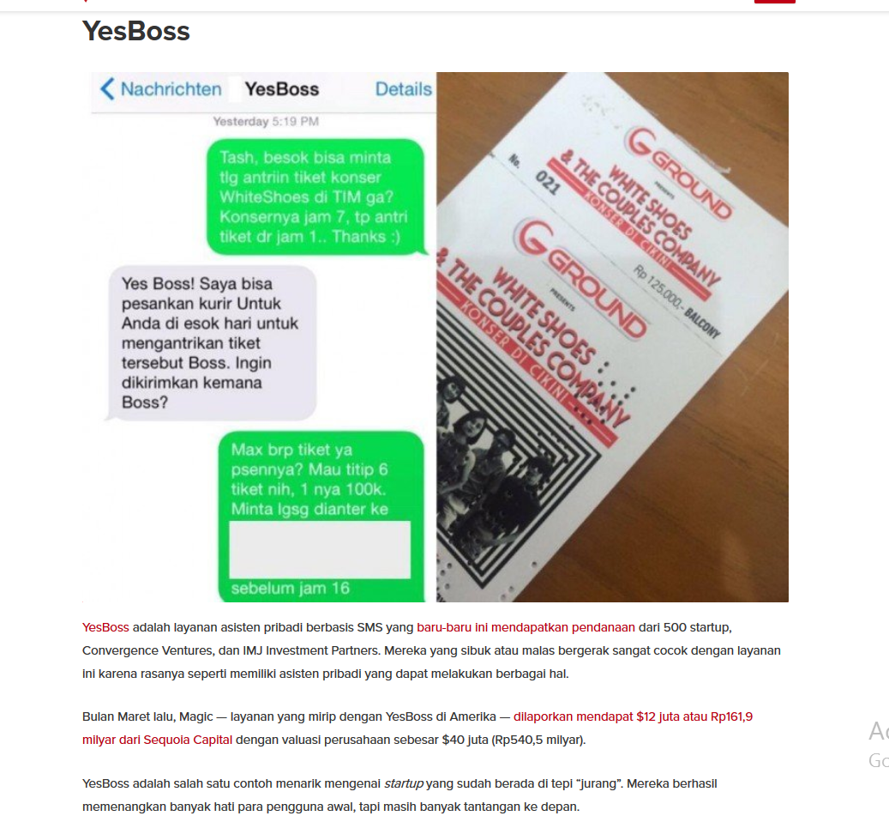
1. YES BOSS

Slide 5
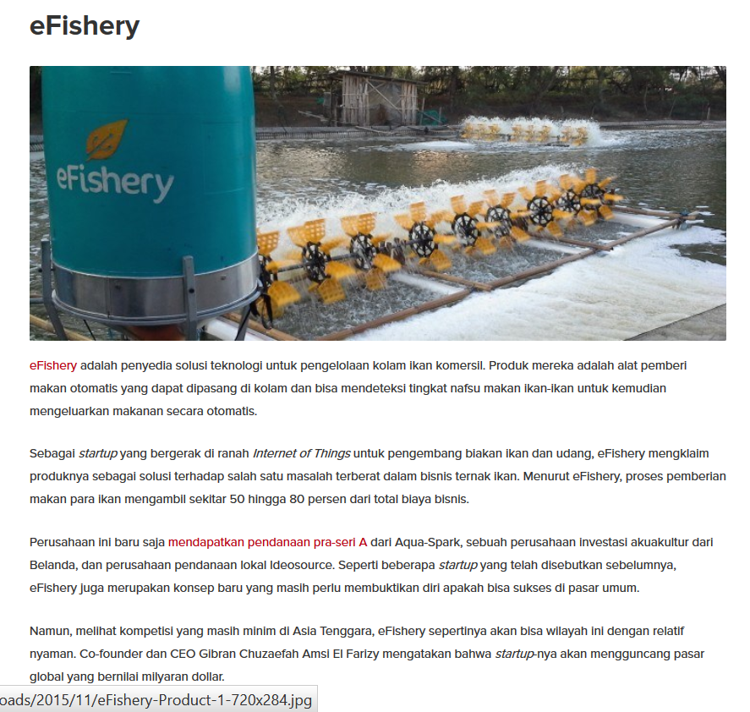
2. E FISHERY

Slide 6
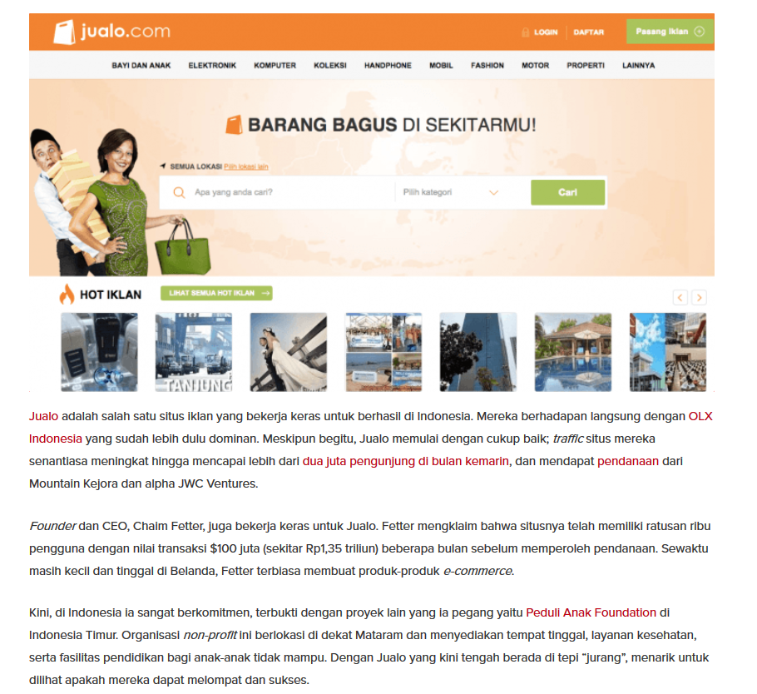
3. JUALO

Slide 7
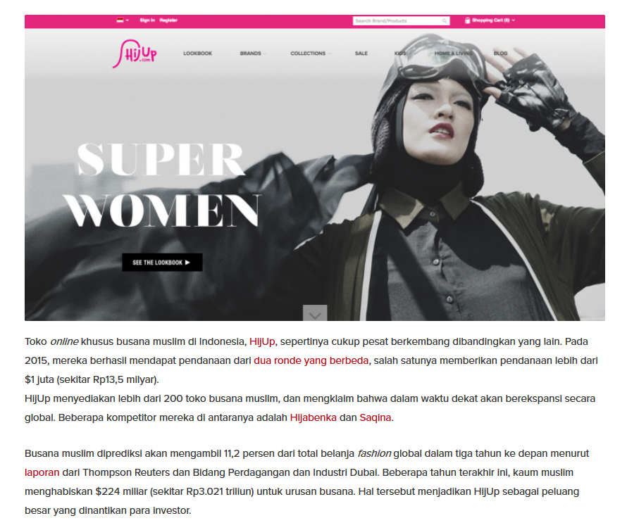
4. HIJUP

Slide 8
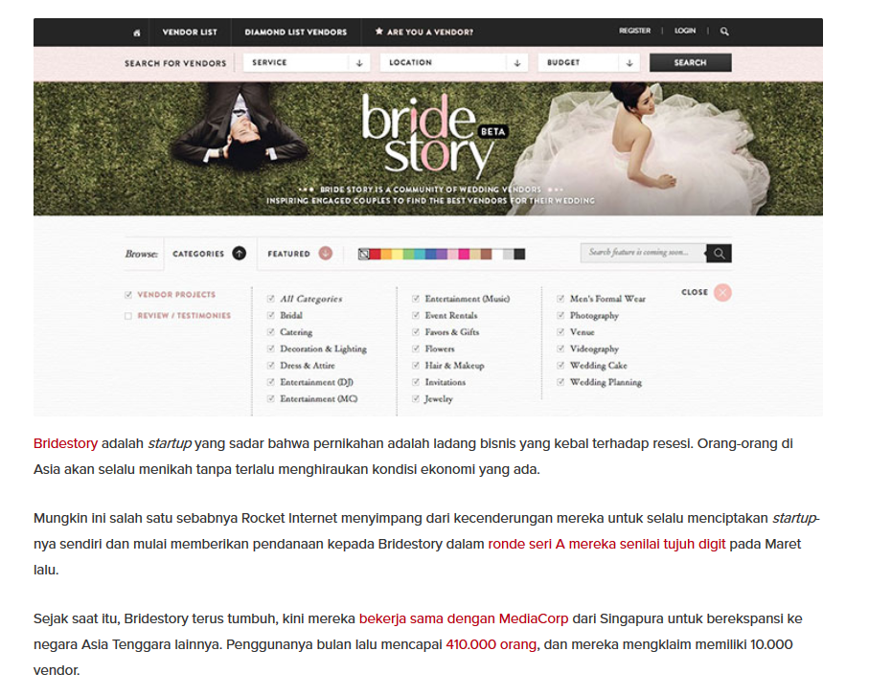
5. BRIDGE STORY

Slide 9
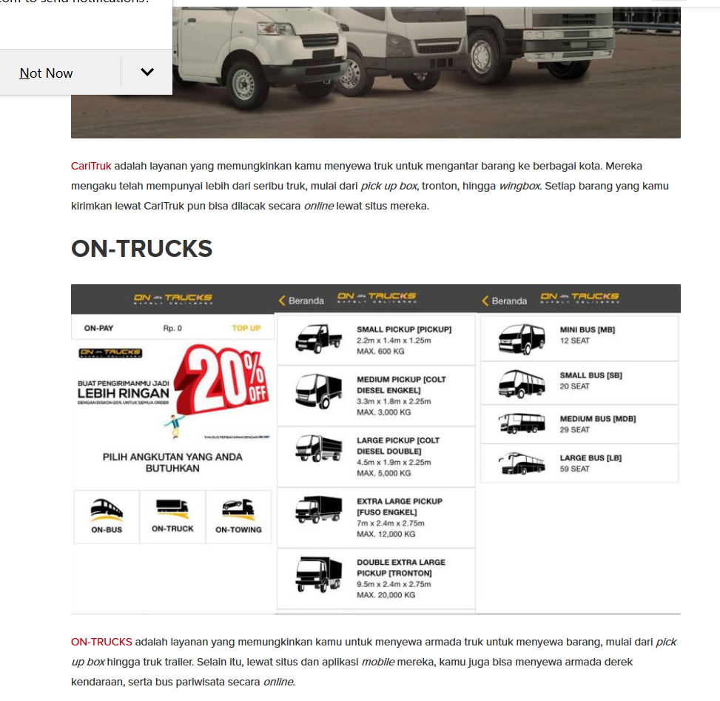
6. ON TRUCKS

Slide 10
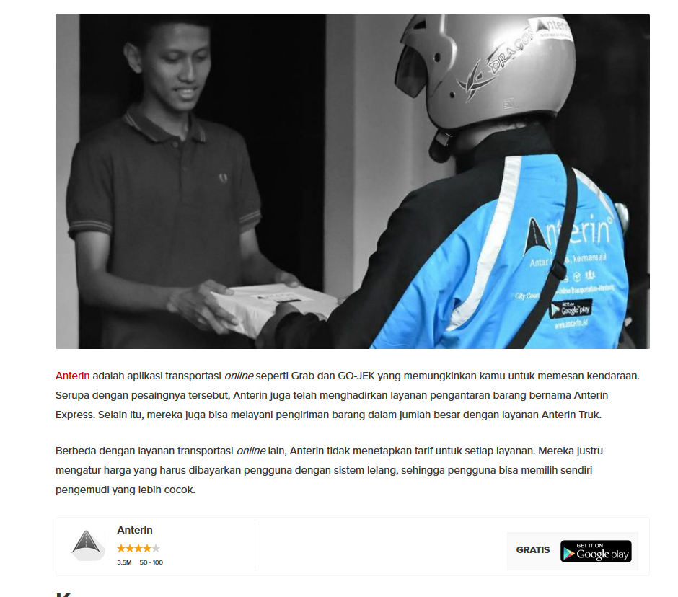
7. ANTER IN

Slide 11
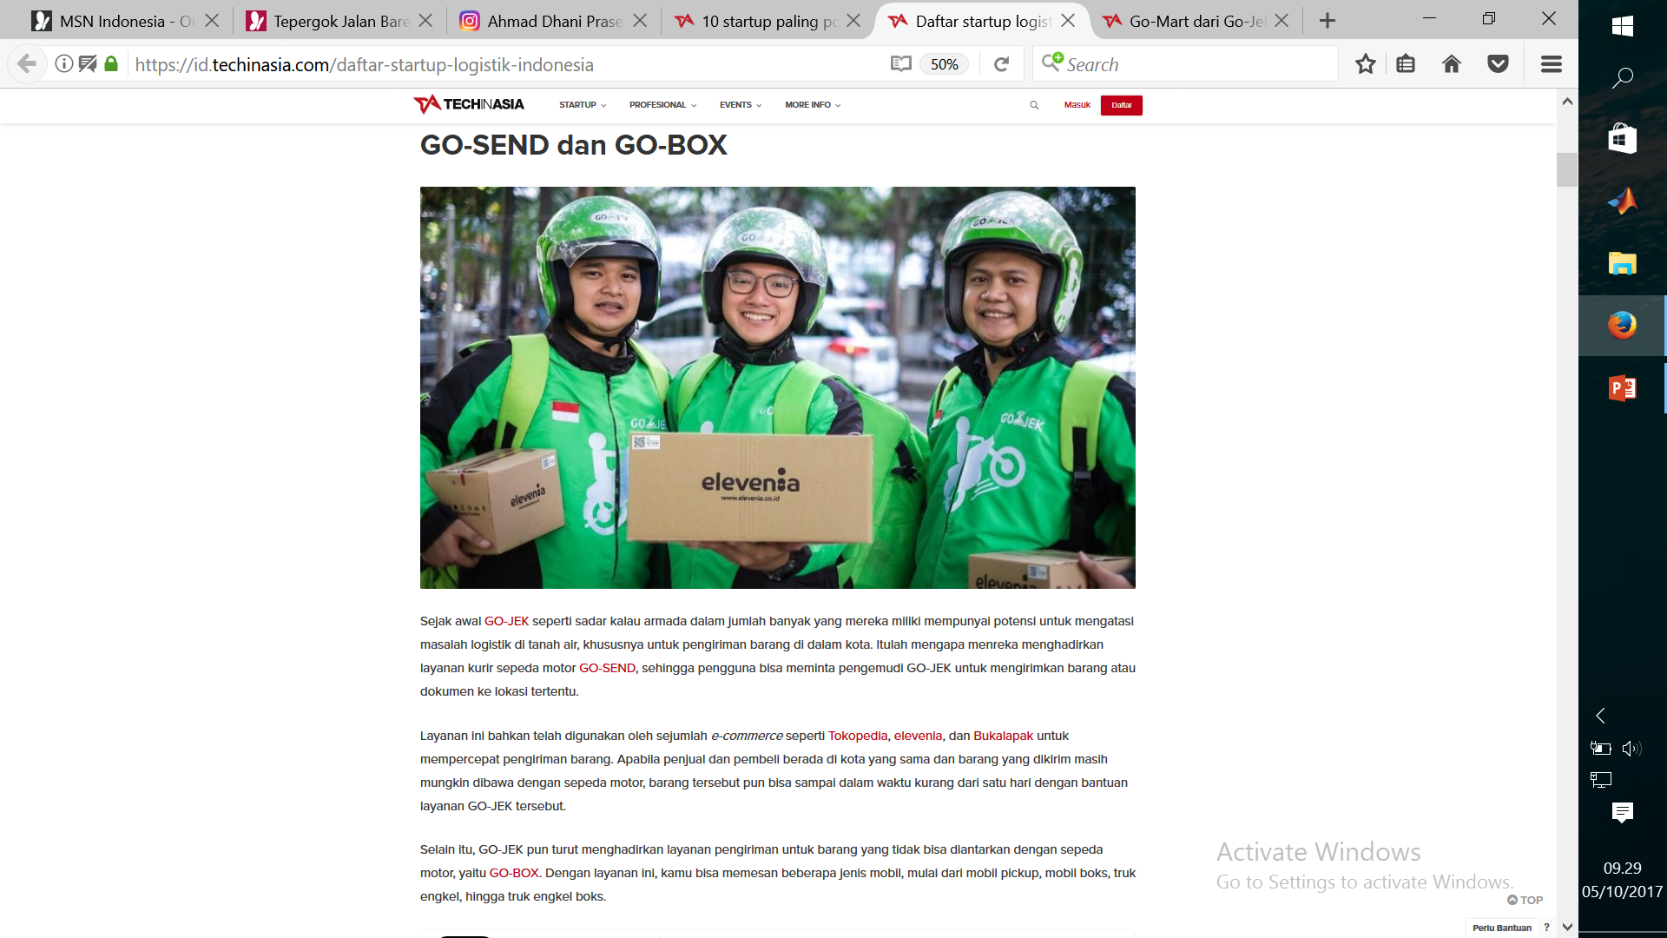
8. GO BOX – GO SEND

