Slide 1
E-Procurement
Presented by Ika Novita Dewi, MCS

Slide 2
E-Procurement
Electronic Procurement (e-procurement) : The electronic integration and management of all procurement activities including purchase request, authorization, ordering, delivery and payment between a purchaser and a supplier
E-procurement should be directed at improving performance for each of the ‘five rights of purchasing’, which are sourcing items:
at the right price
delivered at the right time
of the right quality
of the right quantity
from the right source

Slide 3
E-Procurement System
Electronic Procurement system (EPS) : An electronic system used to automate all or part of the procurement function by enabling the scanning, storage and retrieval of invoices and other documents; management of approvals; routing of authorization requests; interfaces to other finance systems; and matching of documents to validate transactions

Slide 4
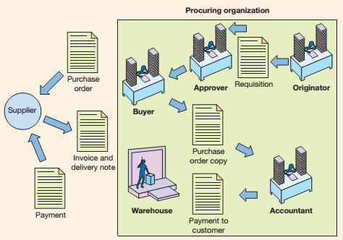
Key procurement activities within an organization

Slide 5
Types of procurement
Production-related procurement
Procurement relate to manufacturing of products
Operating or nonproduction-related procurement
Supports the operations of the whole business and includes office supplies, furniture, information systems, MRO (maintenance, repair, operation) goods and a range of services from catering, buying travel, and professional services such as consulting and training

Slide 6
Participants in online procurement
Traditional manufacturers
Direct sales manufacturers
Value-added procurement partners
Online hubs
Knowledge experts
Online information services
Online retailers
Portal communities

Slide 7
benefits of e-procurement
Reduced purchasing cycle time and cost
Enhanced budgetary control (achieved through rules to limit spending and improved reporting facilities)
Elimination of administrative errors (correcting errors is traditionally a major part of a buyer’s workload)
Increasing buyers’ productivity (enabling them to concentrate on strategic purchasing issues)
Lowering prices through product standardization and consolidation of buys
Improving information management (better access to prices from alternative suppliers and summaries of spending)
Improving the payment process (this does not often occur currently since payment is not always integrated into e-procurement systems)

Slide 8
Barriers to e-procurement
Competition issues, e.g. in exchanges using collaborative purchasing
Possible negative perception from suppliers, e.g. their margins reduced further from e-auctions
Negotiated procurement benefits may be shared with other exchange users who may be competitors
Creation of catalogues can be a long process and costly to suppliers
Culture profile within organizations, e.g. resistance to change.

Slide 9
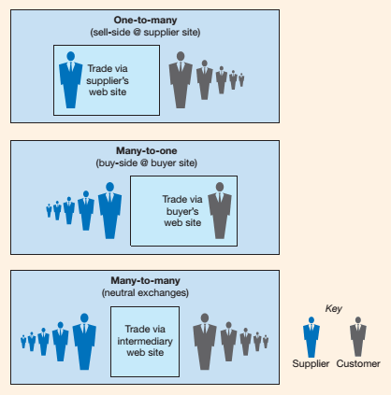
Integrating company systems with supplier systems

