Slide 1
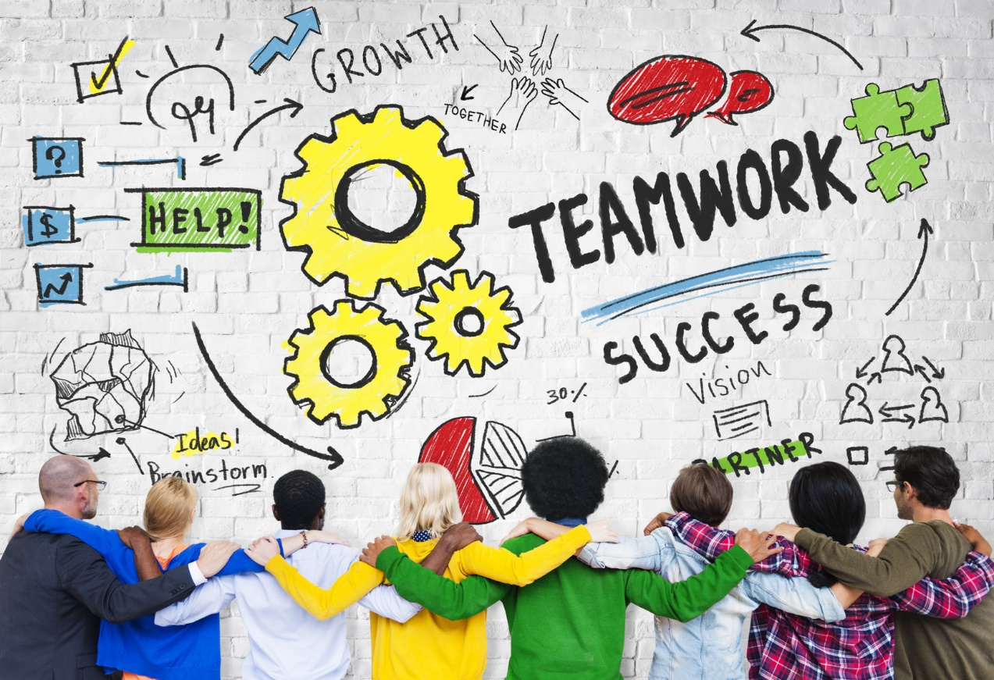
UNIT 1
WORK CULTURE

Slide 2
UNIT 1 WARM-UP ACTIVITIES CHAT In pairs / groups, decide which of these topics or words are most interesting and which are most boring. Hobbies / weather/ sport / education / salary / dream job / pet / relationship/ career opportunities / memories / friendship / life goals / holiday Have a chat about the topics you liked. Change topics and partners frequently.

Slide 3
Work CULTURE: India vs. west
Watch this YouTube video https://www.youtube.com/watch?v=ytXU_Zyc1mg
What do you think about the video?
What is the comparison between Indonesia and West about work culture?

Slide 4
PAST TENSE

Slide 5
There are four types of past tense verbs:
Simple Past Tense
Past Continuous Tense
Past Perfect Tense
Past Perfect Continuous Tense

Slide 6
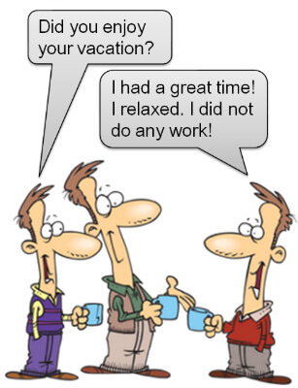
Simple Past Tense
The simple past is a verb tense that is used to talk about things that happened or existed before now.
Example: Patricia entered an E-Sport games.
The time of the action can be in the recent past or the distant past and action duration is not important.
Unlike the past continuous tense, which is used to talk about past events that happened over a period of time,
the simple past tense emphasizes that the action is finished.

Slide 7
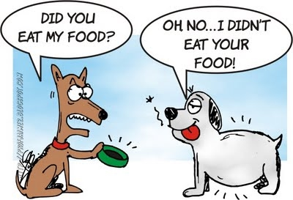
You may search by yourself about Simple Past Tense in YouTube for more visual explanation or just read something in the Google.
You may practice yourself with irregular or regular verbs. It will improve your understanding about Simple Past Tense.

Slide 8
Talking About Stress Do you think the workplace is a stressful place? Complete the table below.
Stress | Most stressful thing | How to reduce this stress
Boss
Colleagues
Customers / Clients
Deadlines
Job security

Slide 9
EXERCISE Tell your own past experience in front of your friends.
Try to tell your story in expressive way

