Slide 1
Network layer
Jarkom Dasar – Week 6
Aisyatul Karima, 2012

Slide 2
outline
Introduction
IPv4
Network
Routing
Routing Process

Slide 3
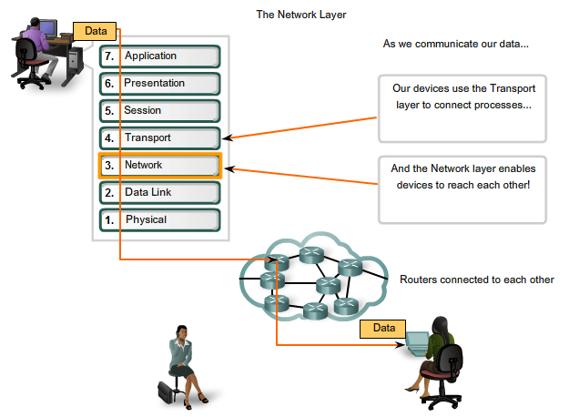
INTRODUCTION

Slide 4
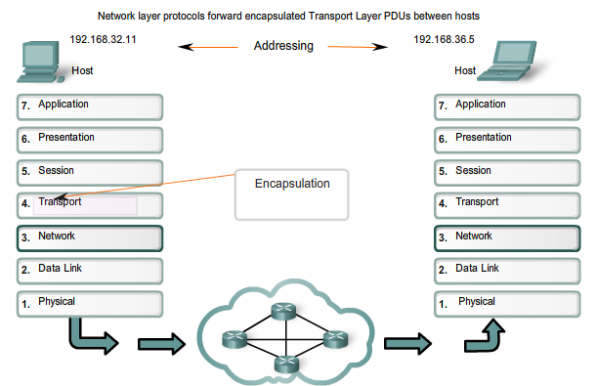
INTRODUCTION
Network Layer

Slide 5
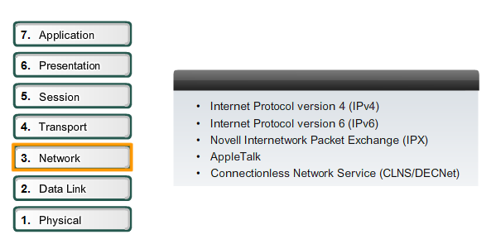
Ipv4
Network Layer Protocol

Slide 6
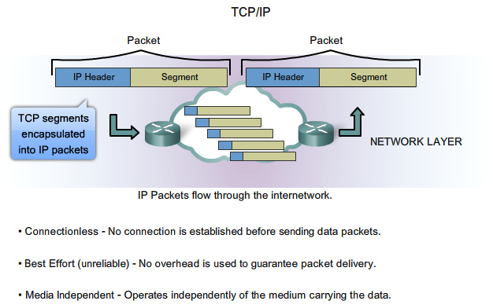
Ipv4

Slide 7
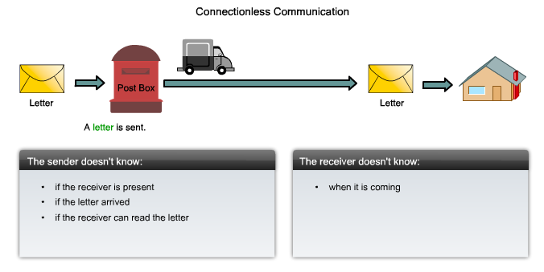
Ipv4
Connectionless Communication

Slide 8
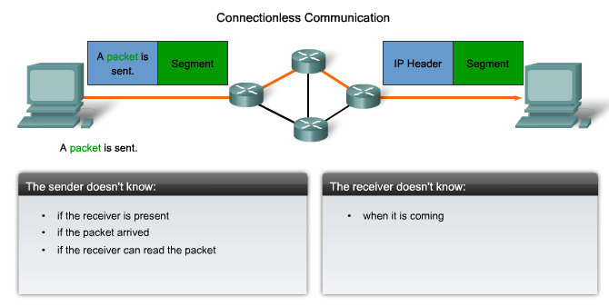
Ipv4
Connection Communication

Slide 9
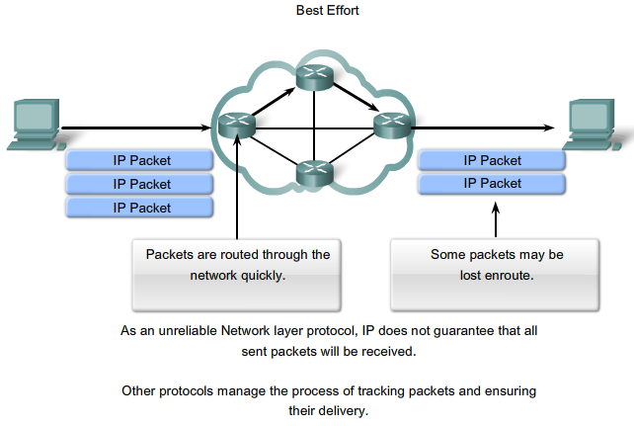
Ipv4
Best Effort

Slide 10
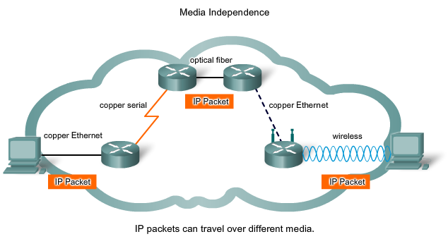
Ipv4
Media Independence

Slide 11
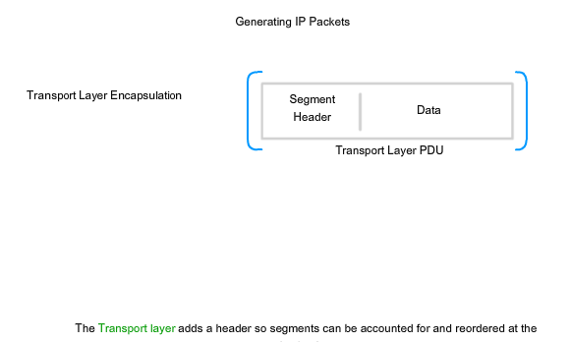
Ipv4
Generating IP Packet

Slide 12
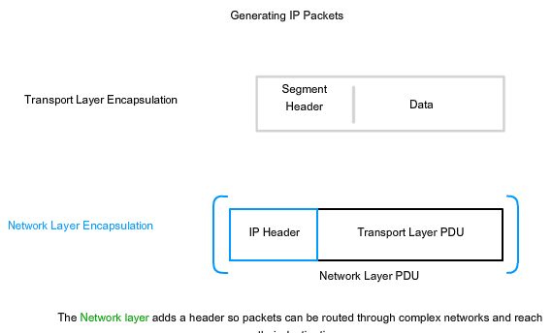
Ipv4
Generating IP Packet

Slide 13
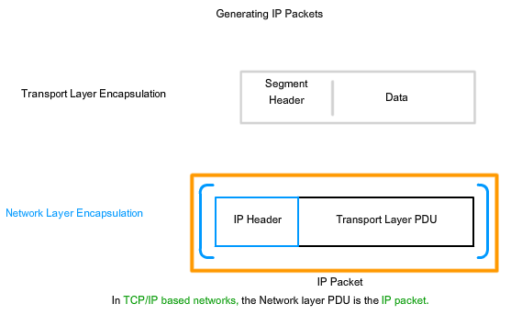
Ipv4
Generating IP Packet

Slide 14
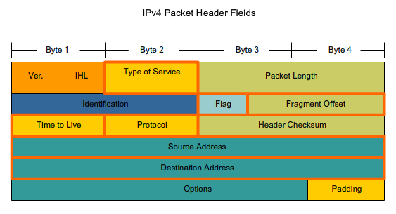
Ipv4
IP Packet Header Fields

Slide 15
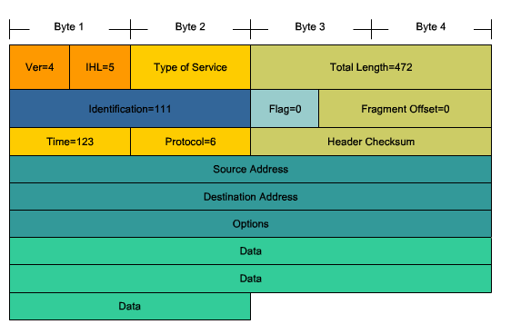
Ipv4
IPv4 Packet

Slide 16
Network
Networks can be grouped based on factors that include:
Geographic location
Purpose
Ownership

Slide 17
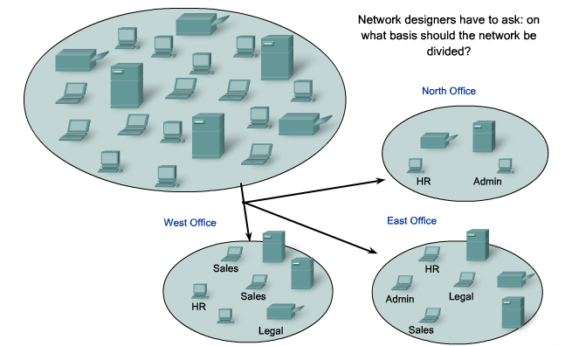
Network
Separating host into common groups :
Based on geographic location (before)

Slide 18
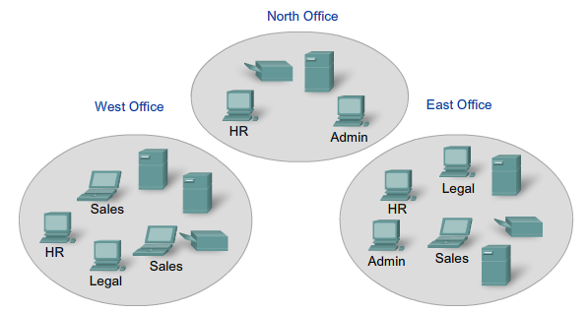
Network
Based on geographic location (after)

Slide 19
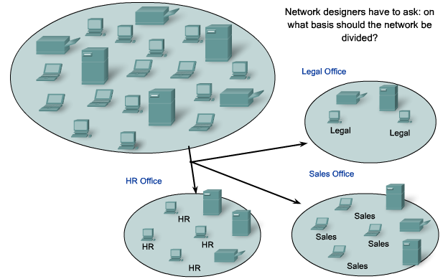
Network
Based on purpose (before) :

Slide 20
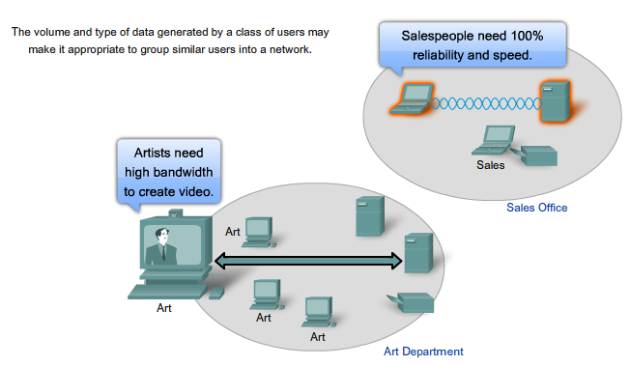
Network
Based on purpose (after) :

Slide 21
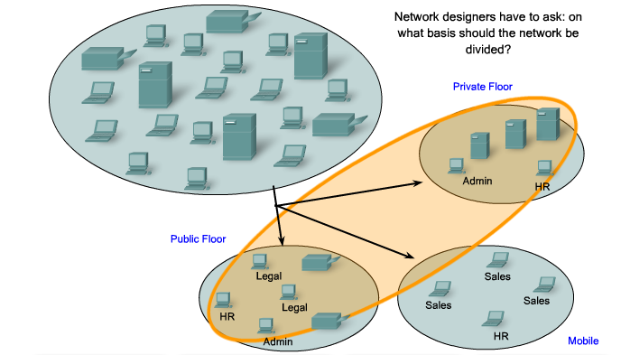
Network
Based on owner (before) :

Slide 22
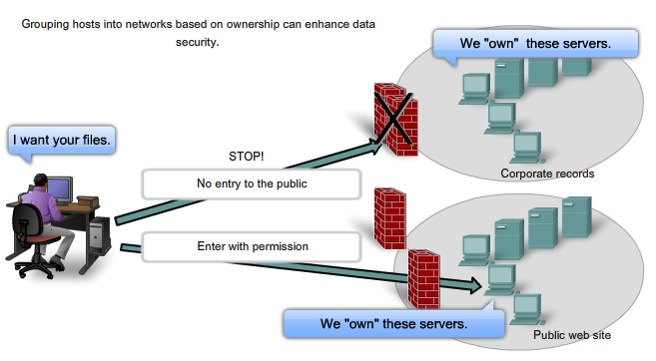
Network
Based on owner (after) :

Slide 23
Network
Why separate host into network ?
Performance degradation
Security issues
Address Management

Slide 24
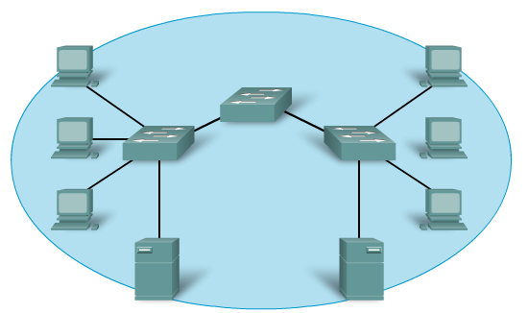
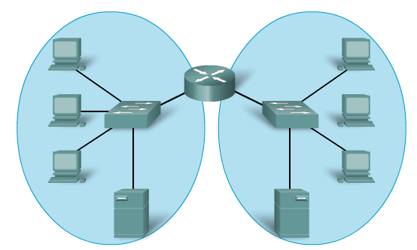
network
Increase Performance

Slide 25
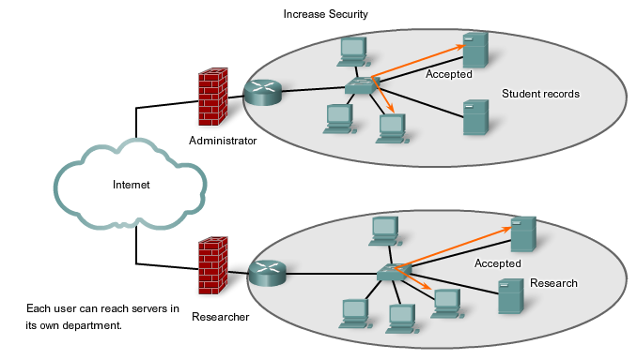
Network
Increase Security

Slide 26
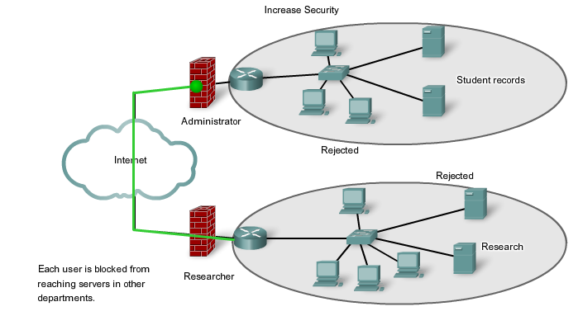
Network
Increase Security

Slide 27
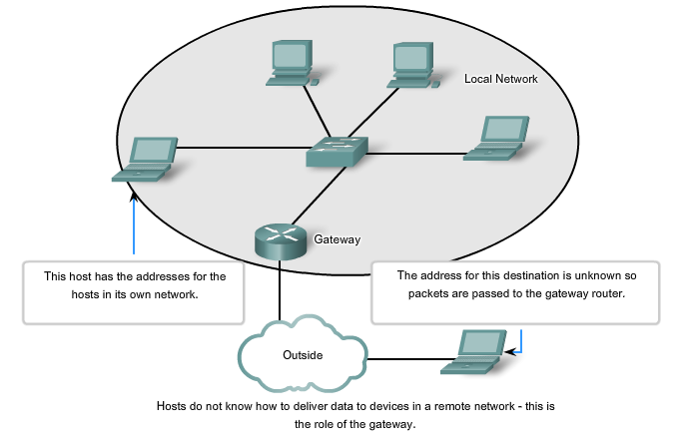
Network
Address Management

Slide 28
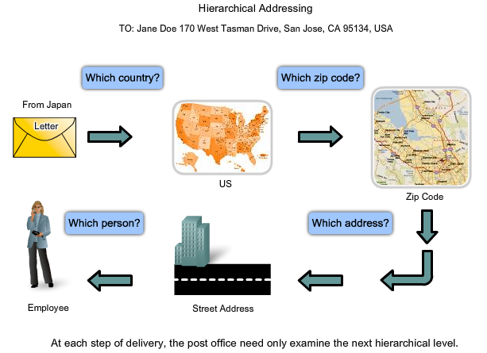
Network
Hierarchial Addressing

Slide 29
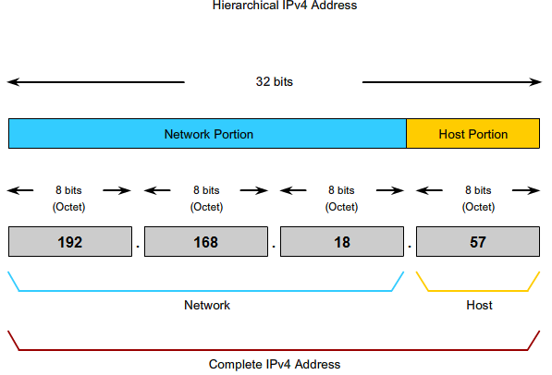
NETWORK
Hierarchical IPv4 Address :

Slide 30
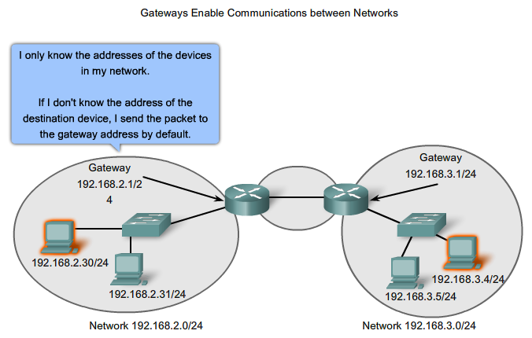
ROUTING
Device Parameter

Slide 31
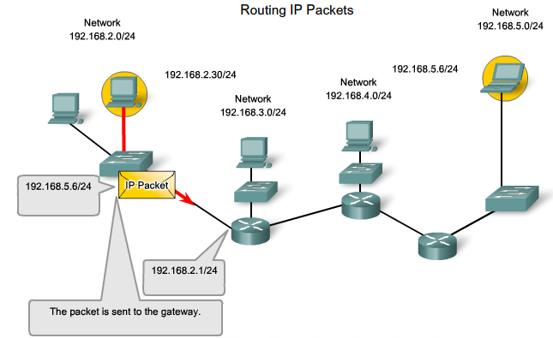
ROUTING
IP Packet

Slide 32
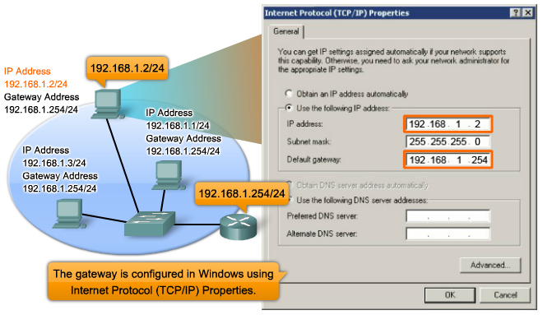
ROUTING
Gateway

Slide 33
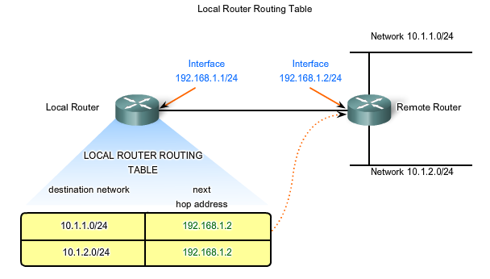
ROUTING
Gateway

Slide 34
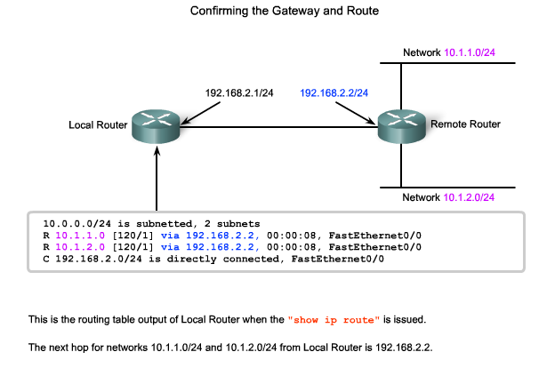
ROUTING
A route

Slide 35
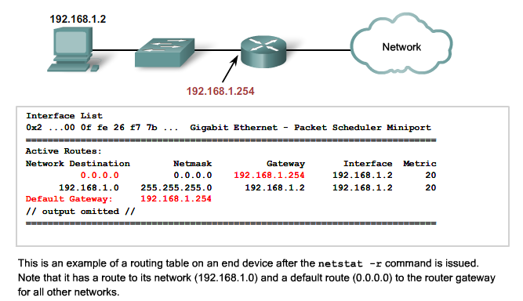
ROUTING
A route

Slide 36
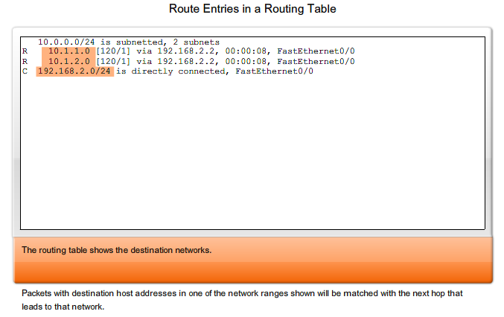
routing
Routing table entries

Slide 37
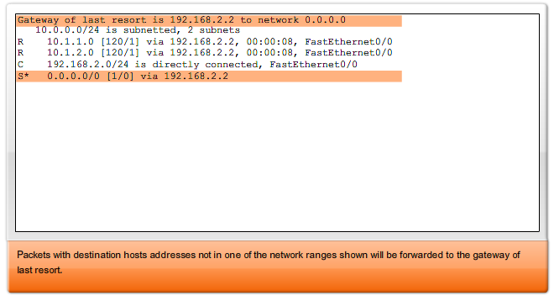
routing
The routing table shows the default route 0.0.0.0

Slide 38
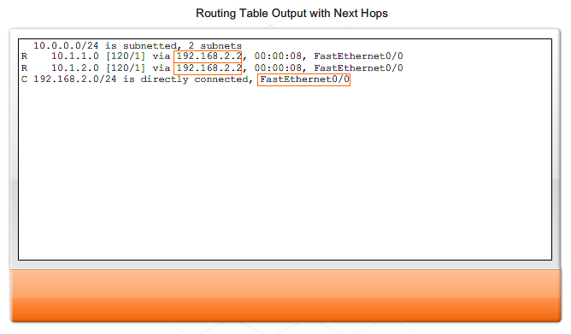
routing
The next hops

Slide 39
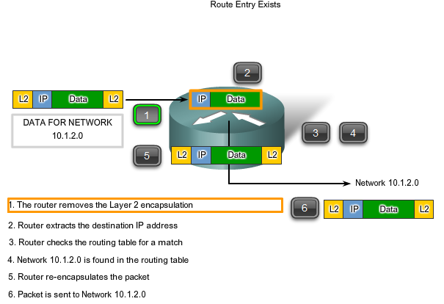
routing
Packet forwarding

Slide 40
routing
Packet forwarding

Slide 41
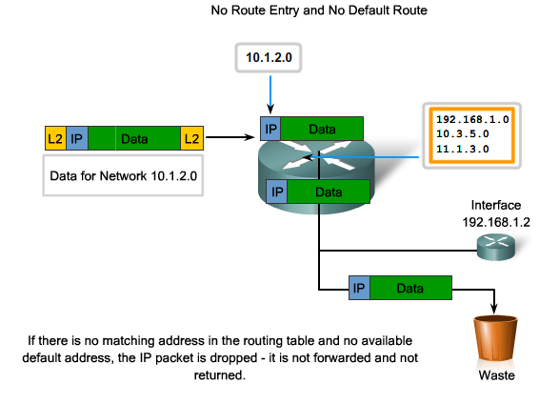
routing
Packet forwarding

Slide 42
Routing process
Routing requires that every hop, or router, along the path to a packet's destination have a route to forward the packet.
The routing table contains the information that a router uses in its packet forwarding decisions.
For the routing decisions, the routing table needs to represent the most accurate state of network pathways that the router can access.
Out-of-date routing information means that packets may not be forwarded to the most appropriate next-hop, causing delays or packet loss.

Slide 43
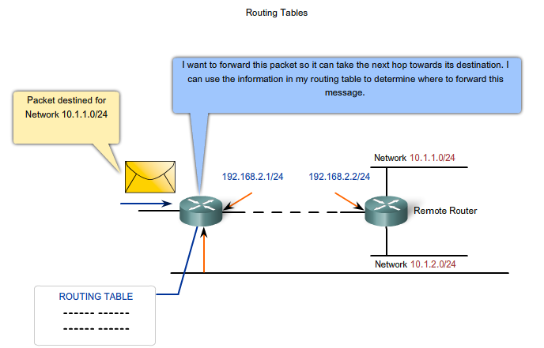
Routing process
Routing Protocol

Slide 44
Routing process
Static Routing
Routes to remote networks with the associated next hops can be manually configured on the router.
This is known as static routing.
A default route can also be statically configured.

Slide 45
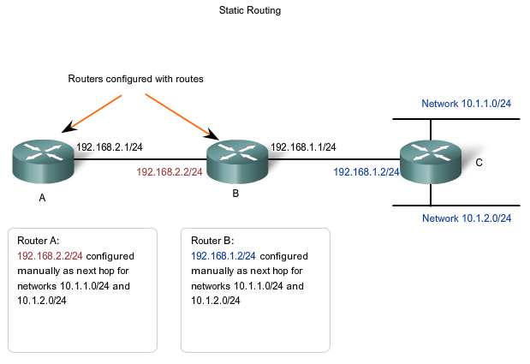
Routing process
Static Routing

Slide 46
Routing process
Dynamic Routing
Although it is essential for all routers in an internetwork to have up-to-date extensive route knowledge, maintaining the routing table by manual static configuration is not always feasible.
Therefore, dynamic routing protocols are used.
Routing protocols are the set of rules by which routers dynamically share their routing information
Common routing protocols are:
Routing Information Protocol (RIP)
Enhanced Interior Gateway Routing Protocol (EIGRP)
Open Shortest Path First (OSPF)

Slide 47
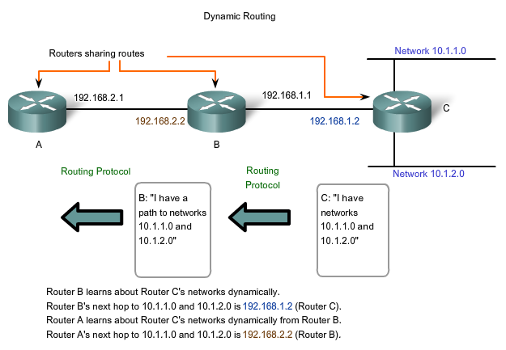
Routing process
Dynamic Routing

