Slide 1
Public Relations, Sponsorship and
Corporate Advertising
MEETING 11
Meeting, Incentive, Convention, Exhibition

Slide 2
Learning Objectives
LO1: Distinguish between advertising and public relations.
LO2: Describe the key tasks of public relations practitioners.
LO3: Explain the potential benefits and drawbacks of sponsorships in an Integrated Marketing Communications plan.
LO4: Discuss the functions of corporate advertising

Slide 3

The Role of Public Relations
Reputation Management
  The main goal of PR is to manage a company’s reputation
Difference between Advertising & PR
  PR is not paid for like advertising
  PR is more trusted because the message is edited & filtered by the media.
  credibility is therefore stronger

Slide 4
The Role of Public Relations
Marketing vs. Public Relations
  MPR (Marketing Public Relations) is when public relations is used to support marketing
  MPR and other IMC strategies need to be closely coordinated

Slide 5
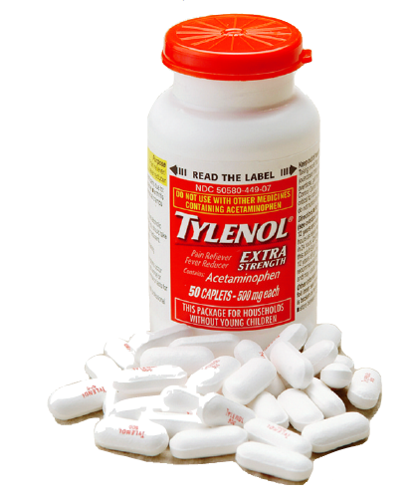
The Public Relations Job
PR Planning & Research
Reputation management
    crisis management, publicity,
    press agentry, & community involvement
Speechwriting
Publications
Social Media
Corporate Blogs

Slide 6

The Public Relations Job
Public Relations Tools
  News (press) Release
  Press (media) Kit
  Photos
  Feature Articles
  Printed Materials
  Posters
  Exhibits

Slide 7

Sponsorships & Events
Sponsorships
  a sponsorship is a cash or in-kind fee paid to a property in return for access to the exploitable
  commercial potential associated with that property
  Cause Marketing vs. Philanthropy
  Philanthropy is an idea, event, or action that is
  done to better humanity and usually involves
  some sacrifice as opposed to being done for a profit motive
  Acts of philanthropy include donating money to a charity, volunteering at a local shelter, or raising money to donate to cancer research.

Slide 8
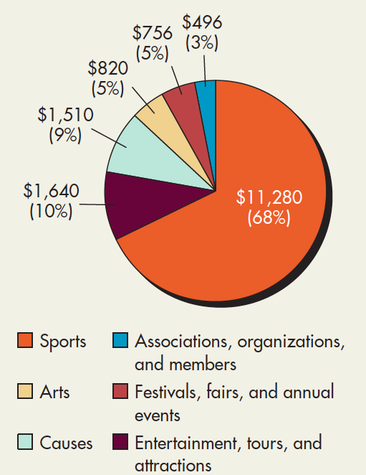
Sponsorships & Events
Types of Sponsorship
  Sports Marketing
  Arts
  Causes
  Associations
  Festivals
  Entertainment

Slide 9

Sponsorships & Events
Measuring Sponsorship Results
  Experts suggest 3 methods
    measure changes in awareness
    measure spending equivalencies
    measure changes in sales revenue with tracking devices

Slide 10
Sponsorships & Events
Measuring Sponsorship Results
  Pointers for measuring the value of sponsorships
    Have clear goals & narrowly defined objectives
    measure against a benchmark
    do not change other marketing variables
    incorporate an evaluation program into sponsorship
    establish a budget for measuring results

Slide 11

Sponsorships & Events
Benefits of Sponsorship
  offers those with limited media alternatives a means of communication
  public approves of it much more than advertising
  highly self-selective audience
  enhances company image
  can boost company morale

Slide 12
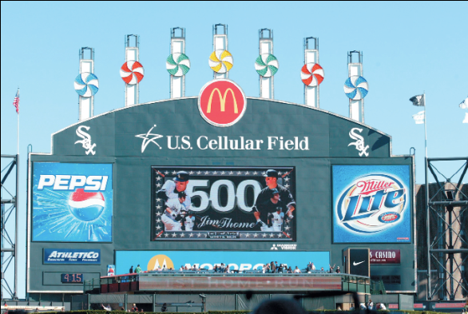
Sponsorships & Events
Drawbacks of Sponsorship
  costly
  cosponsorship is cluttered
  evaluation of effectiveness is tricky

Slide 13

Corporate Advertising
Public Relations Advertising
  ads used to improve company relations with labor, government, suppliers,
  customers or even voters

Slide 14
Corporate Advertising
Corporate/Institutional Advertising
  nonproduct advertising aimed at enhancing a company’s image or increase awareness
    advertorials
    umbrella advertising
    corporate identity advertising
    advocacy advertising
17-14

Slide 15
Terima kasih

