Slide 1
What Is Vendor Management And Why Is It Important To You?

Slide 2
  Who manages third party vendors at your organization?
  Is there a vendor management framework that consistently manages third party risks?
  Do you know all of your vendors? Do they have a contract?

Slide 3
Agenda
  Vendor Management
    Key Components
    Effective Vendor Management Framework
  Regulator Expectations
    Focus Areas

Slide 4
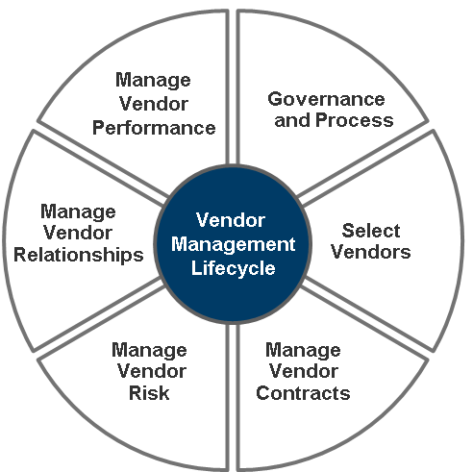
What is Vendor Management?
  Vendor Management is the ongoing management of third-party providers of products or services
  The goal of VM is to ensure the organization continuously obtains the best value from external providers of products and services while controlling exposure to vendor-related risk
Lifecycle | Description
Governance & Process | Establish strategy and governance. Define SOPs, documentation, system, roles and responsibilities
Select Vendors | Select vendors in accordance with a formal, unbiased practice. Ensure the best fit for the product/service requirements and the best value at the optimal exposure to vendor risk
Manage Vendor Contracts | Manage vendor contracts through the contract lifecycle
Manage Vendor Risk | Manage vendor risk to protect the organization from negative effects that can be caused by events on the vendor’s side
Manage Vendor Relationships | Maintain effective relationships with vendors
Manage Vendor Performance | Ensure vendors perform as contracted
Vendor Manager
Business Owner
Procurement
Finance
Legal
Sr. Mgmt.

Slide 5
Why is it important?
Because we must measure, manage, and scrutinize the vendors we rely on to deliver value
Reliance
  Need vendors to deliver critical specialized services
  Over half of a company’s expenditure is with vendors
  Vendors globally help us achieve our mission
Our Contracts are a Strategic Asset
Value
  Maximise value and deliver great commercial outcomes through our relationships
Vendor Management is a Core Competence
Risk
  Increased regulatory and member scrutiny on how financial institutions manage third party vendor risk - operational, cyber security, supply chain, compliance, strategic, financial and reputational
Importance has evolved with changing business environment
2000
2005
2008
2013
2015
Y2k
Offshore
Financial Crisis
Nearshore
Digital / Internet of Things
Oversight

Slide 6

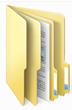
What is a third party vendor?
  Any individual or entity, which is not a direct employee, which provides a produce/service to, or behalf of, the organization
  Typically managed at both the engagement and relationship levels
Vendors
Service Providers
Agencies
Affiliates
Partnerships
Law firms
Contractors
Joint Ventures
Government Organizations
One service, one contract, provided to one line of business
Multiple engagements with the same company
Engagement
Relationship

Slide 7
Vendors may present a combination of risks
Risk | Description
Cyber | Ensuring confidentiality, integrity, availability of information assets
Compliance/legal | Actions inconsistent with legal, policy or regulatory requirements
Service delivery | Third party failures resulting in impact to the service
Contractual | Inability to deliver services per contract
Business continuity | Inability to continue providing services
Intellectual property | Inappropriate use of intellectual property
Financial | Inability to meet contractual obligations due to financial difficulties
Reputation | Issues impacting an organization’s brand and reputation
Geopolitical | Region/country-specific factors
Strategic | Third party not aligned with the organization’s strategic objectives
Credit | Inability to make obligated payments
Quality | Inability to deliver a quality service/produce
Inherent risk to the product/ service
Risks unique to the third party
Source: Deloitte

Slide 8
Regulatory
Expectations

Slide 9
Regulatory Expectations
Regulators globally have issued heightened standards and guidance for third party’s. These cover most regulatory expectations….
Expanded scope | Oversee all service providers, affiliates, partnerships and other third parties
Governance and accountability | Define responsibilities of the board, senior management, and relationships managers
End-to-end risk management | Formalize risk management across the life-cycle and risk domains. Greater scrutiny with high risk vendors.
Due Diligence | Access how vendors are sought, vetted, selected
Contracts | Do you have them? Do they have the appropriate clauses? Execute a contract inventory.
Monitoring | Timely and effective reporting in vendor relationships. Demonstrate you have sufficient visibility and control. Use of scorecards and dashboards
Compliance | Identify all relevant compliance requirements and document how they are being met
Independent Reviews | Do your vendors…’Say what they do?’ and ‘Do what they say’. Risks are documented and controls in place.
Business Continuity | Consider the systemic implications of outsourcing and potential third party failures
Notes:
Regulators globally have issued heightened standards and guidance for third party’s. These cover most regulatory expectations.

Slide 10
Governance
Executive and Board engagement
  Defined roles and responsibility
  Drive and approve policy
  Monitor and oversee vendor portfolio
Two tier governance model
General awareness of vendors… is no longer an acceptable
Sets the tone…
  Strategic Alignment
  Policy
  Risk appetite
  Vendor oversight
  Escalations
Executive Committee
Vendor / Operations Committee
Drives Vendor….
  Performance
  Compliance
  Demand pipeline
  Business Continuity
  Audits

Slide 11
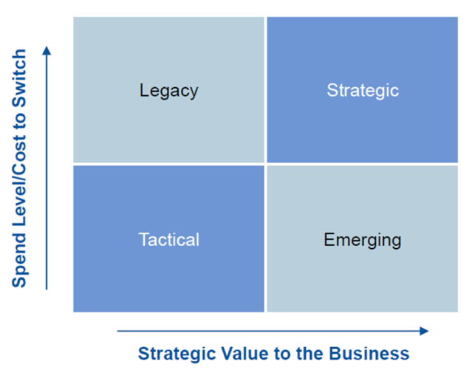
Risk Classification
Formal risk management across the life cycle and risk domains
Risk- based segmentation tool
  Risk is not based on value alone
Apply resources based on level of segmentation
Risks Considerations
Reputational
Info Security and Privacy
Contractual
Service Delivery
Financial
Business Continuity
Geopolitical
Regulatory
Exit Strategy
Other Considerations
Domestic/Offshore
Core / Non-core

Slide 12
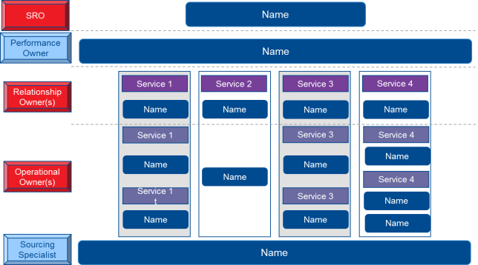
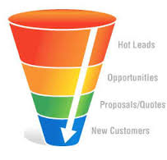
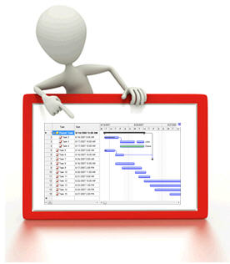
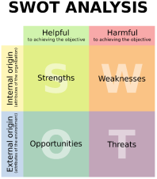
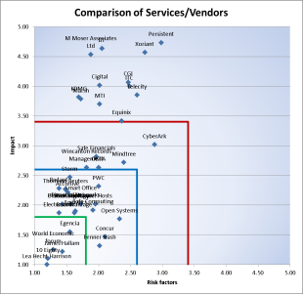
Monitoring
Governance
Account Plans
Dept. Sourcing plans
Pipeline
Supplier Account plans:
Engagements
Pipeline
Improvement plans
Innovation
Investment
Stakeholder maps
Governance meetings
Performance Dashboards
Vendor Risk Dashboards
Consolidated reporting :
Commercial
Performance
Risk
Financials
Relationship
Portfolio reporting
Segmentation
Aligned governance and resources

Slide 13
Takeaways
Third-party relationships must be good for the company, its vendors and consumers
  Understand how vendors are being managed at your organization
  Are you focused on the right things?
  Familiarize yourself with the latest regulatory guidance
  Regularly assess and monitor the effectiveness of vendor program, not just at the vendor selection stage
  Include vendor risk management as a function within the vendor management program
Notes:
Would you buy a company or even a house with a contract? No, why. Because a

Slide 14
TUGAS
PERTEMUAN KE 7
Paper Mice yang Sudah dikirim ke Email di cetak ke dalam kertas A4 dan diberi Cover

