Slide 1
Pemrograman Berorientasi Objek (PBO)
By: Junta Zeniarja, M.Kom, M.CS

Slide 2


Profil - Perkenalan
Nama : Junta Zeniarja, M.Kom, M.CS
Alamat : Permata Tembalang
Kontak
  Phone : 085727181701
  E-mail : junta@dsn.dinus.ac.id
  Room : Ruang dosen TI-S1
Pendidikan
  S1 => TI – UDINUS
  S2 => TI – UDINUS
  S2 => Computer Science UTeM (Universiti Teknikal Malaysia Melaka)
Konsultasi - Sharing
  Selasa, Rabu, Kamis => 13.00 – 16.00
  Appointment via sms or phone.

Slide 3
Outline (Sebelum UTS)
Konsep dasar Pemrograman Berorientasi Objek (PBO)
Object dan Class
Interaksi antar Object
Koleksi Object
Package Library
Inheritance (Pewarisan)

Slide 4
Outline (Setelah UTS)
Polymorphism
Eksepsi
Konsep Abstract dan Interface
GUI
GUI database
Unit testing
Application Design (Supplement)

Slide 5
Kontrak Kuliah
Komponen Penilaian | Persentase
Tugas dan Responsi | 40 %
UTS | 25 %
UAS | 25 %
Absensi | 10 %
Total | 100 %

Slide 6
Kontrak Kuliah (2)
Semangat belajar dan kejujuran dalam kuliah.
Disiplin, batas waktu keterlambatan : 20 menit (Teori dan Praktikum).
Mengumpulkan tugas tepat waktu.
Pakaian sopan dan bersepatu.
Surat Ijin bagi yang berhalangan hadir.
Tidak boleh diabsenkan (sanksi bagi yang ketahuan).
Bertanya jika ada yang kurang atau tidak paham.
Tidak ada toleransi jika bermasalah dan tidak jujur.

Slide 7
Teori
*Konsep Dasar PBO*

Slide 8
Bahasa Pemrograman?
Komputer bekerja seperti switching dan hanya mengenali 0 dan 1.
Manusia tidak (paham) berbicara dengan bahasa 0 dan 1.
Perlu bahasa pemrograman yang dapat menjadi perantara percakapan antara komputer dan manusia.
Bahasa pemrograman diubah ke dalam bahasa yang dipahami oleh komputer dengan menggunakan interpreter atau compiler.

Slide 9
Compiler or Interpreter?
Compiler:
Mengkompilasi source code menjadi bentuk file yang bisa dieksekusi.
Interpreter:
Mengkompilasi dan menjalankan source code secara langsung.

Slide 10
C Language (Compiler)
#include <stdio.h>
main()
{
printf(“Hallo”);
}
000101000011001010000100010010010101010101010010
C Compiler
Machine language program
(executable “.exe” file)
C Program

Slide 11

Java Language
(Compiler + Interpreter)
javac
(Java Compiler)
java
(Java Interpreter)

Slide 12
Tingkat Bahasa Pemrograman
Bahasa Pemrograman Tingkat Rendah (Assembler)
Bahasa Pemrograman Tingkat Sedang
(C, Pascal, Fortran)
Bahasa Pemrograman Tingkat Tinggi
(Java, C++, C#)

Slide 13
Paradigma Pemrograman
Sudut pandang dan style pemrograman berhubungan dengan bagaimana sebuah masalah diformulasikan dalam bahasa pemrograman
Functional Programming: Urutan fungsi secara sekuensial (Scheme, Lisp).
Procedural Programming: Pemecahan masalah berdasarkan prosedural kerja yg terkumpul dalam unit pemrograman bernama fungsi (C, Pascal).
Object-Oriented Programming: Koleksi object yang saling berinteraksi . Class adalah unit pemrograman (Java, C#, C++).

Slide 14
Sejarah Java
James Gosling, Mike Sheridan, and Patrick Naughton initiated the Java language project in June 1991
The language was initially called Oak after an oak tree that stood outside Gosling's office
It went by the name Green later, and was later renamed Java, from a list of random words
Gosling aimed to implement a virtual machine and a language that had a familiar C/C++ style of notation
Sun Microsystems released the first public implementation as Java 1.0 in 1995
On May 8, 2007, Sun finished the process, making all of Java's core code available under free software/open-source distribution terms (GNU Public License)

Slide 15
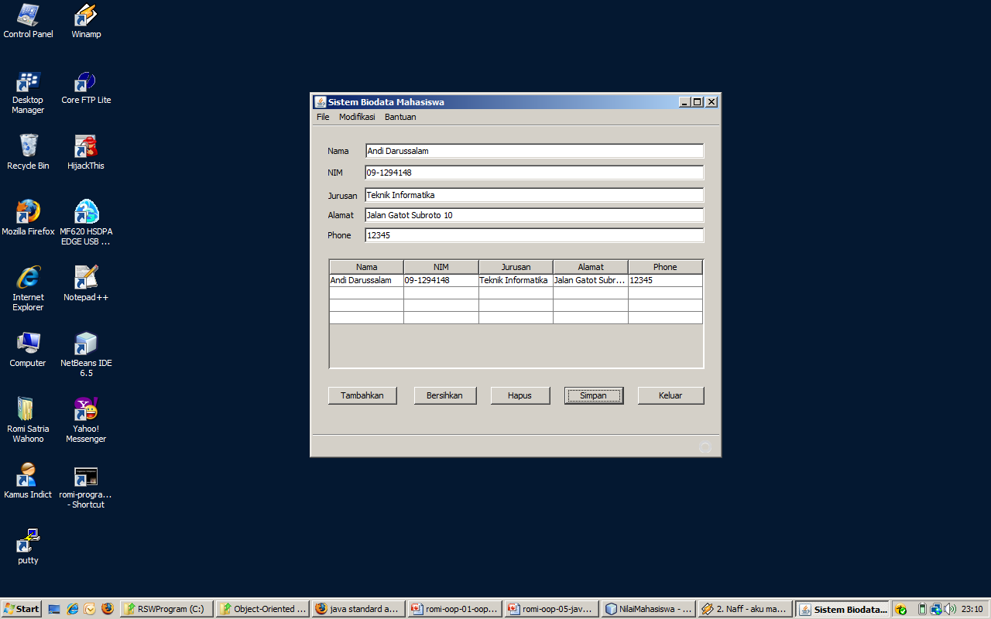
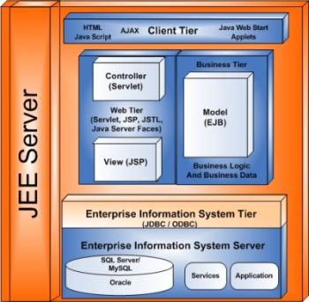
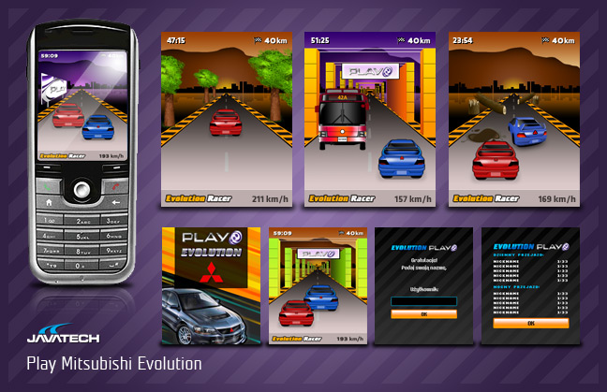
Java Family Suite
Java Standard Edition (Java SE)
  For desktop, client/server application
Java Enterprise Edition
(Java EE)
  For e-business, e-commerce web based application
Java Micro Edition
(Java ME)
  For small devices, like palm, handphone, etc

Slide 16
Java Version
Version | Year | Important New Features
1.0 | 1996
1.1 | 1997 | Inner classes
1.2 | 1998 | Swing, Collections
1.3 | 2000 | Performance enhancements
1.4 | 2002 | Assertions, XML
5 | 2004 | Generic classes, enhanced for loop, auto-boxing, enumerations
6 | 2006 | Library improvements
7 | 2010 | Small language changes and library improvements

Slide 17
Why Java?
Simple and familiar object oriented programming
Architecture neutral (platform independent)
Open Source
First rank in TIOBE Index
De-Facto standard programming language in education

Slide 18
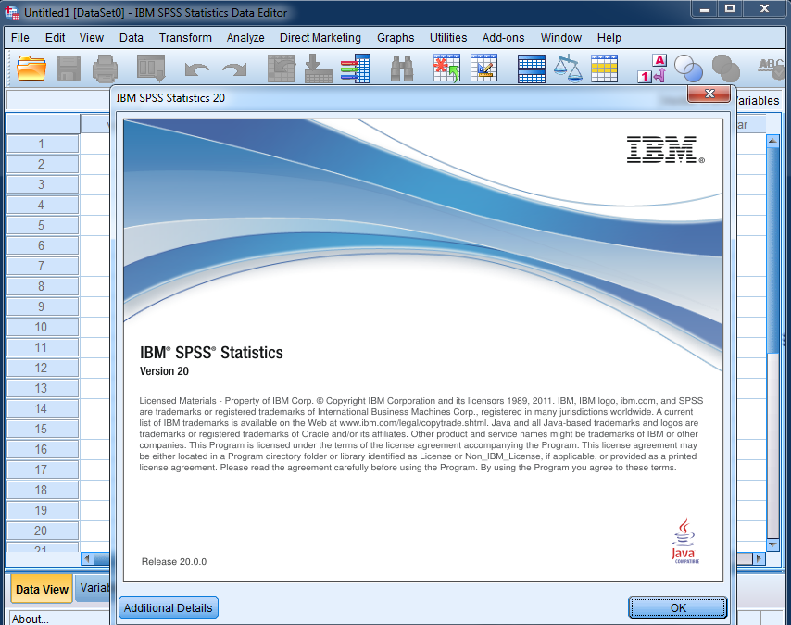
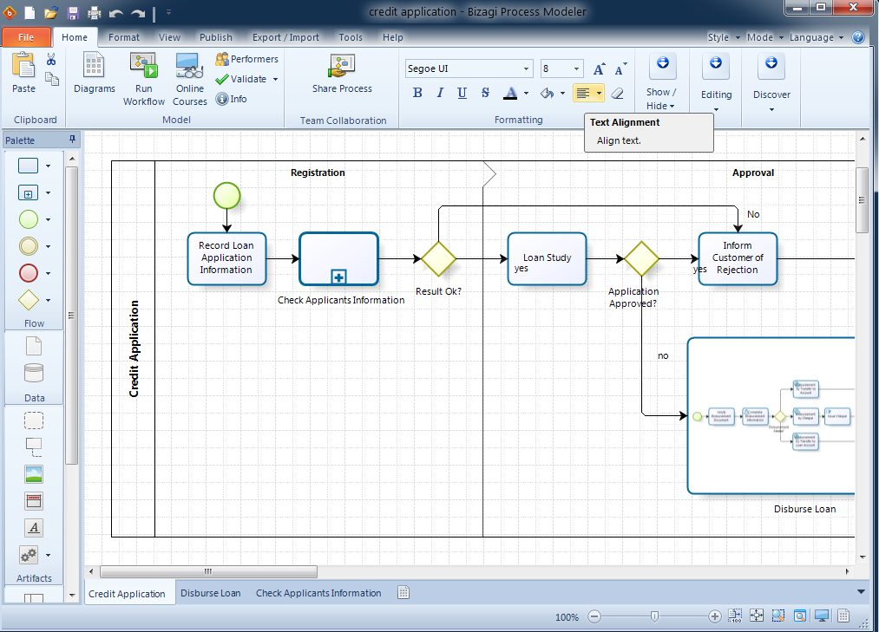
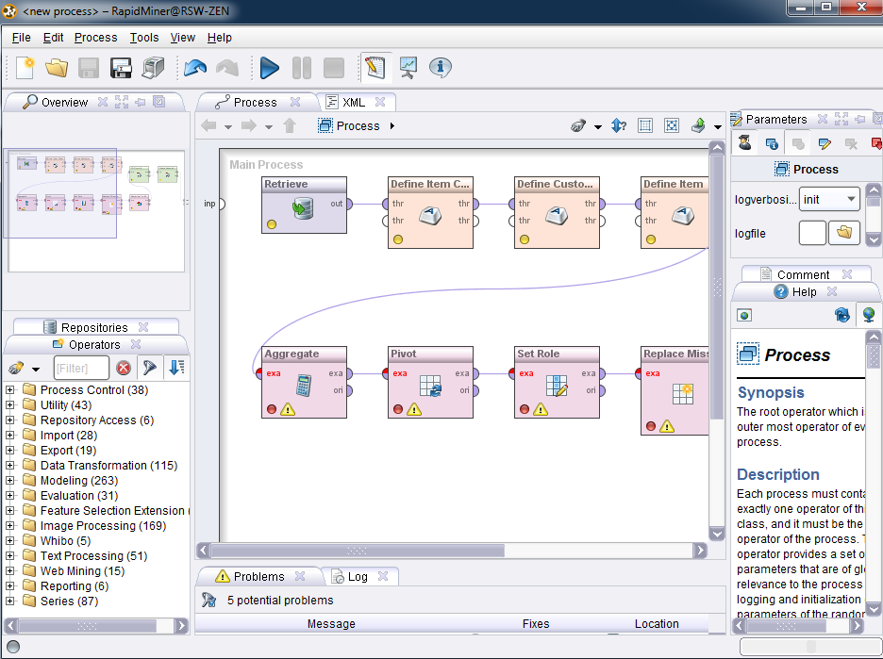

Slide 19
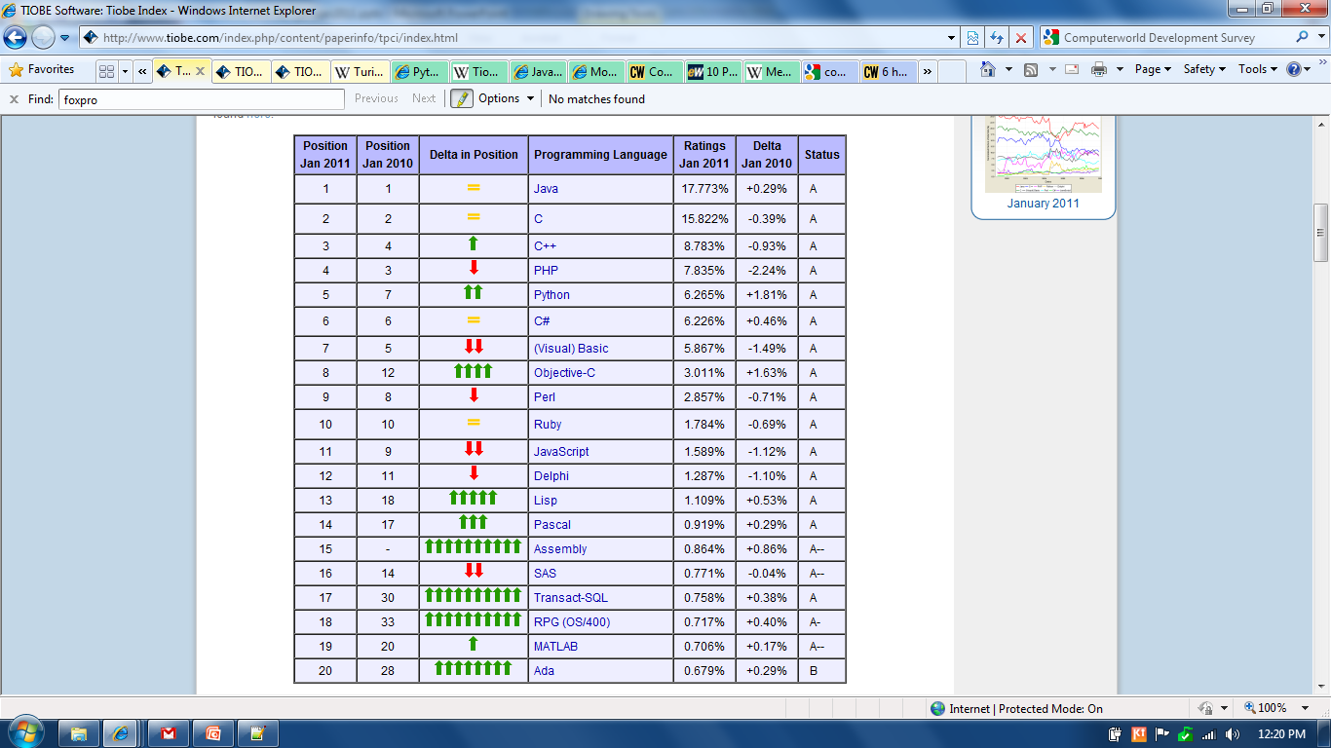

Slide 20
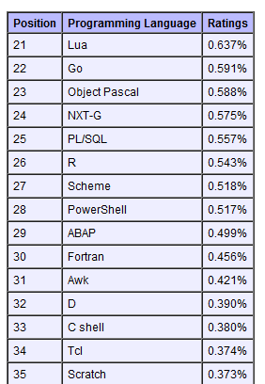
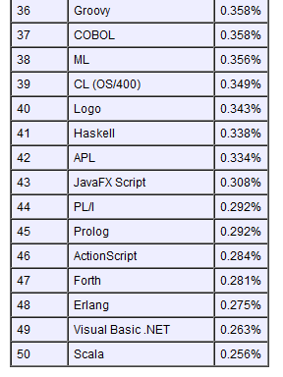

Slide 21
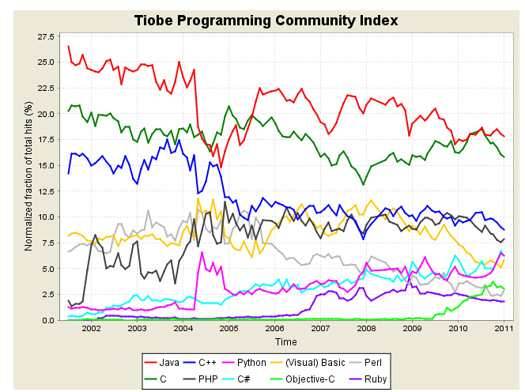

Slide 22
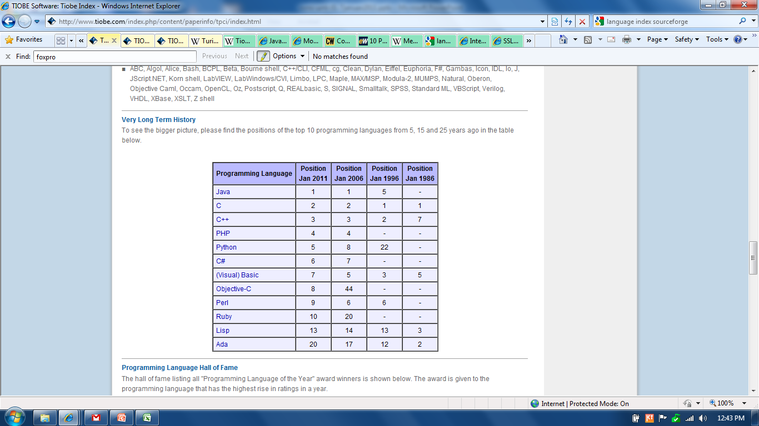

Slide 23
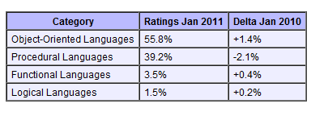
Programming Paradigm Index

Slide 24
Perangkat Pemrograman Java
Compiler (Interpreter):
Java Standard Edition (JSE)
Code Editor:
  Text Editor:
  TextPad, Notepad++
  Integrated Development Environment (IDE):
  Netbeans, Eclipse, JCreator

Slide 25
Instalasi Java SE dan Netbeans IDE
Instalasi Java SE dengan mengklik:
jdk-7u51-windows-i586.exe (32 bit)
jdk-7u51-windows-x64.exe (64 bit) (download dari: http://java.sun.com/javase/downloads)
Instalasi Netbeans dengan mengklik: netbeans-7.4-windows.exe
(download dari: http://netbeans.org)
Ikuti seluruh proses instalasi sampai selesai

Slide 26
Instalasi Text Editor dan Set Path
Set path dan instalasi text editor diperlukan
untuk yang mengembangkan aplikasi text-based dengan console
  Klik Start →Control Panel → System → Advanced →Environment Variables dan set system PATH:
  C:\Program Files\Java\jdk1.7.0_51\bin
  Instal text editor untuk editing code:
  textpad, notepad++, JCreator

Slide 27
Praktikum
Steps Instalation JDK 1.7.0 and Set Path in Windows 7 (Details)

Slide 28
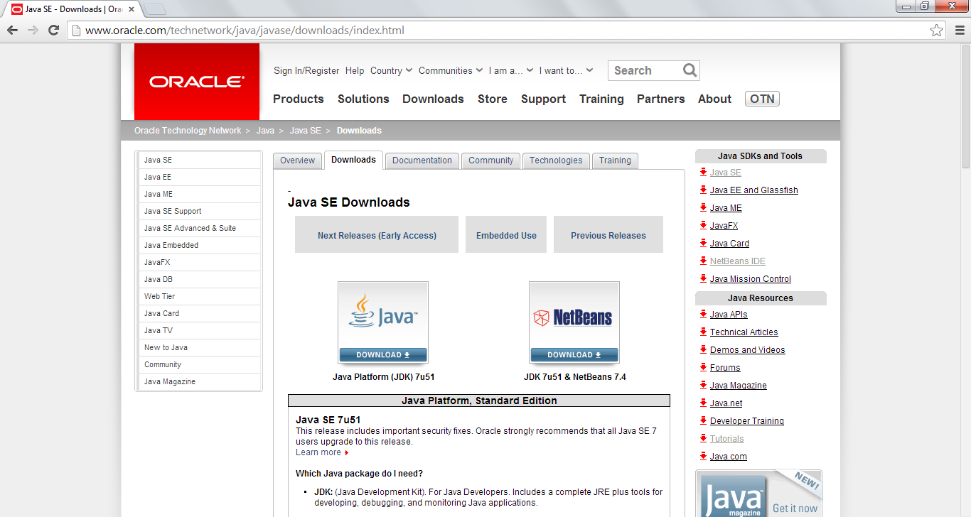
1st
Go to http://www.oracle.com/technetwork/java/javase/downloads/index.html

Slide 29
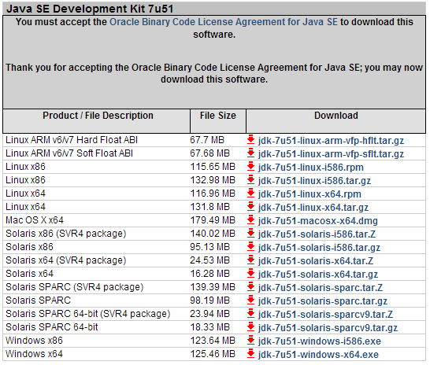
2nd
Accept License Agreement, download jdk

Slide 30
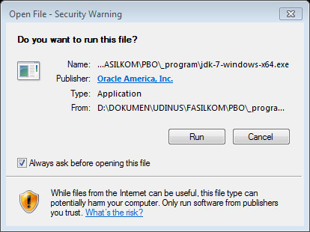
3rd
Install jdk-7-windows-x64.exe for 64 bit architecture or jdk-7-windows-i586.exe for 32 bit architecture
Note: from step 3 until end we use jdk-7-windows-x64.exe in Windows 7 64 bit

Slide 31
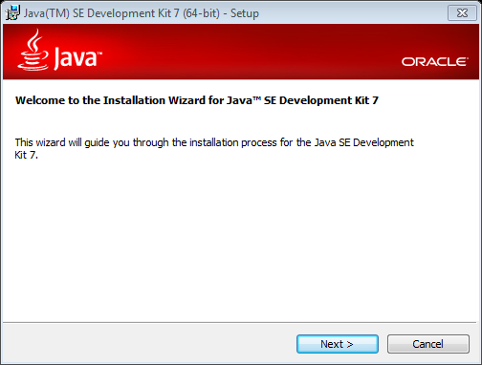
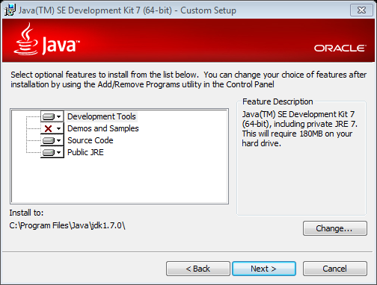
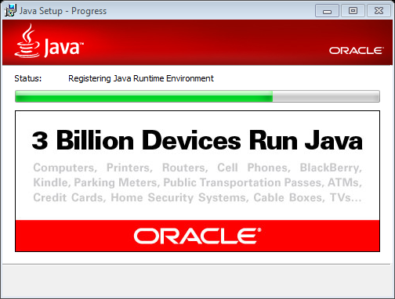
4th
Installation process

Slide 32
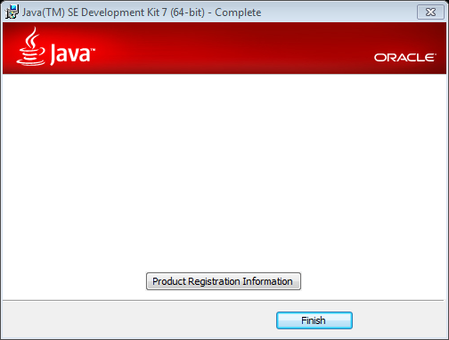
5th
Finish Installation

Slide 33
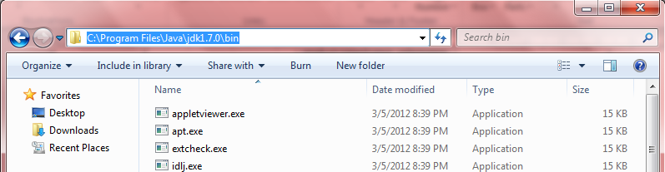
6th
Open folder C:\Program Files\Java\jdk1.7.0_51\bin and copy this path

Slide 34
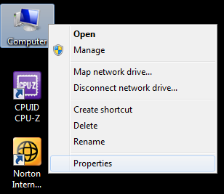
7th
Right click computer → properties

Slide 35
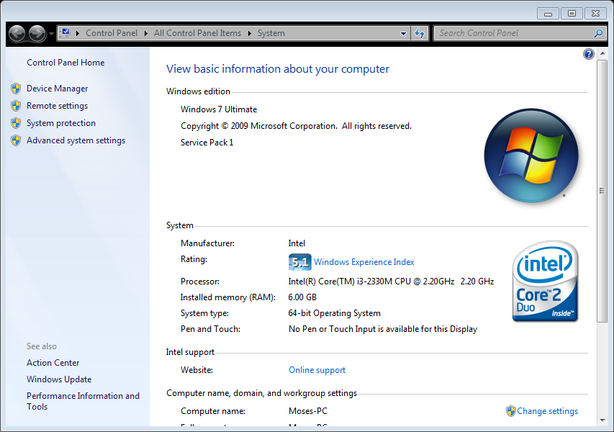
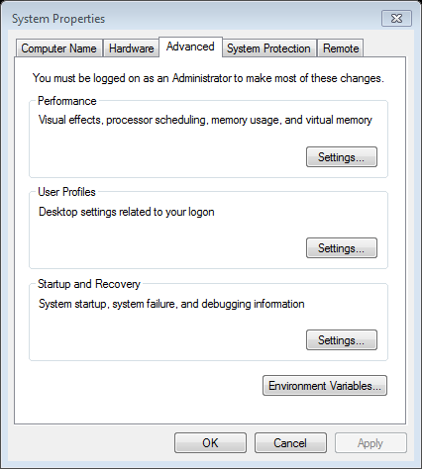
8th
Click “Advanced system setting”

Slide 36
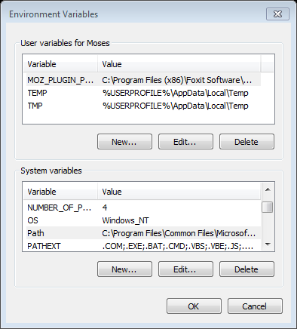
9th
Click “Environment Variable”

Slide 37
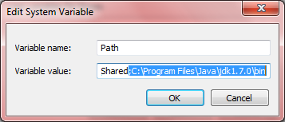
10th
Choose Path and click “edit” → put semicolon(;)paste path → Ok

Slide 38
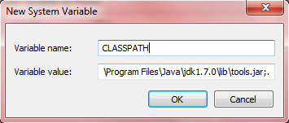
11st
Click “new…” → paste in variable value“C:\Program Files\Java\jdk1.7.0_51\lib\tools.jar;.” and variable name = CLASSPATH → Ok

Slide 39
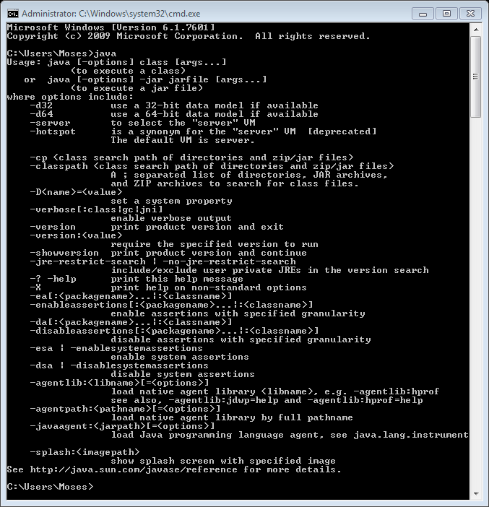
Check Java is Active
Open cmd (command promt) → type “java” → enter
If java active, command promt will display like beside

Slide 40







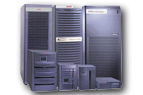
How Java Works …
Jalankan dengan:
C:\>java Hello (Application)
Web Browser (Applet)
public class Hello
public static void main(String[] args){
System.out.println("Hello World!");
}
}
Hello.java
javac (java compiler)
Interpreter
Interpreter
Interpreter
Interpreter
Kompiler memproduksi
Bytecode (Class)
Hello.class
Write Once Run Everywhere !
Web Server
Notes:
Typical Java environment

Slide 41
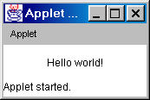
Compile and Run Java Applet
  import java.applet.*;
  import java.awt.*;
  public class HelloWorld extends Applet {
  public void paint(Graphics g) {
  g.drawString("Hello world!",50,25);
  }
  }
C:\appletviewer Hello.html
<HTML>
<HEAD>
<TITLE>A Simple Program</TITLE>
</HEAD>
<BODY>
Here is the output of my program:
<APPLET CODE="HelloWorld.class" WIDTH=150 HEIGHT=25>
</APPLET>
</BODY>
</HTML>
C:\javac HelloWorld.java

Slide 42
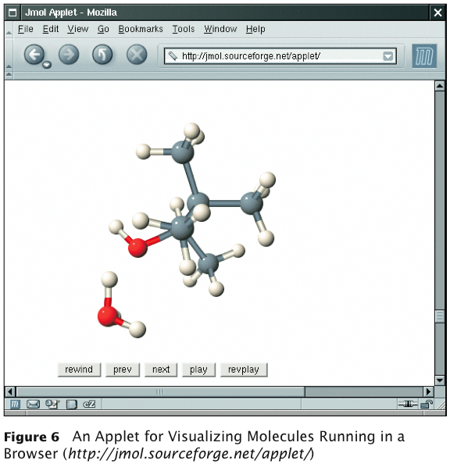
Applet on a Web Page

Slide 43
Menulis Program Java
Bentuk program:
  Text-Based Console Application → menggunakan library non-GUI di Java
  GUI Application → menggunakan AWT atau Swing untuk library GUI
Suatu class bisa dieksekusi karena memiliki method main
  public static void main(String[] args)
  → Program Java mulai dari sini!

Slide 44
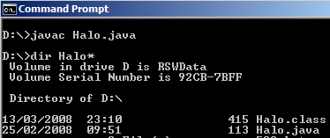
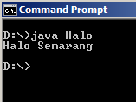
Latihan: Tulis dan Compile Halo.java
public class Halo{
public static void main(String[] args){
System.out.println(“Halo Semarang”);
}
}

Slide 45
Latihan: Membuat Program dg Netbeans
public class HaloSemarang{
public static void main(String[] args){
System.out.println(“Halo Semarang”);
}
}

Slide 46
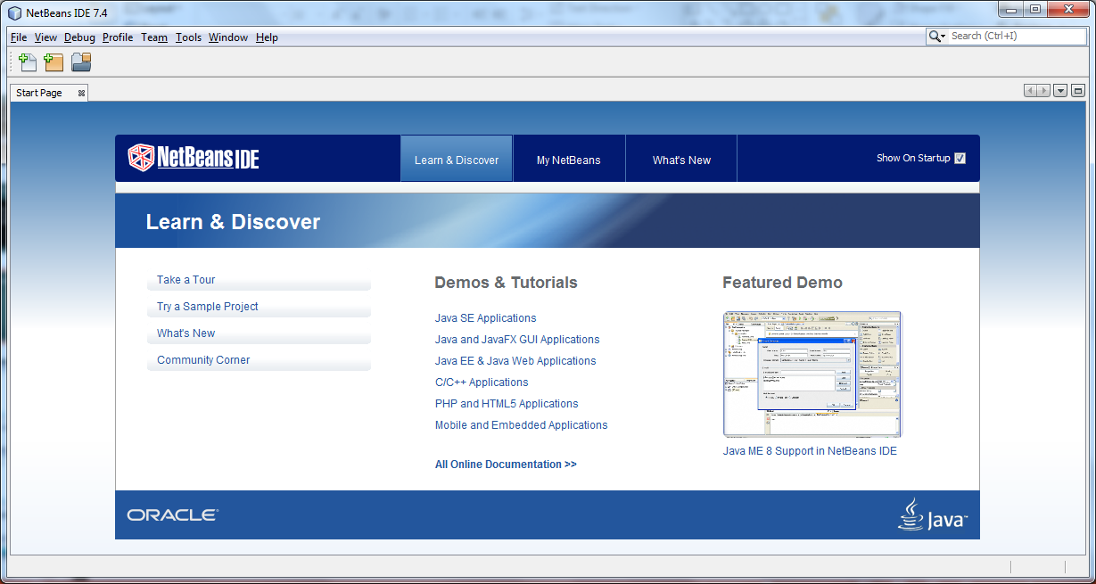
Tampilan Netbeans IDE 7.4

Slide 47
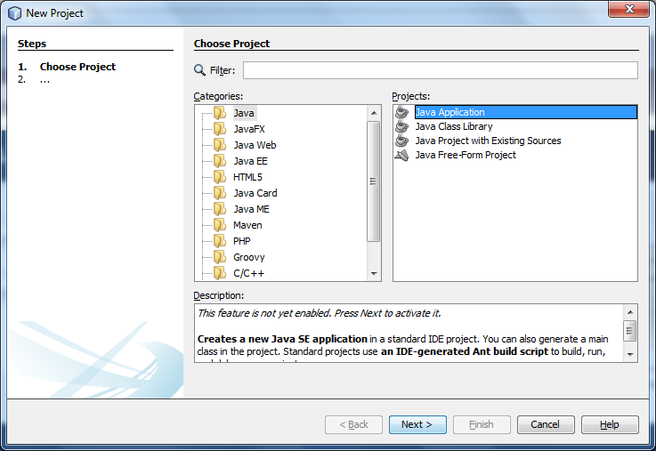
Buat Project Baru

Slide 48
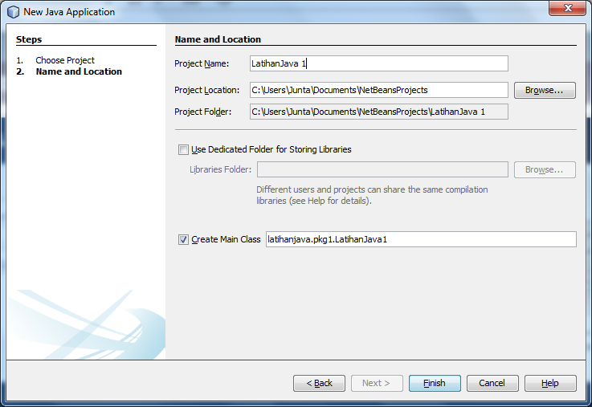
Setting Nama dan Lokasi Project

Slide 49
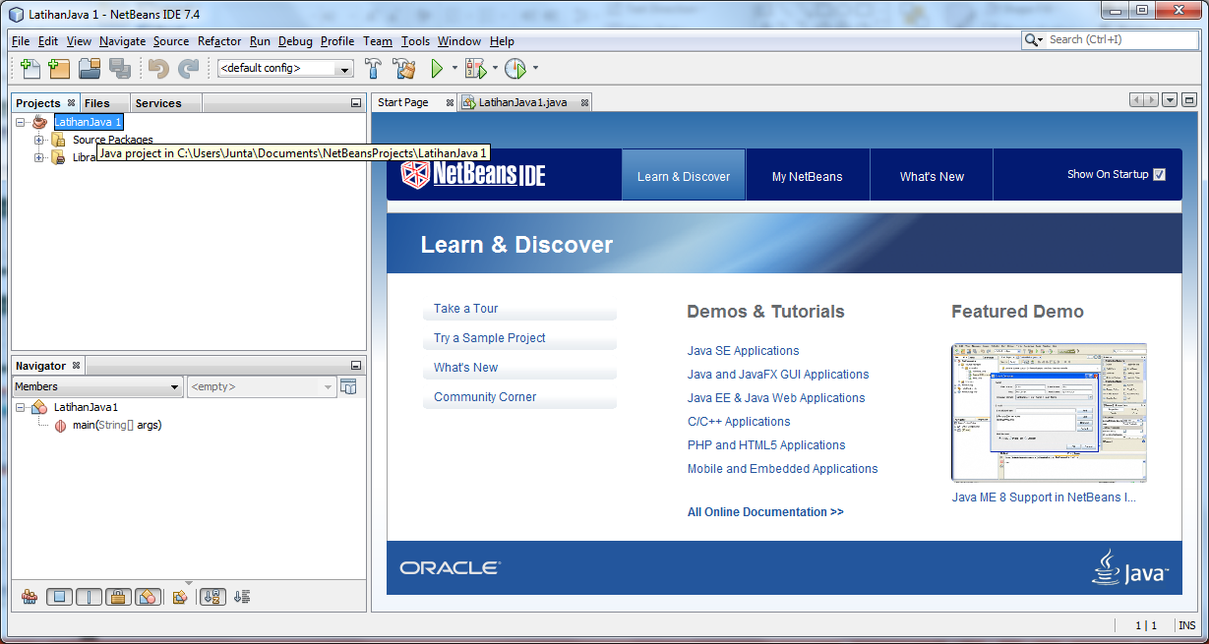
Hasil Project – LatihanJava 1

Slide 50
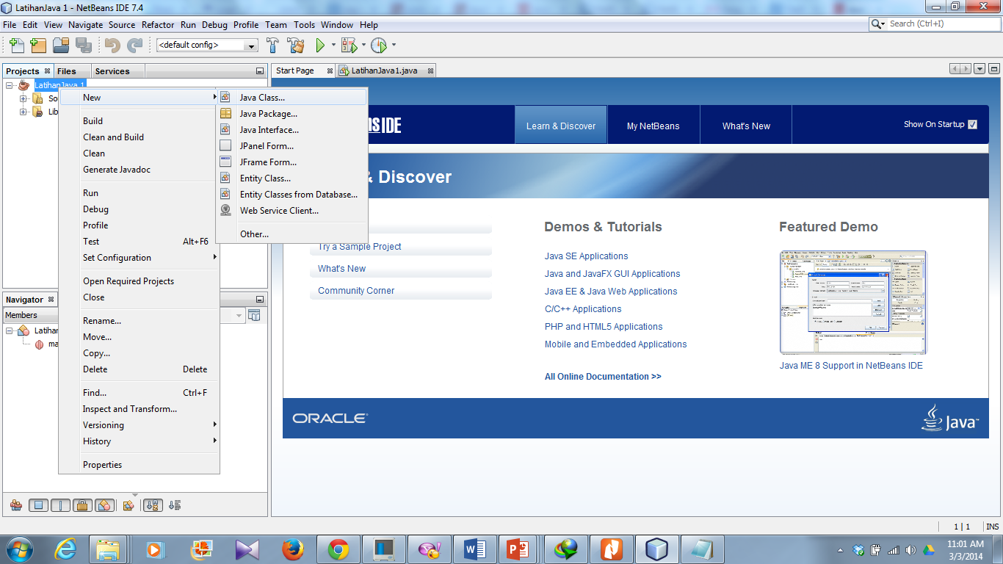
Buat Java Class Baru

Slide 51
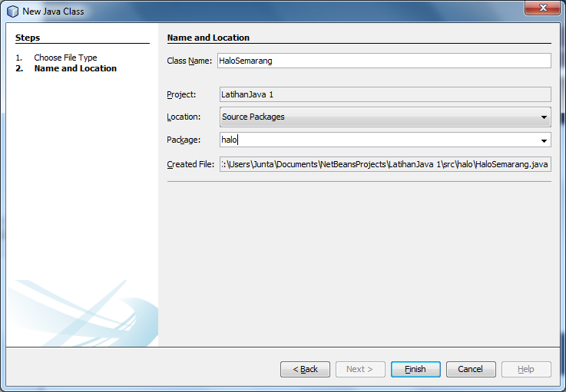
Setting Nama dan Lokasi Java Class

Slide 52
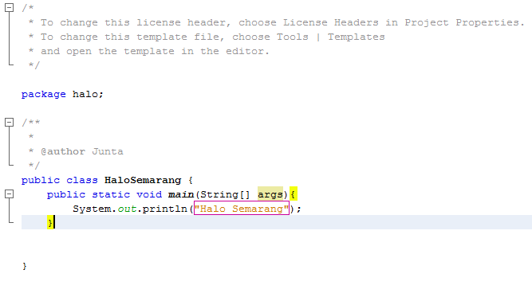
Source Code - Halo Semarang

Slide 53
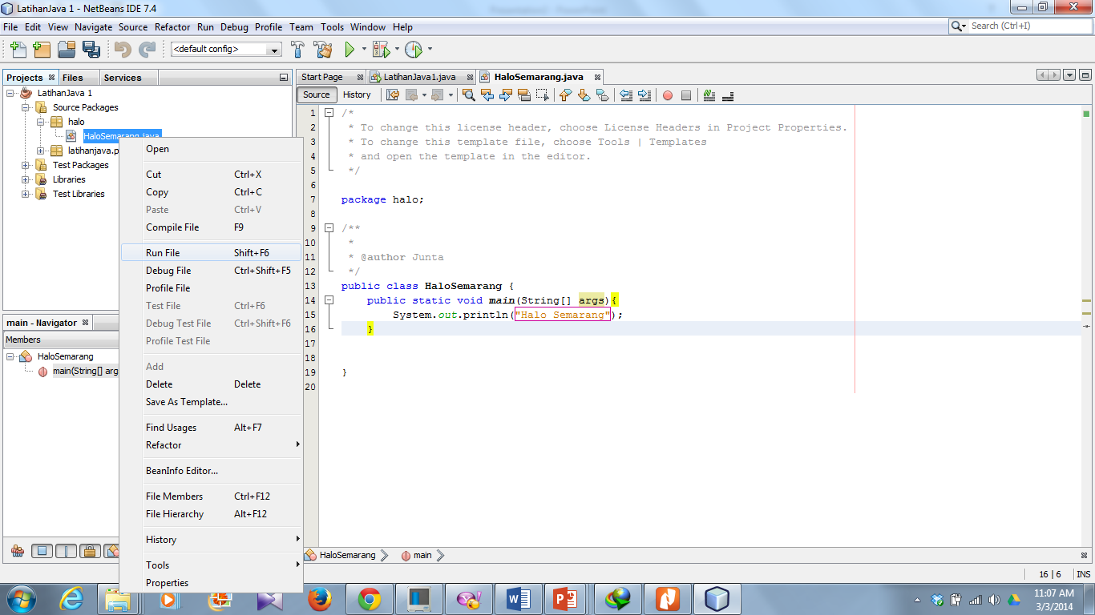
Mengeksekusi Program (Run File)

Slide 54
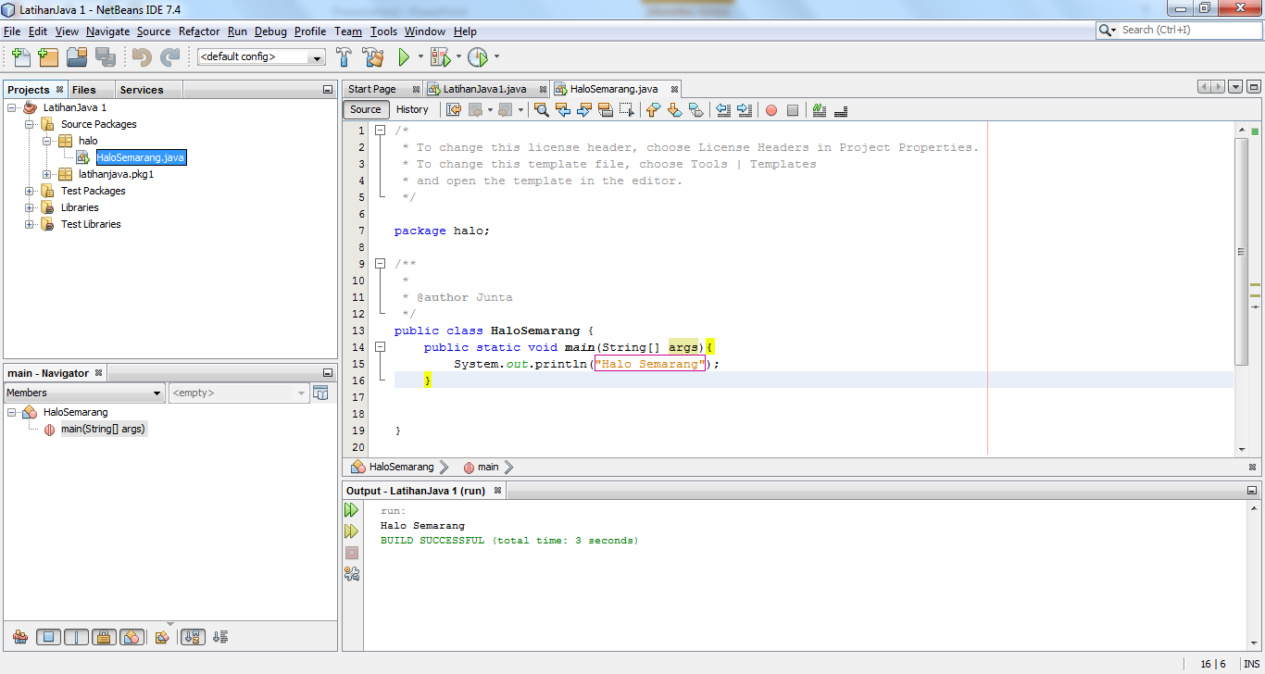
Tampilan Output

Slide 55
Latihan
Buat class HaloIndonesia di dalam package halo
Isi HaloIndonesia.java dengan main method dan tiga tampilan di bawah:
Halo Indonesia
Selamat Pagi Indonesia
Jaya Indonesia

Slide 56
Terimakasih . . .

Slide 57
Referensi
http://romisatriawahono.net/lectures/
Object First With Java, Fifth edition, David J. Barnes & Michael Kölling, Prentice Hall / Pearson Education, 2012.
The JavaTM Tutorial, http://docs.oracle.com/javase/tutorial/java/nutsandbolts/, Oracle, 1995-2014.
Java SE Tutorial, http://www.oracle.com/technetwork/java/javase/downloads/java-se-7-tutorial-2012-02-28-1536013.html, Oracle, 2014.
SCJP Sun Certified Programmer for JavaTM 6 Study Guide Exam (310-065), Kathy Sierra & Bert Bates, Mc Graw Hill, 2008.

