Slide 1
Theory *OOP Charachteristic*
Abstraction, encapsulation, inheritance, polymorphism

Slide 2
Abstraction
The way we look at a system in a simpler form, ie as a collection of subsystems (object) interacting.
Car is a collection of ignition system, steering system, braking system .
Tools to abstract something is class.
Object is modularity. Object can be written and maintained separate (independent) from another object.

Slide 3
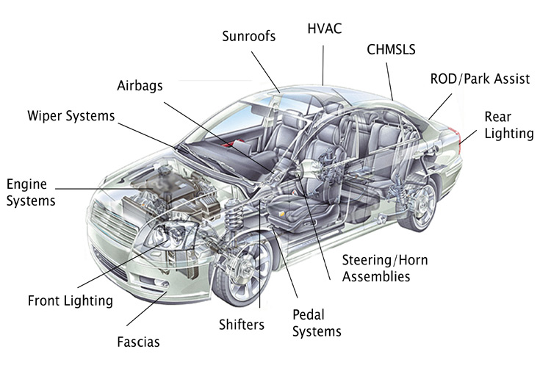

Slide 4
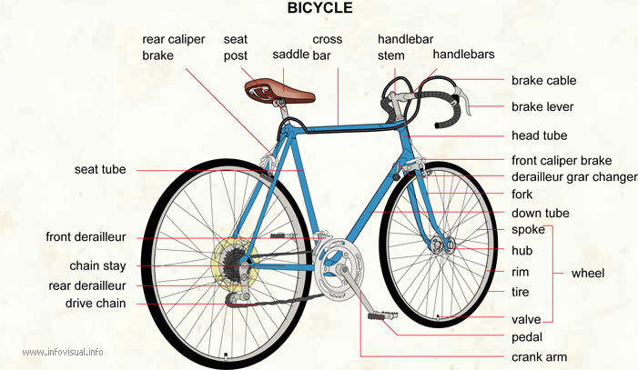

Slide 5
Encapsulation
Mechanism hide a process and the data in the system to avoid interference, and simplify the use of the process itself.
Stick transmission (gear) on the car.
The button on / off (temperature setting) on the air conditioner.
Class access levels (public, protected, private) is the implementation of the concept of encapsulation.
Data encapsulation can be done by:
declare instance variables as private.
methods that are declared public to access these variables.

Slide 6
Class Circle{
void createCircle(){
}
for(){
Line.createLine()
}
}
class Line{
private void createPoint(x, y){
}
public void createLine(tA, tB){
}
}

Slide 8
Encapsulation and Access Modifier
Modifier | In the Same Class | In the Same Package | In SubClass | In Another Package
private | ✓
without signs (empty) | ✓ | ✓
protected | ✓ | ✓ | ✓
public | ✓ | ✓ | ✓ | ✓

Slide 9
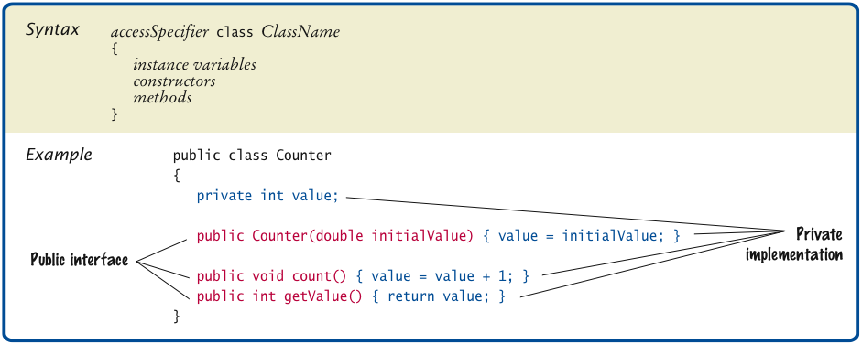
Encapsulation
Data encapsulation can also be done by:
declare instance variables as private.
methods that are declared public to access these variables.

Slide 10
Bicycle.java
public class Bicycle{
int gir;
void setGir(int increaseGir) {
gir = gir + increaseGir;
}
int getGir() {
return gir;
}
}

Slide 11
BicycleDemo.java
public class BicycleDemo{
public static void main(String[] args) {
Bicycle mybike = new Bicycle();
mybike.setGir(1);
/* Variabel bisa diubah atau tidak sengaja diubah.
Hal ini berbahaya dan sering menimbulkan bug.
Berikan access modifier private pada instance variable */
mybike.gir = 3;
System.out.println(“Gir today is : “ + mybike.getGir());
}
}

Slide 12
Bicycle.java
public class Bicycle{
private int gir; // access modifier private in instance variable
void setGir(int increaseGir) {
gir = gir + increaseGir;
}
int getGir() {
return gir;
}
}

Slide 13
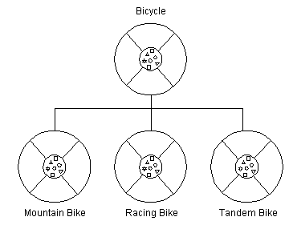
Inheritance
A class can inherit attributes (variable) and methods to another class (subclass), as well as forming a class hierarchy.
Important for Reusability.
Java Keyword: Extends

Slide 14
Bicycle.java
public class Bicycle{
private int gir;
void setGir(int increaseGir) {
gir = gir + increaseGir;
}
int getGir() {
return gir;
}
}

Slide 15
MountainBike Class Inherits Bicycle Class
public class MountainBike extends Bicycle{
private int saddle;
void setSaddle (int total) {
saddle = getGir() - total;
}
int getSaddle(){
return saddle;
}
}
public class MountainBikeDemo {
public static void main(String[] args) {
MountainBike mb = new MountainBike();
mb.setGir(3);
System.out.println(mb.getGir());
mb.setSaddle(1);
System.out.println(mb.getSaddle());
}
}
MountainBike.java
MountainBikeDemo.java

Slide 16
Exercise: Inheritance Mathematics
Make AdvancedMathematics class which is inherit from class Mathematics
Add method modulo (int a, int b) that calculates the modulo of a and b.
The modulo operator is %.
Create a class that calls the method AdvancedMathematicDemo that is accretion(+), multiplication (*) and modulo (%).

Slide 17
Polymorphism
The ability to treat objects that have behavior (shape) different.
Implementation of the concept of polymorphism:
Overloading: The ability to use the same name for several method that different parameters (type and/or number).
Overriding: The ability of a subclass to override a superclass method, that is by using the same name and parameters on method.

Slide 18
Polymorphism – Overloading
class Car {
String color;
int productionYear;
public Car(String color, int productionYear){
this.color = color;
this.productionYear = productionYear;
}
public Car(){
}
void info(){
System.out.println(“Color: " + color);
System.out.println(“Year: " + productionYear);
}
}
public class CarConstructors{
public static void main(String[] args){
Car mycar = new Car(“Red”, 2014);
mycar.info();
Car yourcar = new Car();
yourcar.info();
}
}
Output Programs :
Color: Red
Year : 2014
Color: null
Year: 0

Slide 19
Polymorphism – Overloading
class Circle{
void createCircle(){
}
void createCircle(int diameter){
...
}
void createCircle(double diameter){
...
}
void createCircle(int diameter, int x, int y){ ...
}
void createCircle(int diameter, int x, int y, int color, String circleName){ ...
}
}

Slide 20
Polymorphism - Overriding
public class Bicycle{
private int gir;
void setGir(int increaseGir) {
gir = gir + increaseGir;
}
int getGir() {
return gir;
}
}

Slide 21
Polymorphism - Overriding
public class MountainBike extends Bicycle{
void setGir(int increaseGir) {
super.setGir(increaseGir);
gir = 2*getGir();
}
}
public class MountainBikeDemo {
public static void main(String[] args) {
MountainBike mb = new MountainBike();
mb.setGir(2);
System.out.println(mb.getGir());
mb.setGir(3);
System.out.println(mb.getGir());
}
}
MountainBike.java
MountainBikeDemo.java

Slide 22
Exercise: Overloading in Mathematics
Develop Mathematic class, AdvancedMathematic and MathematicDemo.
Perform overloading the existing method (accretion[+], subtraction[-], multiplication[*], division[/], modulo[%])
Add a new method with data type double and has 3 parameters.
Test class with parameters MathematicDemo fractions: 12.5, 28.7, 14.2
For example: accretion(12.5, 28.7, 14.2)
accretion(12, 28, 14)
accretion(23, 34)
accretion(3.4, 4.9)

Slide 23
Mathematic.java
public class Mathematic{
void accretion(int a, int b){
int total= a + b;
System.out.println(“Result:” + total);
}
void accretion(double a, double b, double c){
double total = a + b + c;
System.out.println(“Result:” + total);
}
...
}

Slide 24
Thankyou . . .

Slide 25
Reference
http://romisatriawahono.net/lectures/
Object First With Java, Fifth edition, David J. Barnes & Michael Kölling, Prentice Hall / Pearson Education, 2012.
The JavaTM Tutorial, http://docs.oracle.com/javase/tutorial/java/nutsandbolts/, Oracle, 1995-2014.
Java SE Tutorial, http://www.oracle.com/technetwork/java/javase/downloads/java-se-7-tutorial-2012-02-28-1536013.html, Oracle, 2014.
SCJP Sun Certified Programmer for JavaTM 6 Study Guide Exam (310-065), Kathy Sierra & Bert Bates, Mc Graw Hill, 2008.

