Slide 1
Trichuriasis aka: Whipworm Infection
Brian Ta

Slide 2
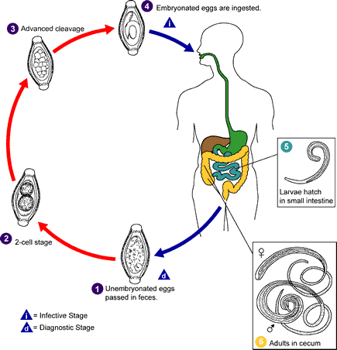
Life Cycle of Trichuris Trichiura

Slide 3
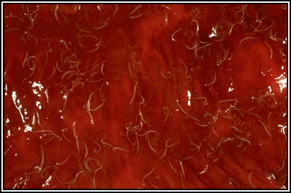
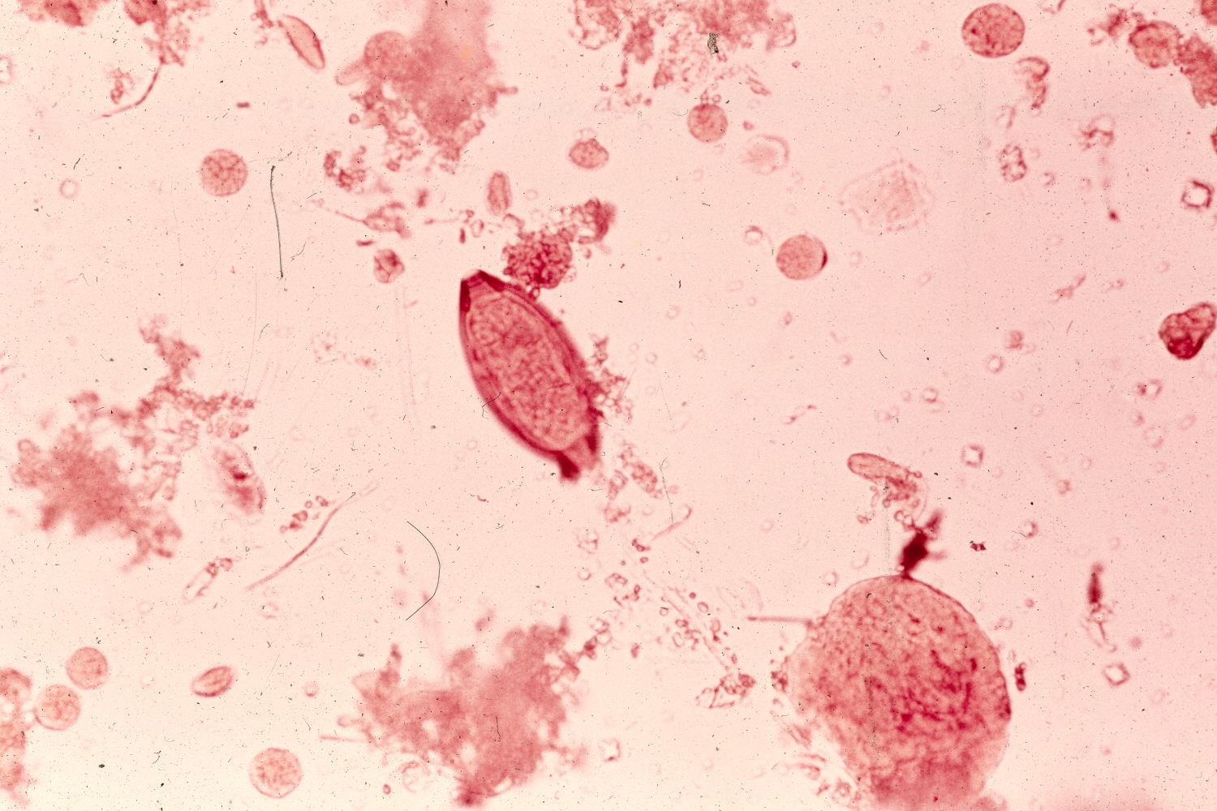
Trichuriasis is spread by ingestion off eggs by means of contaminated/unhygienic food

Slide 4
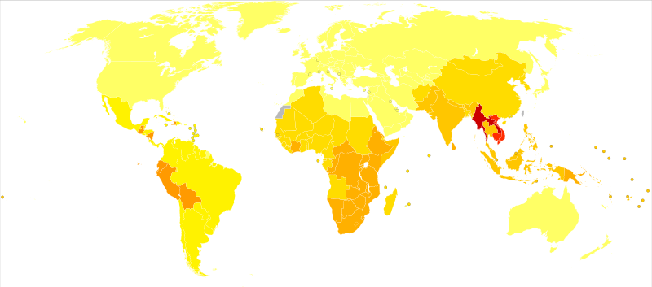
Trichuriasis is most prominent in tropical climates

Slide 5
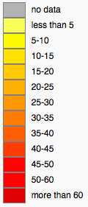

Slide 6
Symptoms of Trichuriasis
Abdominal pain
Bloody Diarrhea
Weight loss or Malnutrition
Painful or frequent defecation
Rectal Prolapse

Slide 7
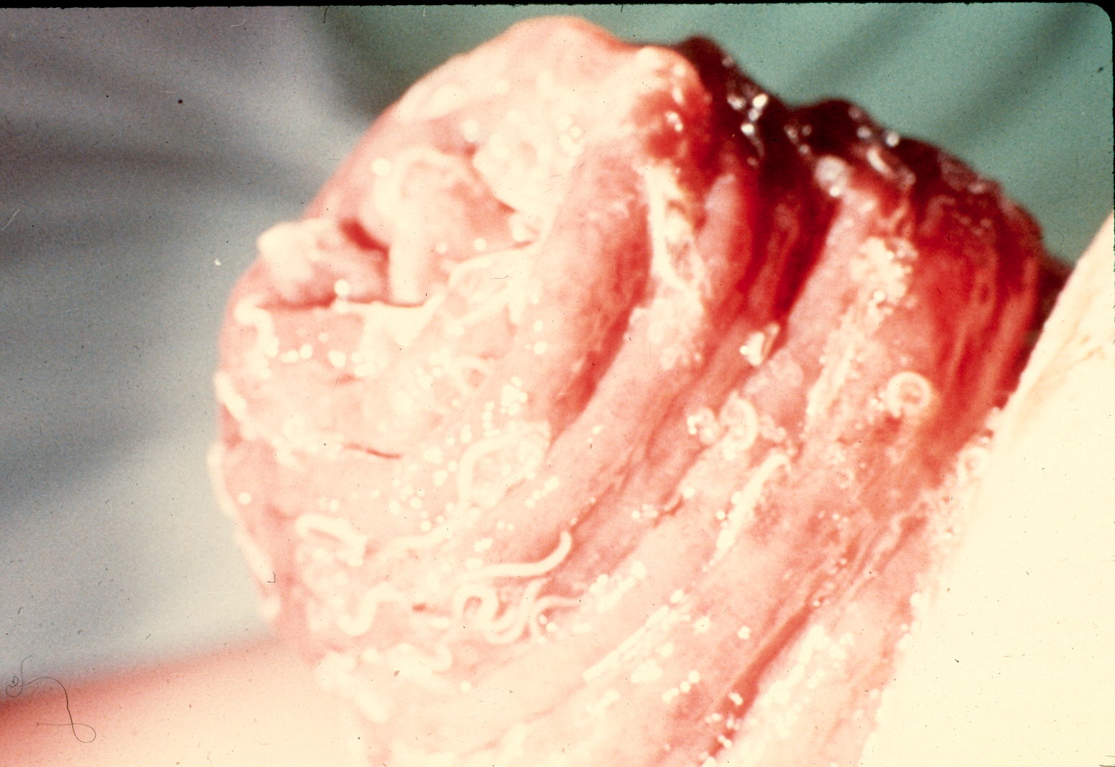

Slide 8
Treatment of Trichuriasis
Antiparasitic Drugs
    Albendazole
    Mebendazole
Iron supplements

Slide 9
Trichuriasis may be associated with low iron status of children in developing countries

Slide 10
Treatment of Light to Moderate Trichuriasis with Albendazole may cause growth reduction in children

Slide 11
Trichuriasis can be greatly reduced
Hygiene Education
Clean Water Access
Distribution of Drugs

Slide 12
Citations
CDC. (2013). Parasites- trichuriasis (also known as whipworm infection). Centers for Disease Control and Prevention, Retrieved from http://www.cdc.gov/parasites/whipworm/index.html
Gabbey, A. E. (2012, August 07). Whipworm infection. Healthline, Retrieved from http://www.healthline.com/health/whipworm-infection
Hill, M., & Smith, S. Trichuriasis. Retrieved from http://www.stanford.edu/class/humbio103/ParaSites2002/trichuriasis/trichintopg.html
Quihui-Cota L. et al. Trichuriasis and low-iron status in schoolchildren from Northwest Mexico. European Journal of Clinical Nutrition 64, 1108-1115 (2010)
Tee, M.H. et al. Growth Reduction Among Primary Schoolchildren with Light Trichuriasis in Malaysia Treated with Albendazole. Southeast Asian J Trop Med Public Health 44, 19-24 (2013).
Wikimedia. (2009, November 10). Trichuriasis world map. Retrieved from http://commons.wikimedia.org/wiki/File:Trichuriasis_world_map_-_DALY_-_WHO2002.svg

