Slide 2
L
E
A
D
I
N
G

Slide 3
“Leading is when managers instill enthusiasm by communicating with others, motivating them to work hard, and maintaining good interpersonal relations” (Schermerhorn et al, 2000)

Slide 4
Behavioral Sciences
Motivational
Communi-cation
Leadership
Personality research and studies of job attitudes
Notes:
The behavioral sciences have made many contributions to understanding this function of management. Personality research and studies of job attitudes provide important information as to how managers can most effectively lead subordinates. For example, this research tells us that to become effective at leading, managers must first understand their subordinates’ personalities, values, attitudes, and emotions.
Studies of motivation and motivation theory provide important information about the ways in which workers can be energized to put forth productive effort. Studies of communication provide direction as to how managers can effectively and persuasively communicate. Studies of leadership and leadership style provide information regarding questions, such as, “What makes a manager a good leader?” and “In what situations are certain leadership styles most appropriate and effective?”

Slide 5
Behavioral Sciences
Notes:
The behavioral sciences have made many contributions to understanding this function of management. Personality research and studies of job attitudes provide important information as to how managers can most effectively lead subordinates. For example, this research tells us that to become effective at leading, managers must first understand their subordinates’ personalities, values, attitudes, and emotions.
Studies of motivation and motivation theory provide important information about the ways in which workers can be energized to put forth productive effort. Studies of communication provide direction as to how managers can effectively and persuasively communicate. Studies of leadership and leadership style provide information regarding questions, such as, “What makes a manager a good leader?” and “In what situations are certain leadership styles most appropriate and effective?”

Slide 6
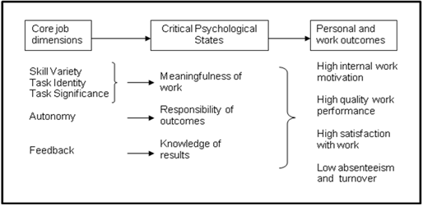
How managers can lead their subordinates effectively ?
Personality research and studies of job attitudes
Notes:
The behavioral sciences have made many contributions to understanding this function of management. Personality research and studies of job attitudes provide important information as to how managers can most effectively lead subordinates. For example, this research tells us that to become effective at leading, managers must first understand their subordinates’ personalities, values, attitudes, and emotions.
Studies of motivation and motivation theory provide important information about the ways in which workers can be energized to put forth productive effort. Studies of communication provide direction as to how managers can effectively and persuasively communicate. Studies of leadership and leadership style provide information regarding questions, such as, “What makes a manager a good leader?” and “In what situations are certain leadership styles most appropriate and effective?”

Slide 7
How managers can effectively and persuasively communicate ?
Communi-cation
Notes:
The behavioral sciences have made many contributions to understanding this function of management. Personality research and studies of job attitudes provide important information as to how managers can most effectively lead subordinates. For example, this research tells us that to become effective at leading, managers must first understand their subordinates’ personalities, values, attitudes, and emotions.
Studies of motivation and motivation theory provide important information about the ways in which workers can be energized to put forth productive effort. Studies of communication provide direction as to how managers can effectively and persuasively communicate. Studies of leadership and leadership style provide information regarding questions, such as, “What makes a manager a good leader?” and “In what situations are certain leadership styles most appropriate and effective?”

Slide 8
important information about the ways in which workers can be energized to put forth productive effort
Motivational
Notes:
The behavioral sciences have made many contributions to understanding this function of management. Personality research and studies of job attitudes provide important information as to how managers can most effectively lead subordinates. For example, this research tells us that to become effective at leading, managers must first understand their subordinates’ personalities, values, attitudes, and emotions.
Studies of motivation and motivation theory provide important information about the ways in which workers can be energized to put forth productive effort. Studies of communication provide direction as to how managers can effectively and persuasively communicate. Studies of leadership and leadership style provide information regarding questions, such as, “What makes a manager a good leader?” and “In what situations are certain leadership styles most appropriate and effective?”

Slide 9
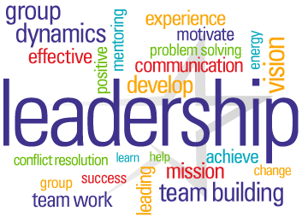
“What makes a manager a good leader?” and “In what situations are certain leadership styles most appropriate and effective?”
Leadership
Notes:
The behavioral sciences have made many contributions to understanding this function of management. Personality research and studies of job attitudes provide important information as to how managers can most effectively lead subordinates. For example, this research tells us that to become effective at leading, managers must first understand their subordinates’ personalities, values, attitudes, and emotions.
Studies of motivation and motivation theory provide important information about the ways in which workers can be energized to put forth productive effort. Studies of communication provide direction as to how managers can effectively and persuasively communicate. Studies of leadership and leadership style provide information regarding questions, such as, “What makes a manager a good leader?” and “In what situations are certain leadership styles most appropriate and effective?”

Slide 10
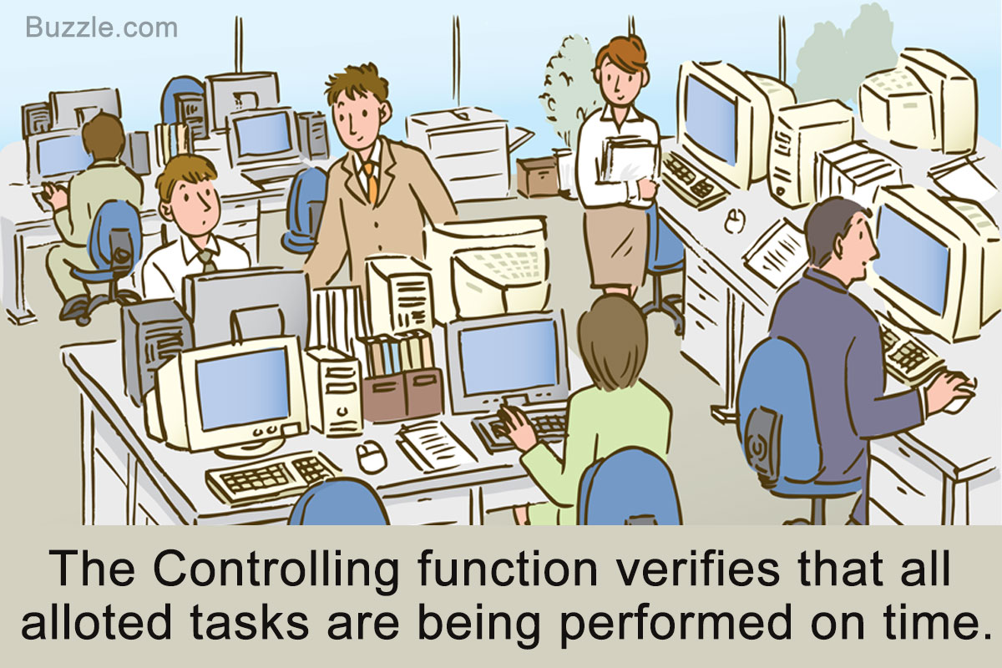
C
O
N
T
R
O
L
L
I
N
G

Slide 11
Where we are ?
(measurement)
How can we get on track again ?
(correction)
Where we planned to be ?
(evaluation)

Slide 12
Gejala yang memerlukan Pengawasan
Menurut Kreitner (1992)
Banyak pegawai menanggur
Pekerjaan tidak terorganisasi dengan baik.
Biaya melebihi anggaran
Adanya penghamburan dan inefisiensi.
Terjadi penurunan pendapatan/profit
Penurunan kualitas pelayanan
Ketidakpuasan pegawai
Kas berkurang

Slide 13
Definisi Pengawasan
Schermerhon (2000) : penetapan uk.kinerja & pengambilan tindakan yang dapat mendukung pencapaian hasil yang diharapkan.
Stoner, Freeman, Gilbert (2000) : Memastikan segala aktivitas yang terlaksana sesuai dengan apa yang telah direncanakan.

Slide 14
Tujuan Fungsi Pengawasan
Adaptasi Lingkungan
Meminimumkan kegagalan
Meminimumkan biaya
Menciptakan suasana keterbukaan, kejujuran, partisipasi, dan akuntabilitas
Meningkatkan kinerja organisasi

Slide 15
Ruang Lingkup Pengawasan
Pemantauan
Penilaian
Pelaporan

Slide 16
Langkah-Langkah Pengawasan
Penetapan Standar dan
Metode Penilaian Kinerja
Penilaian kinerja
Penilaian apakah kinerja memenuhi standar atau tidak
Pengambilan tindakan koreksi
Ya
Tidak
Jangan lakukan apapun

Slide 17
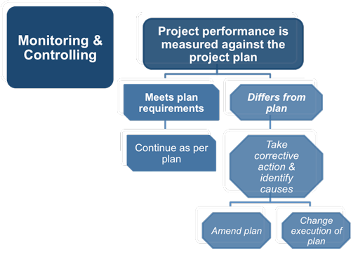
Langkah-Langkah Pengawasan

Slide 18
Jenis Pengawasan
Awal
Proses
Akhir
Berdasarkan Proses Kegiatan
Notes:
Awal : Faktor input sesuai dengan standar atau tidak
Proses : dilakukan saat proses berlangsung
Akhir : dilakukan saat akhir proses pengerjaan. (hasil telah diperoleh)
Internal : pengawasan mandiri oleh setiap pekerja/Unit Kerja
Eksternal : pengawasan yang dilakukan terhadap seorang atau Unit lain.

Slide 19
Jenis Pengawasan
Eksternal
Internal
Berdasarkan Pihak Yang Melakukan

Slide 20
