Slide 1
E-Commerce Fundamentals
Presented by Ika Novita Dewi, MCS

Slide 2
Background – E-commerce
Electronic communications are disruptive technologies that have caused major changes in industry structure, marketplace structure and business models
Traditional Business
Sold
Sold
Business organization
Networks or distributors
Customers

Slide 3
Background – E-commerce
E-commerce
Sold
Sold
Business organization
Networks or distributors
Customers

Slide 4
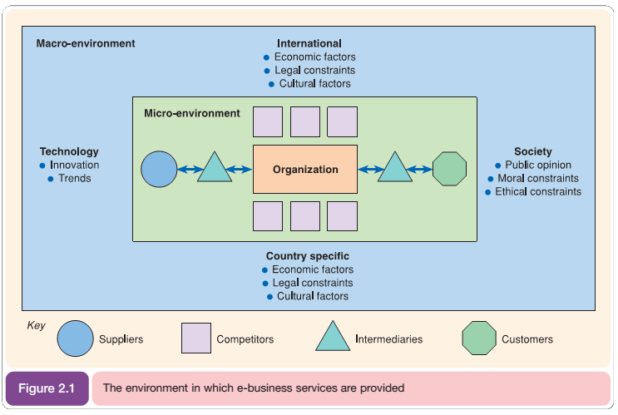
Situation analysis for e-business strategy development
Collection and review of
information about an
organization’s external
environment and internal
processes and resources
in order to inform its
strategies

Slide 5
E-Commerce Environment
Strategic agility
The capability to innovate and so gain competitive advantage within a marketplace by monitoring changes within an organization’s marketplace and then to efficiently evaluate alternative strategies and then select, review and implement appropriate candidate strategies
Online marketplace analysis
Analysis of the online marketplace or ‘markets place’ is a key part of developing a long-term e-business plan or creating a shorter-term digital marketing campaign

Slide 6
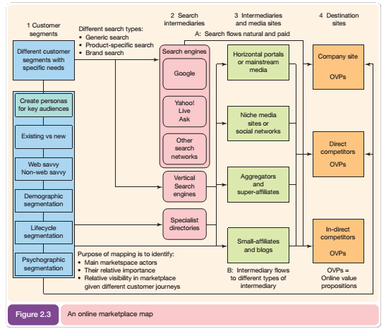

Slide 7
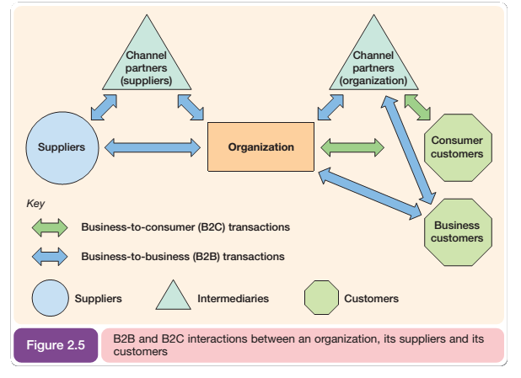
Marketplace channel structures describe the way a manufacturer or selling organization delivers products and services to its customers

Slide 8
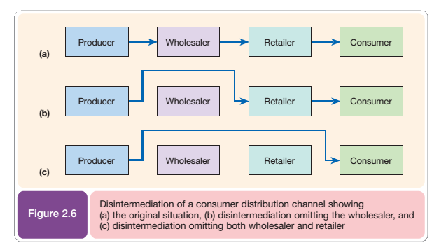
Disintermediation → The removal of intermediaries such as distributors or brokers that formerly linked a company to its customers

Slide 9
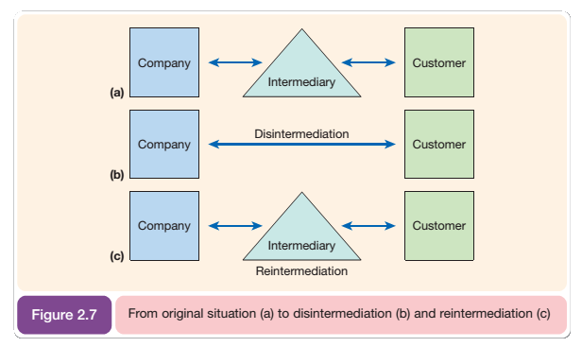
Reintermediation → The creation of new intermediaries between customers and suppliers providing services such as supplier search and product evaluation
reintermediationis perhaps a more significant phenomenon resulting from Internet-based communications

Slide 10
Electronic Marketplace
A virtual marketplace such as the Internet in which no direct contact occurs between buyers and sellers
Seller-controlled sites are the main home page of the company and are e-commerce-enabled
Buyer-controlled sites are intermediaries which have been set up so that it is the buyer who initiates the market-making

Slide 11
Different types of online intermediary
Infomediary → A business whose main source of revenue derives from capturing consumer information and developing detailed profiles of individual customers for use by third parties
Infomediaries which have developed in response to the online marketplace include:
Directories (such as Yahoo!, Excite).
Search engines (AltaVista, Infoseek).
Malls (BarclaySquare, Buckingham Gate).
Virtual resellers (own-inventory and sell-direct, e.g. Amazon, CDNow).
Financial intermediaries (offering digital cash and cheque payment services, such as Digicash).
Forums, fan clubs and user groups (referred to collectively as ‘virtual communities’).
Evaluators (sites which perform review or comparison of services)

Slide 12
Assignment

