Slide 1
E-business Strategy

Slide 2
Strategy
the direction and scope of an organization over the long-term: which achieves advantage for the organization through its configuration of resources within a changing environment to meet the needs of markets and to fulfil stakeholder expectations
E-business strategies share much in common with corporate, business and marketing strategies

Slide 3
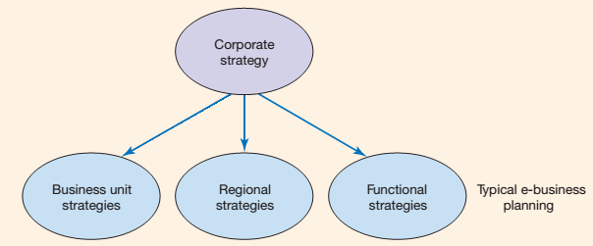
E-business strategy Definition of the approach by which applications of internal and external electronic communications can support and influence corporate strategy

Slide 4
corporate strategy which is concerned with the overall purpose and scope of the organization,
business unit strategy which defines how to compete successfully in a particular market
operational strategies which are concerned with achieving corporate and business unit strategies
functional strategies that describe how the corporate and business unit strategies will be operationalized in different functional areas or business processes
Functional or process strategies refer to marketing, supply chain management, human resources, finance and information systems strategies.

Slide 5
e-business strategy should support corporate strategy objectives and it should also support functional marketing and supply chain management strategies

Slide 6
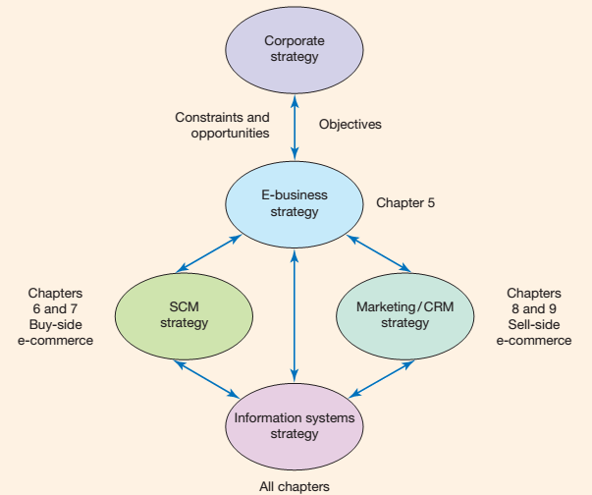
Relationship between e-business strategy and other strategies

Slide 7
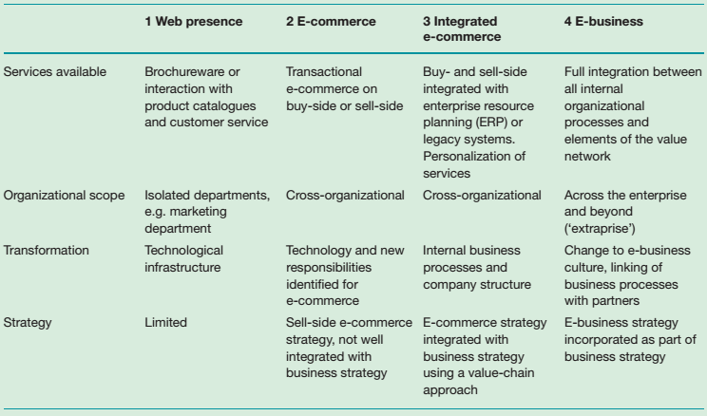
A stage model for e-business development

Slide 8
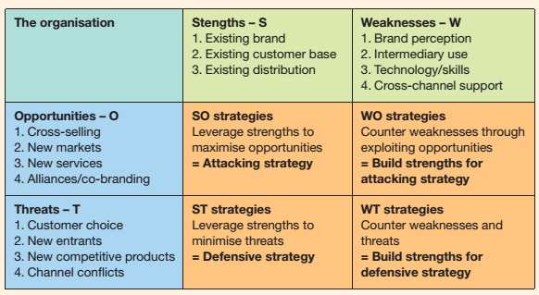
SWOT analysis

Slide 9
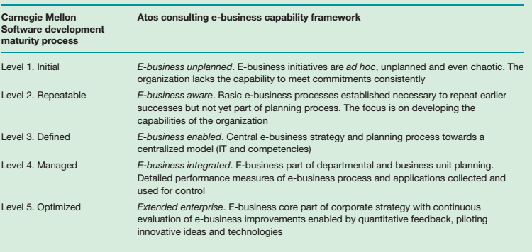
Capability maturity model of the adoption of e-business

Slide 10
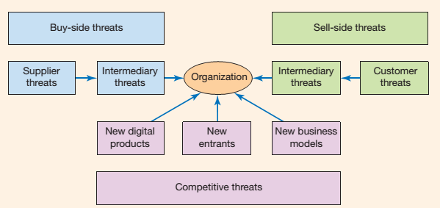
Competitive threats acting on the e-business

Slide 11
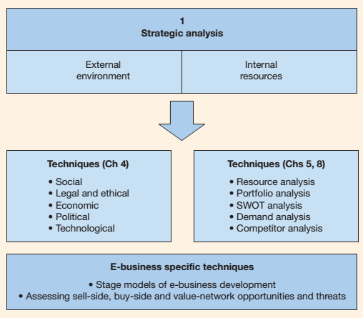
Elements of strategic situation analysis for the e-business

Slide 12
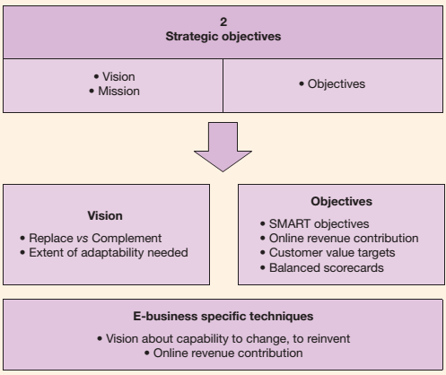
Elements of strategic objective setting for the e-business

Slide 13
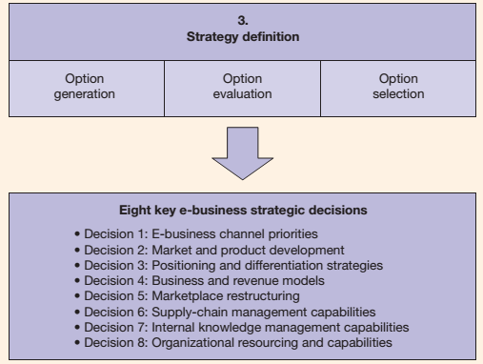
Elements of strategy definition for the e-business

Slide 14
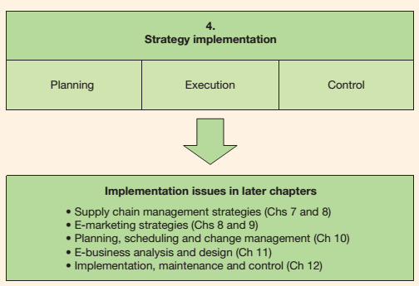
Elements of strategy implementation for the e-business

Slide 15
Assignment
Buat rangkuman mengenai SWOT analysis dan Balanced scorecard
Berikan contoh masing masing
Maksimal 3 halaman, diketik dan di print
Penilaian tugas: kemandirian dan kesiapan menerima materi

