Slide 1
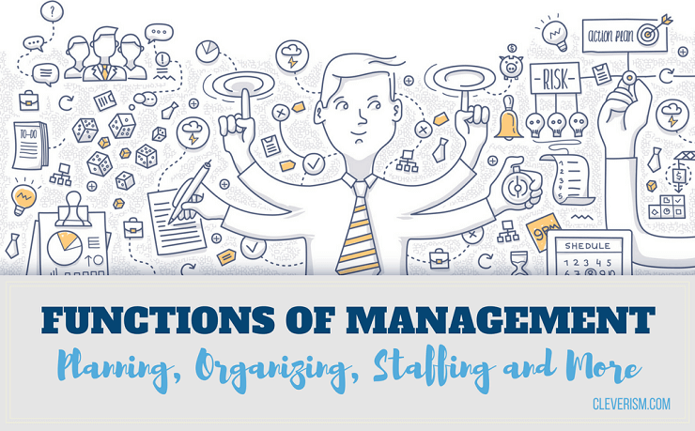

Slide 2
O
R
G
A
N
I
Z
I
N
G

Slide 3
Purpose of Organizing
Human Treatment of Employees
Optimum use of resources
Helps to attain organizational goal
Facilities Growth and Diversification
To perform social control function

Slide 4
URAIAN PENGORGANISASIAN
Pemerincian Pekerjaan
Pembagian pekerjaan
Pemisahan Pekerjaan (Pendepartemenan)
Koordinasi Pekerjaan
Monitoring dan Reorganisasi

Slide 5
Designing Jobs
Grouping Jobs
Establishing Reporting Relationships
Distributing Authority
Coordinating Activities
Differentiating Between Positions

Slide 6
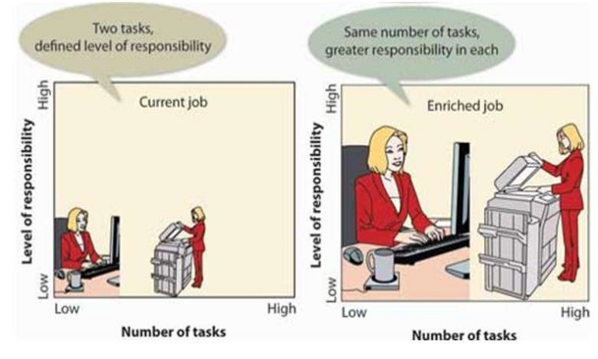
Job Specialization (Division of Labor)
Job Rotation
Designing Jobs
Job Simplification
Job Enlargement
Job Enrichment
1
Notes:
Pembagian Kerja (Designing Jobs)
Upaya menyederhanakan keseluruhan kegiatan → setiap orang ditempatkan/ditugaskan pada kegiatan yang spesifik.
Job Design
The Determination of an individual’s work-related responsibilities.
Job Specialization (Division of Labor)
The degree to which the overall task of the organization is broken down and divided into smaller component parts.
Benefits of Specialization
Wokers can become proficient at a task.
Transfer time between tasks is decreased.
Specialized equipment can be more easily developed.
Employee replament becomes earsier.
Limitations of Specialization
Employee boredom and dissatisfaction with mundane tasks.
Anticipate benefits do not always occur.
Job Rotation : Systematically moving employees from one job to another in an attempt to reduce employee boredom. Most frequent use today is as a training device for skills and flexibility.
Job Enlargement :
An increase in the total number of tasks workers perform
Increase training costs, unions content that workers deserve more pay for doing more tasks, and the work may still be dul and routine.
Job Enrichment : incresing both the numbers of tasks the worker does and the control the worker has over the job.

Slide 7
Pengelompokan Pekerjaan
(Departementalization)
Pengelompokkan pekerjaan sesuai kriteria tertentu yang sejenis
Grouping Jobs
Bentuk Departementalisasi;
Atas Dasar Fungsi
Atas Dasar Wilayah
Atas Dasar Produk
Atas Dasar Langganan
Atas Dasar Proses/Proyek
2

Slide 8
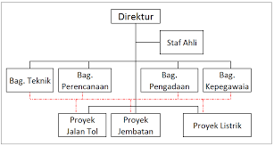
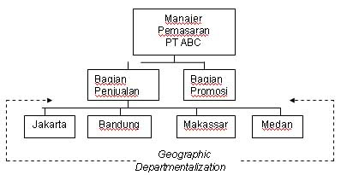

Slide 9
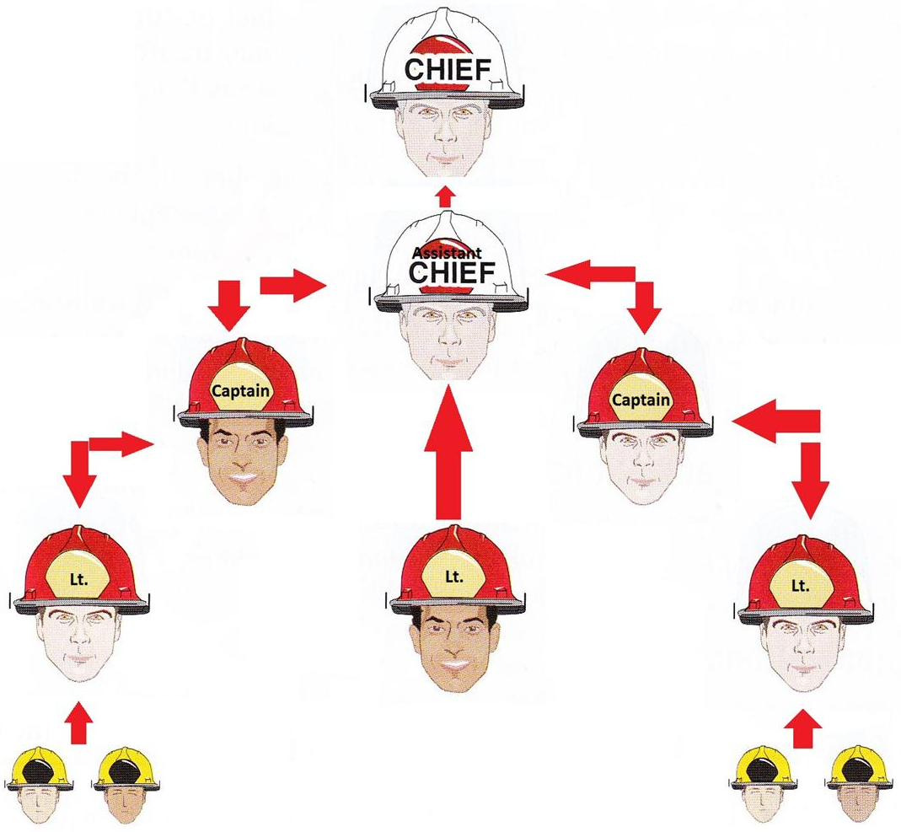
Chain of command shows clear distinct line of author among the positions and
Span of management indicates the number of people who report to a particular manager.
Rumus menghitung jumlah hubungan
R = n(2^{n}/2 + (n-1))
Ket. R= total macam hubungan yang terjadi
n = jumlah bawahan
Here; the organization’s hierarchy, its positions and lines are defined.
Establishing Reporting Relationships
3

Slide 10
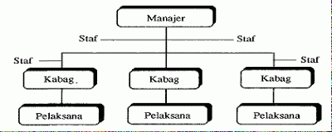
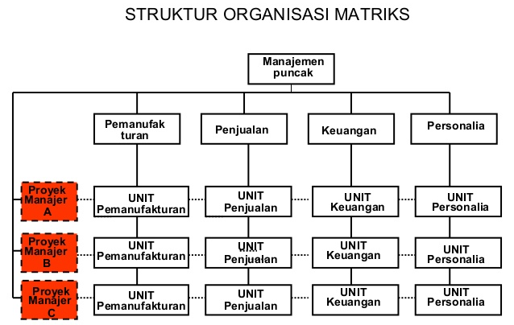
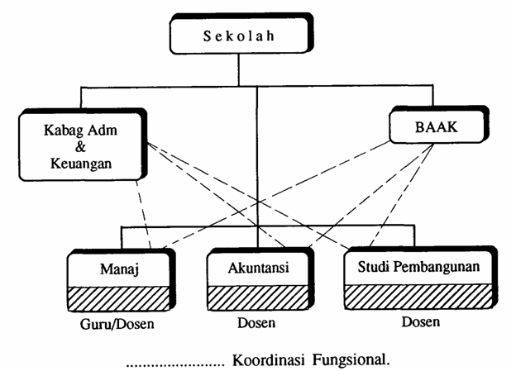
Line Authority Structure
Organisasi Garis dan Staf
Menurut macam-macam wewenang
Organisasi Fungsional

Slide 11
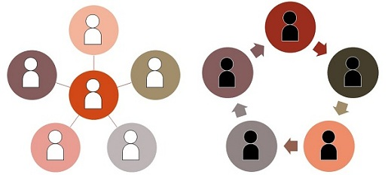
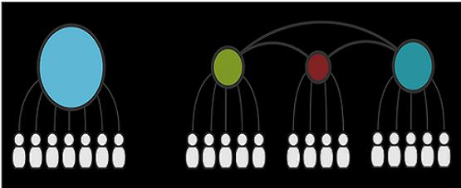
The Delegation Process
1. Authority, responsibility and accountability
2. The scalar Principle
3. Kesatuan Perintah
Decentralization and Centralization
Distributing Authority
Sentralisasi
Desentralisasi
4

Slide 12
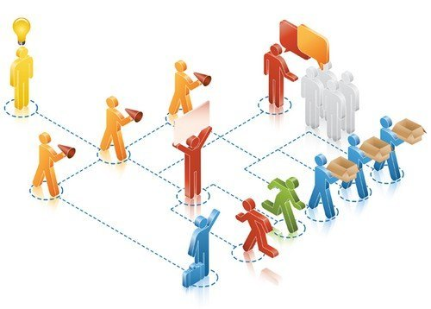
The Need for coordination
Structural Coordination
techniques
Coordinating Activities
5
Notes:
Integrasi seluruh aktivitas dari
berbagai departemen atau divisi

Slide 13
Line & Staff Positions
Administrative Intensity
the degree to which managerial positions are concentrated in staff positions
Differentiating Between Positions
6
Notes:
Line Positions
Positions in the direct chain of command that are responsible for the achievement of an organization’s goals
Have formal (legitime) authority to direct the workforce
Staff Positions
Positions intended to provide expertise, advice and support to line positions
Have advisory authority; can give compulsory advice.
Have functional authority to enforce compliance with organizational policies and procedures.
Administrative Intensity
The degree to which managerial positions are cocentrated in staff positions.

Slide 15
TUGAS
Jelaskan tujuan perlunya organizing pada manajemen organisasi?
Designing jobs ada 5, sebutkan apa saja dan jelaskan!
Ada 5 bentuk struktur organisasi (menurut departementalization), menurut anda struktur organisasi manakah yang lebih sesuai digunakan untuk organisasi Rekam Medis? Buatlah bagan struktur organisasi dan apa alasannya (dibuat pengelompokan pekerjaannya)!

